Slide 1
Portfolio
Be DIFFERENT

Slide 2
What is portfolio?
A portfolio resume is a specialized type of creative resume that showcases examples of your work along with the standard resume information about your work experience. This designed template is best suited for job seekers in creative fields like photography or graphic design.

Slide 3
Another add-on just for you guys
Portfolio helps recruiters to choose a person with the right skills set required for the post.
Let it be fitness, it can be career. Portfolio can guide you in all aspects.
Another step which we want our customers to be happy so, we are also releasing a subscription model in which you can discuss your needs for good template for the portfolio.
You can type up your needs and we give you the best template for portfolio , which we know we can.
Selection Rate
Good Portfolio

Slide 4
BEING DIFFERENT
WE PROVIDE USER FRIENDLY TEMPLATES FOR YOUR PORTFOLIO.

Slide 5
HOW to create a difference?
Difference is being alone in the field or being the best in the game
Dedication and discipline are main aspects of difference
We help you to build your good looking resume and roadmap for the path you want to build different for yourself, it can look at your goals and work accordingly.

Slide 6
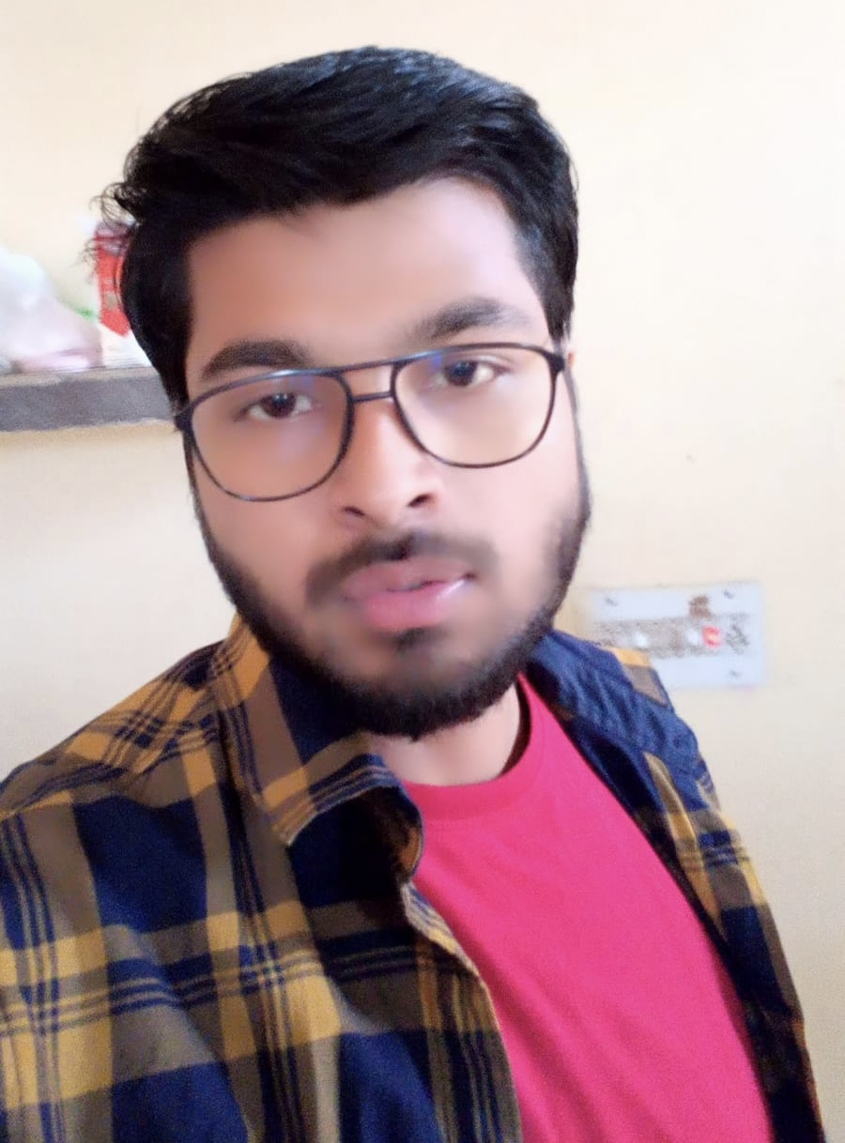

Ansh Bhasin
1st Year
2nd sem
CSE
Abhinav Tripathi
1st Year
2nd sem
CSE
OUR TEAM

Slide 7
THANK YOU

