Slide 1
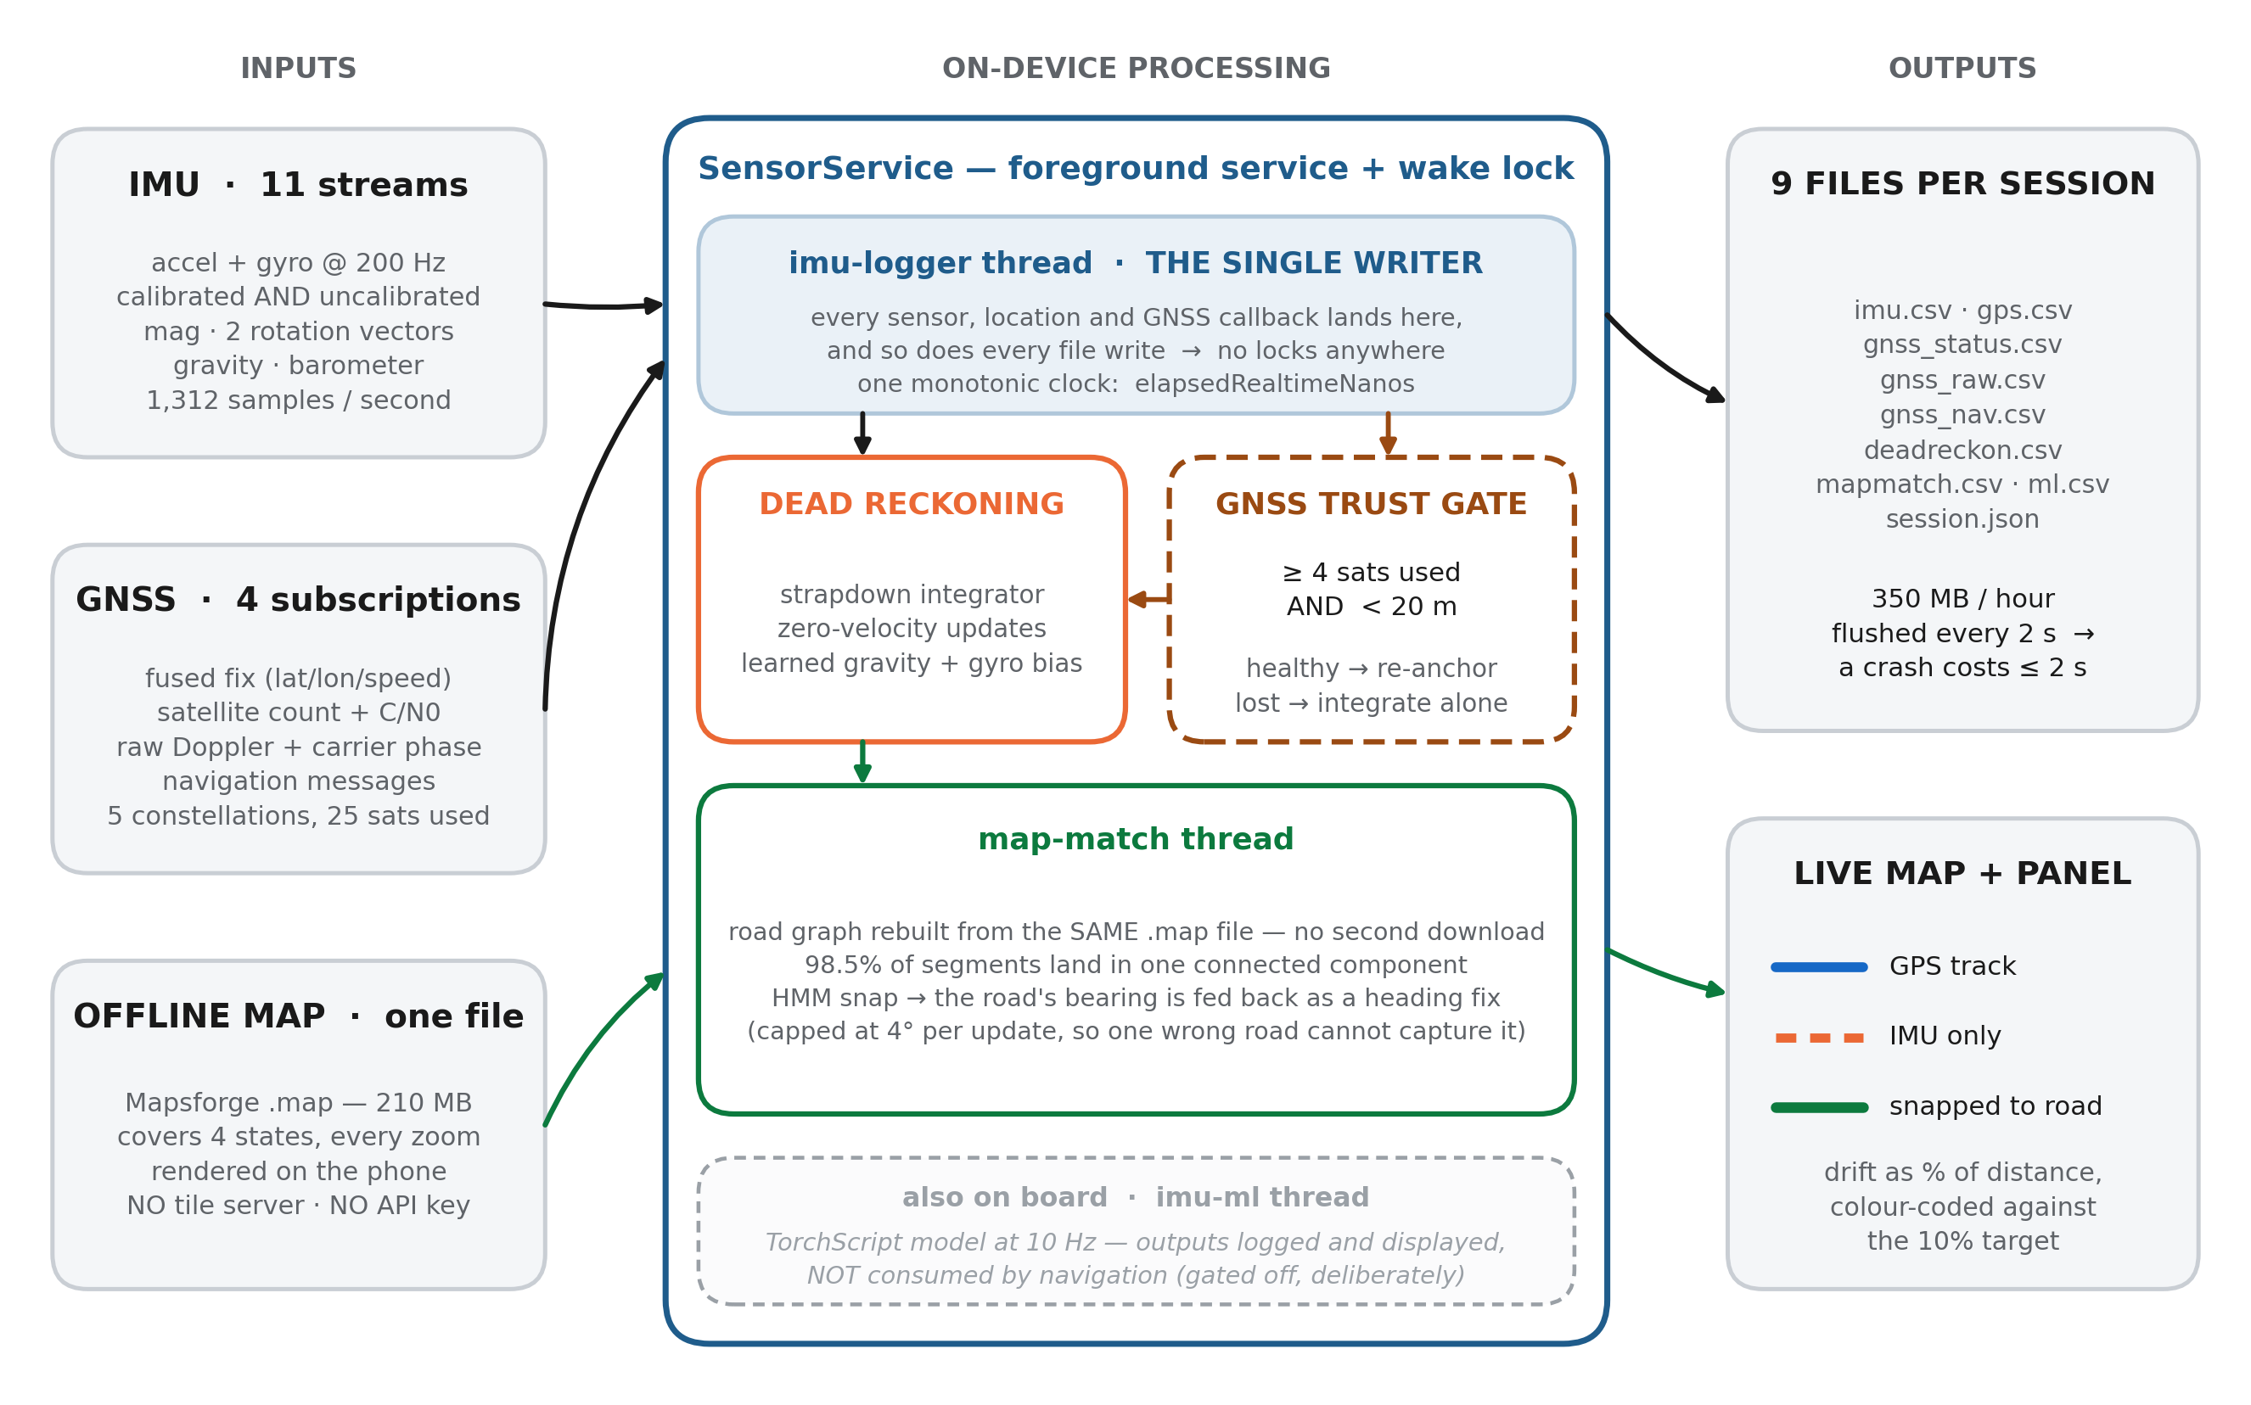
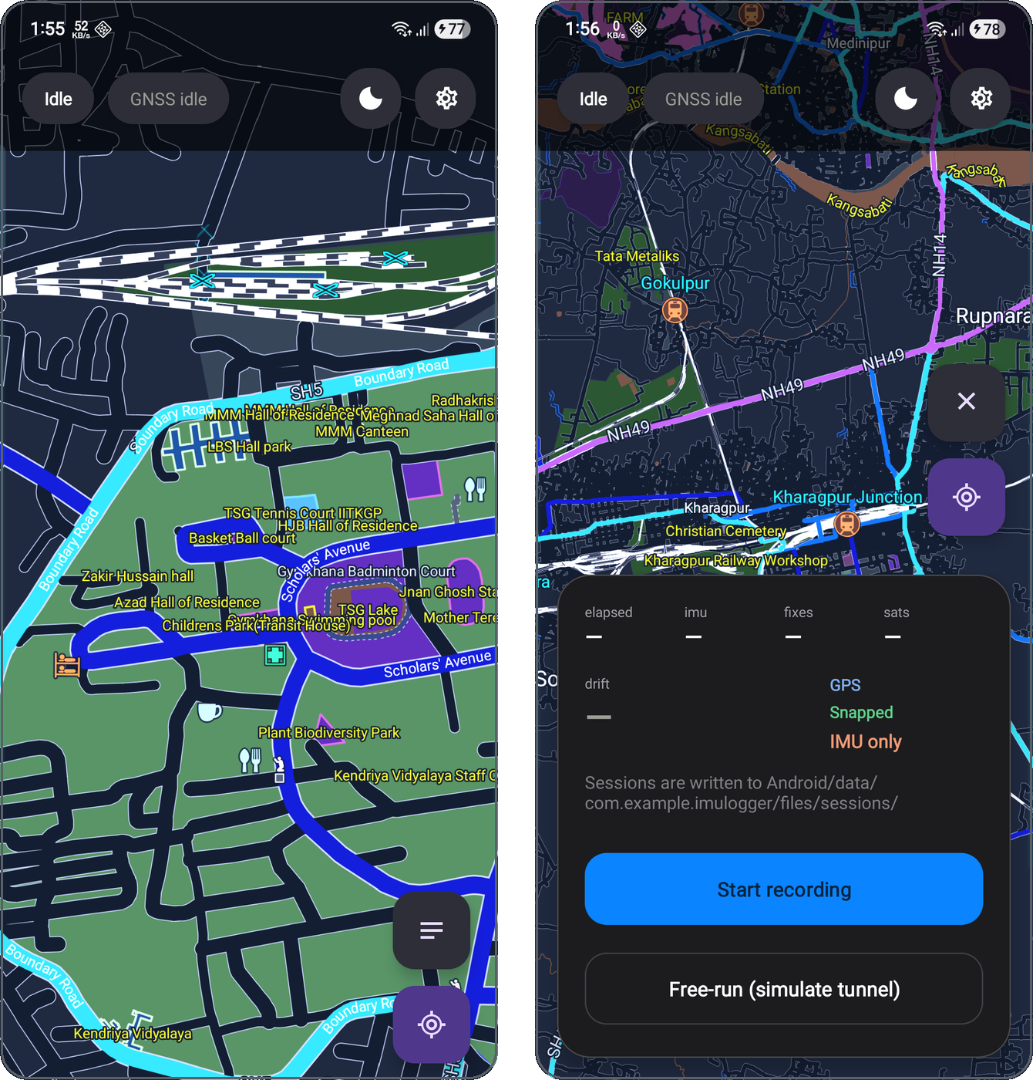
IMU Logger — the application
paste SIH logo here
One phone, eleven sensors, no API keys, no internet at runtime · records the evidence and dead-reckons at the same time
Offline vector map, no network · Session panel: metrics, drift, legend
1,312
IMU samples per second, 11 streams, one monotonic clock
0
API keys, backends, network calls at runtime
210 MB
one file: the basemap AND the road network for matching
The map, the road network and the positioning all live on the device — it works in a tunnel because it never needed a server.
5

