Slide 1

Pressure-to-Deflection
Modelling of an
Eccentric-Cavity
Soft Pneumatic Bending Actuator
B.Tech Project — progress review
Rudranarayan Pradhan · October 2026

Slide 2
OVERVIEW
Where the project stands
Three of the five stages are complete; multi-cavity designs and ANSYS verification come next
✓ DONE
✓ DONE
✓ DONE
NEXT · 5–25 OCT
FROM 26 OCT
1
2
3
4
5
Derivation
Analytical models
3-D nonlinear FEA
Multi-cavity + ANSYS
Mould + tests
Derived the section properties, pressure loading and bending, step by step.
Three beam-model tiers: linear, (1−2ν) factor, wall expansion.
In-house hyperelastic FE solver, verified, then swept the bare and sleeved designs.
Several eccentric cavities for bending in any x–y direction, then an ANSYS check of every model.
3-D printed mould, cast actuators, pressure tests compared with the models.
IN THIS TALK
A · The derivation, step by step
B · Key results and model tiers
C · FEA: how we built it
D · FEA: what we found
E · Plan for the next month
HEADLINE RESULT SO FAR
The bare actuator balloons and snaps through at 104.7 kPa. A hoop-reinforced actuator bends smoothly, 2.8× more at 60 kPa, and the simple beam models match it within 5 % at low pressure. We recommend building the reinforced design.
Eccentric-cavity soft actuator · BTP progress review
2

Slide 3
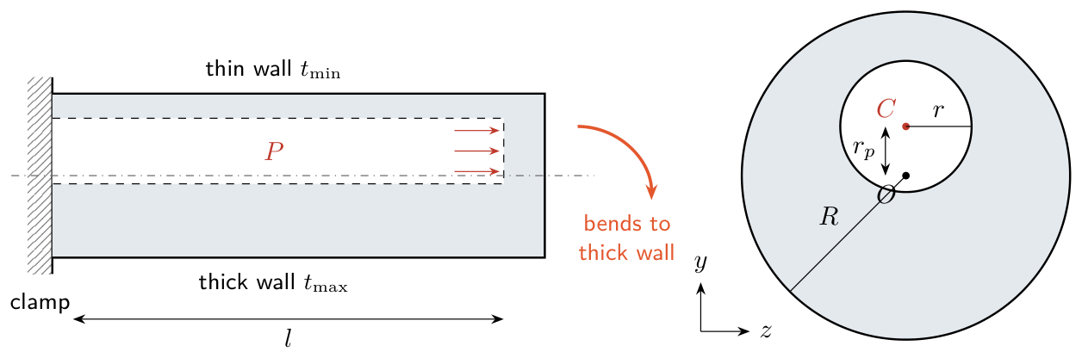
THE PROBLEM
An off-centre cavity turns pressure into bending
Goal: a reliable map from cavity pressure P to tip deflection δ, first by hand, then with 3-D FE, then by experiment
PLACEHOLDER DESIGN
Outer radius R = 10 mm
Cavity radius r = 4 mm
Cavity offset rₚ = 3 mm
Length L = 100 mm
Thin wall 3 mm
Thick wall 9 mm
Silicone neo-Hookean
E = 0.6 MPa (μ = 0.2 MPa)
Pressure 0 – 110 kPa
HOW IT BENDS
Air pressure P pushes on the cavity wall. Because the cavity sits 3 mm off-centre, the wall on one side is thin (3 mm) and on the other thick (9 mm). The thin side stretches more, so the tube curls towards the thick side. The question is how far the tip moves for a given pressure, and which model predicts it reliably.
These are placeholder values. Every model in this deck is parametric, so the real geometry and silicone drop straight in.
Eccentric-cavity soft actuator · BTP progress review
3

Slide 4
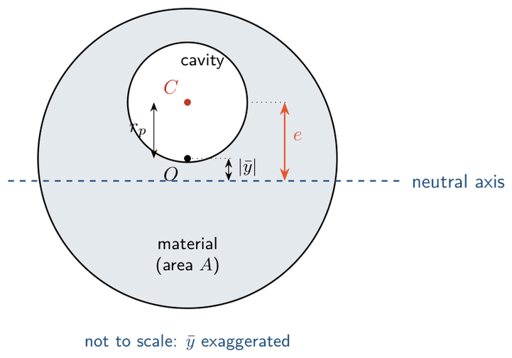
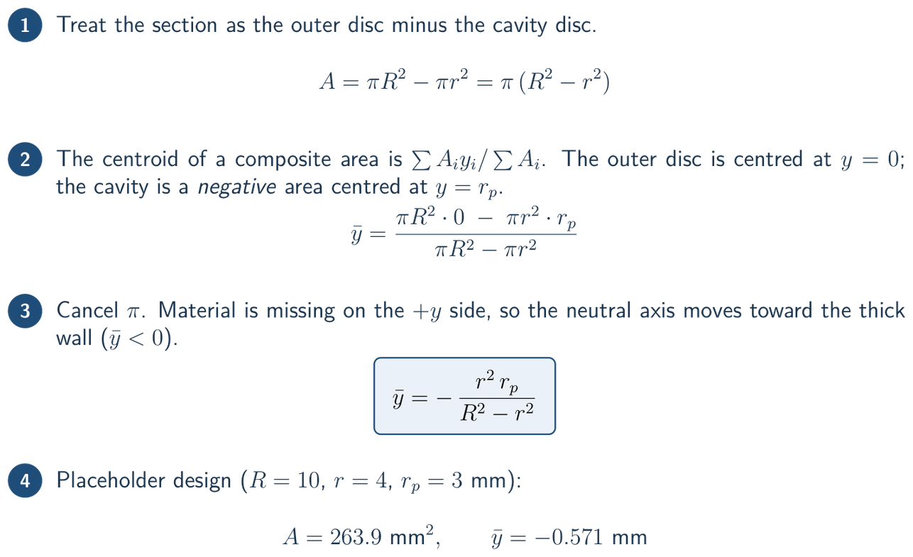
DERIVATION 1 · SECTION GEOMETRY
Cross-section: area and neutral axis
What we did: located the neutral axis of the off-centre (eccentric) section
HOW — STEP BY STEP
The cavity is a negative area centred at C, so the neutral axis moves toward the thick wall.
FINDING
The neutral axis sits 0.57 mm below the outer centre, on the thick-wall side: ȳ = −r²rₚ/(R² − r²).
Eccentric-cavity soft actuator · BTP progress review
4

Slide 5
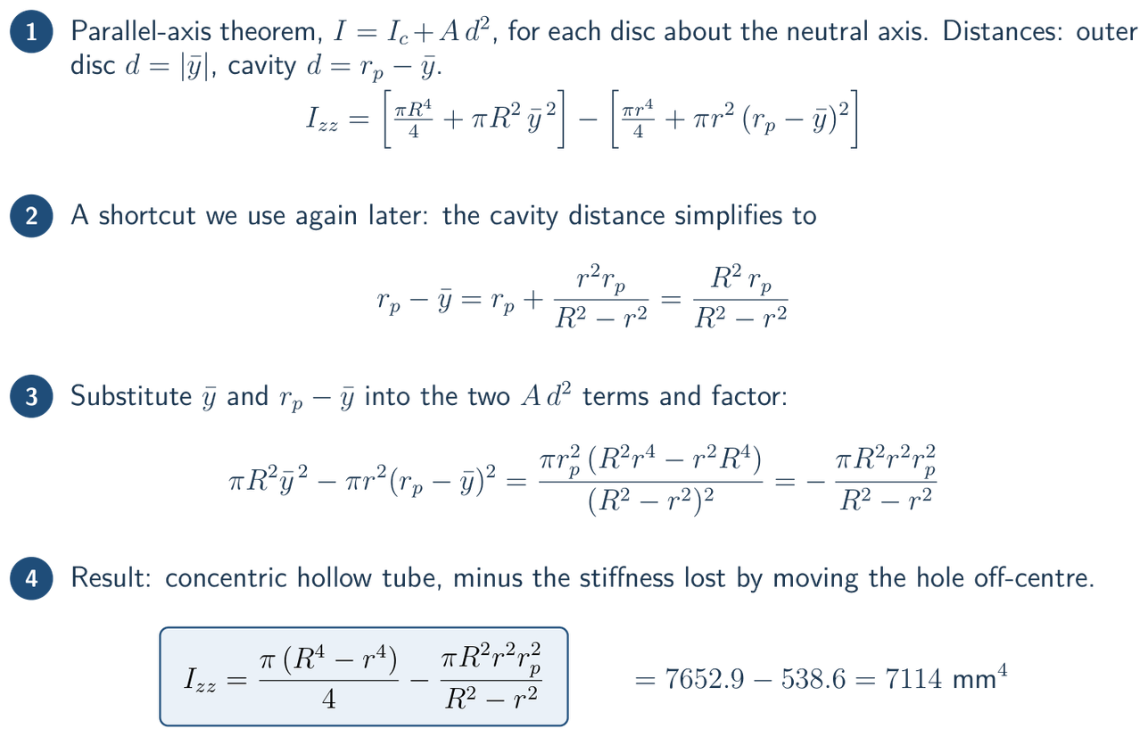
DERIVATION 1 · SECTION STIFFNESS
Cross-section: second moment of area
What we did: computed the bending stiffness I_zz of the eccentric section
HOW — STEP BY STEP
Parallel-axis theorem about the neutral axis: outer disc at |ȳ|, cavity at e = rₚ − ȳ.
FINDING
I_zz = 7114 mm⁴, 7 % below a concentric tube (7653 mm⁴). The identity rₚ − ȳ = R²rₚ/(R² − r²) is reused for the moment arm.
Eccentric-cavity soft actuator · BTP progress review
5

Slide 6
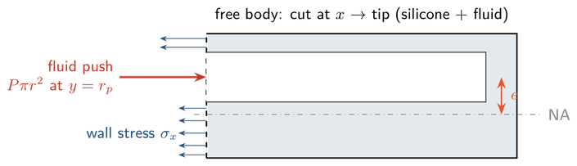
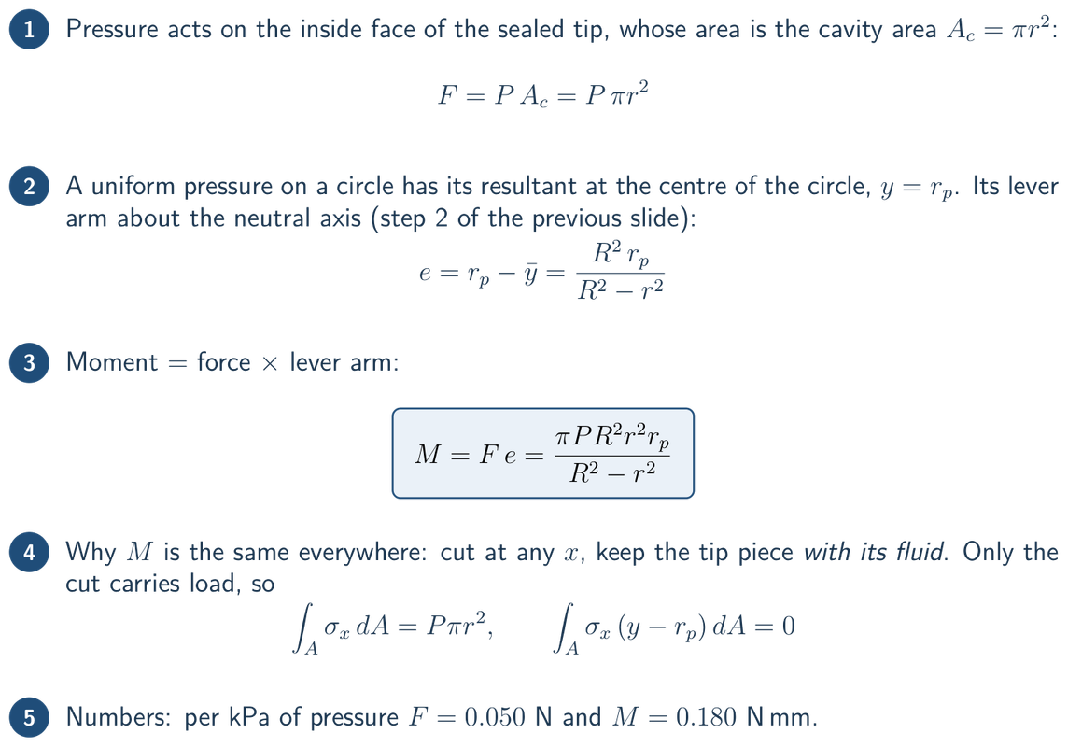
DERIVATION 2 · PRESSURE LOADING
Pressure load and bending moment
What we did: turned the cavity pressure into an end thrust and the bending moment it creates
HOW — STEP BY STEP
Cut the actuator at any x and keep the tip piece together with the fluid inside it.
The fluid beyond the cut pushes with Pπr² through the cavity centre C; the silicone wall pulls back with σₓ.
The push acts a distance e above the neutral axis, so it bends the actuator with M = F·e.
FINDING
M = F·e is linear in P and the same at every cross-section (0.18 N·mm per kPa). The thrust acts on the cavity area: F = P·πr².
Eccentric-cavity soft actuator · BTP progress review
6

Slide 7
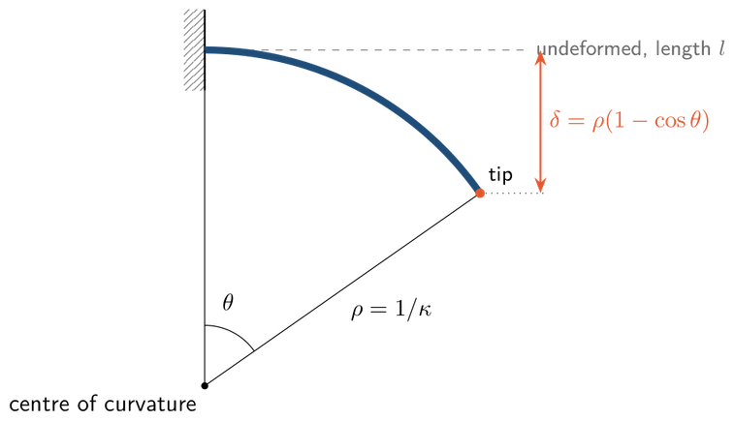
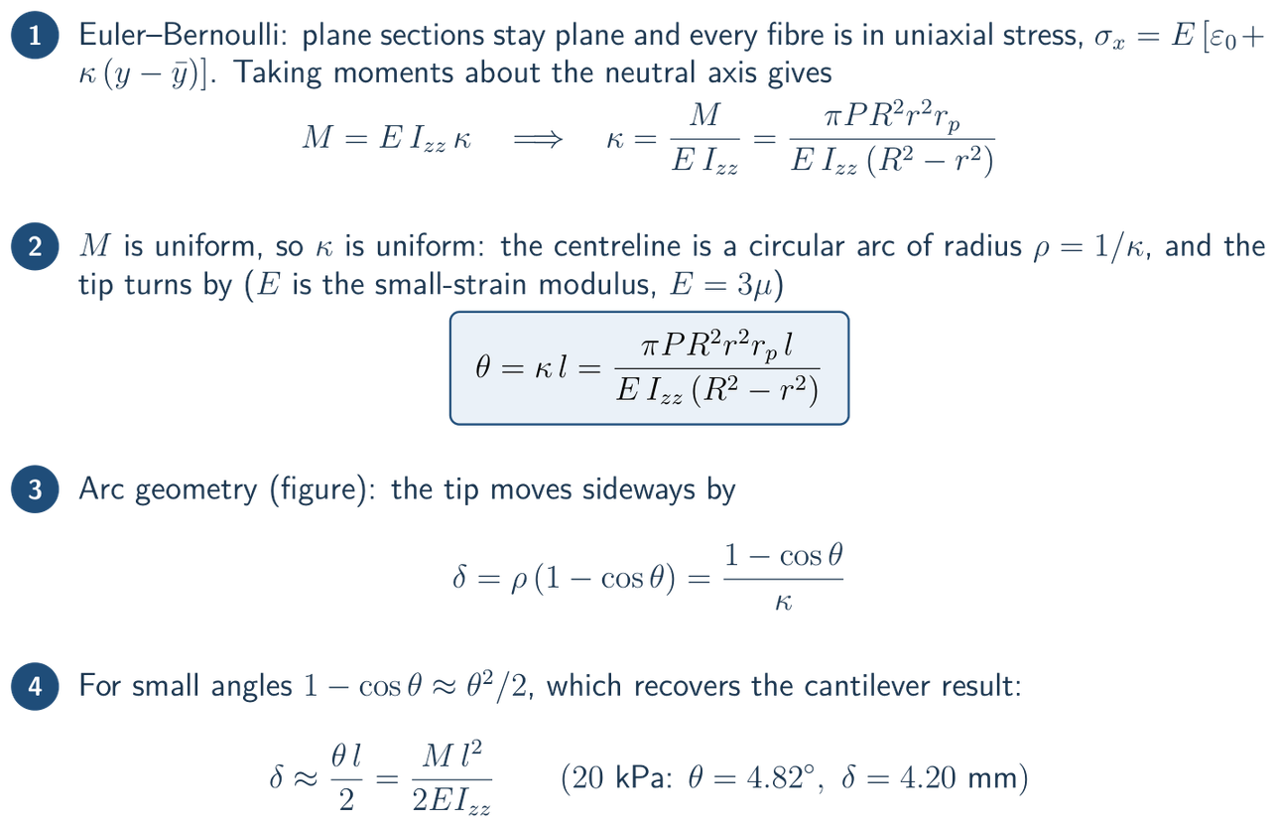
DERIVATION 3 · BEAM RESPONSE
Beam response: curvature, tip angle, deflection
What we did: converted the moment into curvature, tip angle and tip deflection (Euler–Bernoulli beam)
HOW — STEP BY STEP
Uniform moment → constant curvature → the centreline is a circular arc of radius ρ = 1/κ turning through θ.
FINDING
θ = 4.82°, δ = 4.20 mm at 20 kPa, linear in P. Holds only if each fibre is in uniaxial stress, which is true with a hoop sleeve.
Eccentric-cavity soft actuator · BTP progress review
7

Slide 8
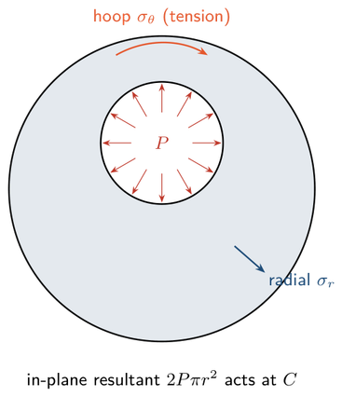
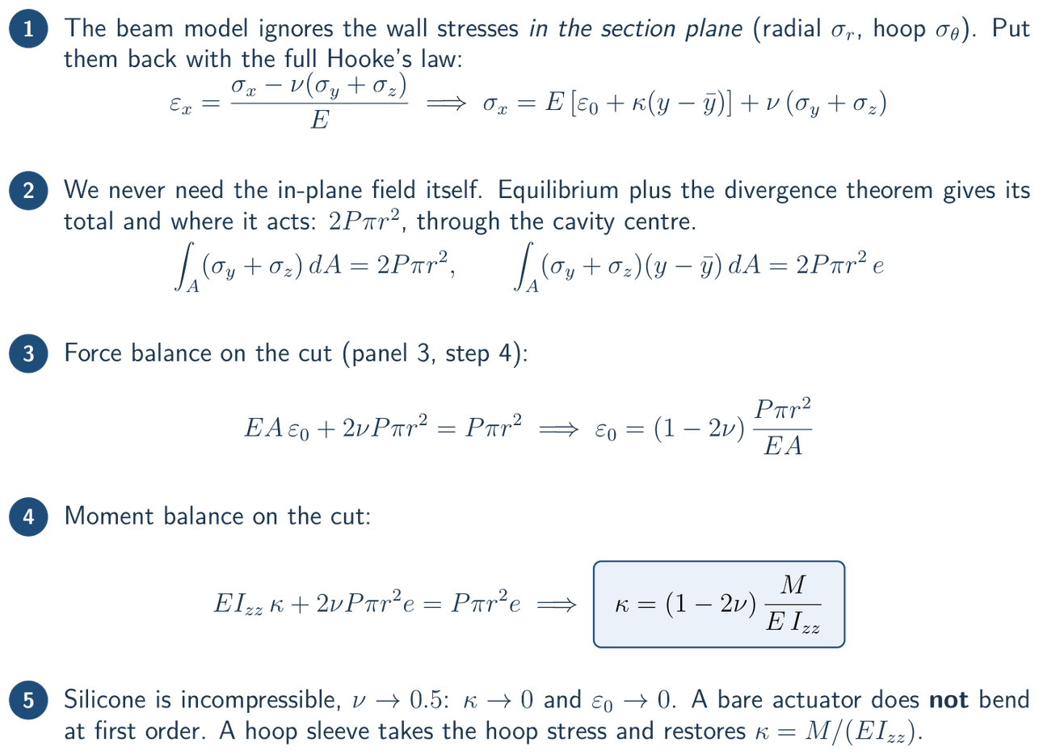
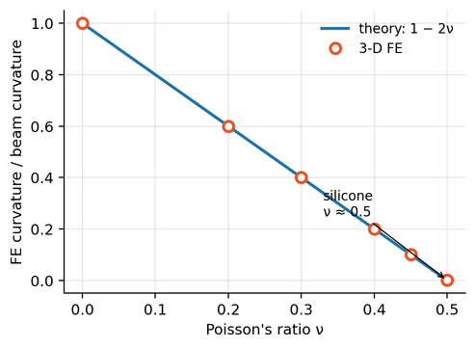
DERIVATION 4 · IN-PLANE WALL STRESSES
The (1 − 2ν) factor: why a bare actuator barely bends
What we did: put back the in-plane wall stresses that the beam model ignores
HOW — STEP BY STEP
Pressure also loads the wall in its own plane (left). Through Poisson's ratio this cancels the thrust moment; the 3-D FE curvature follows 1 − 2ν exactly (right).
FINDING
κ = (1 − 2ν)·M/(E I_zz) → 0 for silicone. A bare actuator does not bend at first order; the beam formula holds only with a hoop sleeve.
Eccentric-cavity soft actuator · BTP progress review
8

Slide 9
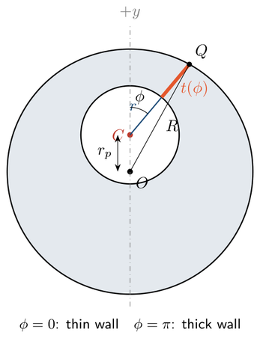
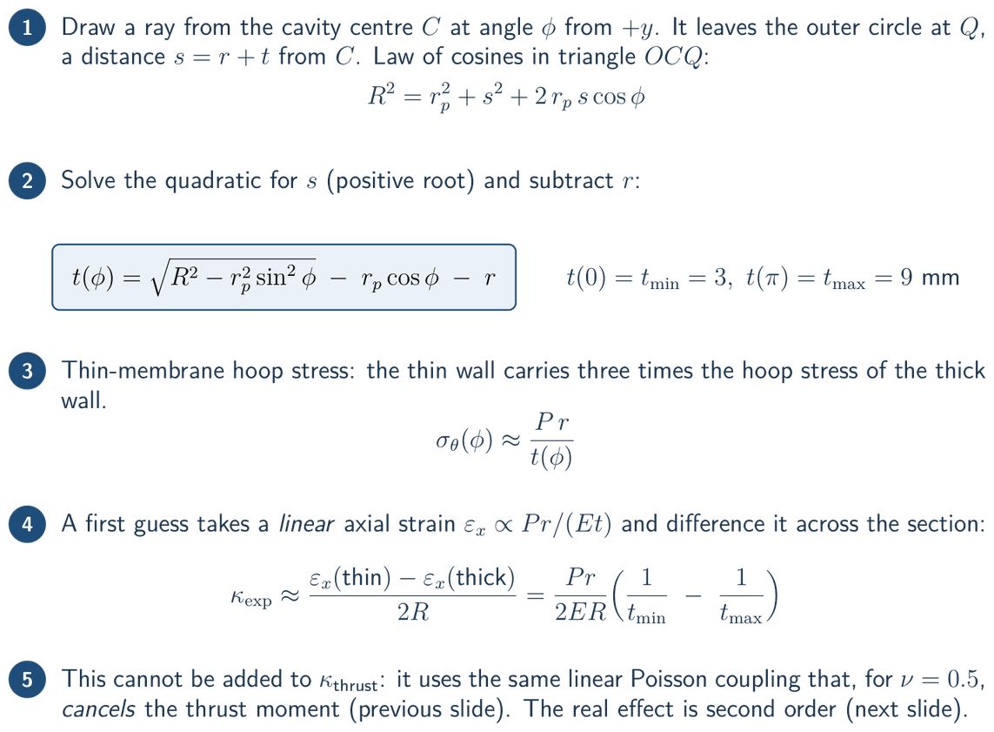
DERIVATION 5 · WALL GEOMETRY
Wall thickness and a linear wall-expansion estimate
What we did: derived the wall thickness t(φ) and tested a curvature that is linear in the wall expansion
HOW — STEP BY STEP
Wall thickness t(φ) along a ray from the cavity centre C: 3 mm at φ = 0 (thin wall), 9 mm at φ = π (thick wall).
FINDING
t(φ) is exact; the FE mesh is built on it. A wall-expansion curvature that is linear in P cannot be added to the beam term.
Eccentric-cavity soft actuator · BTP progress review
9

Slide 10
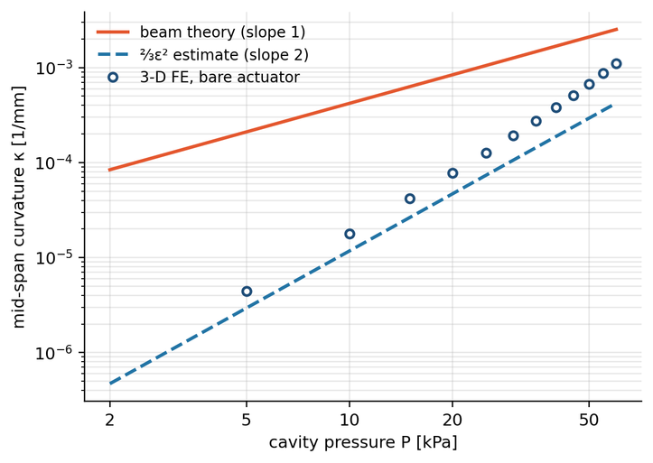
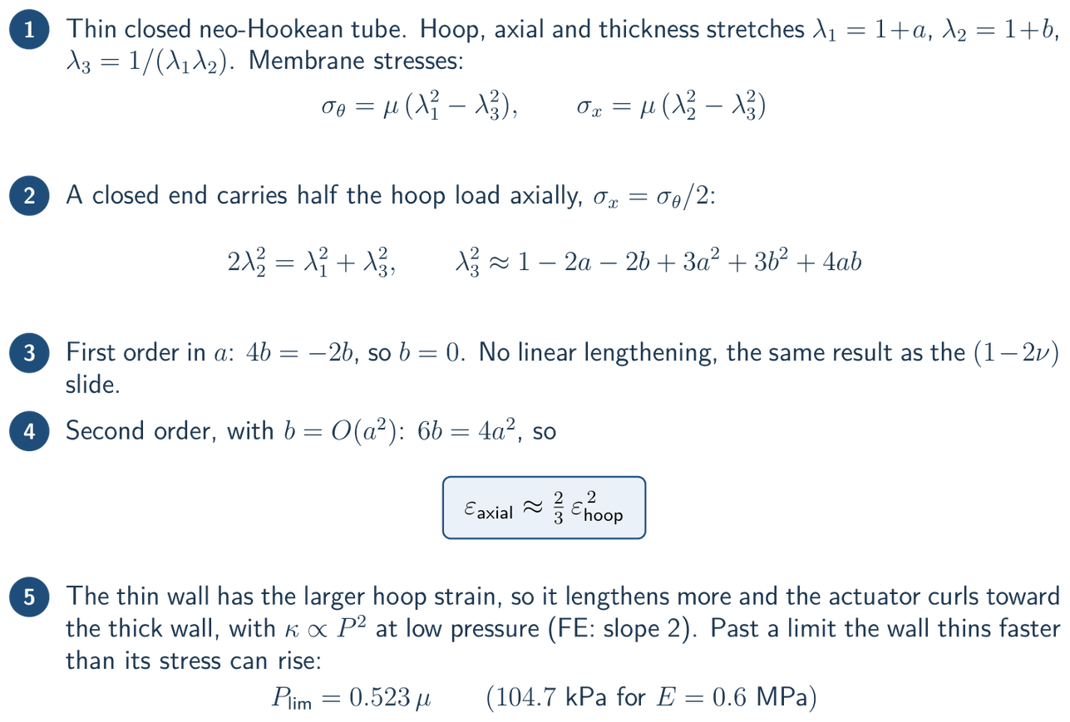
DERIVATION 5 · SECOND-ORDER LENGTHENING
What really bends a bare actuator: second-order lengthening
What we did: expanded the large-strain equations of a closed rubber tube to second order
HOW — STEP BY STEP
On log axes the FE curvature of the bare actuator rises with slope 2, like the ⅔ε² estimate — not slope 1 like beam theory.
FINDING
Axial strain ≈ ⅔(hoop strain)², so curvature grows like P², not P. The thin wall finally balloons at P_lim = 0.523 μ = 104.7 kPa.
Eccentric-cavity soft actuator · BTP progress review
10

Slide 11
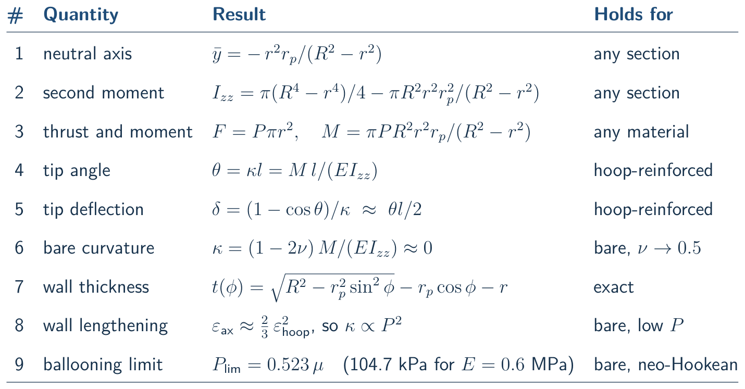
DERIVATION · SUMMARY
The derivation at a glance: key results
Nine results carry the whole model. Every step is written out in report/final/btp_derivation.pdf
Eccentric-cavity soft actuator · BTP progress review
11

Slide 12
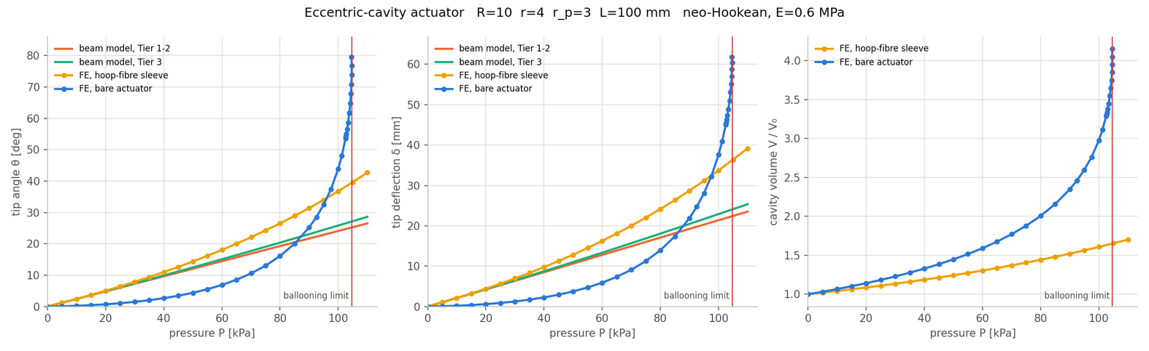
MODELLING FINDINGS
Four model tiers, from closed form to 3-D FE
What we did: built and compared four models of increasing fidelity (actuator_model.py, actuator_fea.py)
Tier 1 · Linear beam
Tier 2 · Arc kinematics
Tier 3 · Hyperelastic section
Tier 4 · Nonlinear 3-D FE
Closed-form Euler–Bernoulli result. Instant; valid for the sleeved actuator at low pressure.
Tier 1 curvature with large rotation and axial stretch: x_tip = ρ sin θ, δ = ρ(1 − cos θ).
Every fibre follows a Yeoh / neo-Hookean law; section equilibrium solved numerically.
Full large-strain solid model; the only tier that captures the bare actuator.
FINDING
Tiers 1–3 follow the sleeved FE within 5 % up to P/E ≈ 0.03 (FE is 25 % higher at P/E = 0.1). No beam tier fits the bare actuator: FE is 4–10× lower at low pressure, then runs away near 104.7 kPa.
HOW — same geometry (R 10, r 4, rₚ 3, L 100 mm) and silicone (E = 0.6 MPa) in every tier; beam tiers plotted against the sleeved and bare FE sweeps (fea_compare.py).
Eccentric-cavity soft actuator · BTP progress review
12

Slide 13
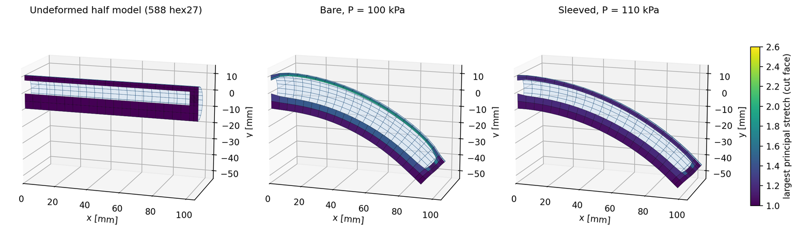
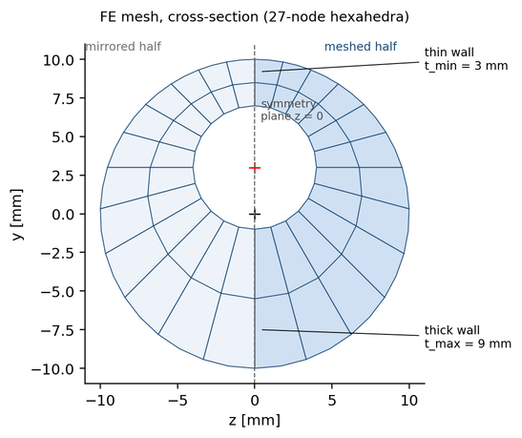
FEA · PROCESS
FEA process: an in-house nonlinear 3-D solver
What we did: wrote and verified our own large-deformation FE code in Python (no FE package was available)
1 · Mesh
2 · Material
3 · Incompressible
4 · Load & supports
5 · Solve
6 · Follow the path
Rays from the cavity centre using t(φ); 588 hex27, half model
Neo-Hookean / Yeoh strain energy W(F) for silicone
Mixed displacement–pressure (Q2/P1) elements, ν = 0.4995
Follower pressure from −P·V; clamped base, symmetry plane
Newton–Raphson; tangent from JAX automatic differentiation
Pressure steps, then volume control over the ballooning peak
FINDING
The mesh follows the exact wall thickness t(φ) from the derivation. One pressure sweep takes 2–3 minutes on a laptop (36 states bare, 23 sleeved). Every step of the method is explained in report/fea_handbook.pdf.
Eccentric-cavity soft actuator · BTP progress review
13

Slide 14
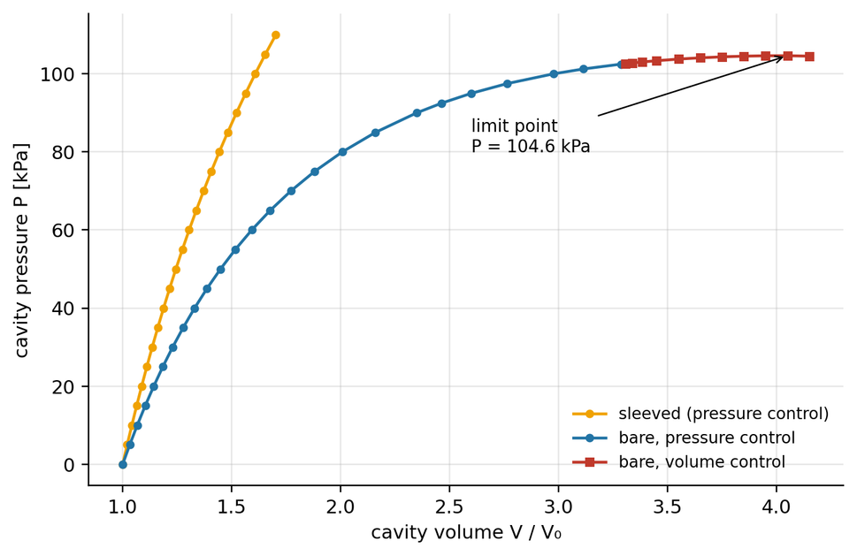
FEA · METHOD
How the solver finds equilibrium
How: minimise the total energy with Newton iterations, and follow the path past the pressure peak
1
Unknowns
Displacements of 6,205 nodes, plus 4 pressure values per element that hold the silicone nearly incompressible (ν = 0.4995).
2
Energy
Π(u) = Σ ∫ W(F) dV − P·V_cavity. Equilibrium is where Π is stationary: R(u) = ∂Π/∂u = 0.
3
Newton–Raphson
Repeat K·Δu = −R until R ≈ 0. The tangent K = ∂²Π/∂u² comes from JAX automatic differentiation — no hand-derived stiffness.
4
Follower pressure
Pressure acts on the deformed cavity; its nodal forces are P·∂V/∂u, so they turn with the wall automatically.
FINDING
5
Path following
Pressure control alone stops at the peak. Volume control — like driving the actuator with a syringe — follows the bare actuator over its limit at 104.7 kPa.
Pressure steps up to the peak; there K turns singular, so we prescribe the cavity volume and solve for P instead.
Eccentric-cavity soft actuator · BTP progress review
14

Slide 15
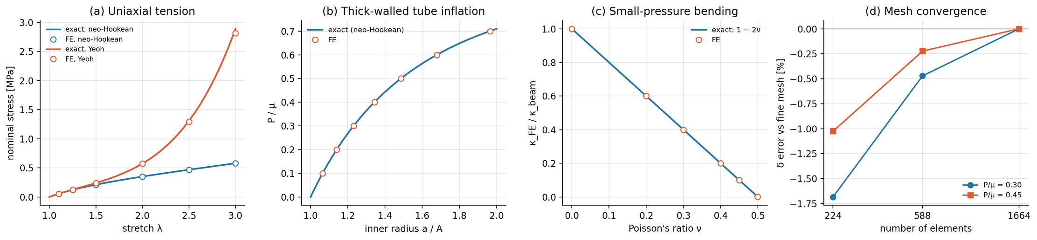
FEA · VERIFICATION
Verifying the solver against exact solutions
What we did: four benchmark tests with known answers before trusting any actuator result (fea_verify.py)
0.2 %
0.05 %
0.0002
0.5 %
max error against the exact stress, stretch up to 3
max error against exact tube inflation, P/μ up to 0.7
max deviation from the 1 − 2ν law, ν = 0 to 0.4995
medium mesh (588) vs fine mesh (1664) in tip deflection
FINDING
The code reproduces exact large-strain solutions within a fraction of a percent and the medium mesh is converged. The FE results can be trusted; the main remaining uncertainty is the silicone's material data, which only tests can fix.
Eccentric-cavity soft actuator · BTP progress review
15

Slide 16
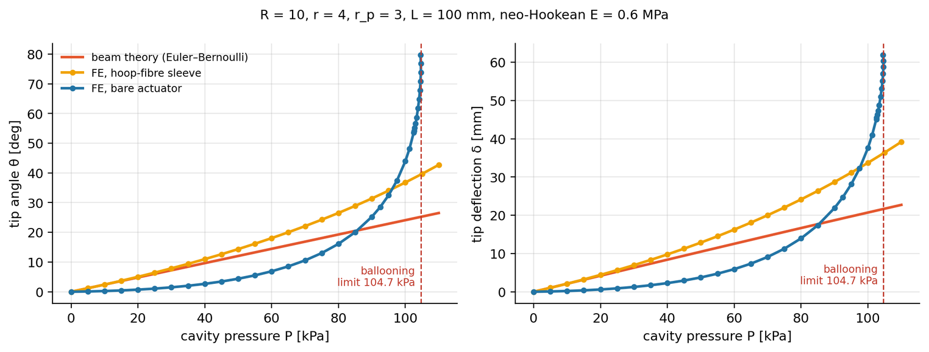
FEA · FINDINGS 1 / 3
Bare vs sleeved: two very different responses
What we did: pressure sweeps 0–110 kPa on both actuators, compared with beam theory (same geometry and silicone)
≤ 5 %
sleeved FE vs beam theory, up to P/E ≈ 0.03
4–10×
beam theory over-predicts the bare actuator at low pressure
104.7 kPa
bare ballooning limit = 0.523 μ (E = 0.6 MPa)
Tip deflection δ: 60 kPa → bare 5.9 mm, sleeved 16.3 mm · 100 kPa → bare 37.6 mm, sleeved 33.7 mm · at the limit → bare 60 mm
FINDING
The sleeve makes the response near-linear and predictable. The bare actuator barely moves at low pressure, then runs away near its ballooning limit.
Eccentric-cavity soft actuator · BTP progress review
16

Slide 17
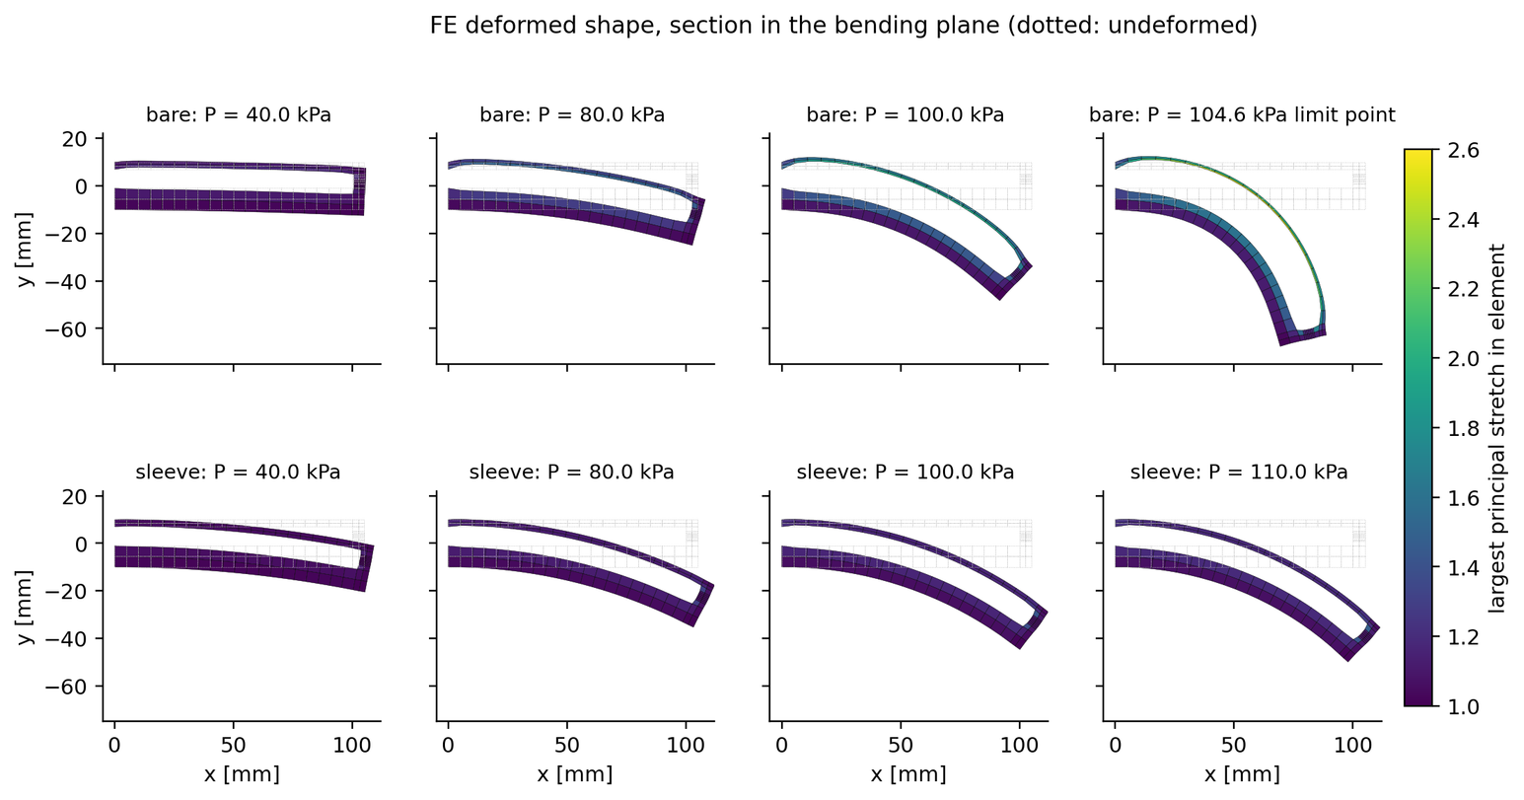
FEA · FINDINGS 2 / 3
Deformed shapes: where the bare actuator balloons
What we did: cut the deformed model along the bending plane at 40, 80, 100 kPa and at the limit; colour = stretch
BARE (TOP ROW)
The thin wall balloons. At the 104.7 kPa limit the cavity holds 4× its volume and the thin wall is ⅓ of its thickness.
SLEEVED (BOTTOM ROW)
Smooth, uniform curvature; no ballooning up to 110 kPa.
FINDING
Reinforce the actuator for a predictable P → δ map. Run a bare actuator below about 90 % of its measured limit pressure.
Dotted outline = undeformed shape. Peak principal stretch reaches 2.5 at the limit.
Eccentric-cavity soft actuator · BTP progress review
17

Slide 18
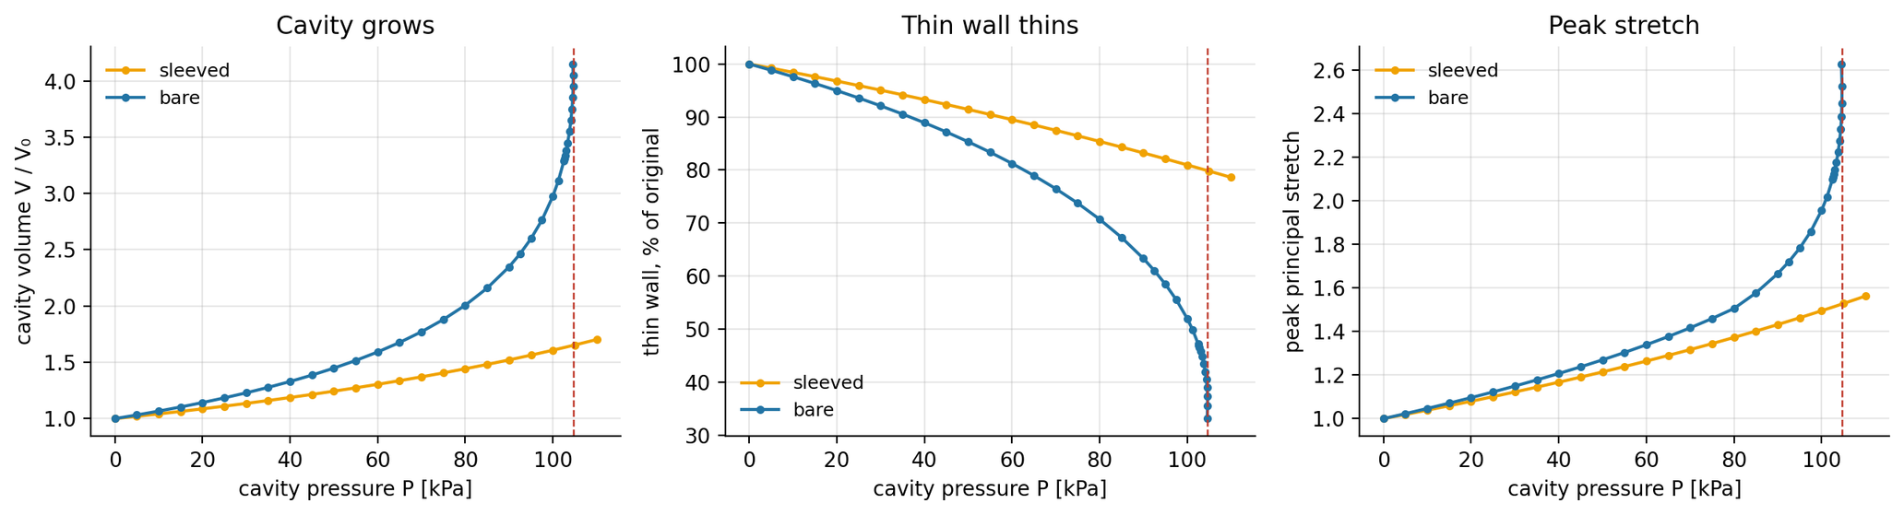
FEA · FINDINGS 3 / 3
Inside the wall: volume, thinning and stretch
What we did: tracked cavity volume, thin-wall thickness and peak stretch through each pressure sweep
× 4.05
cavity volume at the bare limit (sleeved: × 1.70 at 110 kPa)
⅓
of the 3 mm thin wall left at the limit (sleeved: 79 % at 110 kPa)
2.5
peak principal stretch at the limit (sleeved: 1.56 at 110 kPa)
FINDING
The thin wall is the weak point: near the limit it thins to a third and stretches 2.5×, so silicone fatigue must also set the operating window. The sleeve keeps all three quantities moderate.
Eccentric-cavity soft actuator · BTP progress review
18

Slide 19
FEA · DESIGN DECISION
Bare vs reinforced: which actuator to build?
What we did: ran the same pressure sweep on both designs and compared them on six criteria
BARE (NO REINFORCEMENT)
SLEEVED (HOOP-REINFORCED)
Tip deflection at 60 kPa
5.9 mm
16.3 mm (2.8× more)
Tip deflection at 100 kPa
37.6 mm, then snap-through at 104.7 kPa
33.7 mm, smooth and still rising
Deformed shape
Local balloon on the thin wall
Uniform circular arc
Usable pressure window
About 0.3–0.9 of the limit pressure
From zero to at least 110 kPa
Analytical model
Needs the full nonlinear FE
Beam tiers: 5 % at low P, 20–25 % low at 60 kPa
Fabrication
Single silicone cast
Extra step: thread winding or fibre sleeve
RECOMMENDATION
Build the hoop-reinforced (sleeved) actuator: it bends 2.8× more at moderate pressure, stays predictable across the range and is captured by the simple beam model. Keep one bare specimen to measure the ballooning limit.
Eccentric-cavity soft actuator · BTP progress review
19

Slide 20
NEXT MONTH · PLAN
Timeline: 9 October – 8 November 2026
What we will do: multi-cavity designs that bend in any x–y direction, an ANSYS check of every model, then mould and experiments
TASK
W1 · 5–11 Oct
W2 · 12–18 Oct
W3 · 19–25 Oct
W4 · 26 Oct–1 Nov
W5 · 2–8 Nov
Multi-cavity concepts: 2–4 eccentric cavities
Analytical model: cavity moments → bend direction
In-house FE sweeps of the multi-cavity designs
ANSYS model: geometry, hyperelastic silicone, mesh
ANSYS vs in-house FE and beam models
Mould design in CAD and 3-D print
Cast actuators and tensile test strips
Pressure tests + tip tracking in x and y
Compare experiments with the models
MILESTONES
M1 · 11 Oct
Concepts drafted
M2 · 18 Oct
Multi-cavity design chosen
M3 · 25 Oct
ANSYS check done
M4 · 1 Nov
First actuator cast
M5 · 8 Nov
First test data
Eccentric-cavity soft actuator · BTP progress review
20

Slide 21
SUMMARY
What we know so far
01
02
Derivation, step by step
Three analytical model tiers
Section, loading and beam response follow from statics. The (1−2ν) factor shows that axial stretch alone barely bends a silicone actuator; the bending comes from the wall ballooning.
Linear beam → (1−2ν) factor → wall expansion. Valid only for the reinforced actuator: within 5 % of the FE at low pressure, 20–25 % low at 60 kPa.
03
04
Nonlinear 3-D FE, written and verified
Build the reinforced actuator
27-node mixed u–p hexes, follower pressure and Newton with autodiff tangents. Four benchmark checks agree to within 0.5 %.
The bare one balloons and snaps through at 104.7 kPa. The sleeved one bends 2.8× more at 60 kPa and stays smooth and predictable.
Next: multi-cavity designs → ANSYS check → mould and experiments from 26 Oct
Thank you — questions?
Eccentric-cavity soft actuator · BTP progress review
21

