Slide 1

MY EXPERIENCE IN TECH FIELD
2023/11/12 → 2025/8/23

Slide 2

ABOUT ME
I WAS JUST A CURIOUS BOY WHO HAD VERY MUCH INTEREST IN THIS COMPUTER THINGS. IN CHILD I ALWAYS USED TO THINK HOW GAMES ARE MADE WHN I PLAY IT AND TRY TO WATCH VIDEOS AND TRY TO CREATE WITH JUST A PHONE.
THEN SUDEENLY A VIDEO APPEARS IN MY YT FEED WHN I WAS IN 8TH GRADE

Slide 3

ABOUT ME
It was about HTML then I watch it and learned html and css and build some website using it and learn its responsiveness and designing.
And bit about ui/ux also.
I was just curious and rly want to know more so I just keep searching and exploring thing of tech for few month in that time.

Slide 4

ABOUT ME
Then I knew there is something called website developer. And research about it.
And started to learn it.
I watch javascript course and at mid of it it was hard so I quit and after month I got back to learn It this time more focus then I just learn javascript within few month around ¾ month cuz I also did logic building and projects.

Slide 5





ABOUT ME
Then BOOTSTRAP, TAILWIND AND REACT JS.
AFTER IT I BUILD SOME WEBSITE WHILE EATCHING TUTORIAL AND FEW BUILD MYSELF FULLSTACK WEB.
WHILE THIS I ALSO KEEP EXPLORING TECH. AND ALSO LEARNED GIT/GOTHUB AND WEB HOSTING.

Slide 6
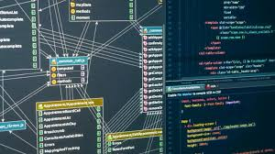
ABOUT ME
THEN I DID BACKEND:
LEARNED NODE JS , EXPRESS JS, MONGOOSE DATABASE
AND DID SOME PRACICE AND ALSO API AND INTEGRATE WITH FRONTEND AND BUILD FULLSTACK WEBSITE’S

Slide 7

ABOUT ME
TO LEARN THIS FULLSTACK WEB DEV IT TOOK ME AROUND 1.5 YR CUZ
IN THIS TIME I ALSO KNEW WEB SECUIRTY, WEB ATTACKS AND TRIED FREELANCING (FAILED)
AND TRY TO WORK IN MY IDEAS (FAILED CUZ NO MARKETTING)
TRIED TO GET ADSENSE APPROVAL (REJECTED MANY TIMES)

Slide 8
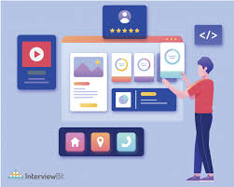
WEB PROJECTS
ITXSAHIL
ANIME SITE
QR GEN
NEWS BOY
NEP CART
PUSTAK HUB
WEB NEX
MORE 5-6

Slide 9
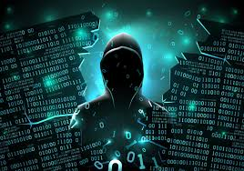
ABOUT ME
AND THEN I STARTED HACKING
I LEARNED KALI LINUX, NETWORKING, AND DID HACKING COURSE AND ALSO LEARN CEH V13 COURSE.
THEN DID SOME ATTACKS AND STILL THERE IS SO MANY ATTACK TO DO WHICH ARE PENDING

Slide 10
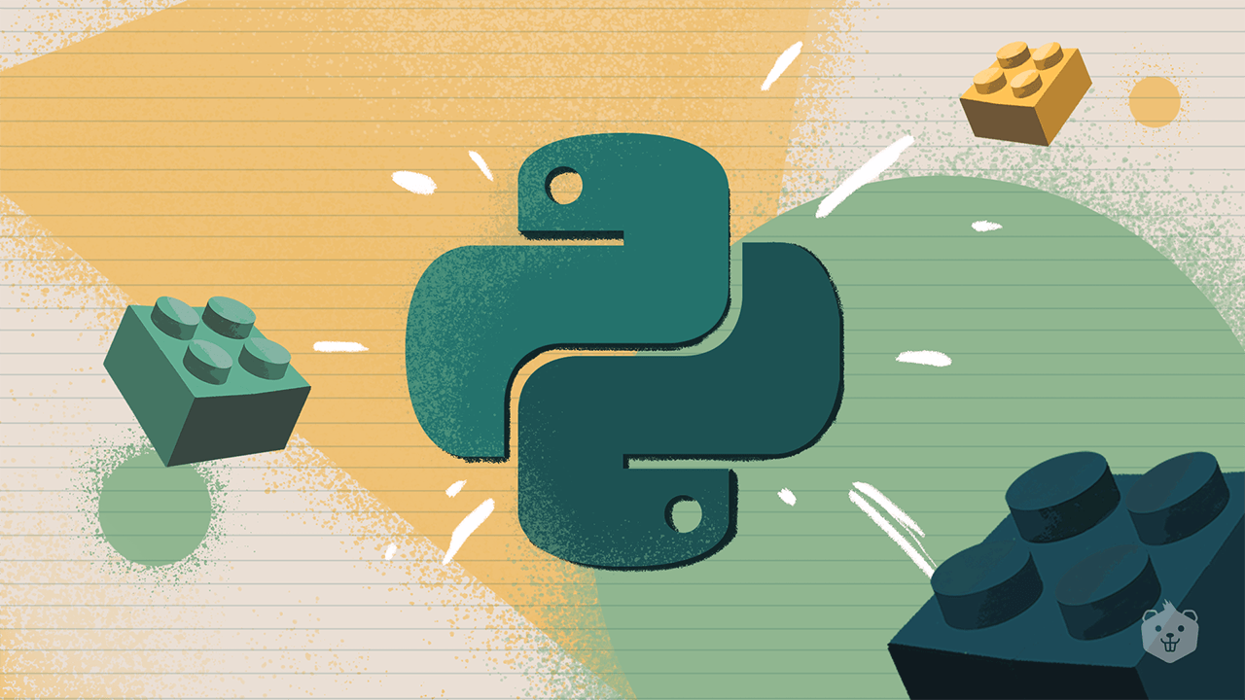
ABOUT ME
THEN I STARTED LEARNING PYTHON AND DID AI/ML BUT QUIT AI/ML.
BUT FINISH LEARNING PYTHON
I BUILD SO MANY PYTHON PROJECTS LIKE:

Slide 11
ABOUT ME
FACE DETECTION
ITEM DETECTER
JARVIS MINI AI
SCREENSHOT SOFTWARE
Internet Speed Checker
Typing Speed checker
Automation projects
Hacking Tools
Many more you can see it in my yt

Slide 12

ABOUT ME
WHILE LEARNING THIS ALL TECH THINGS.
I ALSO FOCUS AND GAVE MY TIME WATCHING TECH RELATED VIDEOS AND
PODCAST, VIDEOS, EXPERIENCE, READ SELF HELP BOOKS, FOUNDER’S STORY
TO BUILD A STRONG MINDSET
SO I CAN ALSO START MY OWN TECH COMPANY IN FUTURE FOR SURE.

Slide 13
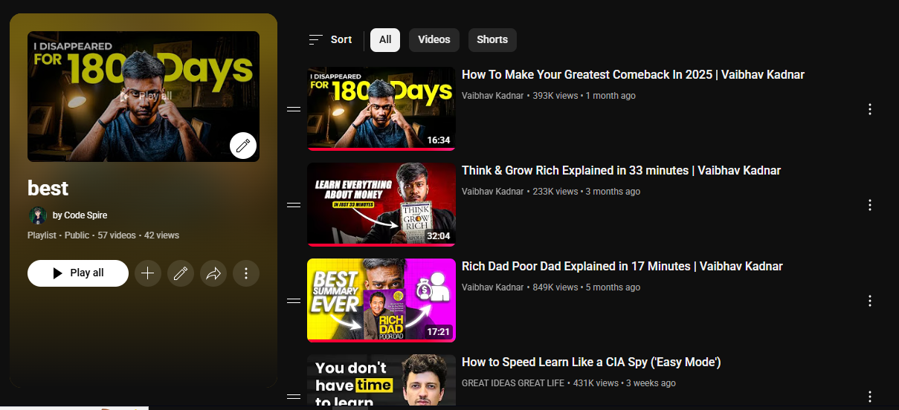
ABOUT ME
THIS IS THE PLAYLIST I CREATED WHERE I ADD ALL VIDEOS I WATCHD
To improve my mindset and to know about business, successful people experience, about tech things, self help books summary and many more.
Over 57+ videos I watched in just 1 to 2 month of improving mindset - 8/14/2025

Slide 14
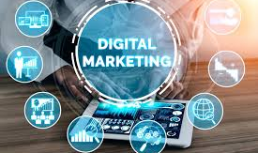


MY FUTURE GOALS
Digital Marketting
Tech Services
Connection
Want to learn Digital Marketting so I can promote my services efficiently and smartly to boost sales
Selling tech based services like selling website or software to businesses or launching own tech product solving real issue
Connecting with people with same vision and mindset like me so we can work together as a team so we can GROW more

Slide 15

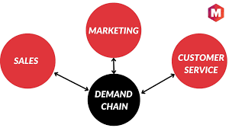
MY FUTURE GOALS
I HAVE DONE RESEARCH IN THIS TOPIC AND STILL DOING
Real Estate smartly
Demand & Supply chain
I have got few smart ways to gain huge profit in this business that’s why I choose it. (not interested to tell others)
Building a chain of services by solving and figuring the demand and building it there

Slide 16
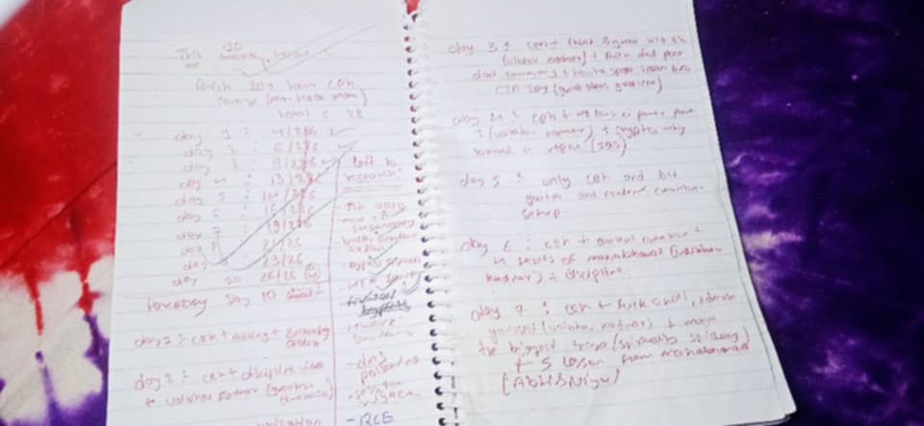
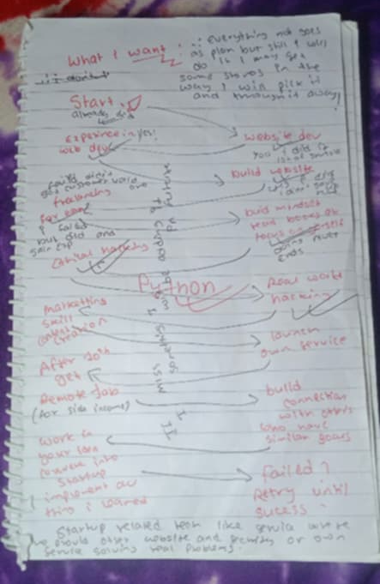
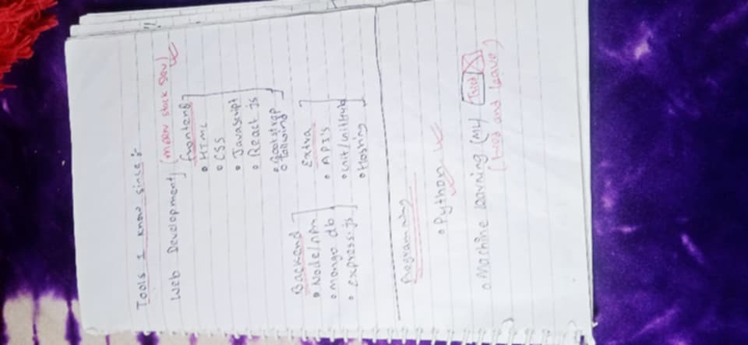
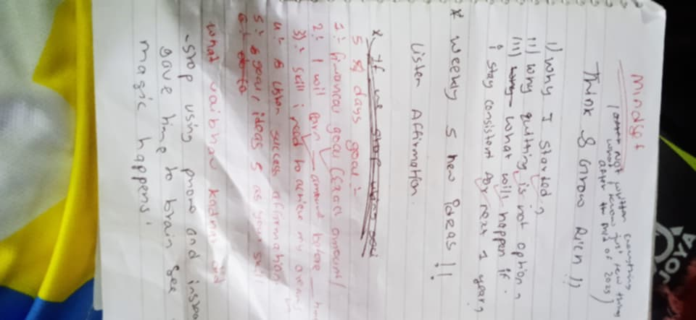
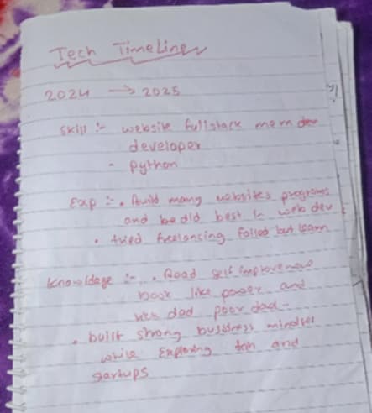
FEW PAGES OF MY DIARY

Slide 17

THANKS FOR WATCHING BYE BYE

