Slide 1

An Analysis of Unemployment in Republic of India using Power BI
Name: Sudharshan Nayak
AICTE Student Id: STU644cd1c41884f1682756036
College : St Joseph Engineering College,
Karnataka, Mangaluru

Slide 2

PROBLEM STATEMENT
Understanding and addressing unemployment in the Republic of India is crucial for fostering sustainable economic development and social stability.
This project aims to analyze the complex dynamics of unemployment within India using Power BI.
By examining various factors such as regional disparities, demographic characteristics, and sectoral trends, the analysis seeks to uncover insights into the root causes and patterns of unemployment across the country.
Through data integration and visualization, this study will provide valuable insights for policymakers, businesses, and other stakeholders to develop targeted strategies and interventions aimed at reducing unemployment and promoting inclusive growth in India.

Slide 3
Project Description
The dataset titled "An Analysis of Unemployment in Republic of India.xlsx" comprises 1708 rows and 4 columns.
It offers a comprehensive view of unemployment trends in the Republic of India, focusing on key variables such as age, gender, period, and the number of unemployed individuals.
Each row represents a unique observation, providing insights into the demographic and temporal dimensions of unemployment across the country.

Slide 4

WHO ARE THE END USERS?
Government agencies and policy makers.
Non-governmental organizations and advocacy groups.
Businesses and employers.
Educational institutions.
Researchers, academics, and the general public.

Slide 5

Technology Used
Power BI for data preprocessing, visualization, and dashboard creation, along with Excel for initial data manipulation and preprocessing

Slide 6
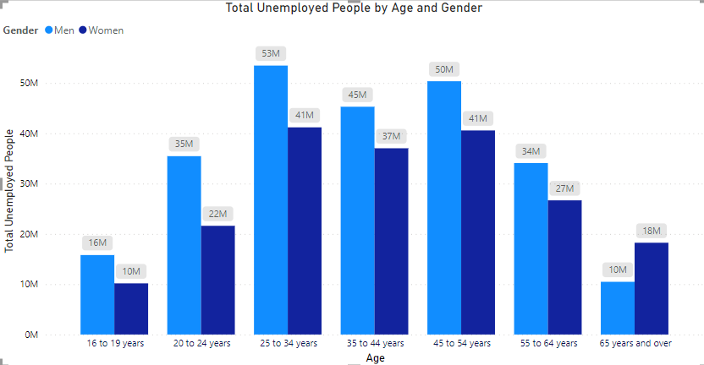
RESULTS
1 ) The total number of unemployed individuals
is depicted by age and gender through a clustered column chart,
providing insight into demographic-based unemployment distribution.

Slide 7
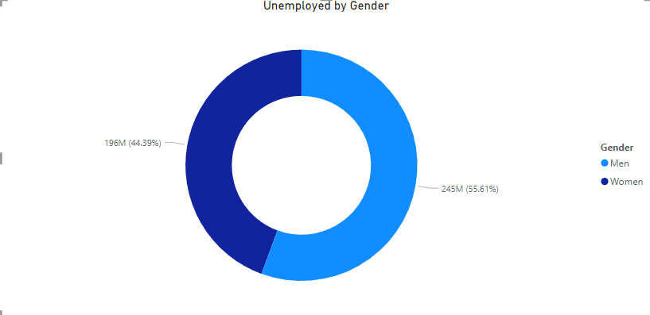
RESULTS
2) The second result showcases the distribution of unemployed individuals by gender,
presented through a donut chart,
offering a succinct visualization of gender-based unemployment proportions.

Slide 8
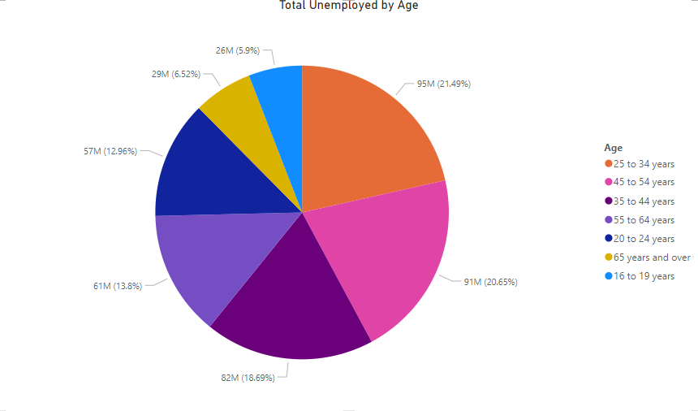
RESULTS
3) The third result presents the overall distribution of unemployment by age group,
visualized using a pie chart, providing a concise
overview of age-based unemployment distribution.

Slide 9
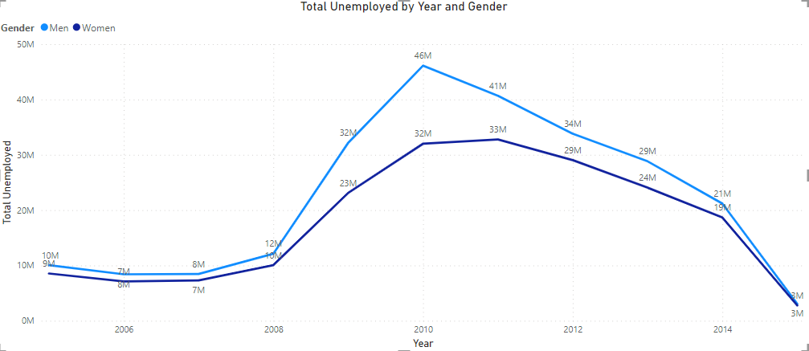
RESULTS
4) The fourth result displays a line filter graph, highlighting the total number
of unemployed individuals by year and gender,
offering insights into longitudinal trends and gender-based disparities in
unemployment

Slide 10
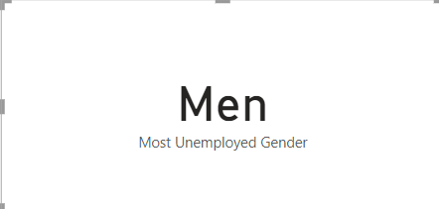
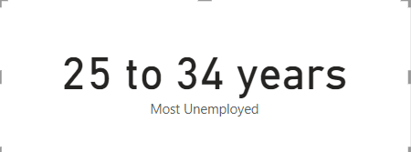
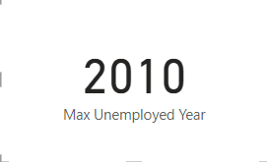
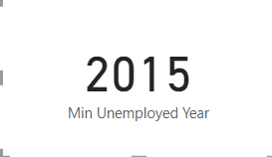
RESULTS
5) The fifth result features a set of card filters, revealing the most
unemployed gender, age group, maximum and
minimum unemployment years, providing key insights into demographic
and temporal unemployment trends

Slide 11
Thank you
Student AICTE ID: STU644cd1c41884f1682756036
Mail: 21CS414.sudharshan@sjec.ac.in
.

