Slide 1

Day 2: Wires n stuff
I couldn’t think of anything to put here
booleans integers strings

Slide 2
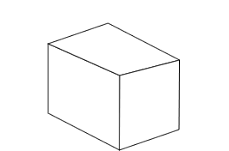
Box

Slide 3
Lets look at the box of awesome
Box

Slide 4
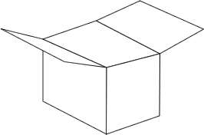
Lets look at the box of awesome
Box
  isOpen [T/F]

Slide 5
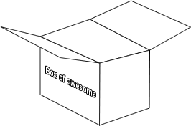
Lets look at the box of awesome
Box
  isOpen [T/F]
  sideText

Slide 6
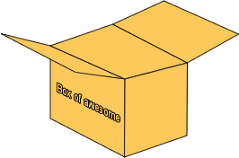
Lets look at the box of awesome
Box
  isOpen [T/F]
  sideText
  color

Slide 7
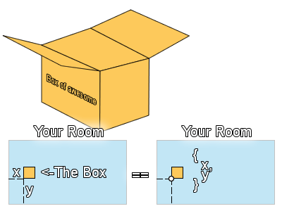
Lets look at the box of awesome
Box
  isOpen [T/F]
  sideText
  color
  position

Slide 8
Todays topics:
Types of LV
  Booleans
  Numbers
    And the many ways they exist
And how to manipulate the above
Strings if we have time
Other types we wont cover yet
  Clusters
  Arrays
This WILL be a packed day!

Slide 9
A simple question
Notes:
Here I ask a Person if his name is “[name]”
Then I ask him if his name is “Troy Bolton”
I will then ask him “Are you a girl?”
he will answer “no”

Slide 10
I asked a question
The answer was yes or no.
There were two possible answers
And in the end
“?? is a girl” is either
true
or
false

Slide 11
Boolean
A boolean can hold one of two values, “true” or “false”
  A boolean could represent whether a light is on, for example.

Slide 12
Boolean Logic
Boolean logic is essential in programming. As in, learn it because you have to.
Notes:
Don’t need to teach short circuit, as we don’t have that stuff in LV afaik.

Slide 13

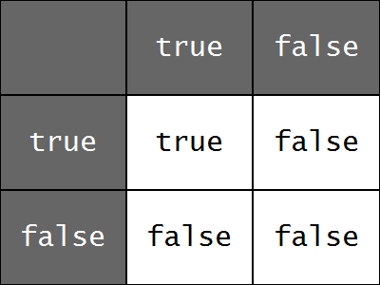
The Logical AND operator
If both operands are true
  the end result is true
Otherwise
  The end result is false

Slide 14
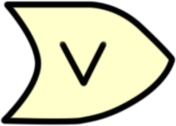
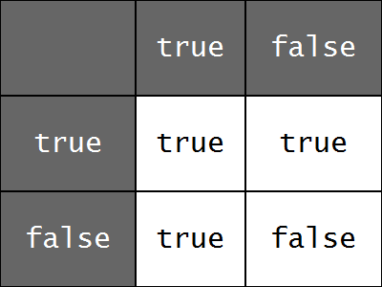
The Logical OR operator
If either operand is true
  the end result is true
Otherwise
  The end result is false

Slide 15

The NOT operator
The NOT operator just returns the opposite of what’s given to it.
What’s true becomes false, and what’s false becomes true.

Slide 16
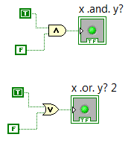
QUICK!
evaluate? ->
evalaute? ->
Notes:
No derp left behind- everyone answers at the same time

Slide 17

EVAL IT!
Notes:
Wait 20 seconds. Then have everyone answer the result

Slide 18
Numbers
Integers and stuff
Computers have finite memory
Most of the time, integers have maximum and minimum theoretical values.
Integers are usually defined as 8-bit, 16-bit, 32-bit, 64-bit

Slide 19
Numbers
Integers and stuff
Integers are usually defined as 8-bit, 16-bit, 32-bit, 64-bit
So how many different patterns can you form with 8 switches?
256, 2^8! It’s simple combinatorics or whatever they call that thingie in math class.
So…
an unsigned byte stores ANY number from 0x00 [0] to 0xFF [255]

Slide 20
Integers [ZzZ]
126 sheep, 127 sheep, -128 sheep…
So to raise our max and lower our min values, we just consume more memory…
And if you try to add to an integer only to exceed its limit
You get an overflow
Which is mildly amusing.

Slide 21
Integers [ZzZ]
-128 sheep, -127 sheep, -126 sheep…
So use integers appropriate for what you’re working with.
If you’re not sure what you want to work with, just use a 32-bit integer…

Slide 22
Integers [ZzZ]
OBJECTION!
So you might notice that I stated you could go from 0-255
However, I started counting at -128!? How’s that possible?

Slide 23
Signed/unsigned ints
Integers can be signed, or unsigned.
Signed- Have sign, smaller max, lower min.
Unsigned- Only positive. Higher max, minimum is 0.

Slide 24
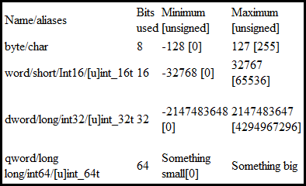
Bounds of ints

Slide 25
For now we just work with signed 32-bit integers
So what can we do with integers in real life? We do things with them every day, right?
Add, subtract, multiply, divide, square root, etc

Slide 26
The operators
I am not teaching you kindergarten math.
No.
Just no.
Mathematical operators can be found under
Programming->Numeric

Slide 27

Evaluate this
[I totally overstretched the picture]

Slide 28
Comparison Operators
These operators are once again self explanatory.
Programming->Comparison

Slide 29
Floats and Doubles
Really Quickly…
An int floored[rounded down] will always equal itself.
Integers can’t have decimal places, and many times, we need decimal places.
We use floats and doubles to accomplish this
Single/double precision floating point numbers aren’t precise.

Slide 30
Wut we b did too day?
Variables
  Booleans [bool]: true/false
    Byte – Group of 8 booleans
  Numbers [int/float]
    Ints: 1337, 123, 456
    Floats/doubles: 3.14
Basic manipulation of the above

Slide 31
Overtime – STRINGS!
“We use strings all the time”
  “Hello, World!”
Strings are concatenated, not added.

Slide 32
\0

