Slide 1

Day [7? Idk lol]
randomCrapAndStuffWeHaventBotheredCoveringLol

Slide 2
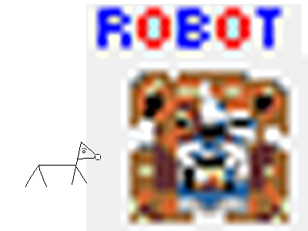
Watchdog

Slide 3
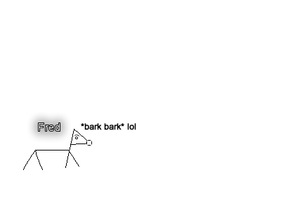
Watchdog

Slide 4
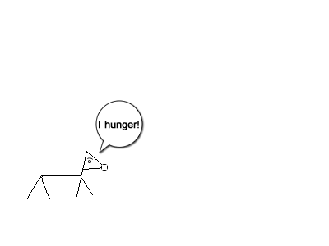
Watchdog

Slide 5
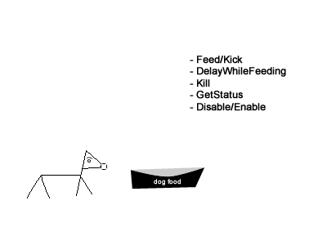
Watchdog

Slide 6
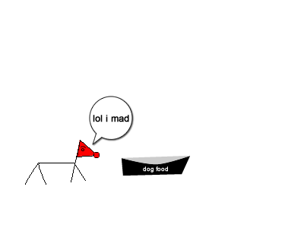
Watchdog

Slide 7
Watchdog
Feed
DelayWhileFeeding
Kill
GetStatus
Disable/Enable

Slide 8
\0

