Slide 1
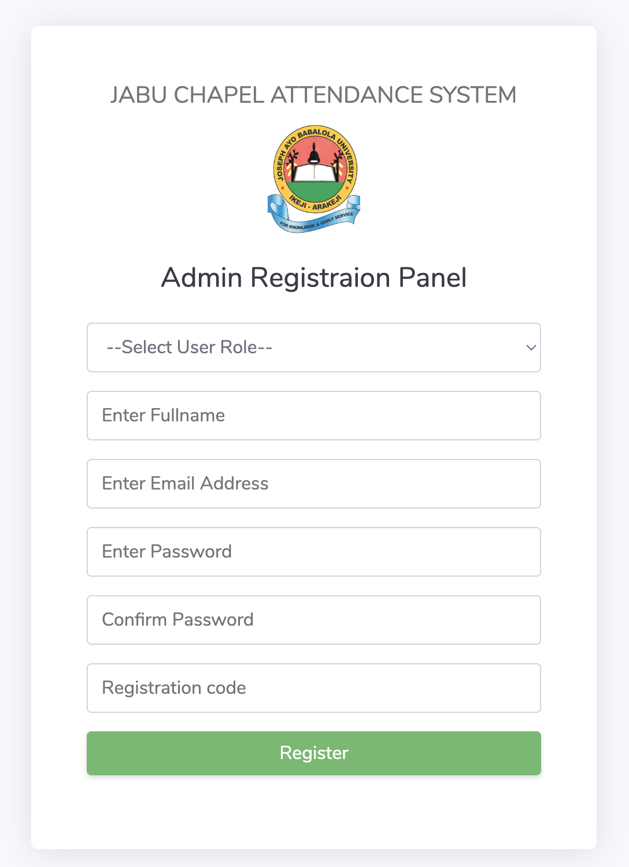
Registration for Super Admin and Moderator

Slide 2
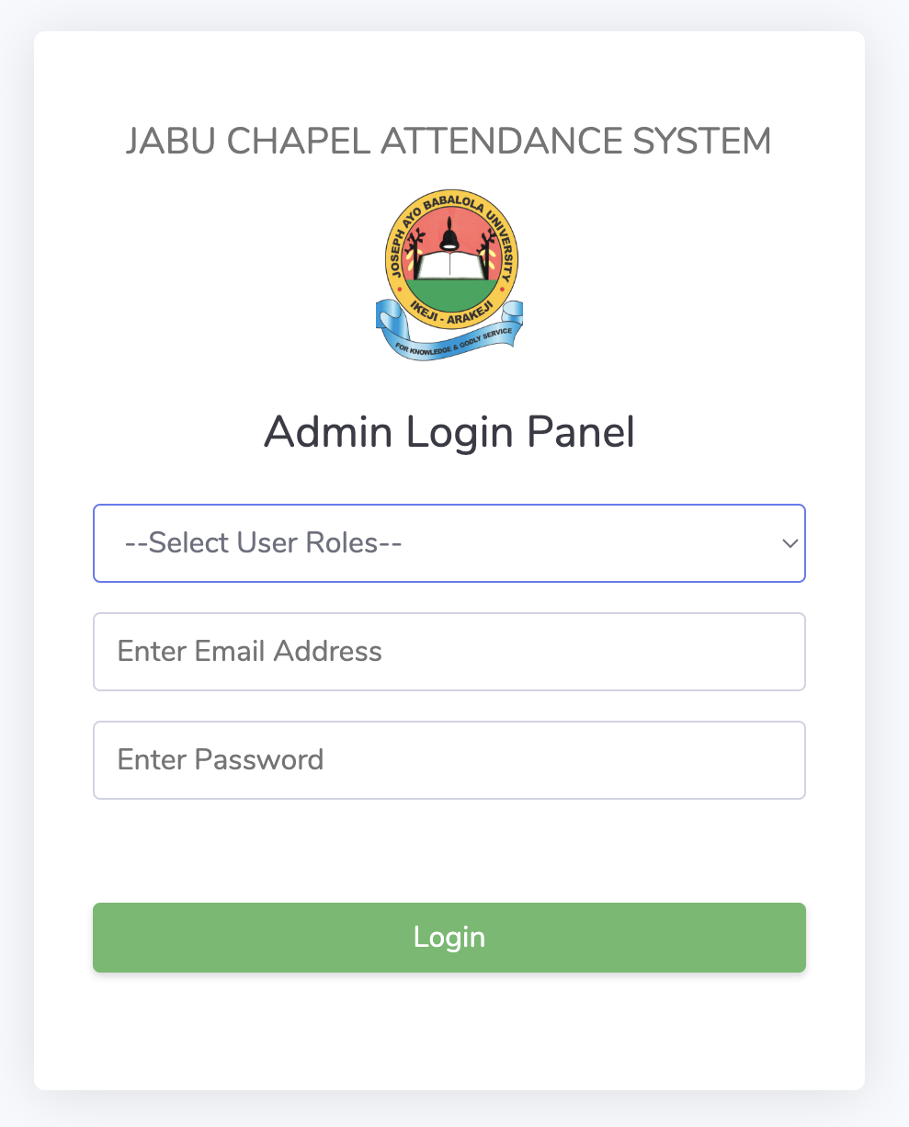
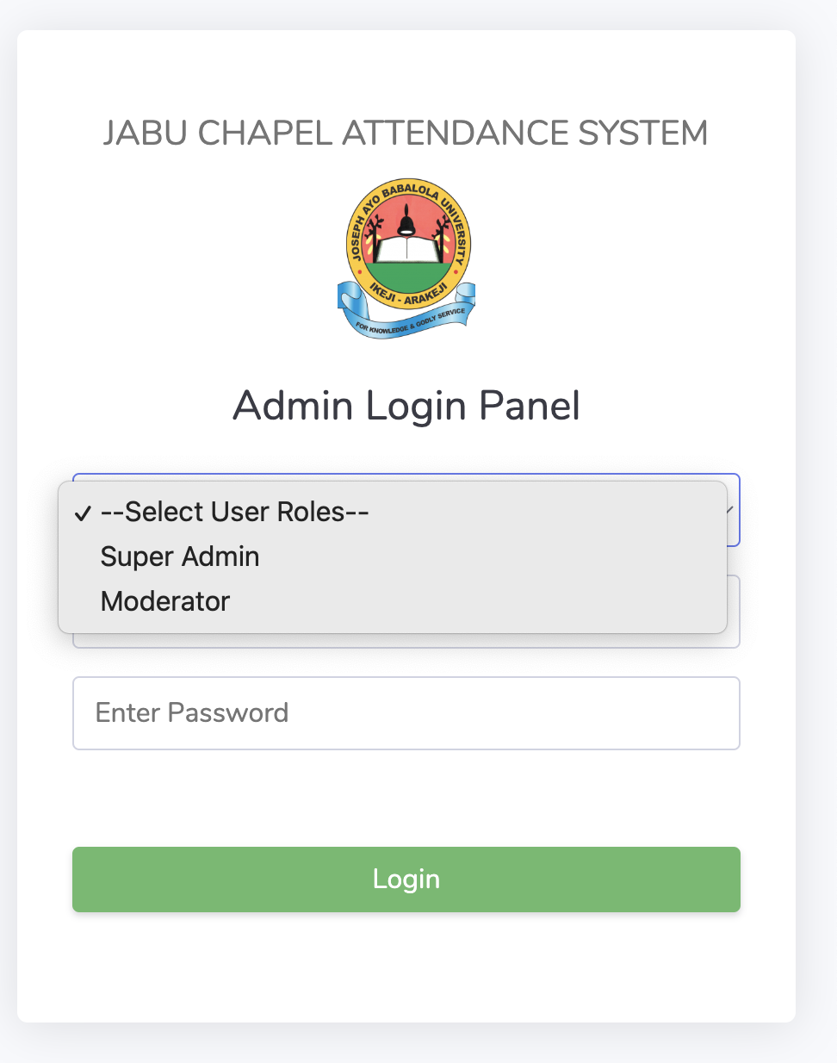
ADMIN LOGIN PAGE

Slide 3

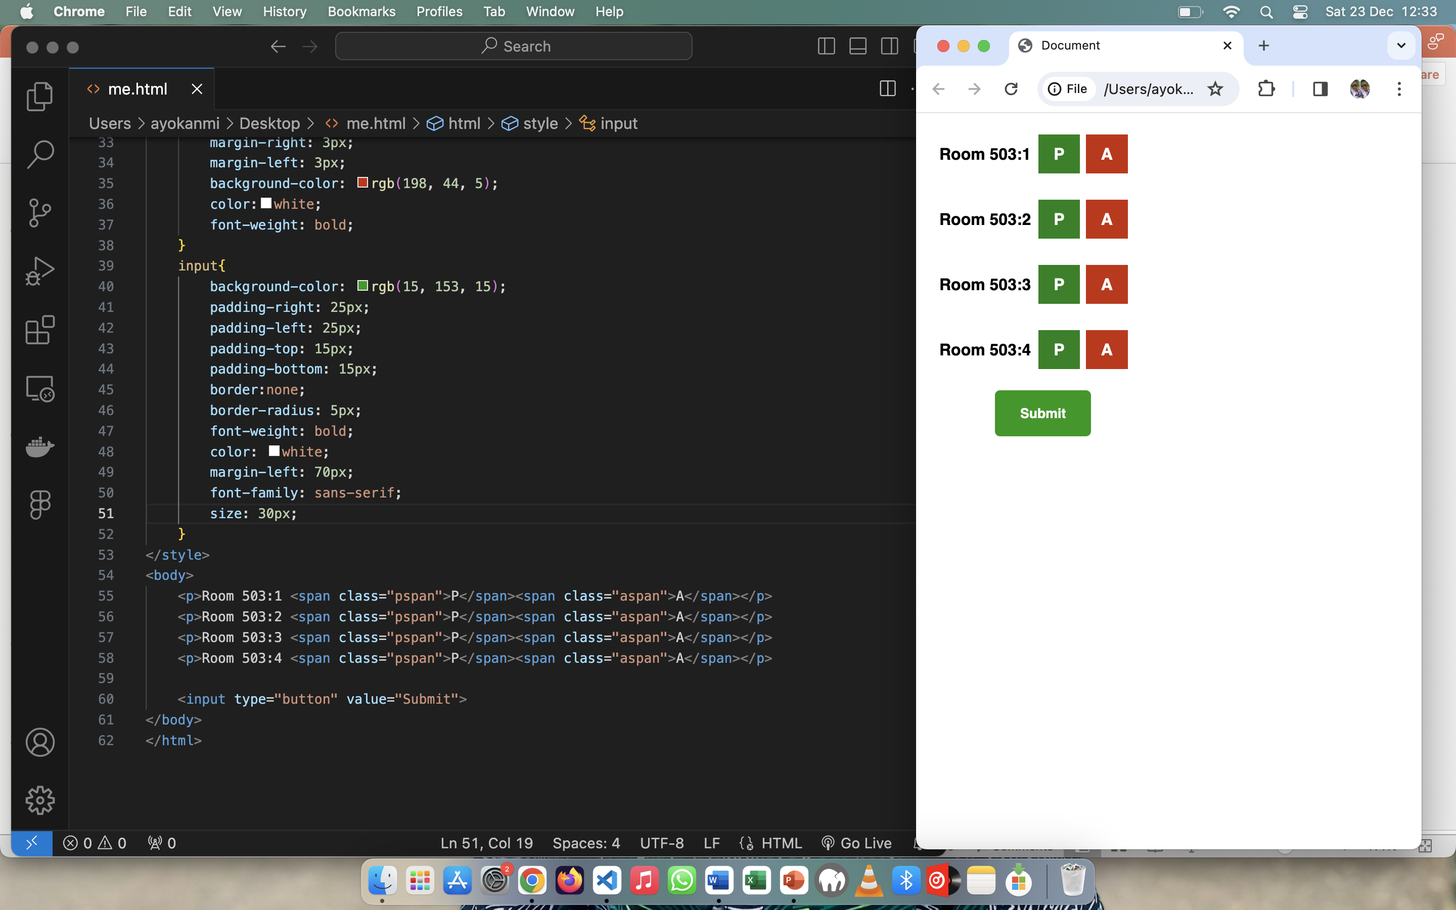
Welcome, Username
Welcome, Username
00:30
Block 5 Attendance
Block 5 Dashboard
Total Student
10
Take Attendance
Monthly record
Download Record
Take Attendance

Slide 4
Welcome, Username
Dashboard
Exeat Students
10
Moderators
10
Monthly record
Download Record
Total Student
100

