Slide 1
Comparing Linear, Neural, and Graph-Based Recommender Models on Implicit Feedback Data
Jose Velasco •Itzel Xu • Erik Bai
San José State University — CMPE 256

Slide 2
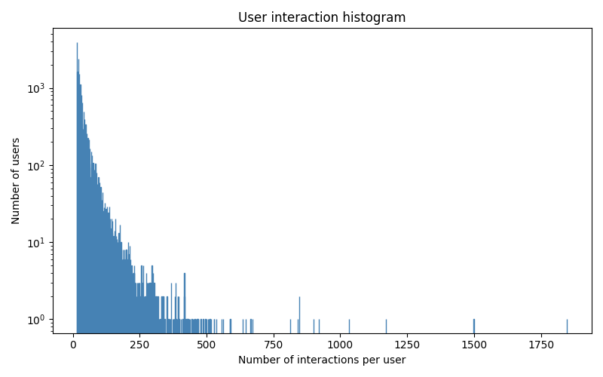
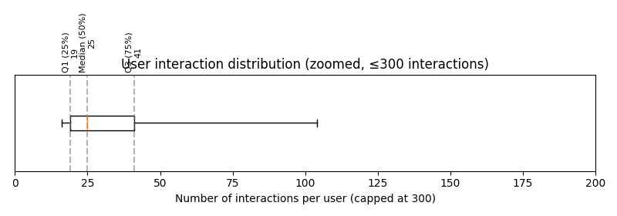
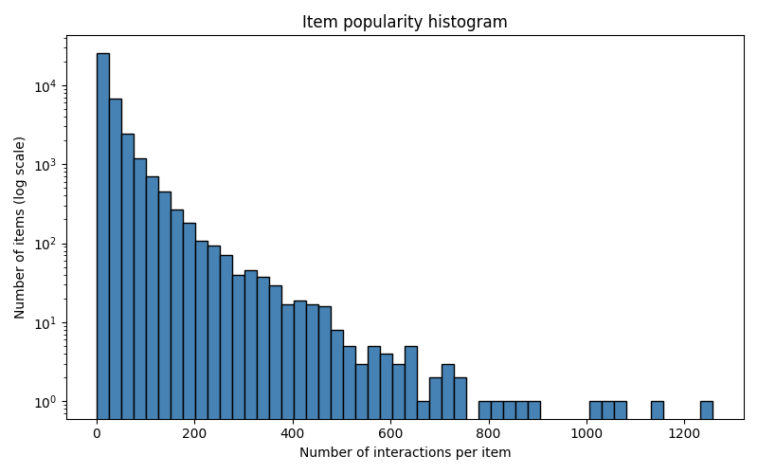
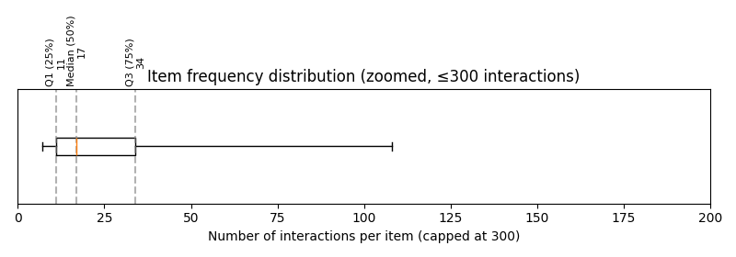
Motivation
Goal: Comparing linear, neural, and graph-Based recommender models that improve ranking accuracy (NDCG@20) on the implicit feedback train-1.txt dataset.
Dataset Overview
31,668 users
38,048 items
1.23M interactions (0.10% density)
Strong skew distribution
Users interaction [16, 1848]
items frequency [1,1258]
Notes:
which is only 0.10% density of the full user–item matrix User interaction:mean=39,median=25, std=45, min=16, max=1848
Item frequency:mean=33, median = 17, std=50 min=1, max=1258
The distribution is very skewed: a few items appear 1,000 times, while many items appear just once.

Slide 3
Problem Definition
Task: Collaborative filtering with implicit feedback Output: Top-20 recommended items per user Metric: NDCG@20 (ranking quality)
Key challenges:
No explicit negatives
High sparsity
Large item space (~38K items)

Slide 4
Algorithms Compared
Ease: Shallow linear autoencoder using closed-form item-item matrix
NCF: Non-linear user-item interaction via MLP
LightGCN: GNN using layed neighborhood aggregation
GraphGPS: Graph Transformer blending GNN + global attention

Slide 5
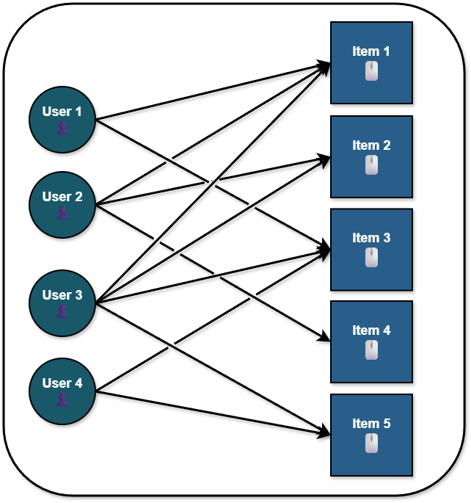
Data Processing Pipeline
 | item0 | item1 | item2 | item3 | I_{u}
Usr1 | 1 | 1 | 1 | 0 | 3
Usr2 | 1 | 0 | 1 | 0 | 2
df | 2 | 1 | 2 | 0
Read & parse interaction into (u,i) pairs
Build sparse matrix (EASE) or bipartite graph (LightGCN, GraphGPS)
Train/validation
For EASE:
Item k-core
Per-user stratified split (0.2)
user-row normalization & IDF weighting
For GNNs:
Construct adjacency matrix
Compute centralities & positional encodings (GraphGPS)
Negative sampling
𝑤_{u,i}=1/√|I_{u}|IDF(i)
Notes:
Item k-core: enforced a minimum item frequency, requiring items to be present for at least 3 users (item_min = 3). This process eliminates cold users/items, improving the conditioning of the Gram matrix.
stratified train/test split.
Bias: The more frequently an item appears, more penalized compared to rare items. Balance dataset between popularity of items and speciality of users.

Slide 6
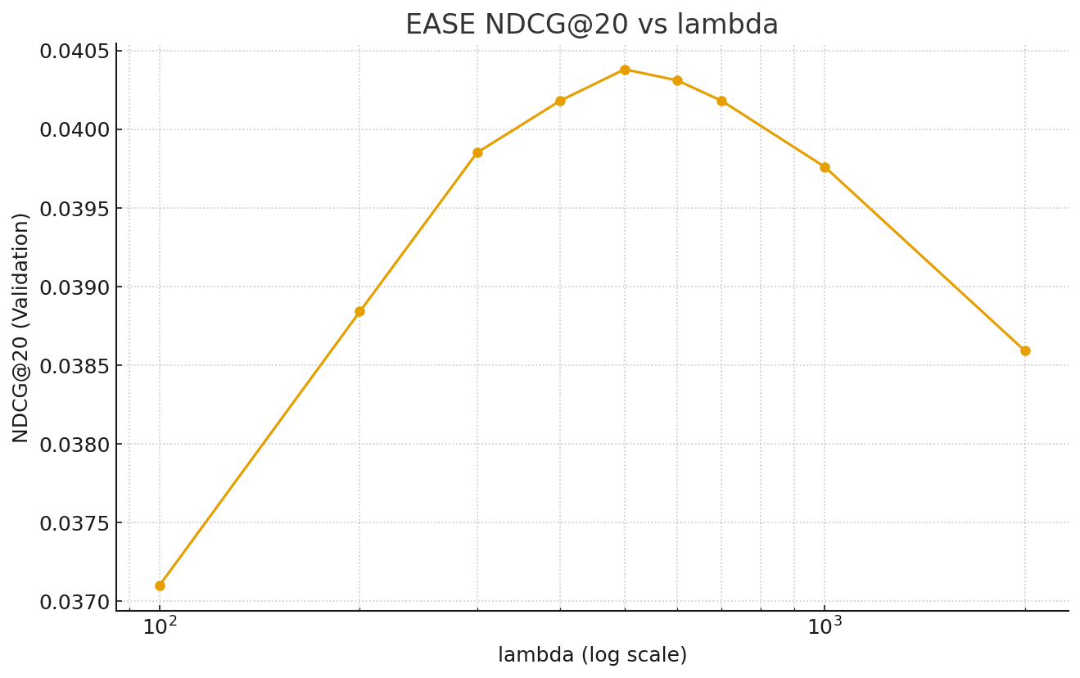
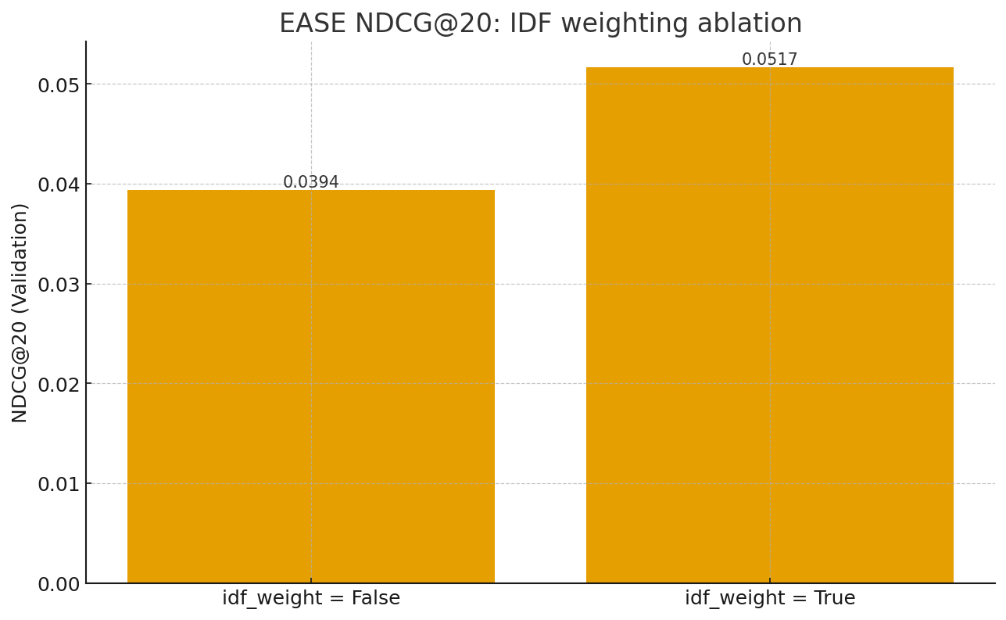
Model Configurations (EASE, NCF)
Ease:
Closed-form linear autoencoder：min||X-XB||²+λ||B||²
Training data：k-core(item_min = 3),
warm-eval (items that appear in ≥2 users)
Bias controls: user row-normalization ON, IDF weighting O N(31% increase)
Final hyperparameter: λ = 500 (best NDCG@20 on validation)
NCF:
Fusion of GMF and MLP pathways, but MLP only worked better during our experiment
Objective function: Binary Cross-Entropy Loss with sigmoid output
Embedding dimension: 16 for GMF and 16 for MLP
MLP: 3 layers(64 -> 32 -> 16)
Dropout: 0.2 applied after MLP layer
Final hyperparameter: Epochs 5 and batch size 256
Notes:
Ease:
the goal is: reconstruct each user’s interaction vector x via B.
X = user–item interaction matrix,
B = item–item weight matrix,
λ = regularization strength.

Slide 7
Model Configurations
LightGCN:
Uses BPR instead of BCE loss and treat it as pointwise binary classification task, which speed up data loading
Learning rate increased to 0,005-0.015 was more effective, since we switched to BCN loss function
Implemented custom tf.Gradient Tape training loop to have control over dynamic negative sampling
Mean pooling across layers to avoid overfitting
Batch size increased from 1024 to 8192 to maximize throughput on local GPU
GraphGPS:
GINE local message passing
Node features
Centrality features, random walk, Eigenvector of Laplacian
learned embedding table
Edge features
random walk, Laplacian
Scoring head: MLP with concatenated user-item embeddings
Link prediction task with edge splits and negative sampling
Notes:
Captures both local & global graph structure
Significantly higher parameter count

Slide 8
Evaluation & Results
 | NDCG@20 (test) | Best params
Ease | 0.0517 | λ=500, row-norm + IDF
NCF | 0.0262 | Sampling ratio=4, MLP dim=16
LightGCN | 0.0426 | Sampling ratio=1, batch size=8192, learning rate=0.005, Dim=64, Layers = 2
GraphGPS | 0.0004 | User embedding=256, negative sampling ratio=2, attention head=4
EASE is strongest among models
NCF-MLP performed better than MLP+GMF, but both struggled with extreme sparsity data.
LightGCN outperformed NCF due to graph structure, and improved over 17.7% NDCG@20 score in the final version
GraphGPS struggled with training stability on this dataset (out-of-memory / low gain).
Notes:
Sampling ratio: is ratio of negative item to positive items. EX. sampling ratio=4 means 4 negative samples per positive sample

Slide 9
Conclusions & Lessons Learned
What worked:
Closed-form EASE with row-normalization and IDF, tuned around λ ≈ 500, gave a strong NDCG@20 and clearly beat the untuned / no-IDF variants.
LightGCN built on a custom training loop with sparse tensor operations and BCE loss, which resolved library instability, enabled the model to converge smoothly and improved NDCG@20
What didn't work:
SciPy EASE (float64/float32): ill-conditioned inverse, NaNs, nearly identical recommendation lists
GraphGPS heavy attention:
sensitive to noise
Training instability
Large memory usage
Lesson learnt:
Simple often wins
Regularization & weighting matter
Notes:
SciPy EASE (float64/float32): The pure SciPy/NumPy version of EASE ran into numerical issues (ill-conditioned inverse, NaNs, nearly identical recommendation lists) and large memory use, so we abandoned it in favor of the PyTorch implementation.
Simple often wins: On this implicit dataset, a well-regularized linear model (EASE) and a light GNN (LightGCN) provided the best trade-off between complexity and NDCG@20; very deep/complex architectures did not clearly pay off under our constraints.
Regularization & weighting matter: Choices like λ, row-normalization, and IDF weighting had a larger impact than adding extra model depth.
Future work: Explore more scalable solvers for even larger item spaces, broader hyperparameter search (e.g., different normalizations, alternative regularizers), and ways to incorporate side information (content, time, user features) on top of the strongest baseline models.

Slide 10
References
[1] H. Steck, “Embarrassingly Shallow Autoencoders for Sparse Data,” Proceedings of the World Wide Web Conference (WWW), San Francisco, CA, USA, May 2019, pp. 3251–3257. doi: 10.1145/3308558.3313710
[2] L. Rampášek, M. Galkin, V. P. Dwivedi, A. T. Luu, G. Wolf, and D. Beaini, “Recipe for a general, powerful, scalable graph transformer,” in Adv. Neural Inf. Process. Syst. (NeurIPS), 2022. [Online]. Available: https://openreview.net/pdf?id=lMMaNf6oxKM
[3] X. He, K. Deng, X. Wang, Y. Li, Y. Zhang and M. Wang, “LightGCN: Simplifying and Powering Graph Convolution Network for Recommendation,” Proceedings of the 43rd International ACM SIGIR Conference on Research and Development in Information Retrieval (SIGIR 2020), Virtual Event, July 25–30, 2020, pp. 639–648, doi: 10.1145/3397271.3401063.
[4] X. He, L. Liao, H. Zhang, L. Nie, X. Hu, and T.-S. Chua, “Neural Collaborative Filtering,” in Proc. 26th Int. Conf. World Wide Web (WWW ’17), Perth, Australia, 2017. doi: 10.1145/3038912.3052569.

