Slide 1
Case Study: MesoNet
By Darius Afchar, Vincent Nozick, Junichi Yamagishi, and Isao Echizen
Presented by Team 7
Notes:
MesoNet: a Compact Facial Video Forgery Detection Network

Slide 2
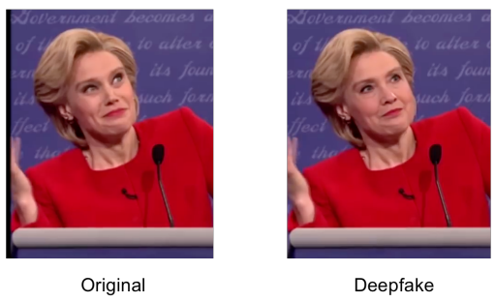
Problem
No good digital video falsification detection tools
Most image forgery detection cannot be applied directly to videos
Deepfakes: Using deep learning for face capture and reenactment
Face2Face: Non-deep learning method to transfer image facial expression from a source to a target person
MesoNet: a Compact Facial Video Forgery Detection Network
Figure 1. Example of an image (left) being forged (right) using the Deepfake technique.
Notes:
2018 MesoNet: a Compact Facial Video Forgery Detection Network
paper addresses the problem of detecting two video editing processes:

Slide 3
Solution I (Meso-4)
Four layers of successive convolutions and pooling + dense network with one hidden layer
ReLU activation function for each convolution
Batch normalization regularizes data + prevents vanishing gradient
Fully connected layers use Dropout for robustness
27,977 trainable parameters
Results: 96.9% for Deepfake model, 95.3% for Face2Face

Slide 4
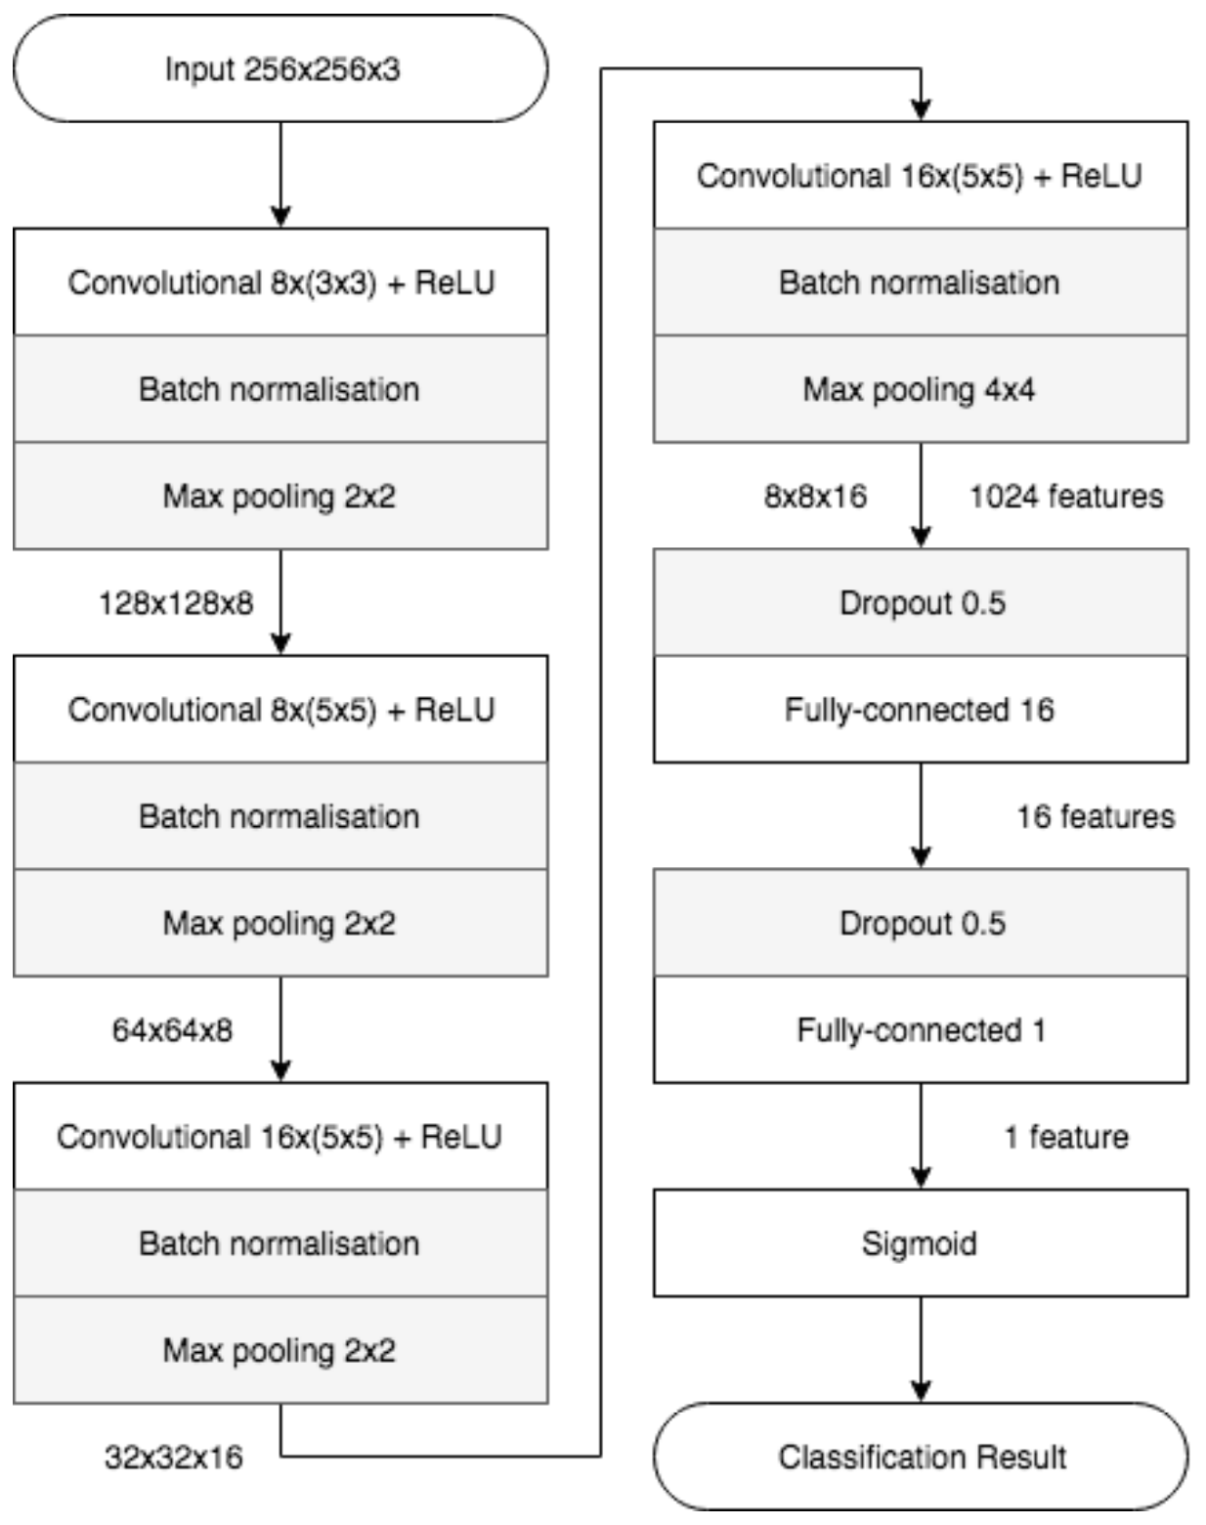
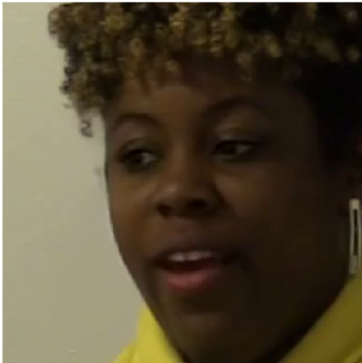
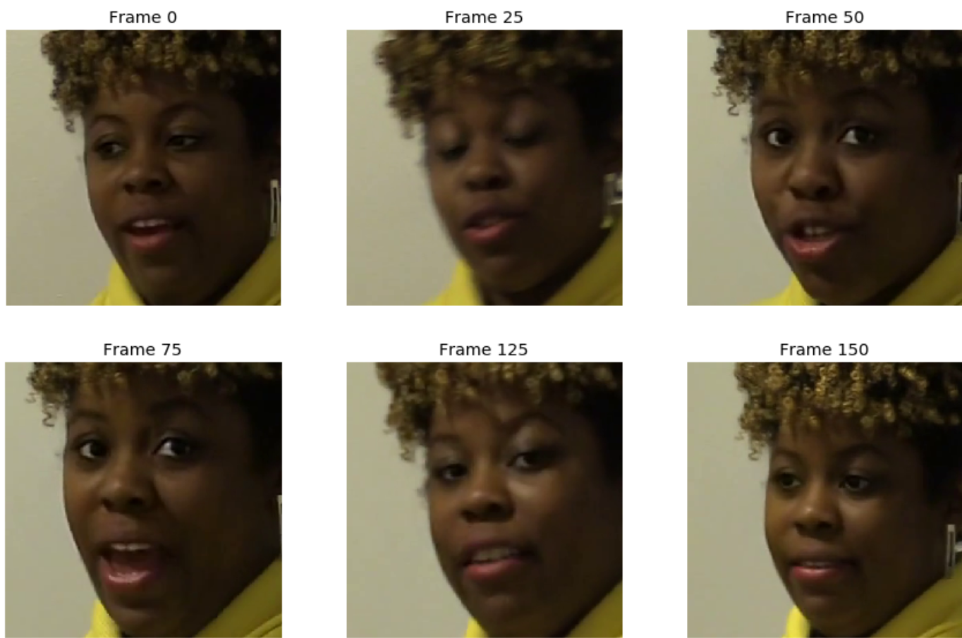
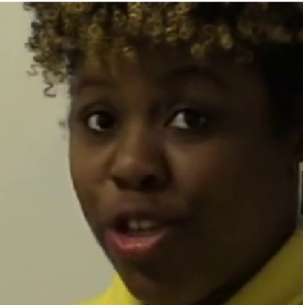
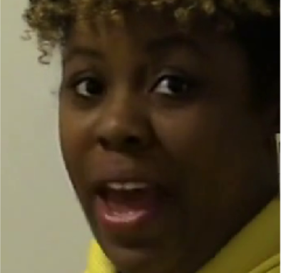
Solution I (Meso-4) - Architecture
Preprocessing: face extraction and alignment
Training: frame detection with NN model
Prediction: aggregation over time
False
True
True
True
Figure 3. Face alignment
Figure 4. Prediction aggregation
Figure 2. Meso-4 network architecture.
Notes:
Face Extraction: isolating faces from video frames
Face Alignment: key facial landmarks (e.g., eyes, nose, mouth) are in a standard position
the model generates a separate prediction for each frame, make use temporal patterns
Idea:model to learn features at multiple scales;
capturing a more diverse set of features,
enhancing its robustness

Slide 5
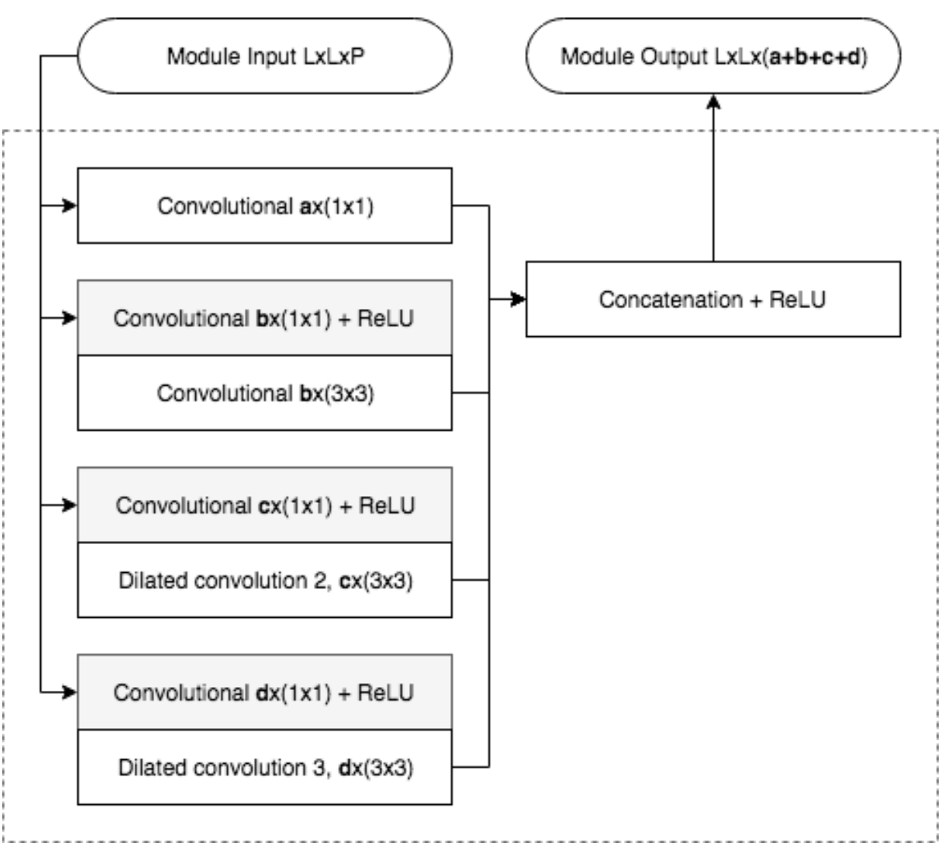
Solution II (MesoInception-4)
1x1 convolutions for dimension reduction
Dilated convolutions avoid high semantic
Concatenation
28,615 trainable parameters
Results: 98.4% for Deepfake model, 95.3% for Face2Face
Figure 5. MesoInception-4 network architecture.
Notes:
Dilated convolutions: learn more detailed and fine-grained features before combining them into higher-level semantic information
Concatenation: Improve robustness; Multi-Scale Feature Learning, Richer Representations

Slide 6
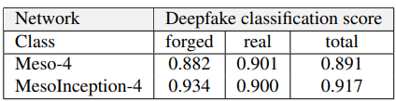
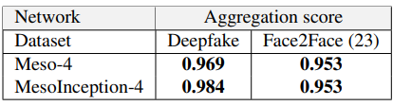
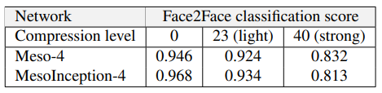

Results
Both Meso-4 and MesoInception-4 reached scores around 90% when considering frames independently
Image aggregation significantly improved detection rates for both networks
Image aggregation with only intra-frames performed worse
Table 3. Classification scores using image
aggregation (Face2Face dataset compressed at rate 23)
Table 1, 2. Classification scores for each frame independently.
Table 4. Classification score variation on the Deepfake dataset using only I-frames.

Slide 7
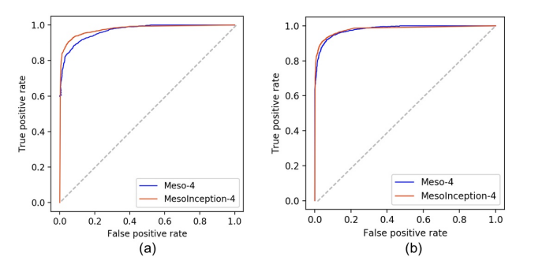
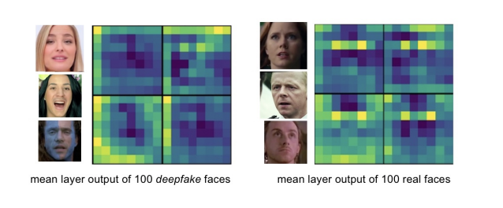
Evaluation of MesoNet
Strengths:
High detection rate: 98% success for Deepfake videos and 95% for Face2Face videos.
Lightweight 4-layer structure, quick response, real-time applications
Low computational cost and fast training compared to other deepfake detection models.
Weaknesses:
Cannot handle temporal patterns.
Training should have included multiple datasets to prevent overfitting.
The blurriness of the image data impacted the model's performance, causing it to prioritize features like eyes and noses, which were clearer (Fig. 8), when making decisions. This could have had a significant impact on the outcomes, which we can work to address in our project.
Figure 6. ROC curves of the evaluated classifiers on the Deepfake dataset (a) and the Face2Face dataset compressed at rate 23 (b).
Figure 8. Mean outputs of the Deepfake dataset for the some filters of the last convolutional layer of MesoInception-4.

Slide 8
Our Suggestions
Possible adoption of techniques for the group's project:
Create a neural network with architecture similar to MesoNet
Improvements:
Increased Dropout Layers
Multi-Scale Pooling
Densified Convolution Blocks
Increased Batch and Layer Normalization
Residual connections
Attention Mechanisms
Notes:
To improve MesoNet’s performance and robustness for video forgery detection:
1. Increased Dropout Layers: Apply varying dropout rates (0.3–0.5) throughout the network, especially in denser layers, to prevent overfitting without impacting inference time significantly.
2. Multi-Scale Pooling: Use a combination of max and average pooling to capture diverse features and potentially improve detection of nuanced artifacts.
3. Batch and Layer Normalization: Adding layer normalization alongside batch normalization in deeper layers may stabilize training across different video compressions.
4. Densified Convolution Blocks: Use densified connections in initial layers to enhance feature reuse without increasing the parameter count drastically, potentially improving generalization.
5. Residual connections: Adding residual connections to capture more complex and temporal features.
6. Attention Mechanisms: Introduce attention modules within the architecture to focus on facial regions more prone to distortions in forged videos, like the eyes and mouth.

Slide 9
Reference
[1] M. R. K. Mofrad, Z. S. Safavian, and A. Rahmani, "A Survey on Unsupervised Feature Learning Using Mutual Information," arXiv preprint arXiv:1809.00888, Sep. 2018. [Online]. Available: https://arxiv.org/abs/1809.00888. [Accessed: Oct. 13, 2024]

Slide 10
THANK YOU!

