Slide 1
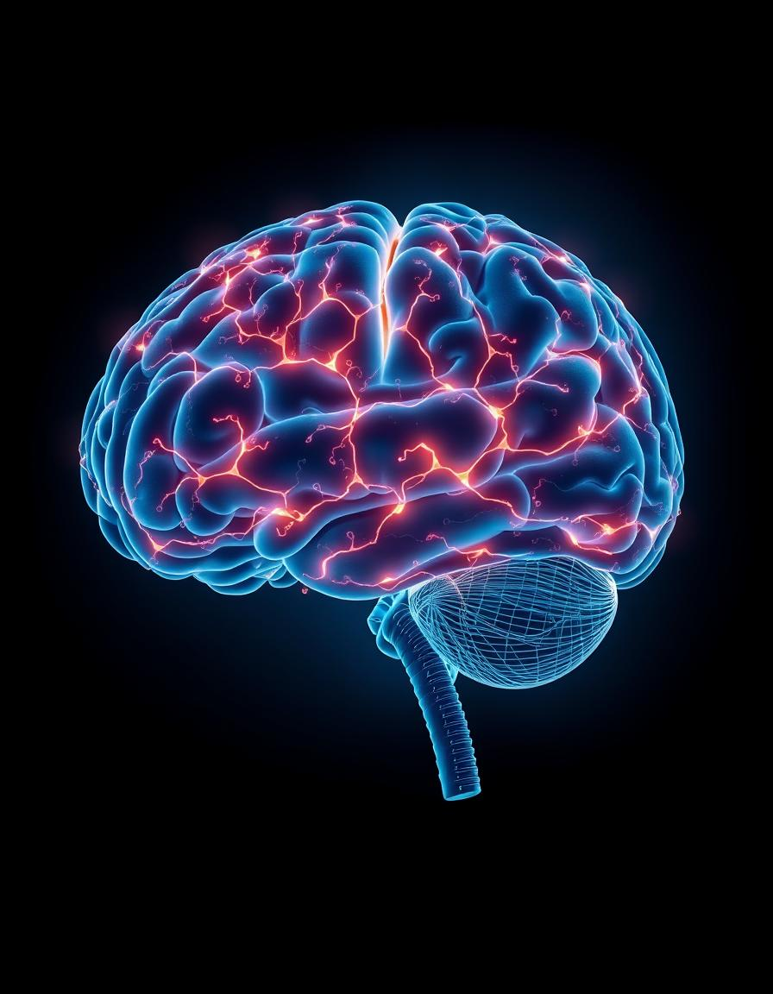
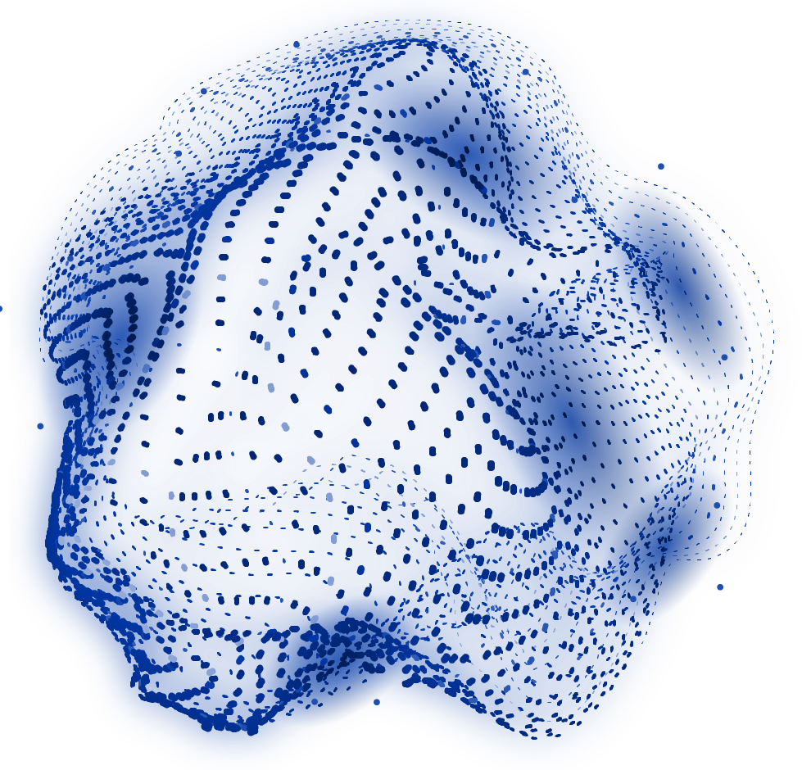
CMPE 217 Human AI Interaction Project
GAN-Based EEG Artifact Removal
TUH EEG Artifact Corpus (TUAR)
Itzel Xu
May 12th, 2025

Slide 2
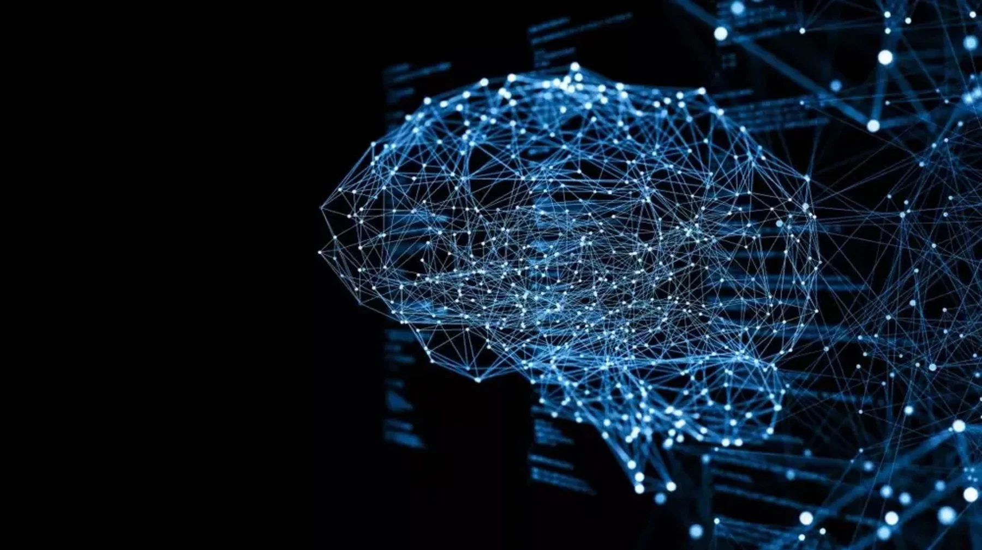
TABLE OF CONTENTS
01
02
03
04
05
Problem Statement
Solution
Experiment
Results & Evaluation
Conclusion

Slide 3
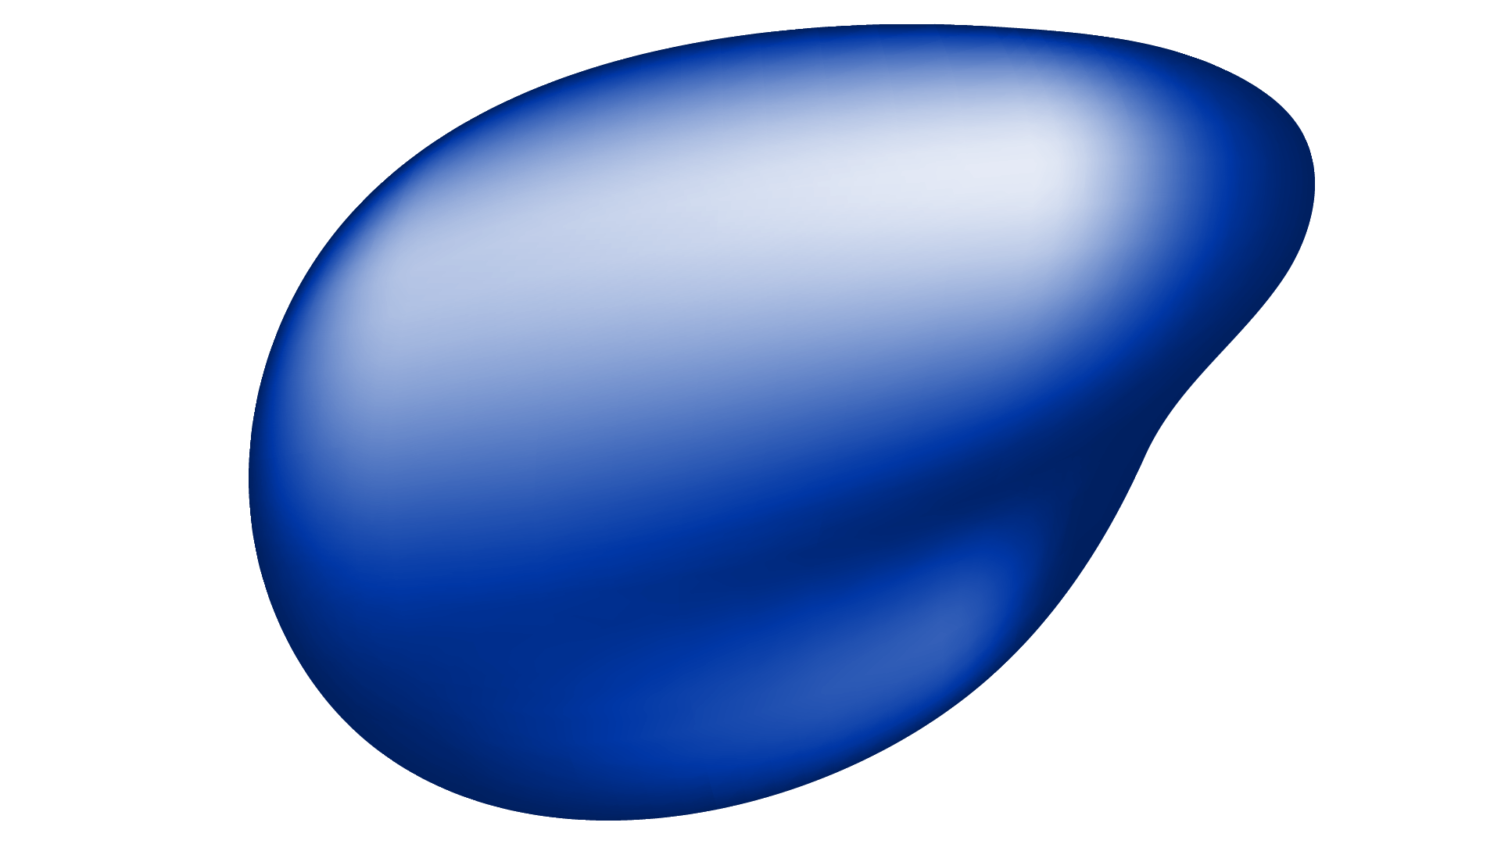
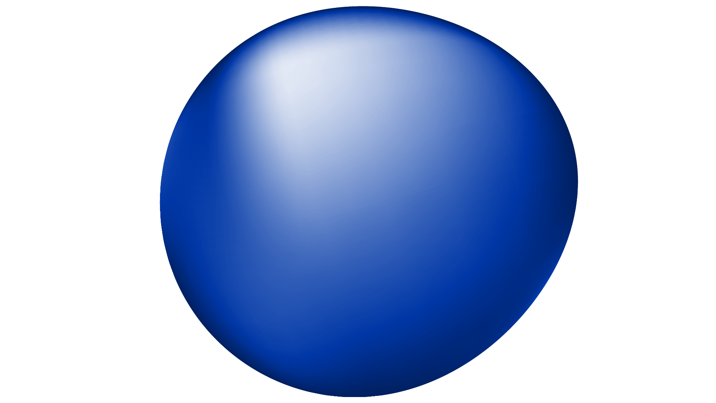
Problem Statement
Lack of Real‑World Ground Truth
Artifact Removal
overlapping noise sources—such as eye blinks, muscle activity, and other artifacts—can severely distort the true brain signals.
Low-pass filters - attenuate genuine high‑gamma oscillations
ICA - needs manual identification of artifact components
Beamforming - knowledge of spatial artifact sources
Deep learning methods require reliable labels
Synthetic data provides ground truth but lacks clinical realism
No true clean signal
Notes:
Artifact removal problem: in EEG is challenging because overlapping noise sources—such as eye blinks, muscle activity, and other artifacts—can severely distort the true brain signals.
Traditional methods (band-pass filtering, regression, ICA) either lose important high‑frequency brain signals or require extensive manual intervention or prior knowledge.
Lack of Real‑World Ground Truth: Deep learning models (CNNs, RNNs, EEGANet,) promising alternative for EEG artifact removal by leveraging its ability to model complex, non-linear relationships in data. however the majority of these models rely on synthetic or controlled datasets, which restricts their ability to generalize to real-world clinical EEG scenarios.

Slide 4
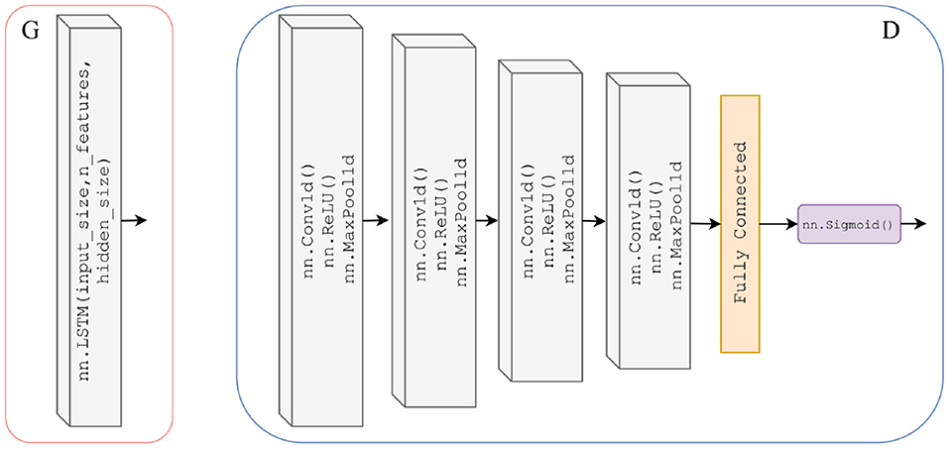
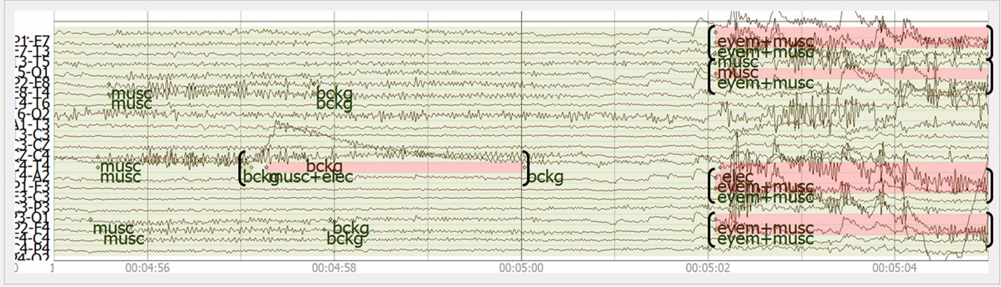
Solution
LSTM‑GAN
TUAR Dataset
Generator (denoiser) - learns artifact
Discriminator - distinguishes denoised vs. real clean EEG
LSTM layer - captures temporal dynamics of EEG
310 bipolar EEG files each with 20-21 channels
Duration - 99.98 hrs, avg 19.35 mins/each
10 types of artifact annotation -
ex. musc, eyem, chew, shiv, elec, ect.
Latent vectors
Codebook
Fig2. TUAR signal
Fig1. LSTM‑GAN Architecture
Notes:
Our solution uses a LSTM‑GAN that learns to predict and subtract artifacts from EEG recordings while preserving true brain signals.
Generator (Denoiser): In the network, the input is the noisy EEG signal, and the generator produces an estimate of the artifact; subtracting this estimate from the noisy input yields the denoised (clean) EEG signal.In other words, it learns the mapping:
Clean EEG ≈ Noisy EEG − Generator(Noisy EEG)
Discriminator: The discriminator is a CNN that aims to distinguish between true clean EEG signals and the denoised outputs generated by the model. Its adversarial loss pressures the generator to produce outputs that are statistically similar to real clean EEG, thereby further refining the quality of the cleaned signals.
The TUAR dataset, with its realistic clinical annotations, provides the essential ground truth for effective training.

Slide 5
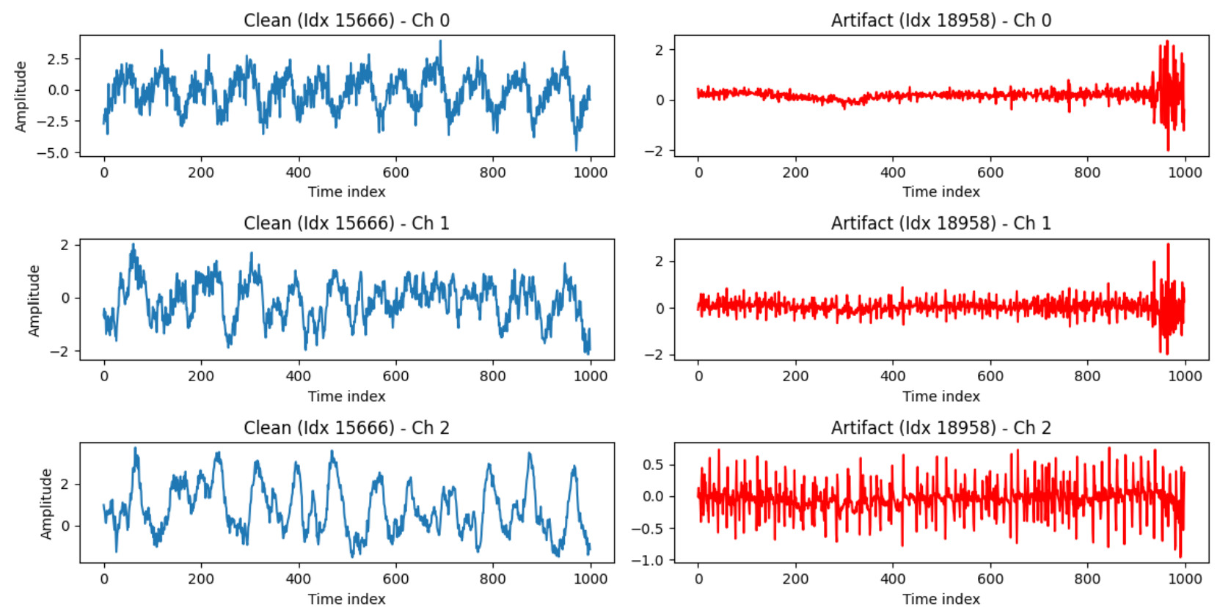
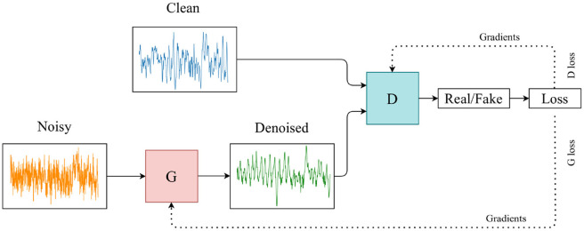
Experiment
Preprocessing
Read .edf files by reference to bipolar montage
Segment into 4 s windows
Artifact Masking
Use annotation labels to identify artifact vs. clean segments.
Data Pair Generation
Noisy EEG(ouput) ≈ Clean EEG(input) + Noisy EEG
Model Training
Train the LSTM-GAN on these noisy/clean pairs
Clean EEG ≈ Noisy EEG − Generator(Noisy EEG)
Losses - Adversarial loss (GAN) + reconstruction (MSE) loss for fidelity
[B,C, T
Notes:
experiment workflow.
All EEG recordings are imported with corresponding bipolar montage files. The data is then chopped into 4-second windows, and artifact annotations are used to separate out noisy segments.
To train the network, we simulate noisy EEG by linearly mixing clean EEG with real artifact recordings (a semi-synthetic approach)
The LSTM-GAN is then trained so that its generator learns to remove the added artifact, while the discriminator ensures the output still looks like genuine EEG.

Slide 6
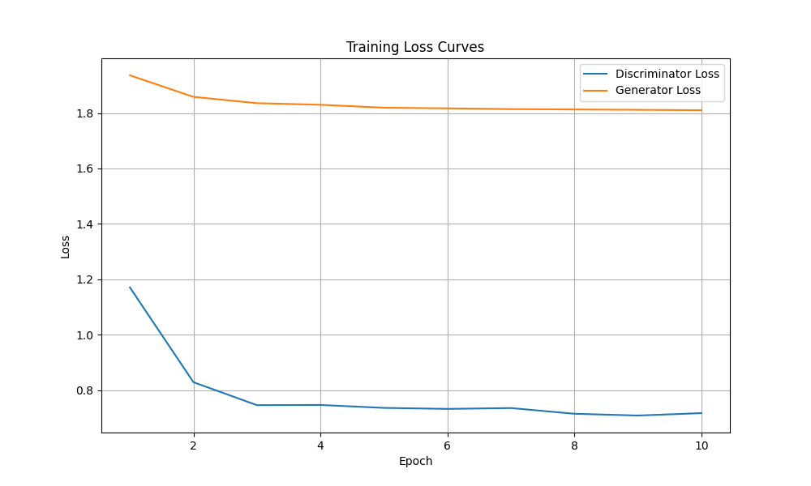
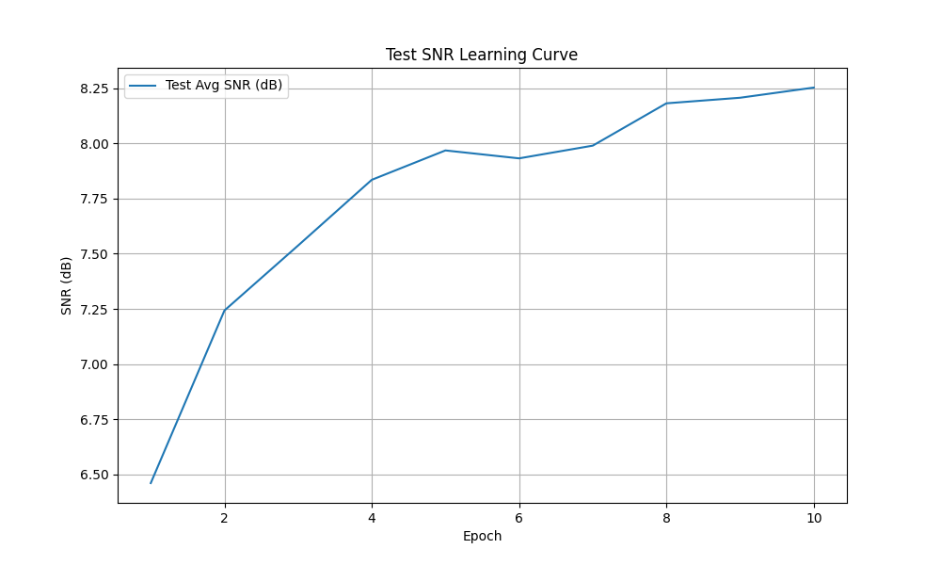
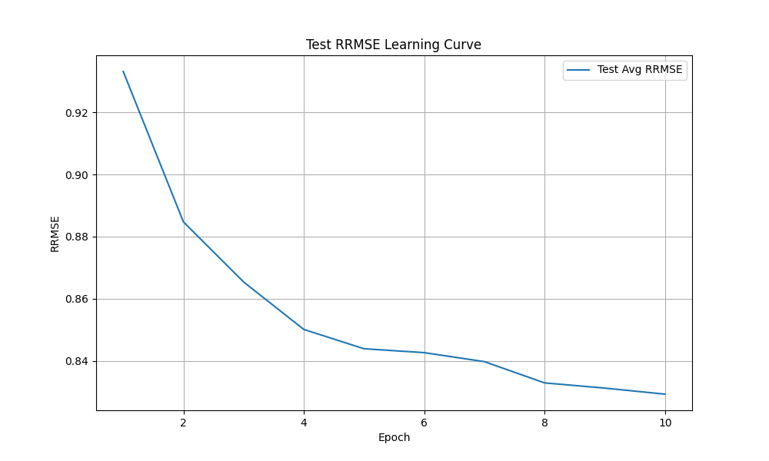
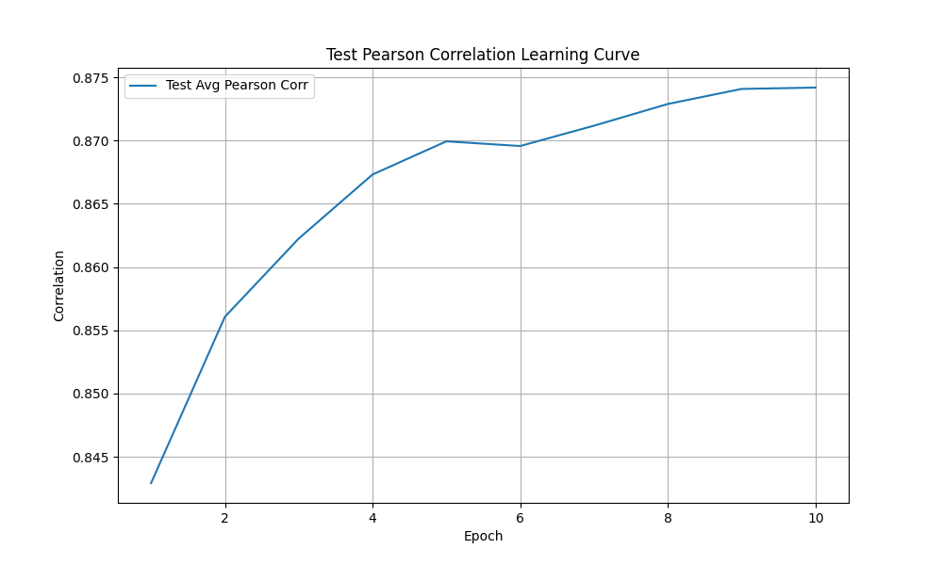
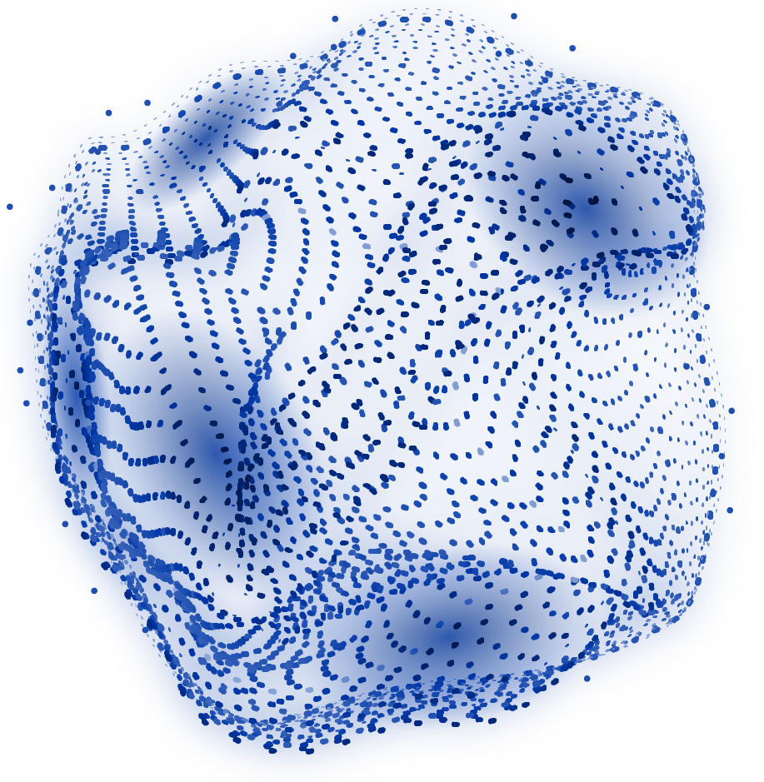
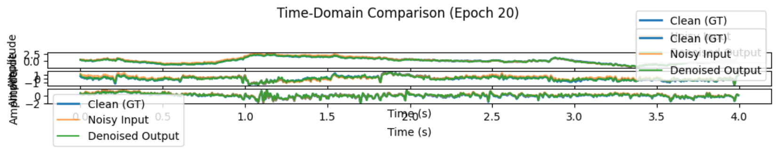
Result
Metrics
SNR increases - Avg SNR: 14.39 dB,
Std: 6.41, 95% CI: (14.20, 14.59)
RMSE decreases - Avg RMSE: 0.3174,
Std: 0.9321,, 95% CI:(0.29, 0.34)
Pearson correlation coefficient: 0.877
Paired t-test: t-stat = 43.04, p-value < 0.0001
Time‑Domain Comparison
Denoised signal (green) aligns with clean EEG (blue)
Artifact peaks are successfully removed
[8192, 64]
vector-quantized patches
Notes:
SNR the cleaned EEG signal has significantly more signal power than noise, indicating effective artifact removal.
High Std: Some may have much stronger improvement, while others may still retain artifacts.
The low Avg RMSE suggests that the denoised EEG is close to the clean reference, meaning strong performance.
Strong Positive Correlation → The denoised EEG signal is highly similar to the original clean EEG signal.The model preserved essential features → While artifacts were removed, the fundamental EEG structure remained intact.Minor differences remain → Since the value isn’t exactly 1, there are slight variations between the clean and denoised signals, but they still align well.
The high t-stat suggests that the difference between the paired samples (noisy vs. denoised EEG) is large and consistent
the p-value is very small, it confirms that this difference is unlikely due to random chance, meaning that the model significantly alters the signals.

Slide 7
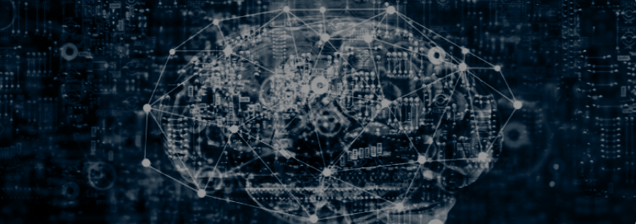
Conclusion:
Future Improvements:
LSTM‑GAN effectively removes real-world artifacts while preserving EEG content.
TUAR’s high-quality annotations enable semi‑supervised training on clinical data.
Results demonstrate substantial SNR gains and minimal distortion of true EEG.
Performance variability need further refining the network architecture and data augmentation strategies.
Integrating complementary artifact removal techniques (like adaptive filters) with our deep model to capture edge cases.
Notes:
In conclusion, our approach using the LSTM‑GAN and the TUAR dataset provides an effective solution to challenging artifact removal. The model not only boosts SNR and reduces error but also retains crucial EEG features, demonstrating its potential for clinical applications.
performance variability need further refining the network architecture and data augmentation strategies.

Slide 8
Reference
Brophy, C., Smith, H., & Zhao, L. (2022). An lstm-based generative adversarial network for eeg artifact removal. Frontiers in Neuroscience, 16, 812345.
Chen, J., & Wang, Z. (2017). Improvement of signal-to-noise ratio in biomedical signals: Theory and practice. Biomedical Signal Processing and Control, 30, 123–135. Corpus, T. (2023). Clinical eeg dataset with artifact annotations. https://tuar-corpus.org. (Accessed: March 22, 2025)
Dong, F., Li, M., & Chen, H. (2023). Wasserstein gan for stabilized artifact removal in eeg data. Journal of Neural Engineering, 20(1), 012345.
Fatourechi, M., Bashashati, A., Ward, R. K., & Birch, G. E. (2007). A review of eeg artifact detection and removal techniques. Journal of Neural Engineering, 4(3), R13–R29.
Gao, Z., Wang, X., & Zhang, Y. (2021). Dual-pathway cnn-lstm model for eeg artifact removal. IEEE Transactions on Neural Systems and Rehabilitation Engineering, 29, 1245–1254.
Jurcak, V., Tsuzuki, D., & Dan, I. (2007). 10/20, 10/10, and 10/5 systems revisited: Their validity as relative head-surface-based positioning systems. NeuroImage, 34(4), 1600–1611.
Liu, Y., Zhang, W., & Xu, J. (2021). Deep learning for eeg artifact detection and removal: A review. Journal of Biomedical Engineering, 18(2), 123–145.
Sawangjai, P., Kiatamornrak, T., & Wongsawat, Y. (2021). Eeganet: A gan-based framework for ocular artifact removal in eeg data. Biomedical Signal Processing and Control, 63, 102123.

Slide 9
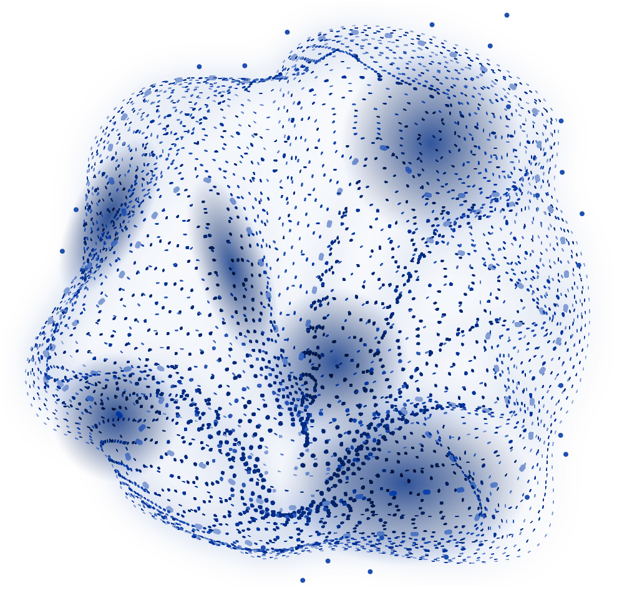
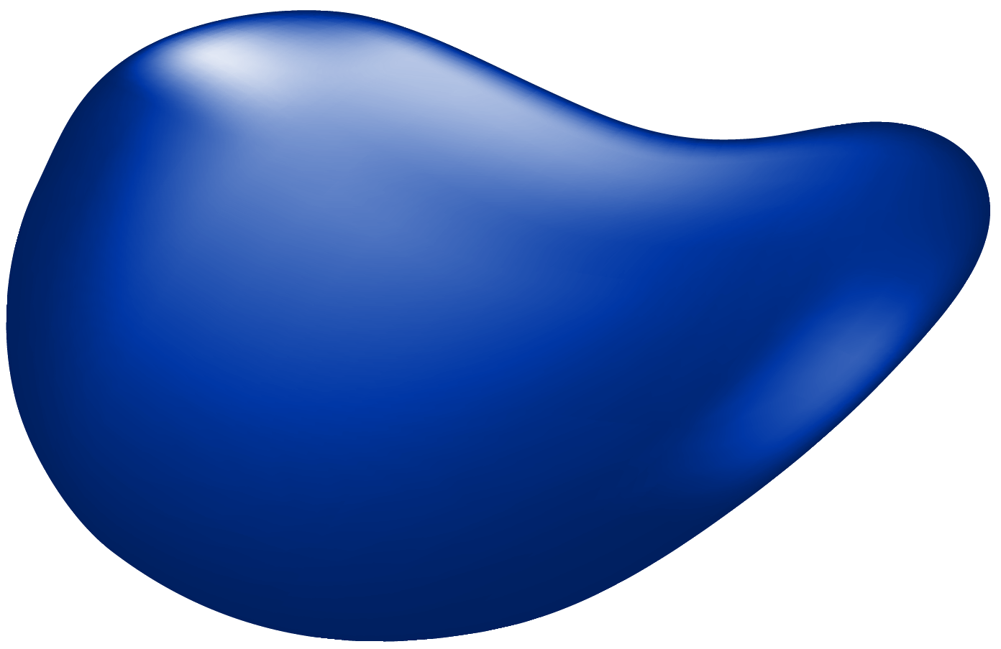
Thank you
You can enter a subtitle here if you need it

