Slide 1
Leveraging Generative AI for Intelligent Source Code Analysis and Vulnerability Detection
KEERTHANA L
DA2232306010039

Slide 2

Leveraging Generative AI for Intelligent Source Code Analysis and Vulnerability Detection
Importance of software in industries: Healthcare, finance, entertainment, etc.
Challenges: Complex codebases, evolving cyber threats
Traditional methods: Manual reviews, static analysis
Need for intelligent, automated solutions: To enhance software security and efficiency
Photo by Jefferson Santos on Unsplash

Slide 3
Introduction
The growing complexity of codebases and the relentless evolution of cyber threats necessitate the development of more sophisticated and efficient methods for safeguarding software security. Traditional approaches to source code analysis, often relying on manual code reviews and static analysis tools, can be time-consuming, labor-intensive, and may not always be comprehensive enough to catch subtle vulnerabilities. As software development cycles become increasingly rapid, there's a growing need for automated and intelligent solutions to identify and address potential issues within the code itself.
This project delves into the exciting potential of available generative AI models to automate and augment the process of source code analysis. Generative AI models are a class of machine learning algorithms trained on massive amounts of text data, enabling them to generate human-quality text, translate languages, write different kinds of creative content, and answer your questions in an informative way. By leveraging these capabilities, we can empower generative AI models to analyze source code, identify potential security vulnerabilities, assess code quality, and even suggest improvements and refactorings. This has the potential to revolutionize the way developers approach code security and quality assurance, enabling them to build more secure and reliable software applications in a shorter time frame.

Slide 4
EXISTING SYSTEM
The current system lacks a centralized platform for managing software development projects effectively. Development teams often rely on disparate tools and manual processes for project planning, task tracking, code collaboration, and issue management, leading to inefficiencies and coordination challenges. Communication gaps and version control issues are common, hindering collaboration and slowing down the development cycle. Additionally, the absence of automated analysis tools results in a reactive approach to identifying and addressing code quality issues and vulnerabilities, increasing the risk of defects and security breaches.

Slide 5
PROPOSED SYSTEM
The proposed system aims to address the shortcomings of the existing system by introducing a comprehensive software development platform that integrates project management, version control, code collaboration, and automated analysis tools. The system will provide a centralized repository for storing code, documents, and project artifacts, facilitating seamless collaboration and version control across distributed development teams. Automated code analysis tools will enable proactive identification of code quality issues, security vulnerabilities, and performance bottlenecks, empowering developers to address them early in the development process. Real-time communication features and task tracking capabilities will enhance team collaboration and project visibility, streamlining the development workflow and accelerating delivery.

Slide 6

Project Overview
Objective: Leveraging Generative AI for source code analysis and vulnerability detection
Tools and Technologies Used: Python for Proof of Concept (POC)
Photo by Hitesh Choudhary on Unsplash

Slide 7

Generative AI Models
Explanation of Generative AI Models: Machine learning algorithms trained on massive text data.
Applications: Text generation, translation, content creation.
Potential in Source Code Analysis: Identifying vulnerabilities, assessing code quality, suggesting improvements.
Photo by Sigita Danil on Unsplash

Slide 8
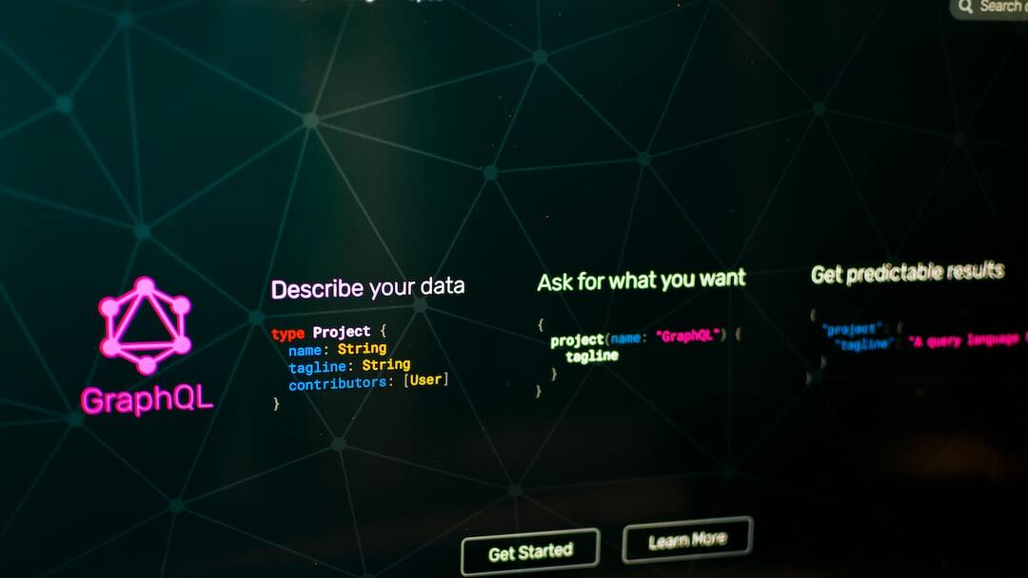
Methodology
Using ChatGPT for Code Analysis: Leveraging ChatGPT for initial source code analysis.
Training Generative AI Models: On source code data.
Techniques for Identifying Vulnerabilities: Utilizing advanced machine learning methods.
Code Quality Assessment: Providing suggestions for improvements and refactoring.
Photo by Pankaj Patel on Unsplash

Slide 9
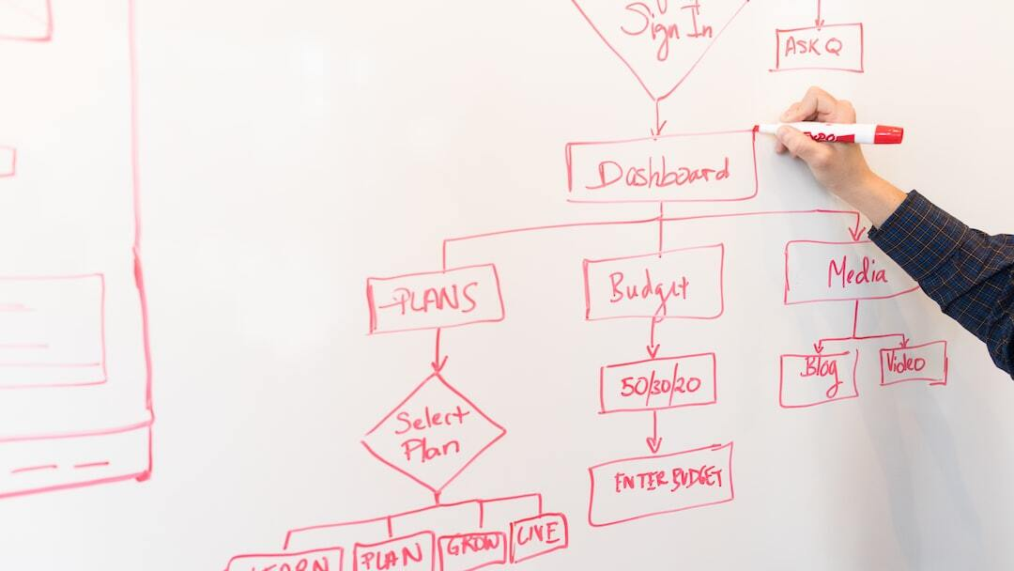
Implementation
Steps in Development of POC: From planning to deployment.
Key Features and Functionalities: Highlighting the core capabilities of the system.
Example of Code Analysis: Demonstrating vulnerability detection.
Photo by Christina @ wocintechchat.com on Unsplash

Slide 10
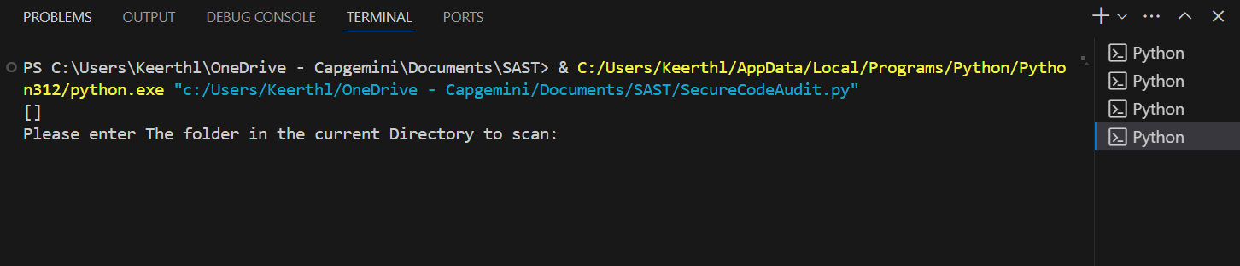
OUTPUTS:

Slide 11
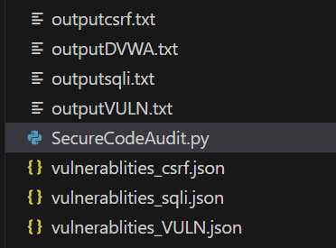
The Vulnerabilities are identified in JSON file.
The detailed Analysis is displayed on the Output texts.

Slide 12

Results
Performance of Generative AI Model: In identifying vulnerabilities.
Comparison with Traditional Methods: Efficiency and accuracy metrics.
Case Studies or Examples: Real-world applications and outcomes.
Photo by Iyus sugiharto on Unsplash

Slide 13
Thank-you

