Slide 1
SpaceX Falcon 9 First Stage Landing Prediction
Data Science Capstone Project Report
Author: Itzraj786iul
Date: July 24th, 2026
GitHub Repository URL: https://github.com/Itzraj786iul/Spacex_Project
Contains all completed notebooks and Python files

Slide 2
GitHub Repository Including All Completed Notebooks and Python Files
Repository URL: https://github.com/Itzraj786iul/Spacex_Project
Completed notebooks and Python files in this repository:
1. 01-data-collection-api.ipynb - SpaceX REST API data collection
2. 01-data-collection-webscraping.ipynb - Wikipedia web scraping
3. 01-data-wrangling.ipynb - data wrangling and Class labels
4. 02-eda-sql.ipynb - EDA with SQL queries
5. 02-eda-dataviz.ipynb - EDA with data visualization
6. 03-folium-map.ipynb - interactive Folium maps
7. 03-dash-app.py - Plotly Dash dashboard application
8. 04-predictive-models.ipynb - classification predictive analysis
This PDF is the final presentation: Data Science Capstone Project Report.pdf
GitHub: https://github.com/Itzraj786iul/Spacex_Project
2

Slide 3
Executive Summary
Summary of methodologies:
- Data collection via SpaceX REST API and Wikipedia web scraping
- Data wrangling to create binary Class labels for landing success/failure
- Exploratory data analysis with SQL (SQLite) and Seaborn visualizations
- Interactive visual analytics with Folium maps and Plotly Dash
- Predictive analysis using Logistic Regression, SVM, Decision Tree, and KNN
Summary of all results:
- Success rate improved over time across launch factors
- KSC LC-39A has the highest launch success rate of all sites
- ES-L1, SSO, HEO, and GEO orbits show the highest success rates
- Heavier payloads had higher early failure rates, improving later
- DecisionTreeClassifier is the most accurate predictive model
GitHub: https://github.com/Itzraj786iul/Spacex_Project
3

Slide 4
Introduction
Project background and context:
- SpaceX Falcon 9 launches cost about $62 million versus $165 million+ for others
- Much of the savings comes from reusing the first stage after a successful landing
- Predicting first-stage landing success helps estimate true launch cost
- This information supports competitive bidding against SpaceX
Problems we want to find answers:
1. Which features predict successful Falcon 9 first-stage landing?
2. Which launch sites and orbits have the best success rates?
3. How do payload mass and yearly trends affect landing outcomes?
4. What geographic patterns exist around launch sites?
5. Which classification model best predicts landing success?
GitHub: https://github.com/Itzraj786iul/Spacex_Project
4

Slide 5
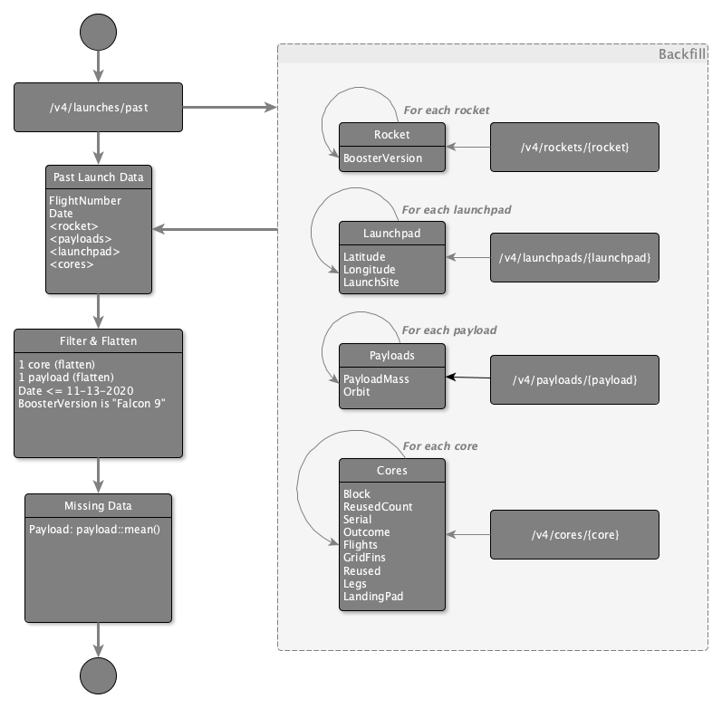
Data Collection Methodology
How data sets were collected:
- SpaceX REST API: GET /v4/launches/past and enrich with rockets, pads,
payloads, and cores endpoints
- Parse JSON into a Pandas dataframe and keep Falcon 9 launches
- Wikipedia web scraping with BeautifulSoup for Falcon 9/Heavy tables
- Convert scraped HTML tables into a structured Pandas DataFrame
Why both sources: API provides structured flight records; scraping adds
historical tabular launch details for validation and enrichment.
Notebooks: https://github.com/Itzraj786iul/Spacex_Project/blob/main/01-data-collection-api.ipynb
and https://github.com/Itzraj786iul/Spacex_Project/blob/main/01-data-collection-webscraping.ipynb
GitHub: https://github.com/Itzraj786iul/Spacex_Project
5

Slide 6
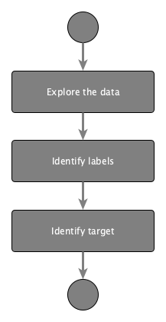
Data Wrangling Methodology
How data were processed:
- Identified missing values and column types (numeric vs categorical)
- Calculated launches per Launch Site and Orbit distributions
- Grouped landing outcomes into binary success/failure
- Created Class label: 1 = successful landing, 0 = failure
- Prepared the labeled dataset for EDA and supervised learning
Result: a clean training-ready table with outcome labels.
Notebook: https://github.com/Itzraj786iul/Spacex_Project/blob/main/01-data-wrangling.ipynb
GitHub: https://github.com/Itzraj786iul/Spacex_Project
6

Slide 7
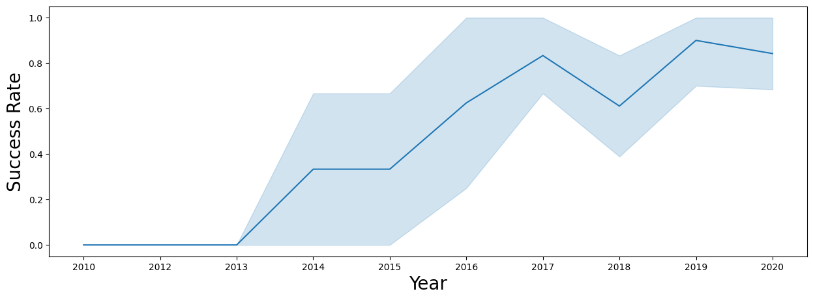
EDA and Data Visualization Methodology
Charts plotted and why:
- Flight Number vs Launch Site: success improves with experience
- Payload vs Launch Site: payload patterns differ by site
- Success Rate vs Orbit Type: compare orbit reliability
- Flight Number / Payload vs Orbit: interaction effects
- Yearly success trend: long-term operational improvement
- One-hot / dummy encoding prepared categorical features for ML
Notebook: https://github.com/Itzraj786iul/Spacex_Project/blob/main/02-eda-dataviz.ipynb
GitHub: https://github.com/Itzraj786iul/Spacex_Project
7

Slide 8
EDA with SQL Methodology
SQL queries performed (SQLite):
1. Unique launch site names
2. Five records where launch site begins with CCA
3. Total payload mass for NASA (CRS)
4. Average payload mass for F9 v1.1
5. First successful ground-pad landing date
6. Successful drone-ship landings with payload 4000-6000 kg
7. Counts of successful and failed mission outcomes
8. Booster versions that carried maximum payload
9. 2015 drone-ship failure records
10. Rank landing outcomes between 2010-06-04 and 2017-03-20
Notebook: https://github.com/Itzraj786iul/Spacex_Project/blob/main/02-eda-sql.ipynb
GitHub: https://github.com/Itzraj786iul/Spacex_Project
8

Slide 9
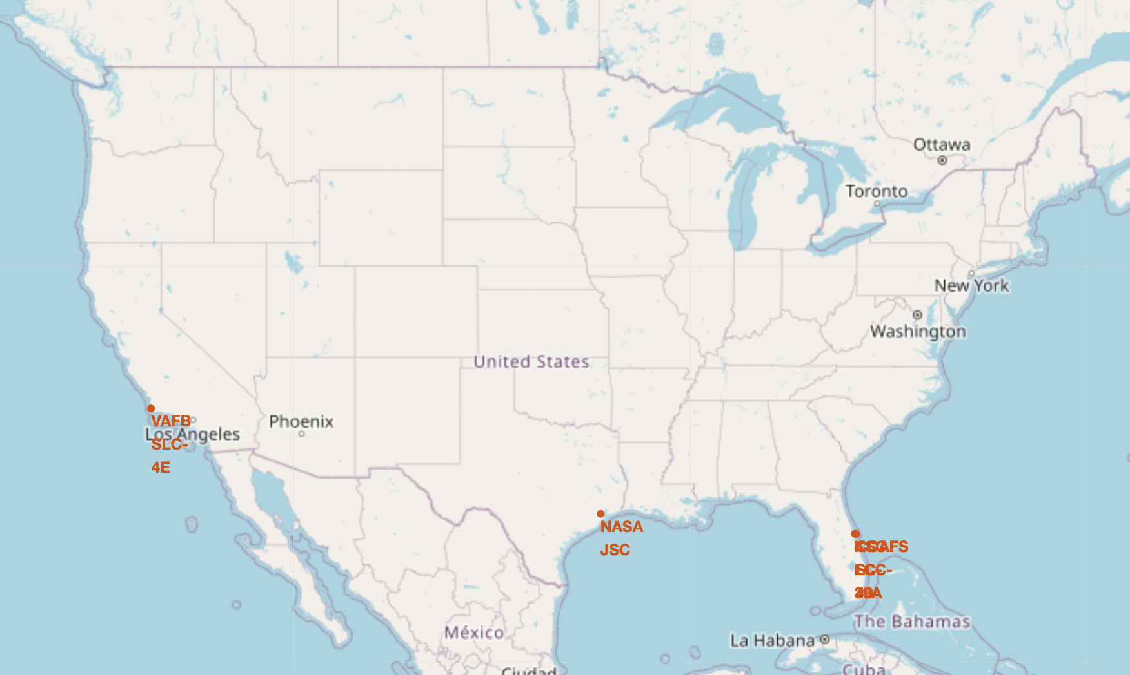
Interactive Map with Folium Methodology
Map objects created and why:
- Circles and Markers for every launch site location
- Green/red markers (and clusters) for success vs failure launches
- Distance markers and lines to railway, roadway, and coastline
Purpose: discover geographic patterns that influence site suitability
and relate location to landing outcomes.
Notebook: https://github.com/Itzraj786iul/Spacex_Project/blob/main/03-folium-map.ipynb
GitHub: https://github.com/Itzraj786iul/Spacex_Project
9

Slide 10
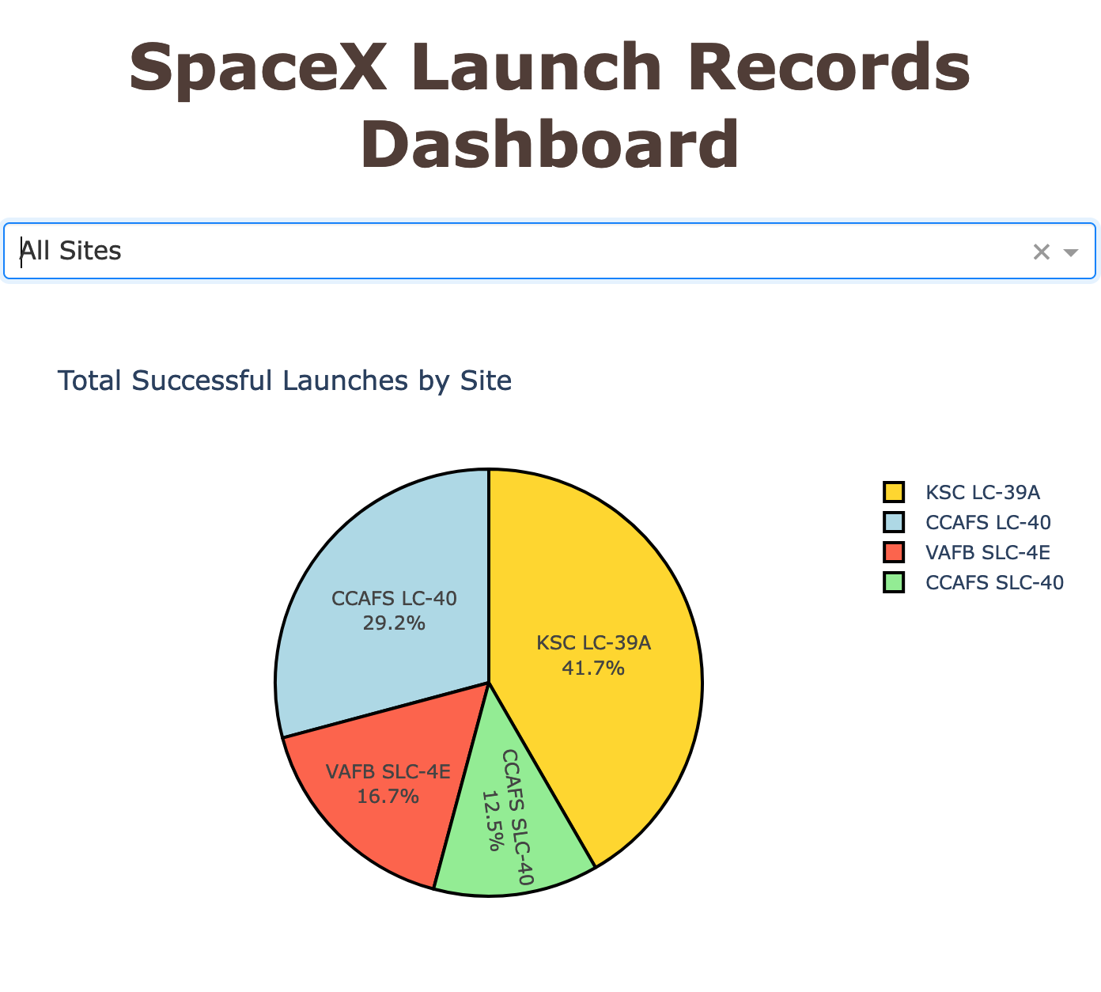
Plotly Dash Dashboard Methodology
Dashboard plots and interactions added:
- Dropdown to select All Sites or one launch site
- Pie chart of success counts / success-failure ratio
- Payload mass range slider
- Scatter plot of Payload vs Outcome by booster version
Why: interactive filtering compares sites and payload ranges quickly.
Python file: https://github.com/Itzraj786iul/Spacex_Project/blob/main/03-dash-app.py
GitHub: https://github.com/Itzraj786iul/Spacex_Project
10

Slide 11
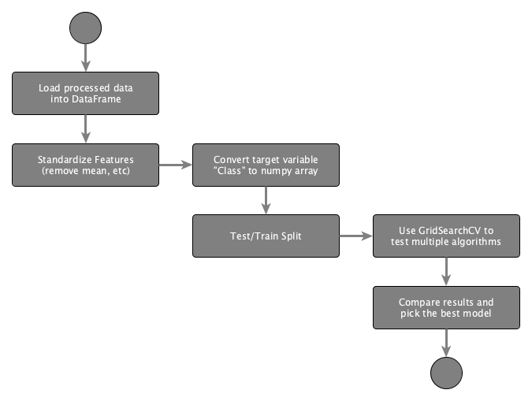
Predictive Analysis (Classification) Methodology
Model development process:
1. Standardize features with StandardScaler
2. Split train/test data (test_size=0.2, random_state=2)
3. Tune hyperparameters with GridSearchCV (cv=10)
4. Train Logistic Regression, SVM, Decision Tree, and KNN
5. Evaluate test accuracy and confusion matrices
6. Select the best performing classifier
Notebook: https://github.com/Itzraj786iul/Spacex_Project/blob/main/04-predictive-models.ipynb
GitHub: https://github.com/Itzraj786iul/Spacex_Project
11

Slide 12
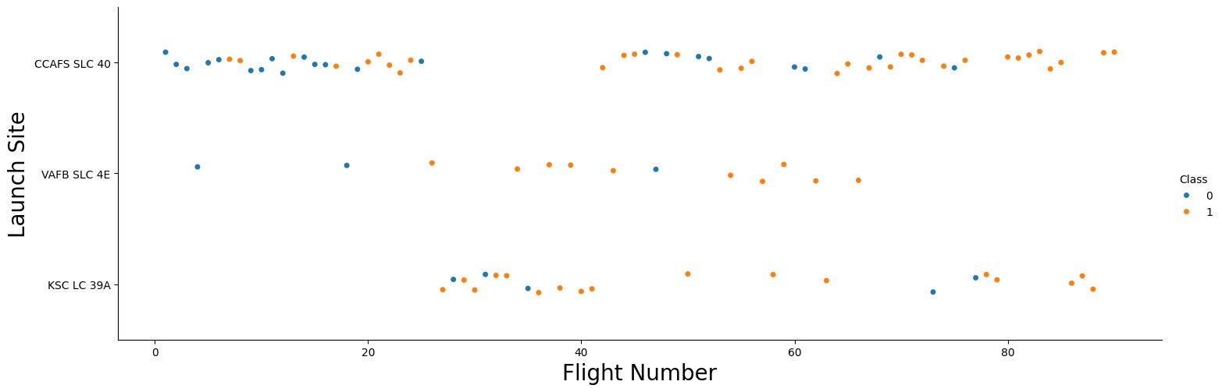
EDA with Visualization: Flight Number vs Launch Site
Scatter plot analysis:
- All sites show a mix of first-stage landing successes and failures
- Later flights generally show more successful landings
- Success improves as flight number increases
Explanation: operational experience over time improves landing success
at each launch site.
GitHub: https://github.com/Itzraj786iul/Spacex_Project
12

Slide 13
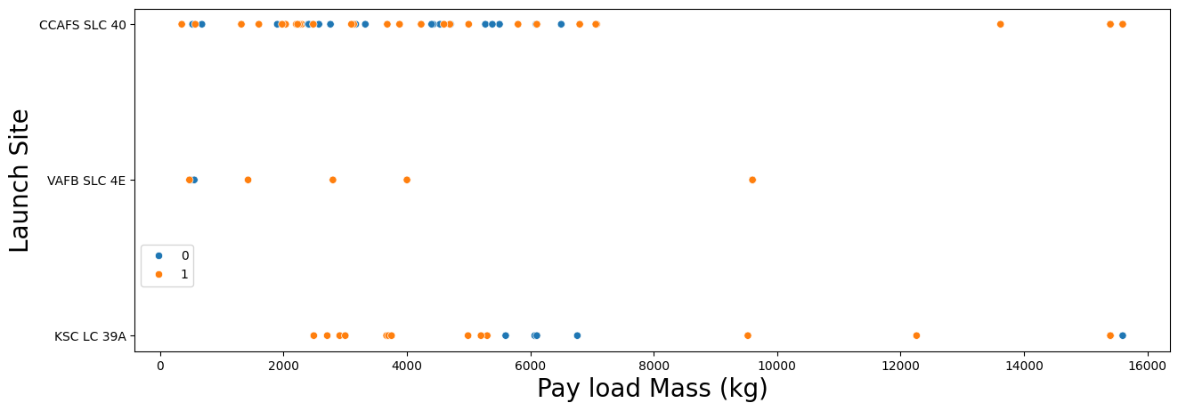
EDA with Visualization: Payload vs Launch Site
Scatter plot analysis:
- Different launch sites handle different payload profiles
- Payload mass distribution varies across CCAFS, KSC, and VAFB
- Site selection is related to mission/payload requirements
Explanation: launch site and payload mass jointly influence outcomes.
GitHub: https://github.com/Itzraj786iul/Spacex_Project
13

Slide 14
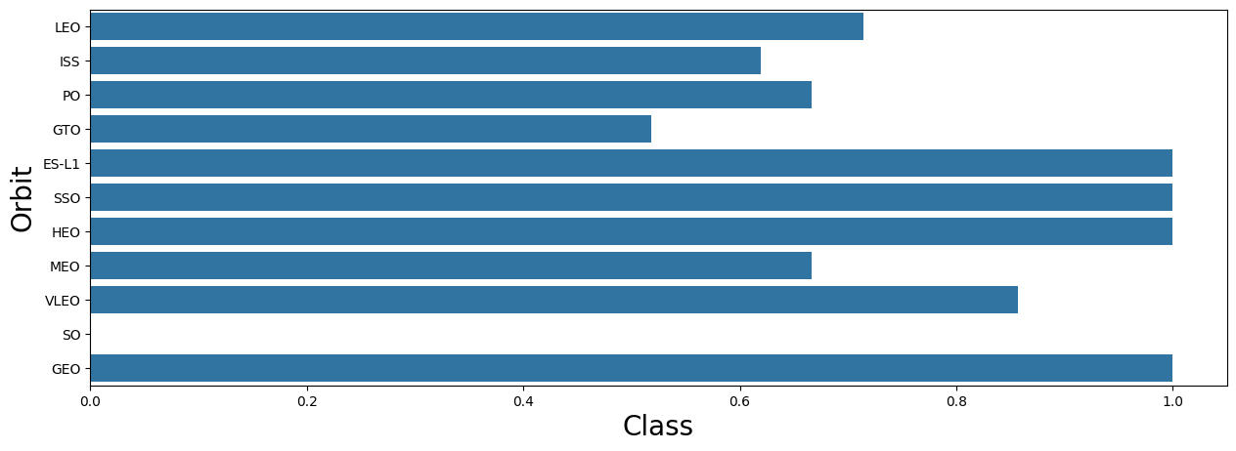
EDA with Visualization: Success Rate vs Orbit Type
Bar chart analysis:
- ES-L1, SSO, HEO, and GEO show the highest success rates
- Other orbits such as GTO show more mixed outcomes
- Orbit type is an important success-rate factor
Explanation: some orbit types are associated with more reliable recovery.
GitHub: https://github.com/Itzraj786iul/Spacex_Project
14

Slide 15
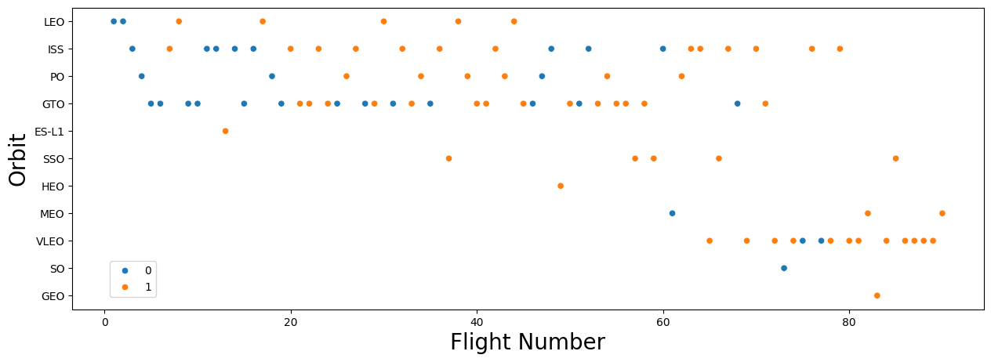
EDA with Visualization: Flight Number vs Orbit Type
Scatter plot analysis:
- Some orbits appear more frequently in later flights
- Successful landings increase for several orbits over time
- Learning effects appear across multiple orbit families
Explanation: program maturity improved outcomes across orbits.
GitHub: https://github.com/Itzraj786iul/Spacex_Project
15

Slide 16
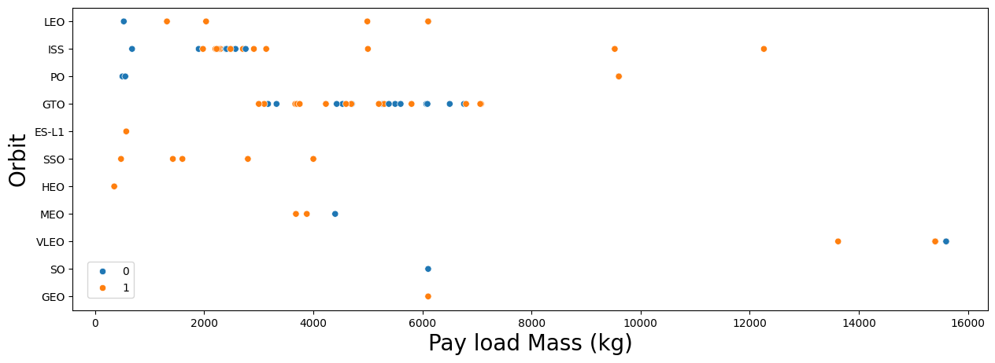
EDA with Visualization: Payload vs Orbit Type
Scatter plot analysis:
- GTO missions often carry heavier payloads with mixed outcomes
- Payload and orbit interact as predictors of landing success
- Heavy payloads on demanding orbits can reduce success probability
Explanation: payload-orbit combination is a key risk signal.
GitHub: https://github.com/Itzraj786iul/Spacex_Project
16

Slide 17
EDA with Visualization: Launch Success Yearly Trend
Line chart analysis:
- From 2016 onward, success rate improved year over year
- A minor setback appears around 2018, then recovery continues
- Recent years approach consistently high success
Explanation: Falcon 9 landing reliability improved with continuous
operational and technological advancements.
GitHub: https://github.com/Itzraj786iul/Spacex_Project
17

Slide 18
EDA with SQL Results: Launch Sites and CCA Records
Query 1 - Unique launch site names:
- CCAFS LC-40, CCAFS SLC-40, KSC LC-39A, VAFB SLC-4E
Query 2 - Five records where launch sites begin with CCA:
- Early CCAFS LC-40 flights from 2010-2013
- Outcomes include Failure (parachute) and No attempt
Explanation: SpaceX launches from Florida and California; early CCAFS
flights show recovery capability evolving over time.
GitHub: https://github.com/Itzraj786iul/Spacex_Project
18

Slide 19
EDA with SQL Results: Payload and First Ground Landing
Query 3 - Total payload mass for NASA (CRS): 45,596 kg
Query 4 - Average payload mass for F9 v1.1: 2,928.4 kg
Query 5 - First successful ground-pad landing date: 2015-12-22
Explanation:
- NASA CRS missions delivered a large cumulative payload mass
- F9 v1.1 carried moderate average payloads
- 2015-12-22 marks the first successful ground-pad landing milestone
GitHub: https://github.com/Itzraj786iul/Spacex_Project
19

Slide 20
EDA with SQL Results: Drone Ship, Outcomes, Max Payload
Query 6 - Successful drone-ship landing with payload 4000-6000 kg:
- F9 FT B1022, F9 FT B1026, F9 FT B1021.2, F9 FT B1031.2
Query 7 - Outcome counts show many successes and fewer failures
as the program matured (Success / Success drone ship / ground pad dominate later).
Query 8 - Maximum payload boosters are Block 5 versions
(F9 B5 B1048/B1049/B1051/B1056/B1058/B1060 family).
GitHub: https://github.com/Itzraj786iul/Spacex_Project
20

Slide 21
EDA with SQL Results: 2015 Failures and Ranked Outcomes
Query 9 - 2015 drone-ship failure records:
- January 2015 | F9 v1.1 B1012 | CCAFS LC-40
- April 2015 | F9 v1.1 B1015 | CCAFS LC-40
Query 10 - Ranked landing outcomes (2010-06-04 to 2017-03-20):
- No attempt is most frequent in this early window
- Success (drone ship) and Failure (drone ship) appear next
- Then Success (ground pad) and ocean-controlled outcomes
Explanation: early years include many no-attempt flights before reuse matured.
GitHub: https://github.com/Itzraj786iul/Spacex_Project
21

Slide 22
Folium Map Results: Launch Site Locations
Folium map screenshot explanation:
- All launch sites are marked near coastal regions
- Florida: CCAFS LC-40, CCAFS SLC-40, KSC LC-39A
- California: VAFB SLC-4E
Important findings:
- Launch sites are in close proximity to the coast
- Launch sites are relatively close to the equator
- Coastal placement supports safer over-water trajectories
GitHub: https://github.com/Itzraj786iul/Spacex_Project
22

Slide 23
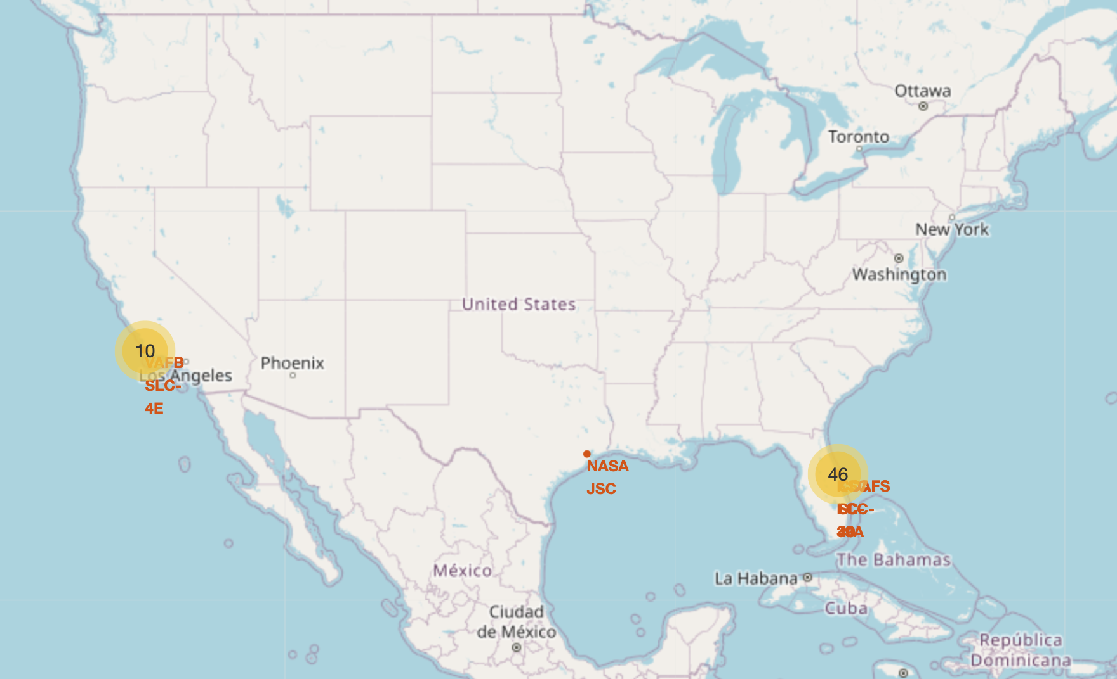
Folium Map Results: Color-Labeled Launch Outcomes
Folium map with success/failure markers:
- Green markers = successful landings
- Red markers = failed landings
- Marker clusters handle overlapping coordinates
Important findings:
- KSC LC-39A shows a high share of successful outcomes
- Color labels make high-performing sites easy to identify
- Outcome geography confirms site-level performance differences
GitHub: https://github.com/Itzraj786iul/Spacex_Project
23

Slide 24
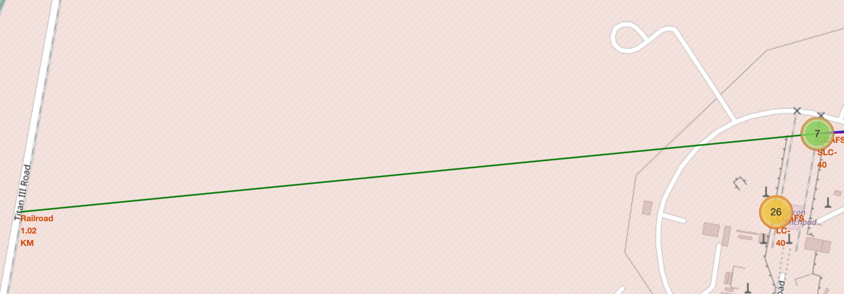
Folium Map Results: Distances to Proximities
Distance analysis on Folium map:
- Railway about 1.02 KM from launch site
- Roadway about 0.59 KM from launch site
- Coast about 0.86 KM from launch site
Important findings:
- Sites are close to transport links for logistics
- Sites are close to coastline for flight safety corridors
- Sites keep distance from dense cities for public safety
GitHub: https://github.com/Itzraj786iul/Spacex_Project
24

Slide 25
Plotly Dash Results: Success Count for All Sites
Dashboard pie chart for all sites:
- Shows successful landing distribution by launch site
- KSC LC-39A experienced the highest proportion of successful landings
Important findings:
- Site mix is uneven; Florida sites dominate volume
- Choosing high-performing sites improves expected success
App: https://github.com/Itzraj786iul/Spacex_Project/blob/main/03-dash-app.py
GitHub: https://github.com/Itzraj786iul/Spacex_Project
25

Slide 26
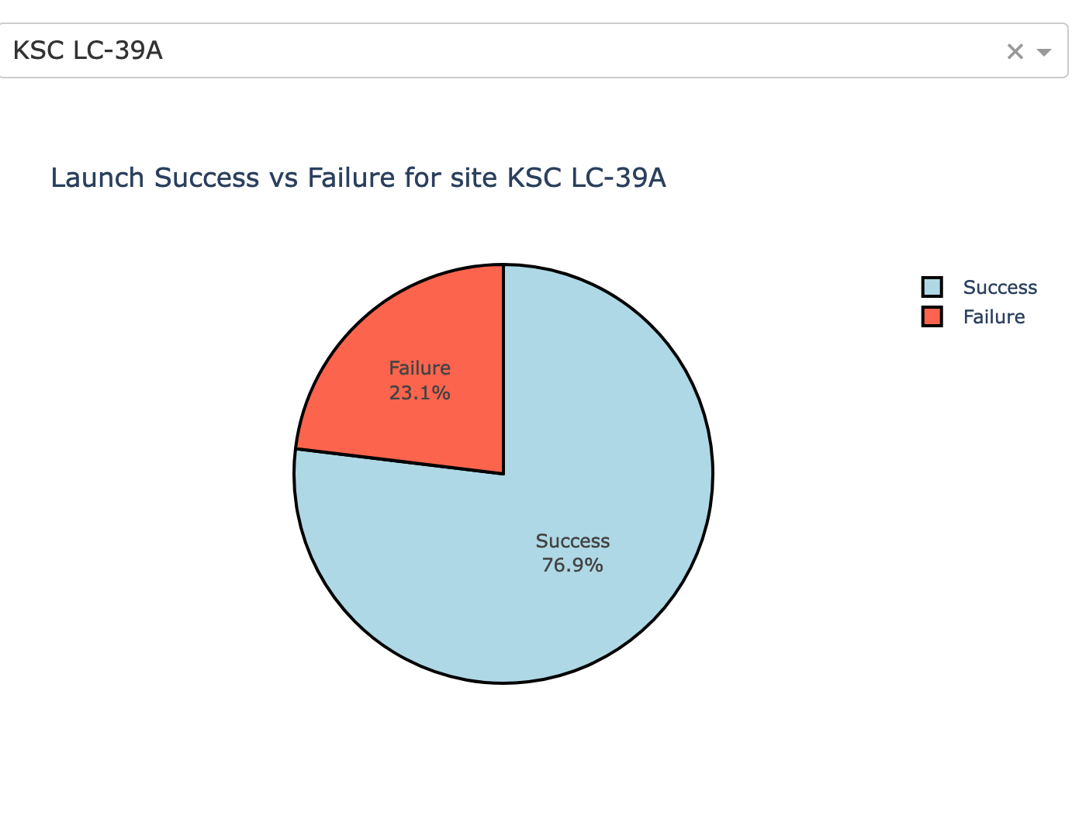
Plotly Dash Results: Highest Success Ratio Site
Dashboard pie chart for best site:
- KSC LC-39A had the highest ratio of successful landings
- Success vs Failure comparison for the selected site
Important findings:
- KSC LC-39A is the strongest site by success ratio
- Interactive site filtering confirms this consistently
GitHub: https://github.com/Itzraj786iul/Spacex_Project
26

Slide 27
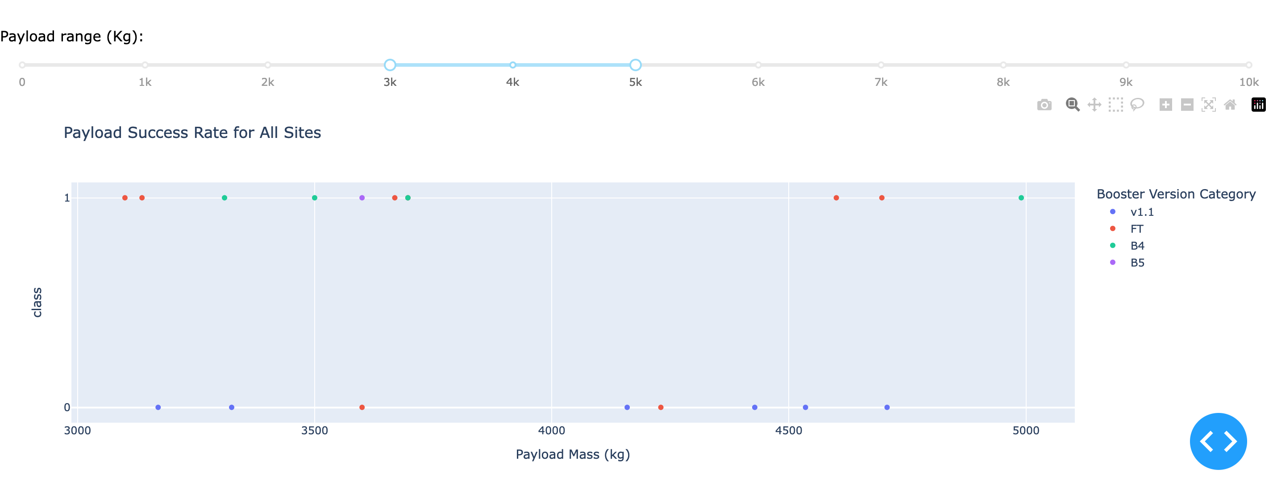
Plotly Dash Results: Payload vs Launch Outcome
Dashboard scatter with payload range slider:
- With payload mass between 3,000kg and 5,000kg, booster performance
patterns become visible by version category
- Mid payload ranges often show stronger landing success
Important findings:
- Payload mass is a key interactive factor
- Booster version category helps explain outcome clusters
GitHub: https://github.com/Itzraj786iul/Spacex_Project
27

Slide 28
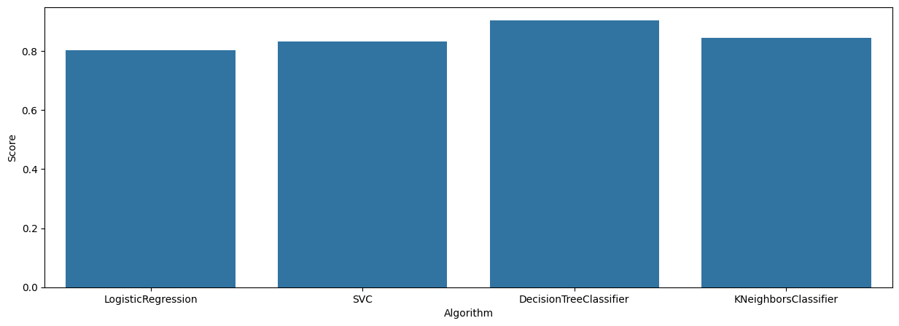
Predictive Analysis Results: Classification Accuracy
Model accuracy comparison after GridSearchCV:
- Logistic Regression: high accuracy (~0.85 validation)
- SVM: high accuracy (~0.85 validation)
- Decision Tree: highest accuracy (~0.875 validation)
- KNN: high accuracy (~0.85 validation)
Finding: DecisionTreeClassifier is the most accurate algorithm tested.
Bar chart on the right visualizes model comparison.
GitHub: https://github.com/Itzraj786iul/Spacex_Project
28

Slide 29
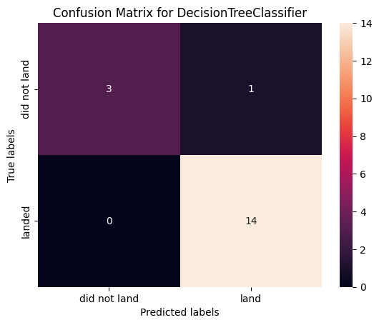
Predictive Analysis Results: Confusion Matrix
Confusion matrix of the best model (Decision Tree):
- Many observations correctly predicted as successful landings (true positives)
- Model distinguishes landed vs did-not-land classes effectively
- Remaining errors are limited on the hold-out test set
Explanation: tuned Decision Tree is selected as the final classifier
for Falcon 9 first-stage landing prediction.
GitHub: https://github.com/Itzraj786iul/Spacex_Project
29

Slide 30
Conclusion
1. DecisionTreeClassifier is the best predictive model in this project
2. Launch success rates increase over time across factors
3. KSC LC-39A has the highest success rate among launch sites
4. ES-L1, SSO, HEO, and GEO orbits show consistently high success
5. Launch sites are near the coast and relatively close to the equator
6. Lower/mid payload ranges often show better landing success
7. Folium and Plotly Dash make these insights interactive and actionable
Full project repository: https://github.com/Itzraj786iul/Spacex_Project
GitHub: https://github.com/Itzraj786iul/Spacex_Project
30

Slide 31
Creativity Applied Beyond the Template
Creativity included in this presentation:
- Clear navy-branded widescreen layout for readability
- Process flow visuals for API, scraping, wrangling, and ML
- Side-by-side explanation + chart layout on results slides
- Real Folium map screenshots and Dash dashboard screenshots
- Runnable Plotly Dash app committed as 03-dash-app.py
- GitHub URL placed on title, methodology, results, and conclusion slides
GitHub: https://github.com/Itzraj786iul/Spacex_Project
31

Slide 32
Innovative Insights
1. Multi-source consensus: SQL, charts, Folium, and Dash independently
identify KSC LC-39A as the top-performing site.
2. Payload-orbit risk cluster: heavy GTO-related payloads show mixed outcomes.
3. Block 5 operational edge: maximum-payload missions concentrate on B5 boosters.
4. Non-linear model advantage: Decision Tree outperforms LR/SVM/KNN,
suggesting threshold interactions among site, orbit, and payload.
5. Geography supports operations: coastal + near-equator siting matches both
safety corridors and observed high-success patterns.
GitHub: https://github.com/Itzraj786iul/Spacex_Project
32

Slide 33
Appendix
GitHub: https://github.com/Itzraj786iul/Spacex_Project
All completed notebooks and Python files are linked above and listed on slide 2.
Additional assets: spacex_launch_dash.csv, presentation PPTX/PDF.
How to run dashboard:
pip install dash pandas plotly
python 03-dash-app.py
GitHub: https://github.com/Itzraj786iul/Spacex_Project
33

