Slide 1
Weather Station with Wi-Fi Connection
Iulia-Olivia Cipleu
Group 30433

Slide 2
Project description
The aim of this project is to design a Home Weather Station, which transmits the measured values through Wi-Fi connection.
Temperature, humidity, luminosity and quantity of methane gas in air are measured and displayed on the online site.
Additionally, on the physical board, 3 colored LEDs are used to indicate in which interval the current temperature belongs. A buzzer will ring when the level on methane gas goes over the threshold.
From the app, the user can modify the interval for the temperatures and light a LED on the board.

Slide 3
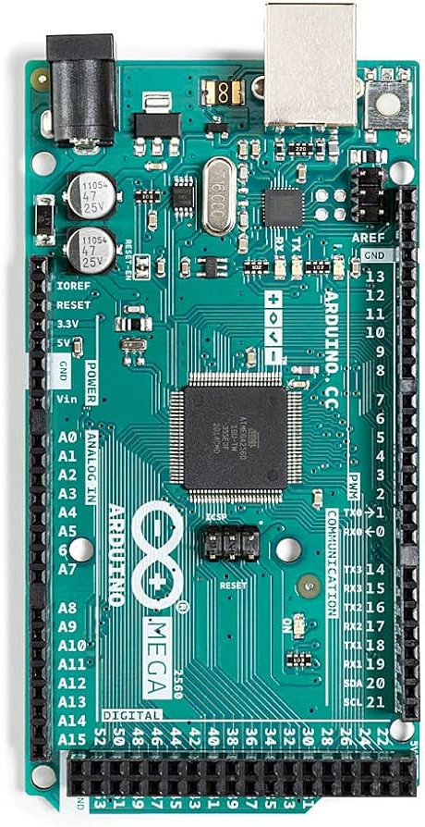
ARDUINO Mega 2560
In this project, the Arduino Mega 2560 serves as the main controller. Its expanded capabilities, including multiple digital and analog pins, are leveraged to interface with various sensors and actuators. The Mega's processing power handles data from the DHT22 sensor, MQ-4 gas sensor, and light sensor. Additionally, it manages the ESP8266-01 WiFi module, enabling wireless communication for remote monitoring and control. The Mega's ample resources make it well-suited for orchestrating diverse sensor inputs and facilitating the seamless integration of IoT functionalities in the weather station project.

Slide 4
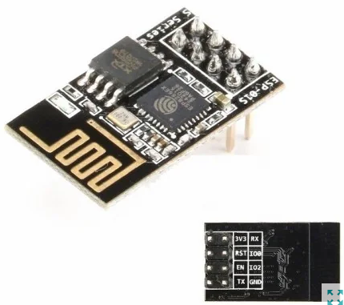
Wi-fi module esp8266 01
In this project, the ESP8266-01 Wi-Fi module is utilized to enable communication between the Arduino and other devices over a Wi-Fi network. The ESP8266-01 connects to the local Wi-Fi network, allowing the Arduino to serve as a web server. This setup enables remote access to the weather station data and control of connected devices through a web interface. The ESP8266-01 facilitates wireless communication, making the weather station accessible and configurable without physical connections, enhancing the project's flexibility and ease of use.

Slide 5
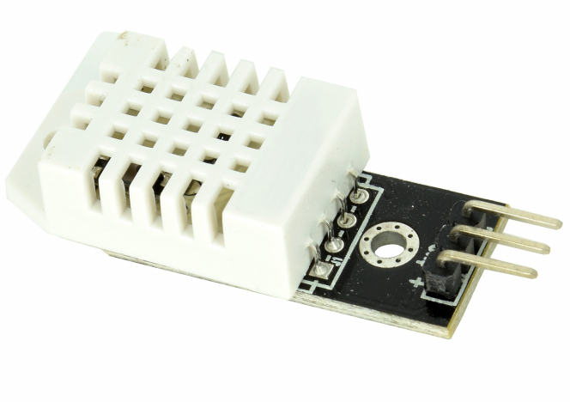
DHT22 sensor
The DHT22 sensor plays a crucial role in this project by measuring both temperature and humidity. Connected to the Arduino Mega 2560, the DHT22 provides accurate environmental data, enabling real-time monitoring of weather conditions. This information is then utilized to make decisions within the system, such as adjusting LED indicators based on temperature thresholds and displaying weather data on a web interface accessible through the ESP8266-01 Wi-Fi module. The DHT22 enhances the project's capabilities by providing essential meteorological data for a comprehensive weather station application.

Slide 6
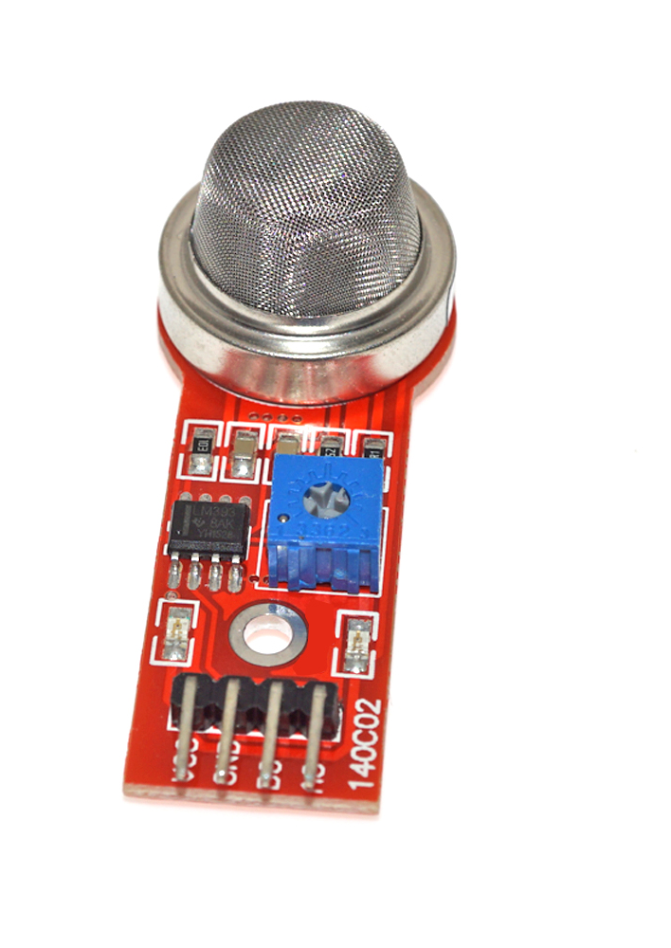
Mq-4 methane cng gas sensor
The MQ-4 gas sensor serves a key function in this project, detecting methane gas concentrations. Interfaced with the Arduino Mega 2560, the MQ-4 sensor provides analog output corresponding to the level of methane gas. The MQ-4 sensor is equipped with a potentiometer, allowing users to fine-tune sensitivity levels. The potentiometer adjustment enables customization of the sensor's response to varying concentrations of methane gas.
The system responds to these readings by activating a buzzer and adjusting LED indicators. This capability enhances the project's utility by incorporating a gas sensing element, making it suitable for applications where monitoring methane levels is essential, such as in safety or environmental monitoring systems.

Slide 7
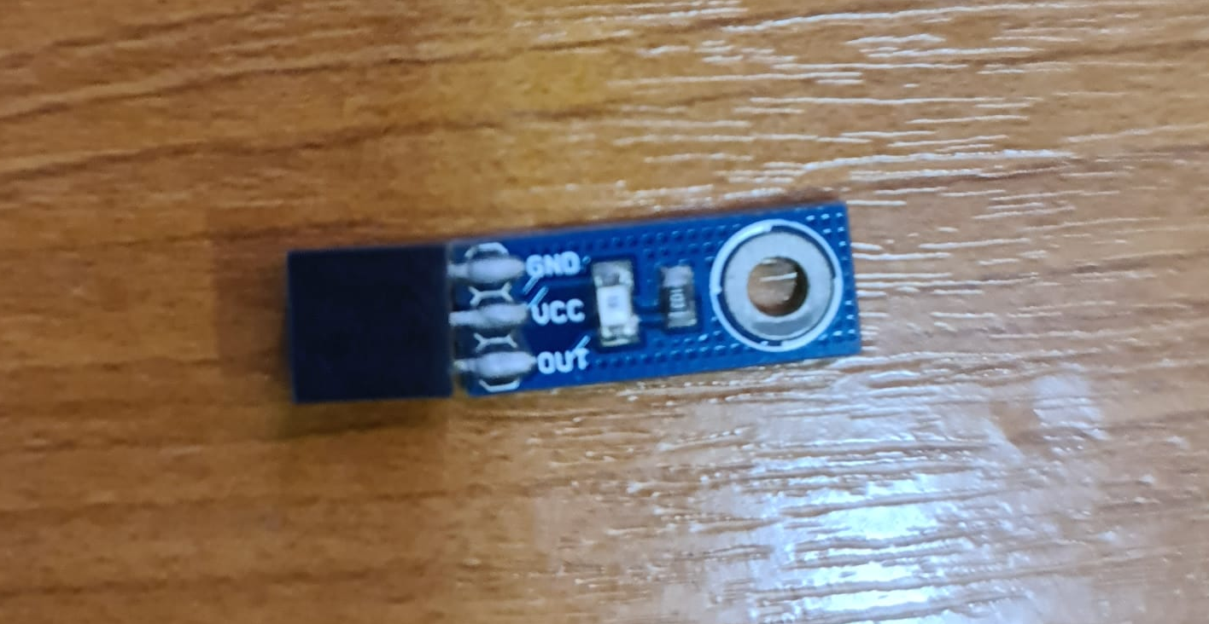
Light sensor
The light sensor in this project measures ambient light levels. By converting light intensity into electrical resistance, it provides a means to gauge luminosity. Integrated into the weather station, this sensor allows monitoring of environmental brightness. The analog output from the light sensor is utilized to assess the current light conditions, offering insights into the project's surroundings, and can be particularly useful for applications requiring adjustments based on varying light levels.

Slide 8
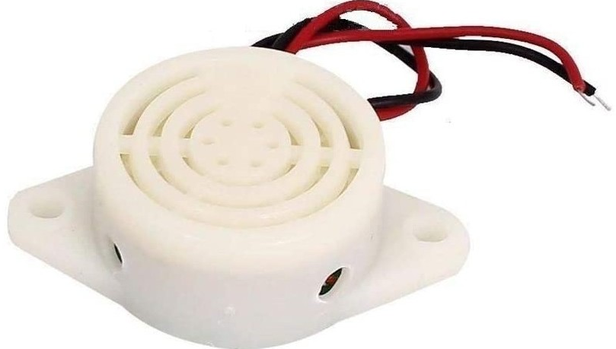
Buzzer
The buzzer in this project is employed as an audible indicator, often in conjunction with the MQ-4 gas sensor. When the methane gas concentration surpasses a certain threshold, the buzzer is activated, providing a sound alert. This feature enhances the safety aspect of the weather station, allowing users to be notified acoustically in case of elevated methane levels.

Slide 9

LED
LEDs (Light-Emitting Diodes) play a crucial role in this project by serving as visual indicators. Different colored LEDs, such as blue, green, and red, are employed to convey information about temperature conditions. The LEDs are controlled to illuminate in specific patterns or colors based on temperature thresholds, providing a quick and intuitive way to understand weather data. Additionally, an LED (built into the Arduino Mega 2560 board) acts as a general indicator, turning on or off based on commands received through the ESP8266 Wi-Fi module. Overall, LEDs enhance the user interface and make real-time data interpretation more accessible.

Slide 10
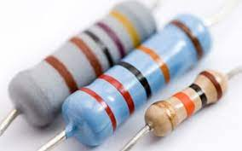
Resistor
Resistors are essential components in this project, serving various purposes. They are likely used in conjunction with LEDs to limit the current flowing through them, preventing damage.

Slide 11
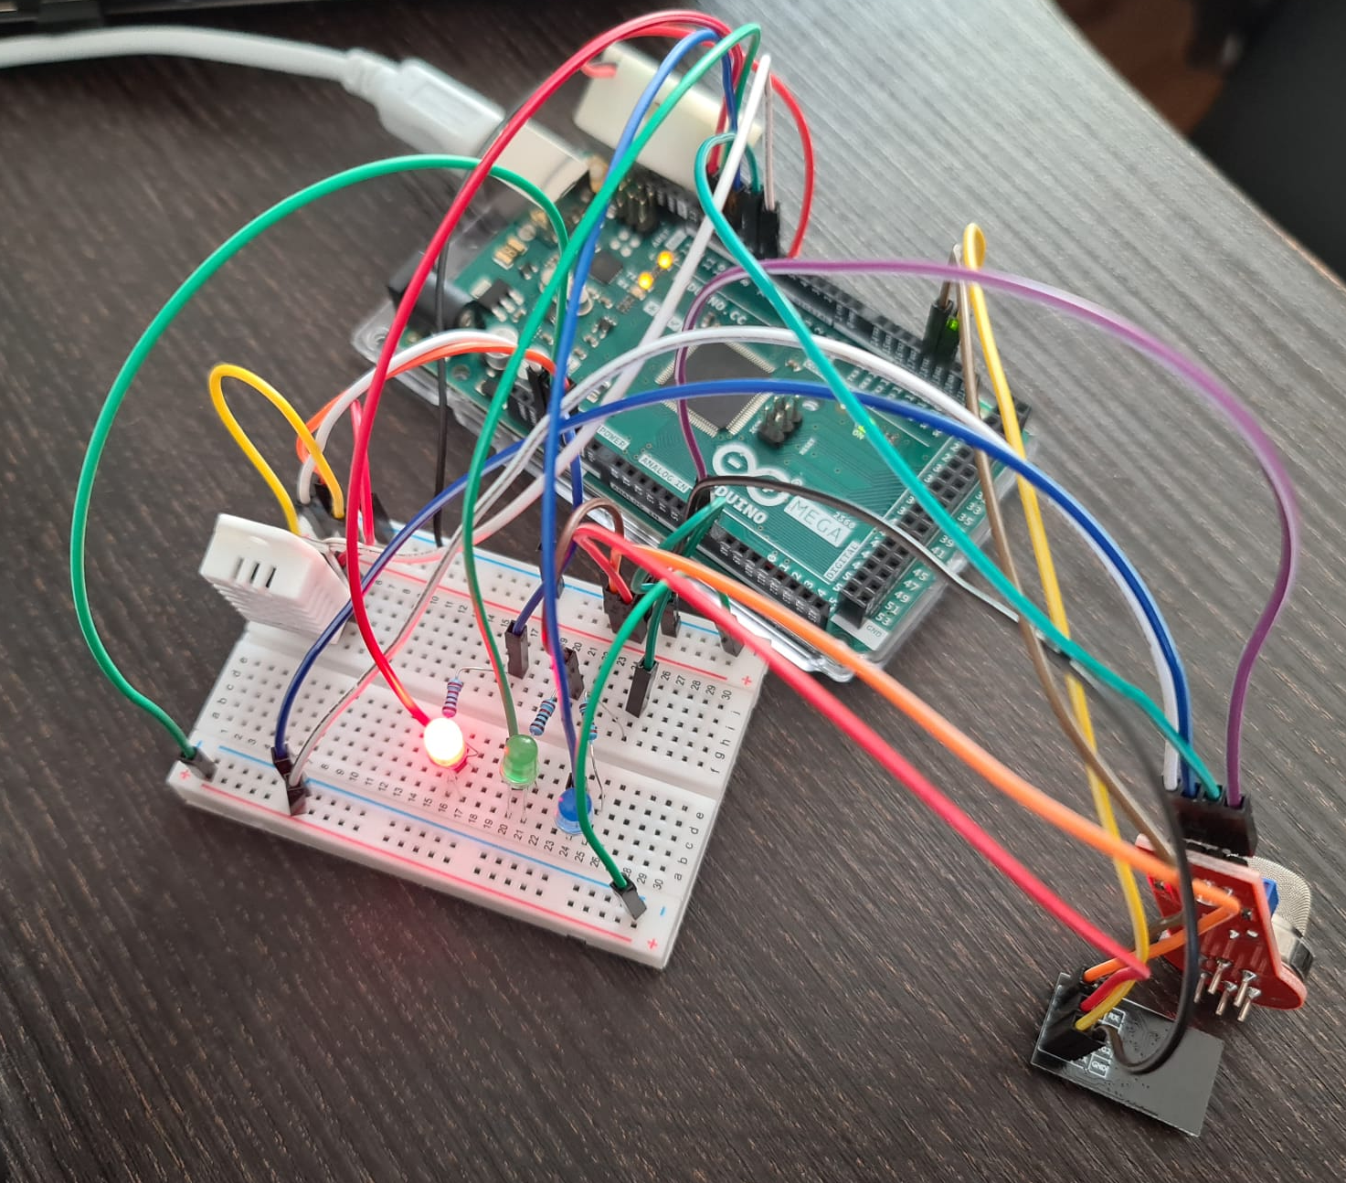
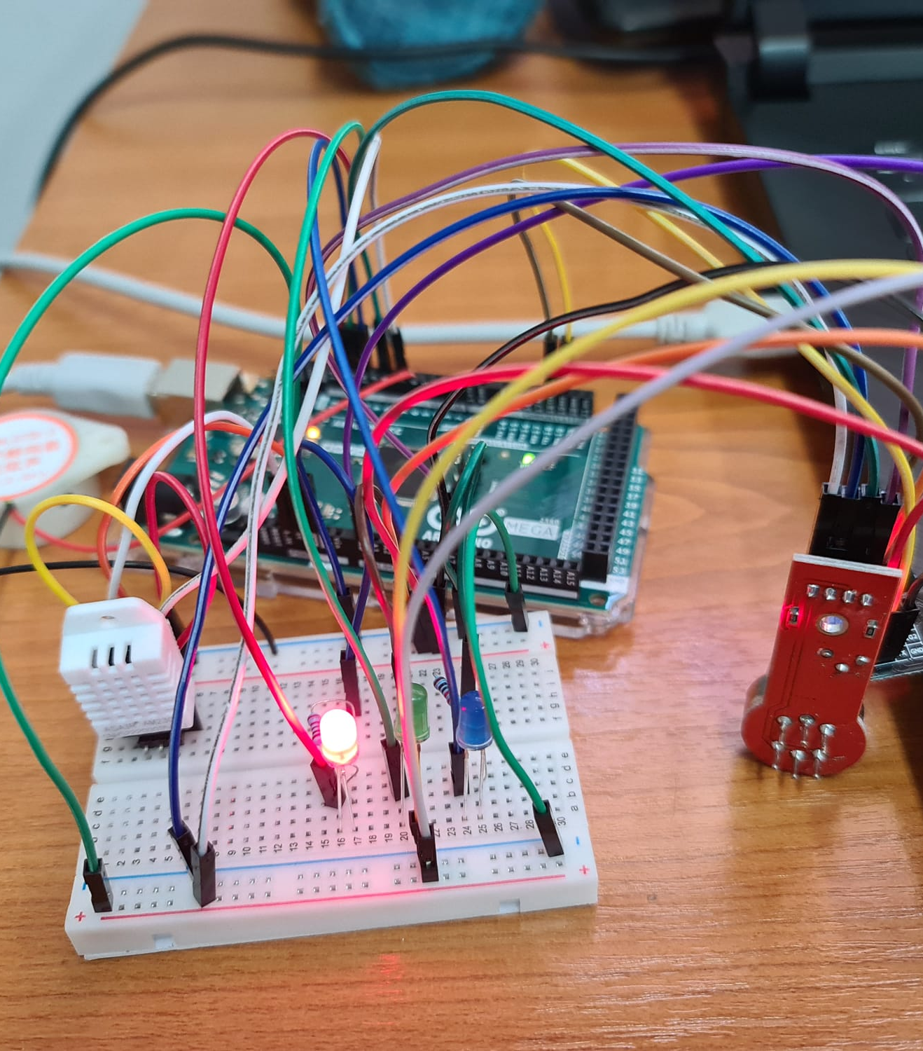
physical setup
The final setup of this project involves the integration of various components for a comprehensive weather station. The Arduino Mega 2560 serves as the main controller, managing data from sensors like DHT22 (for temperature and humidity), MQ-4 (for methane gas detection), and a light sensor. The ESP8266-01 Wi-Fi module enables wireless communication, allowing users to access weather data remotely. The project incorporates LEDs for visual indicators, a buzzer for audible alerts, and a potentiometer for adjusting sensor thresholds.

Slide 12
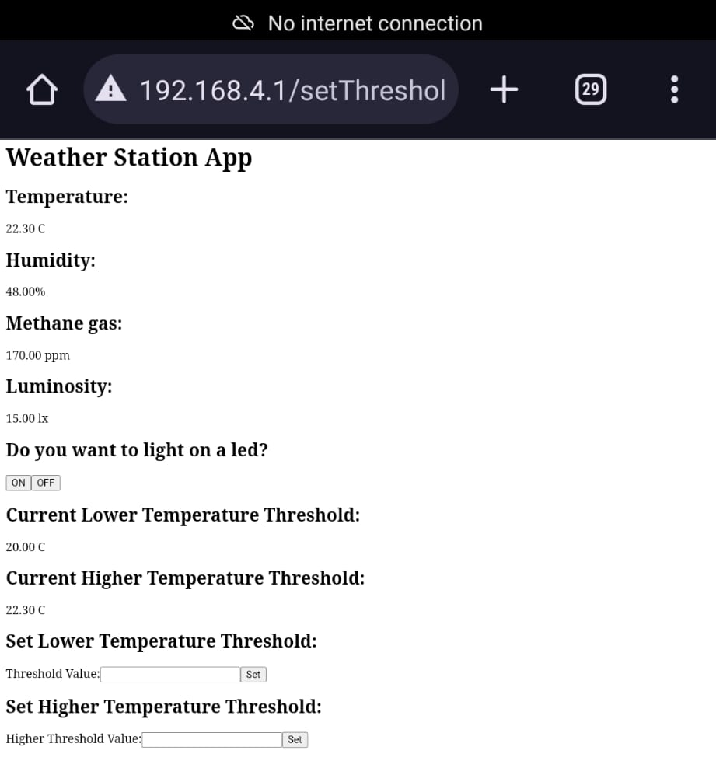
Web page
The user can interact with the system through a web interface hosted on the ESP8266, enabling tasks such as turning on/off LEDs, setting temperature thresholds, and monitoring environmental conditions. This modular and connected setup provides a versatile weather monitoring solution.
The user should connect to the network named “AI-THINKER_2F3A85”. After they connect to the Wi-Fi network, they should open a browser and enter the IP address of the web server: 192.168.4.1. The following page should appear.

Slide 13
Future improvements
Data Logging and Storage: Implement a data logging feature to record historical weather data over time. This could involve using an external storage device or cloud services.
Geolocation Integration: Add GPS functionality to provide location-specific weather information and enhance the precision of the data collected.
Security Features: Introduce security measures for the IoT (Internet of Things) devices to prevent unauthorized access and ensure data integrity.
Web Interface Redesign: Enhance the web interface for improved user experience and accessibility.
Multi-Sensor Support: Allow the connection of additional sensors to provide a more comprehensive range of environmental data, such as air quality sensors or rain sensors.
Weather Forecast Integration: Integrate a weather forecasting API to provide users with short-term and long-term weather forecasts based on current and historical data.
Enclosure Design: Develop a weather-resistant and durable enclosure for outdoor installations, ensuring the longevity and protection of the electronic components.

