Slide 1
INDIVIDUAL PRESENTATION — CPU4:103
Crownfield Eye Hospital Database System
Relational design, normalization, tested SQL features and basic security controls
Iulian-Constantin Fodor
Crownfield Eye Hospital
Individual database development presentation
CPU4:103 Database Development

Slide 2
OPERATIONAL FRAMEWORK
Problem, scope and practical assumptions
Legacy Systems
Centralized Scope
Key Assumptions
Different files made it difficult to keep one reliable version of a record.
Core Entities: Patients, Clinicians, Clinics, Appointments.
Clinician Assignment: Exactly one primary clinician per visit.
Repeated patient and treatment details could become inconsistent.
Clinical Pathways: Diagnoses, Follow-up Plans, Prescriptions.
Optional Follow-Up: Zero-or-one follow-up plan per visit.
Manual entry increased the chance of missing links and invalid values.
One MySQL database stores the synthetic records used in this project.
Multi-Item Script: Prescriptions cover multiple medicines.

Slide 3
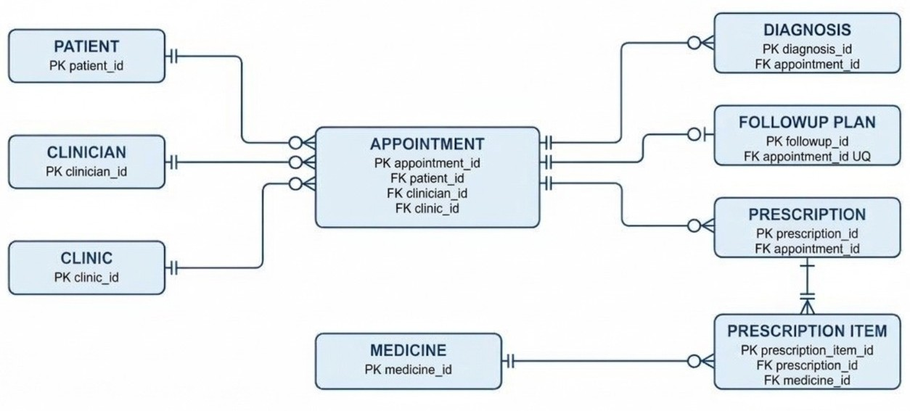
CONCEPTUAL RELATIONSHIPS
Crow's Foot cardinalities used in the final design

Slide 4
DATA ENGINEERING
3NF Architecture & Normalization Pipeline
1
2
3
UNF to 1NF
1NF to 2NF
2NF to 3NF
Atomic Values
Full Functional Dependency
Zero Transitive Dependencies
Split repeating appointment, diagnosis and medicine details so each field contains one value.
Moved medicine-specific dose, route and frequency into prescription_item, where they depend on the full line item key.
Separated patient, clinician, clinic, diagnosis, follow-up, prescription and medicine data to remove transitive dependencies.

Slide 5
RELATIONAL STRUCTURE
Logical Schema & Key Constraints
Surrogate Key Standard
patient (patient_id PK, patient_ref UQ, full_name, postcode)
Auto-increment integer keys keep joins simple; patient_ref provides a readable unique reference.
clinician (clinician_id, full_name, specialty)
clinic (clinic_id, clinic_name, location)
appointment (PK id, FK patient, clinician, clinic, date, time, status)
followup_plan (PK id, FK/UQ appointment, due_date, priority, status)
Zero Orphaned Records
prescription_item (PK id, FK prescription, medicine, dose, route)
NOT NULL foreign keys and RESTRICT on parent records stop appointments from becoming orphaned.

Slide 6
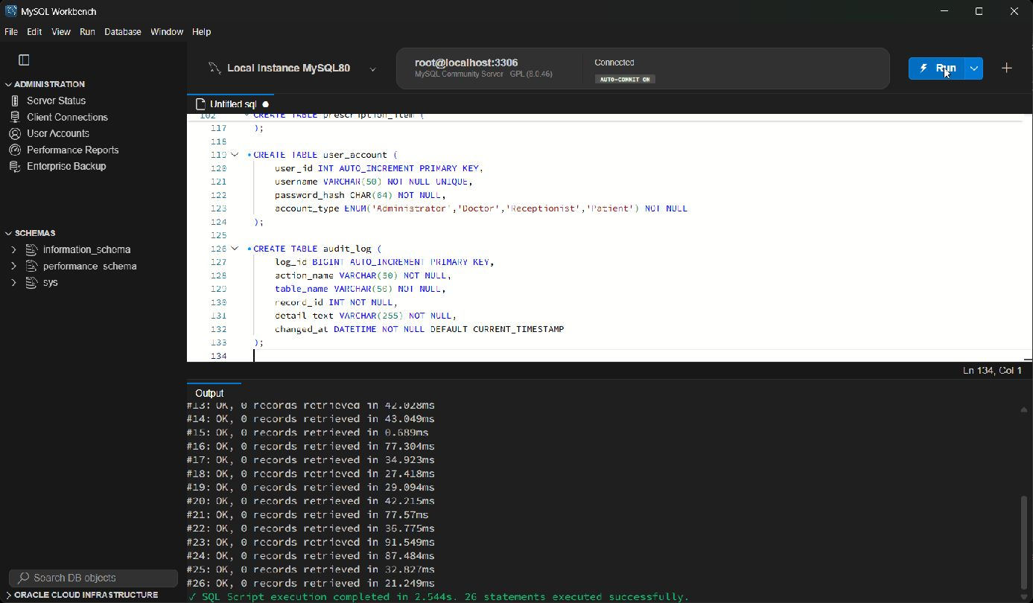
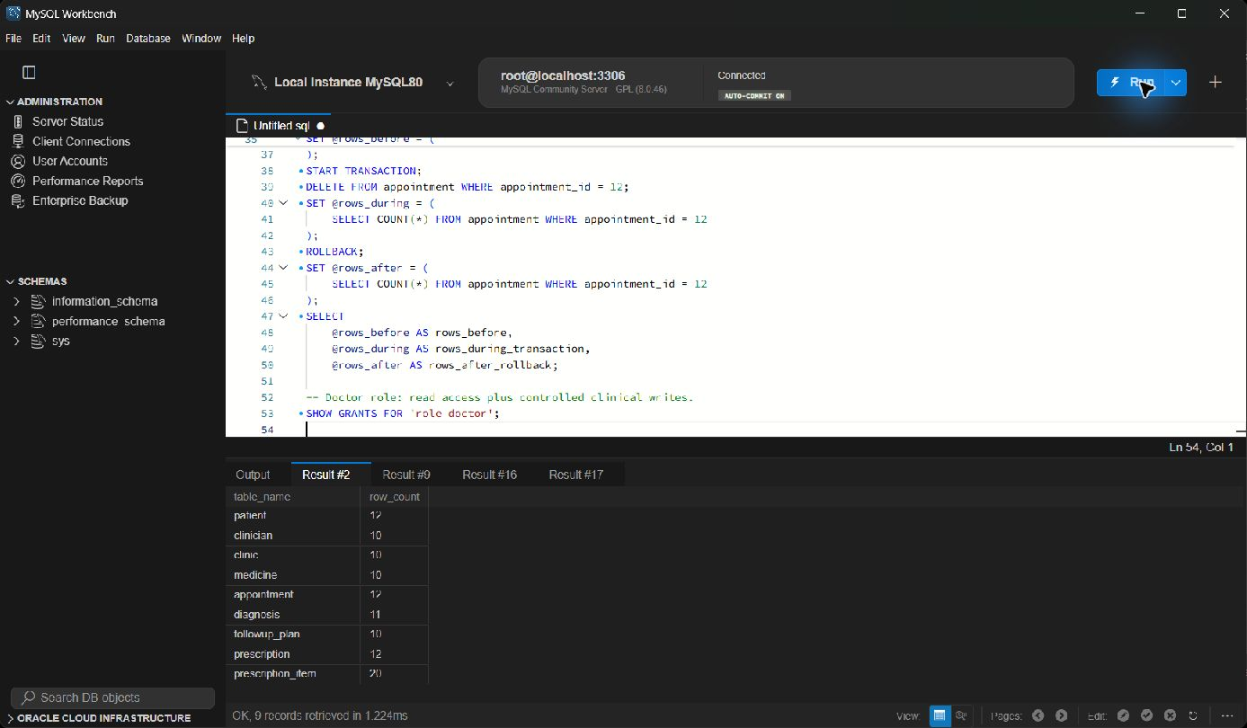
DATABASE IMPLEMENTATION
Schema build and synthetic data checks
REAL EXECUTION
• 26 schema statements completed successfully.
• Main tables contain 10 or more records.
• Names, dates and foreign keys were checked together.
Schema execution
Data volume check
The full MySQL Workbench screen is shown, including both the SQL and the returned result.
[Full screen] — MySQL Workbench evidence from the local MySQL 8.0 server.

Slide 7
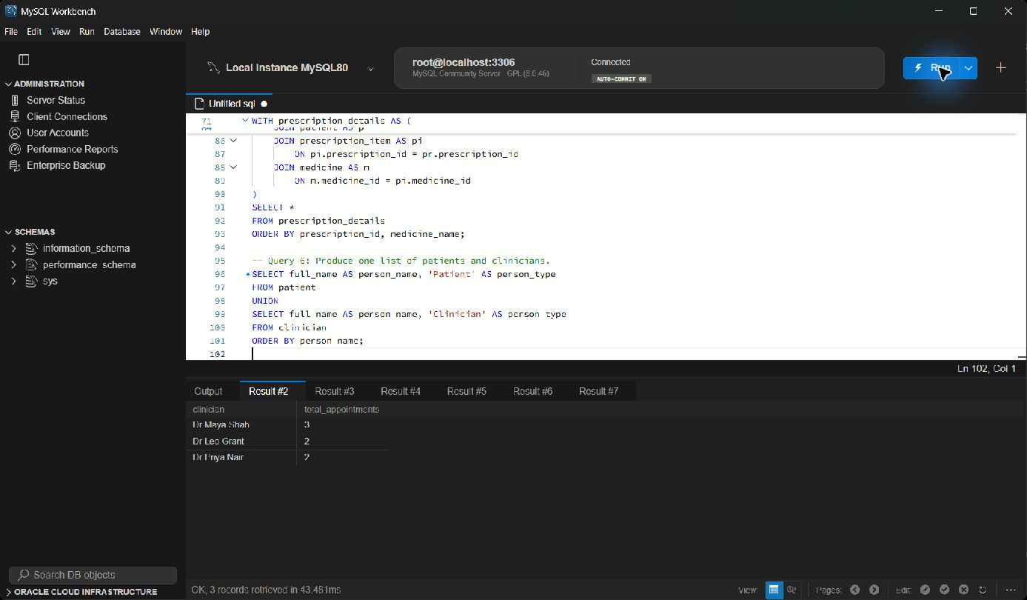
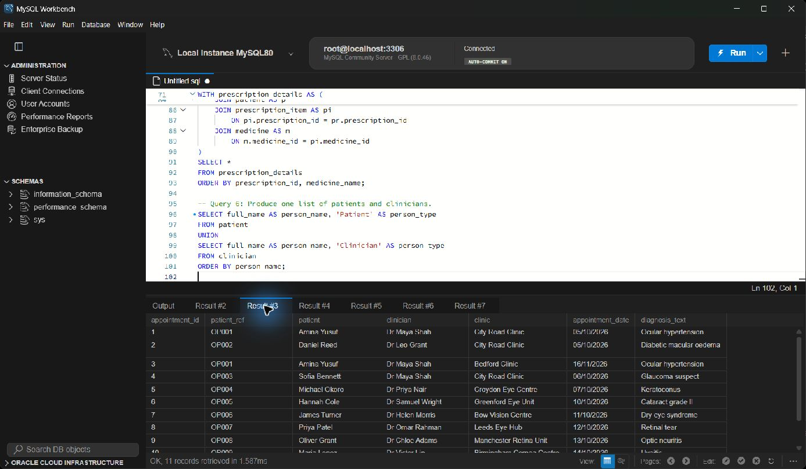
SQL FEATURES
Clinic aggregate and prescription INNER JOIN
REAL EXECUTION
• GROUP BY and HAVING identify clinics with at least two visits.
• The INNER JOIN connects items, prescriptions, visits, patients and medicines.
• The results can be checked against the sample rows.
Feature 1 — aggregate
Feature 2 — INNER JOIN
The full MySQL Workbench screen is shown, including both the SQL and the returned result.
[Full screen] — These are Iulian Fodor's individual query examples.

Slide 8
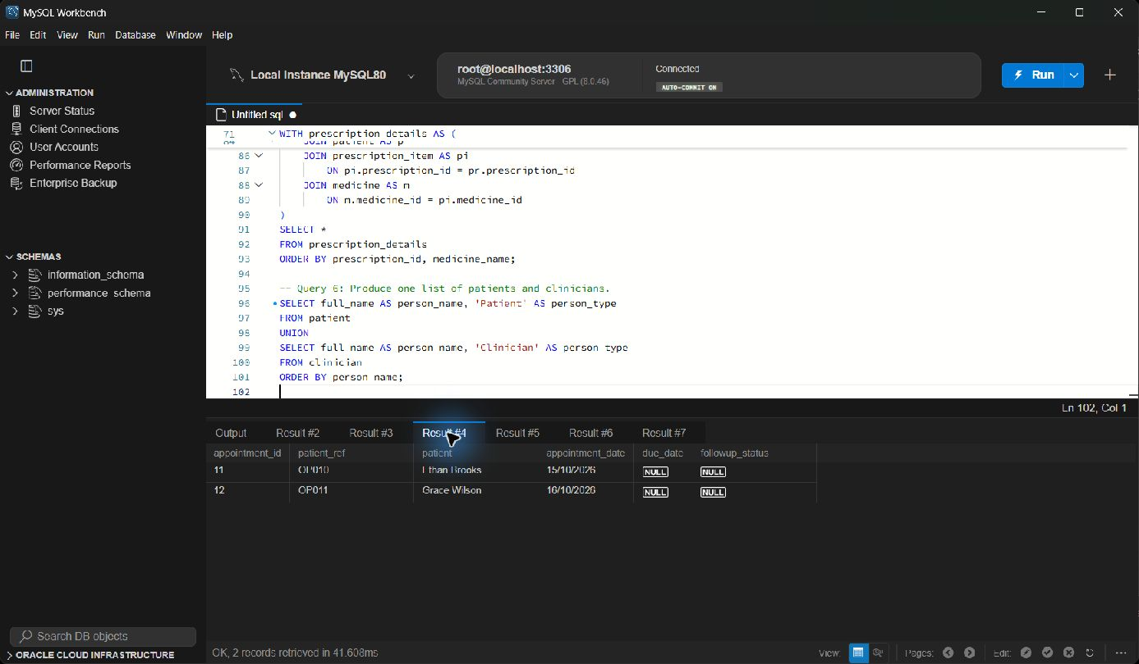
SQL FEATURES
LEFT JOIN and CTE answer different questions
REAL EXECUTION
• LEFT JOIN finds a registered patient with no appointment.
• A CTE prepares pending follow-up work before priority filtering.
• High and Urgent plans remain easy to review.
[Full screen] — The LEFT JOIN preserves patients even when no appointment row exists.

Slide 9
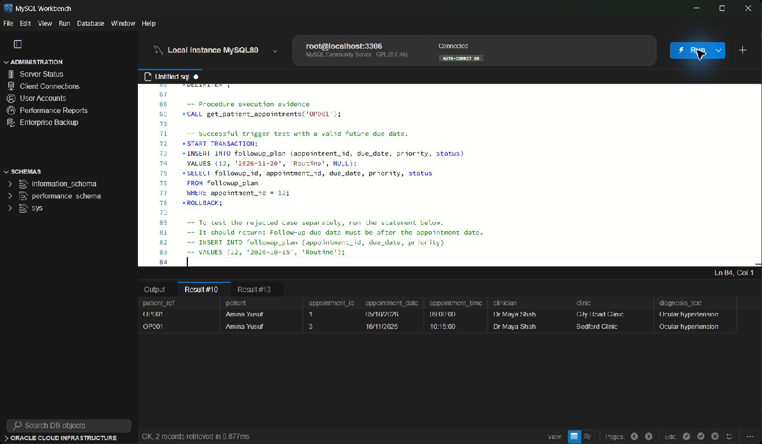
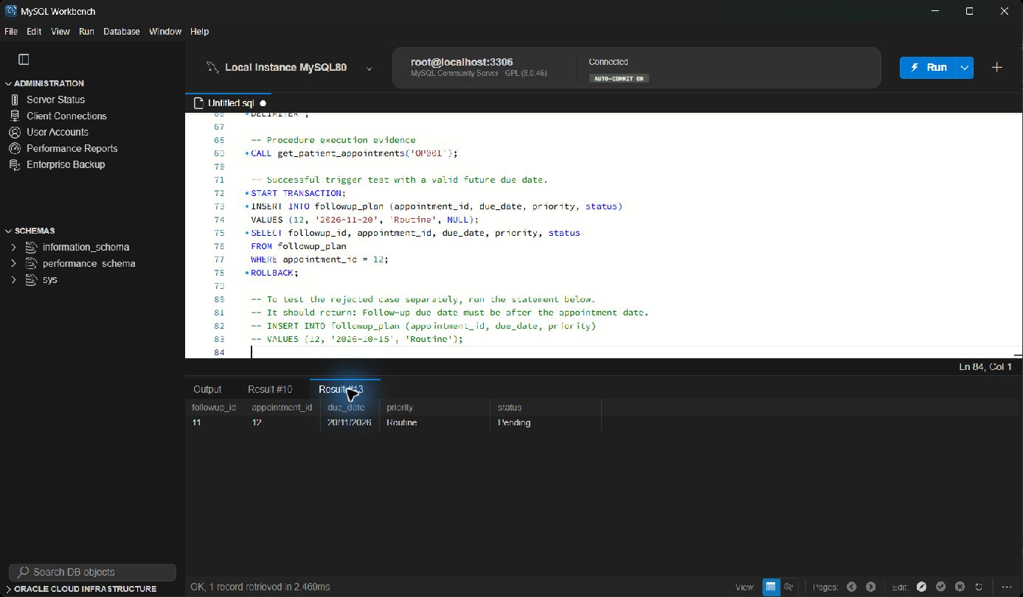
DATABASE AUTOMATION
Clinician schedule procedure and time trigger
REAL EXECUTION
• Procedure accepts a clinician name as its parameter.
• Trigger rejects appointments before 08:00 or after 18:00.
• The valid insert is rolled back after testing.
Procedure — clinician schedule
Trigger — valid appointment time
The full MySQL Workbench screen is shown, including both the SQL and the returned result.
[Full screen] — The procedure and trigger are different from Gabriel's examples.

Slide 10
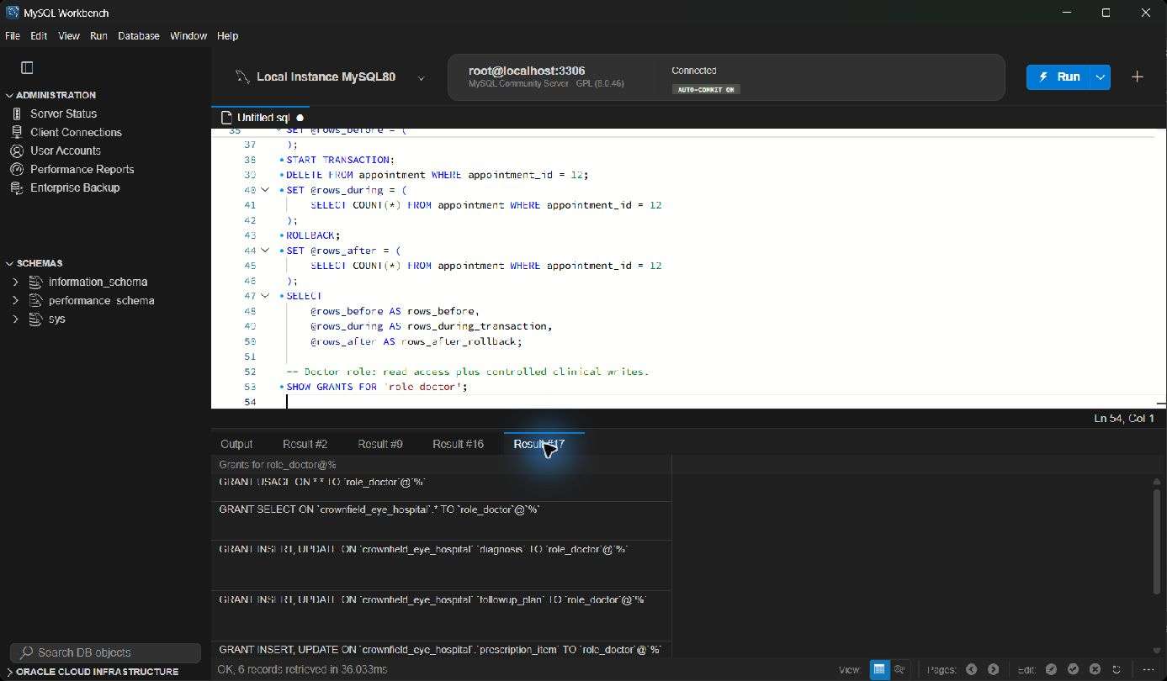
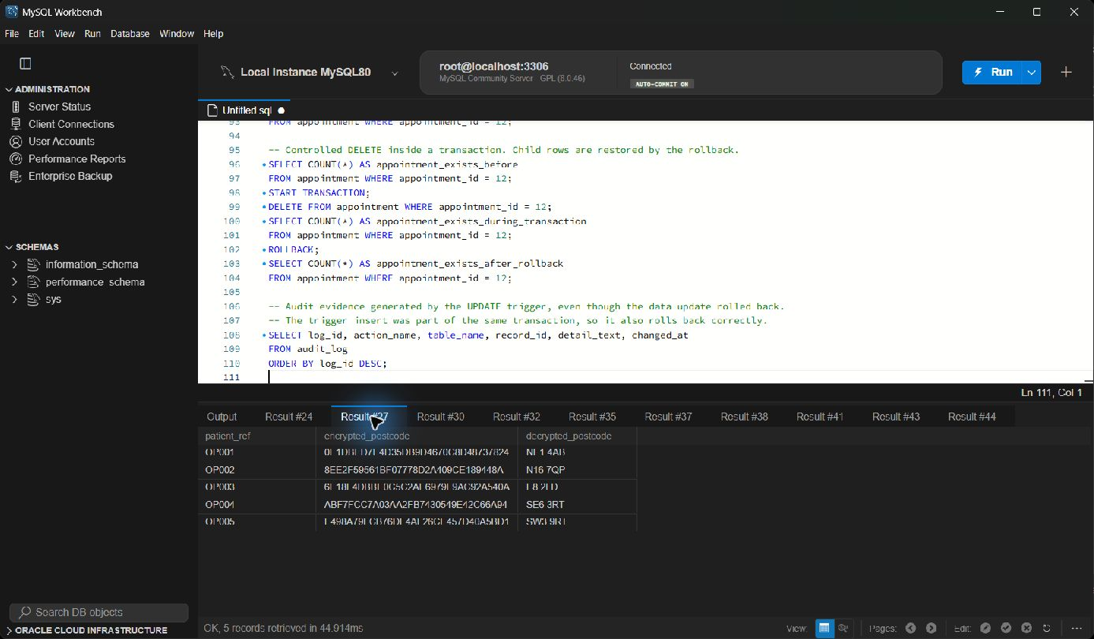
SECURITY
Roles, hashing and encryption demonstration
REAL EXECUTION
• Four database roles apply least privilege.
• User passwords are stored as SHA-256 hashes in the demo table.
• Synthetic postcodes were encrypted and decrypted with AES.
[Full screen] — The patient role is read-only; row-level 'own record' access would require an application layer.
Role grants
Encrypted postcode demo
The full MySQL Workbench screen is shown, including both the SQL and the returned result.

Slide 11
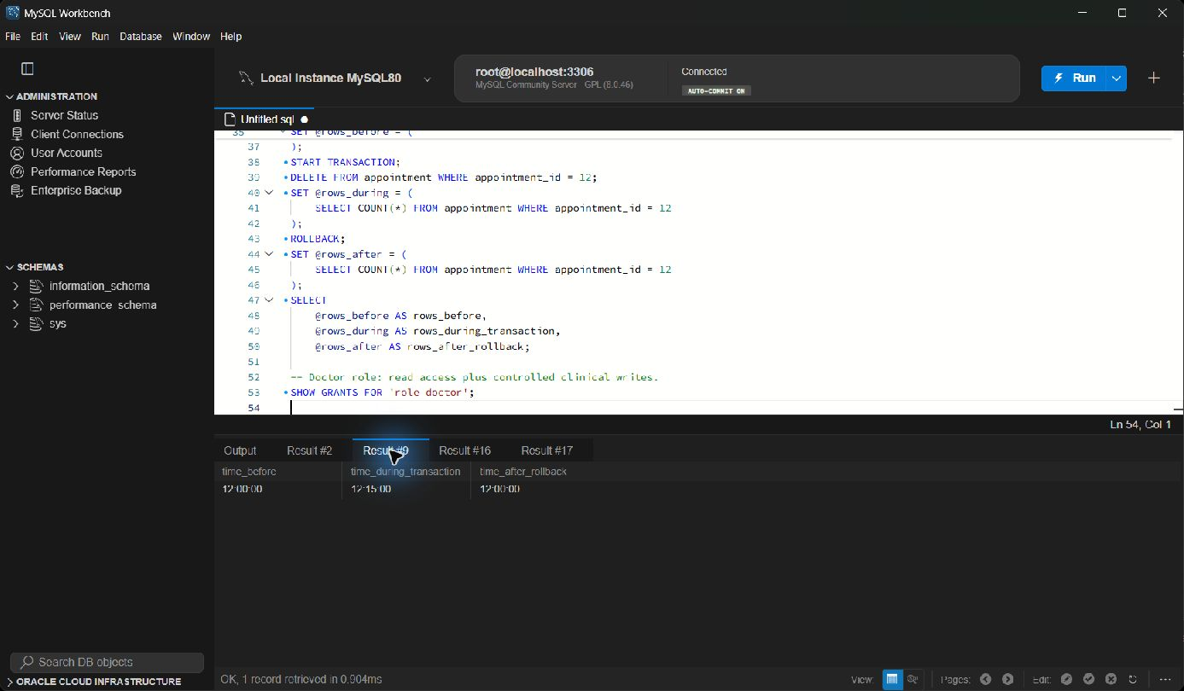
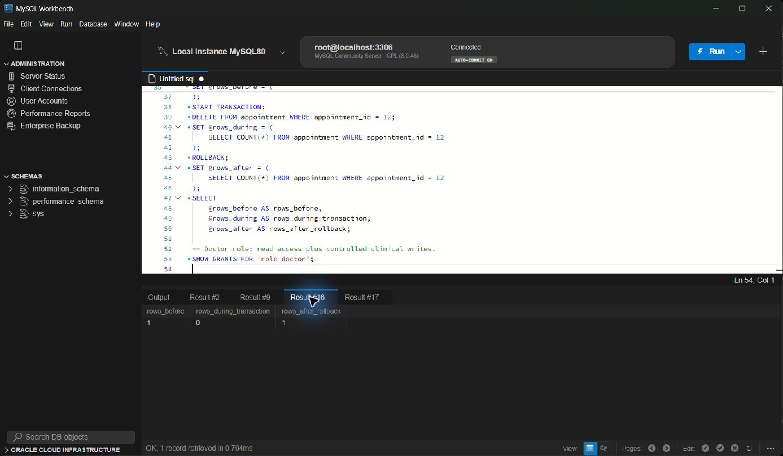
TRANSACTIONS
Controlled UPDATE and DELETE with ROLLBACK
REAL EXECUTION
• The update changes a time only inside the transaction.
• The delete temporarily removes one row.
• ROLLBACK restores the original values in both tests.
UPDATE test
DELETE test
The full MySQL Workbench screen is shown, including both the SQL and the returned result.
[Full screen] — This provides repeatable evidence without damaging the sample dataset.

Slide 12
PROJECT CONCLUSION
What I contributed and what I learned
I corrected the relationships, aligned the schema with 3NF tables, tested the SQL in MySQL Workbench and recorded evidence. The hardest part was keeping the workbook, code and presentation consistent.

