Slide 1
Big Mountain Resort
Capstone Project Summary

Slide 2
Problem identification

Slide 3
Problem identification
Big Mountain Resort, a ski resort located in Montana, offers spectacular views of Glacier National Park and Flathead National Forest.
This mountain can accommodate skiers and riders of all levels and abilities. These are serviced by 11 lifts and recently installed an additional chair lift to help increase the distribution of visitors across the mountain that increases their operating costs by $1,540,000 this season.
The company wants some guidance on how to select a better value for their ticket price. They are also considering a number of changes that they hope will either cut costs without undermining the ticket price or will support an even higher ticket price.

Slide 4
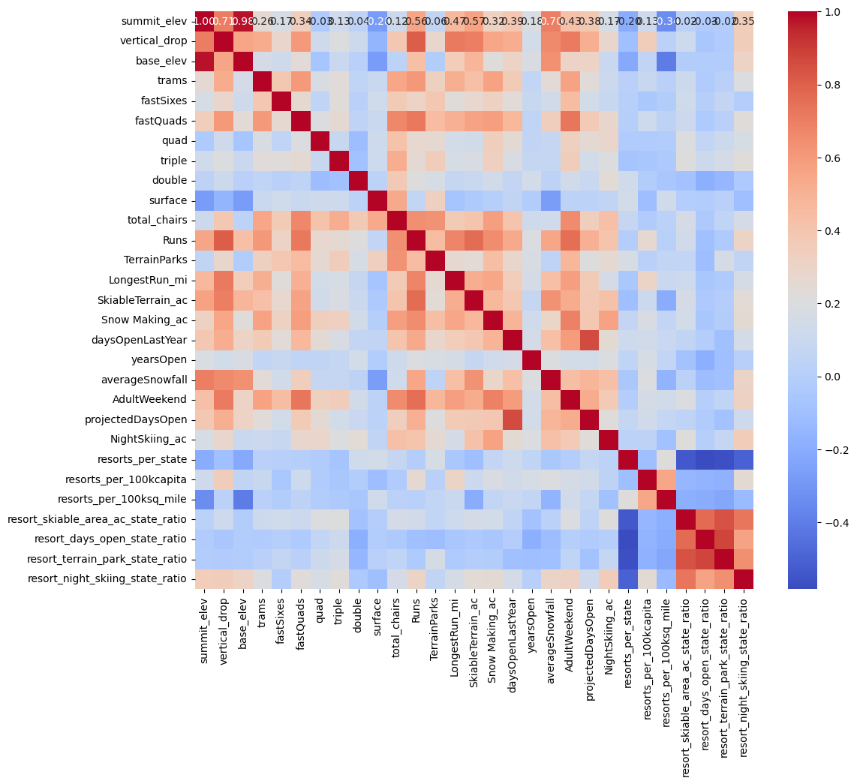
Recommendation and key findings
According the heatmap
there's a positive correlation between the number of runs and the need for chairs,
and a larger night skiing capacity can positively affect ticket prices.
These findings suggest that amenities and capacity are significant factors in resort pricing.

Slide 5
Recommendation and key findings
Introduce discounts for advance purchases, off-peak tickets, and multi-day passes to attract different visitor segments.
If your resort offers unique amenities, consider a premium pricing strategy.

Slide 6
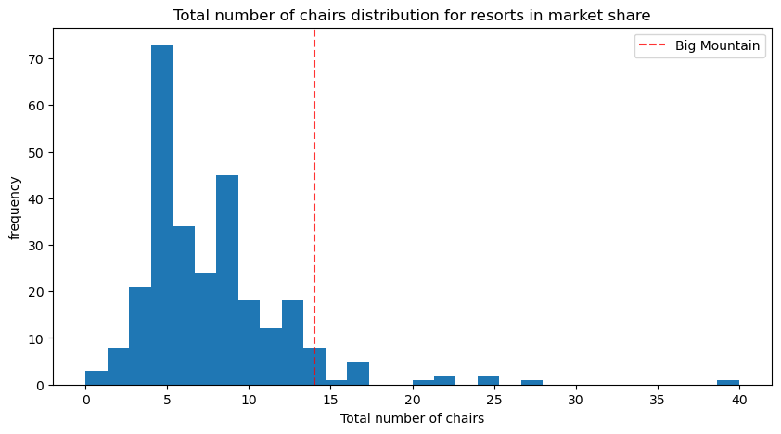
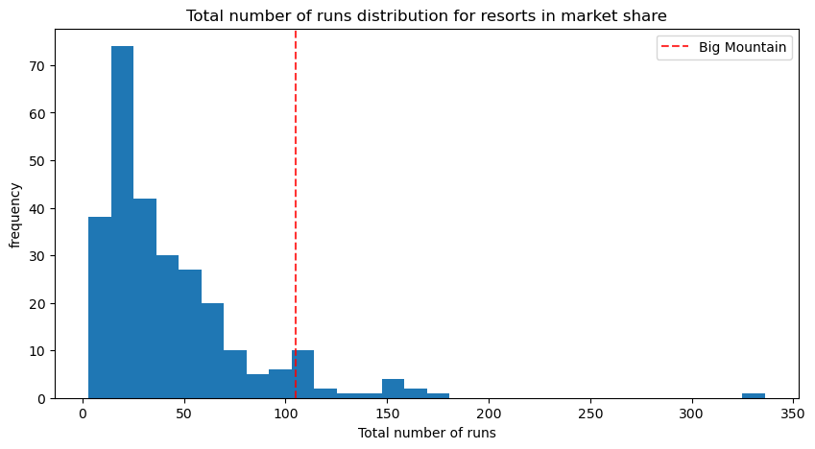
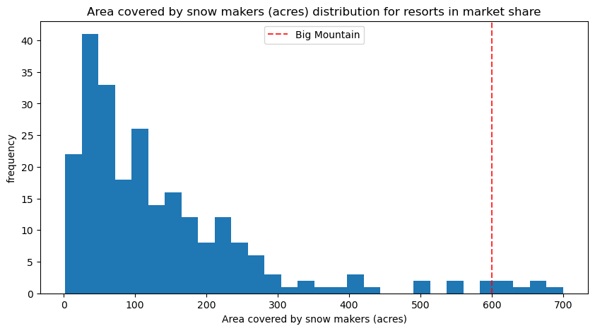
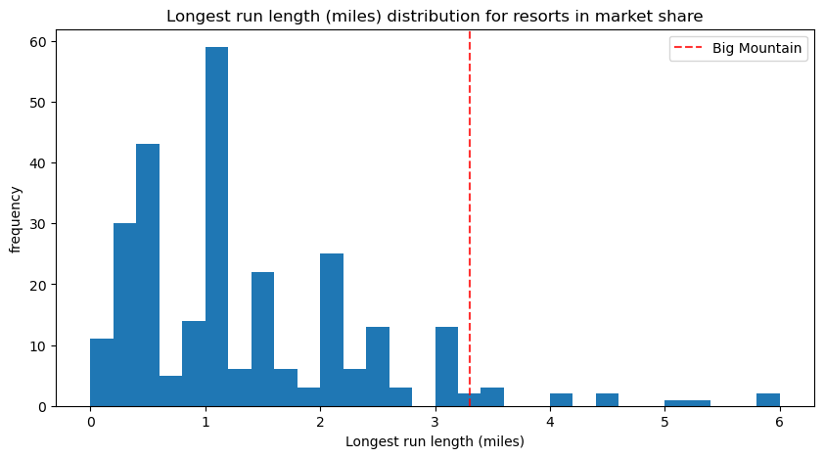
Modeling results and analysis
Big Mountain
is very high up the league table of snowmaking area.
has amongst the highest number of total chairs, resorts with more appear to be outliers.
compares well for the number of runs. There are some resorts with more, but not many.
has a great skiable area.

Slide 7
Modeling results and analysis
Predicted mean ticket price $63.811
After our research:
model could estimate ticket prices within about $9 of the actual price.
TRAINING SET

Slide 8
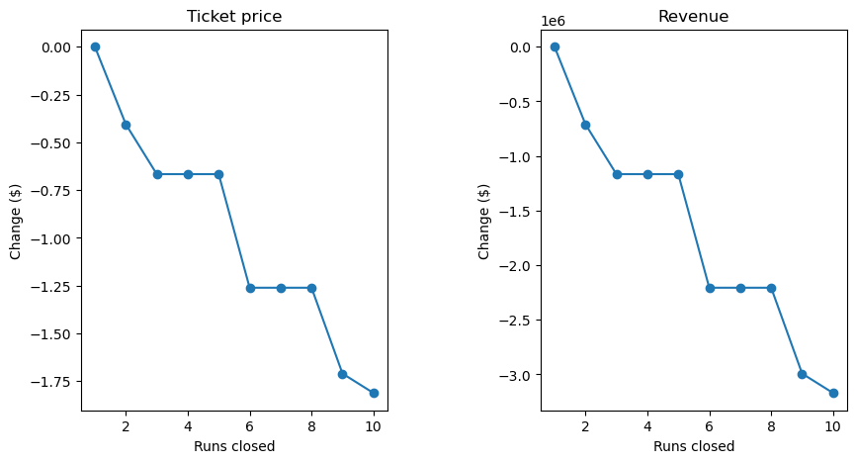
Modeling results and analysis
1, Close up to 10 of the least used runs. ]
The model says closing one run makes no difference. Closing 2 and 3 successively reduces support for ticket price and so revenue. If Big Mountain closes down 3 runs, it seems they may as well close down 4 or 5 as there's no further loss in ticket price. Increasing the closures down to 6 or more leads to a large drop.
See the graph
2. Big Mountain is adding a run, increasing the vertical drop by 150 feet, and installing an additional chair lift.
This scenario increases support for ticket price by $1.99, Over the season, this could be expected to amount to $3474638
3. The second Scenario + adding 2 acres of snow making.
Such a small increase in the snow making area makes no difference!
4. This scenario calls for increasing the longest run by .2 miles and guaranteeing its snow coverage by adding 4 acres of snow making capability.
No difference.
Modeling scenarios

Slide 9
Summary and conclusion
The study for Big Mountain Resort suggests a data-driven approach to refine ticket pricing, emphasizing the value of amenities and strategic facility adjustments.
Recommendations for using analytics to guide pricing strategies are poised to boost profitability and customer satisfaction, providing a roadmap for sustainable growth and informed decision-making in competitive and seasonal markets.

