Slide 1

Smart Basket for Automatic Product Classification and Counting
Iuliia Bolgova
Data Science Intensive Capstone Project, March 11th 2024 Cohort

Slide 2
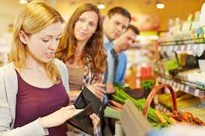
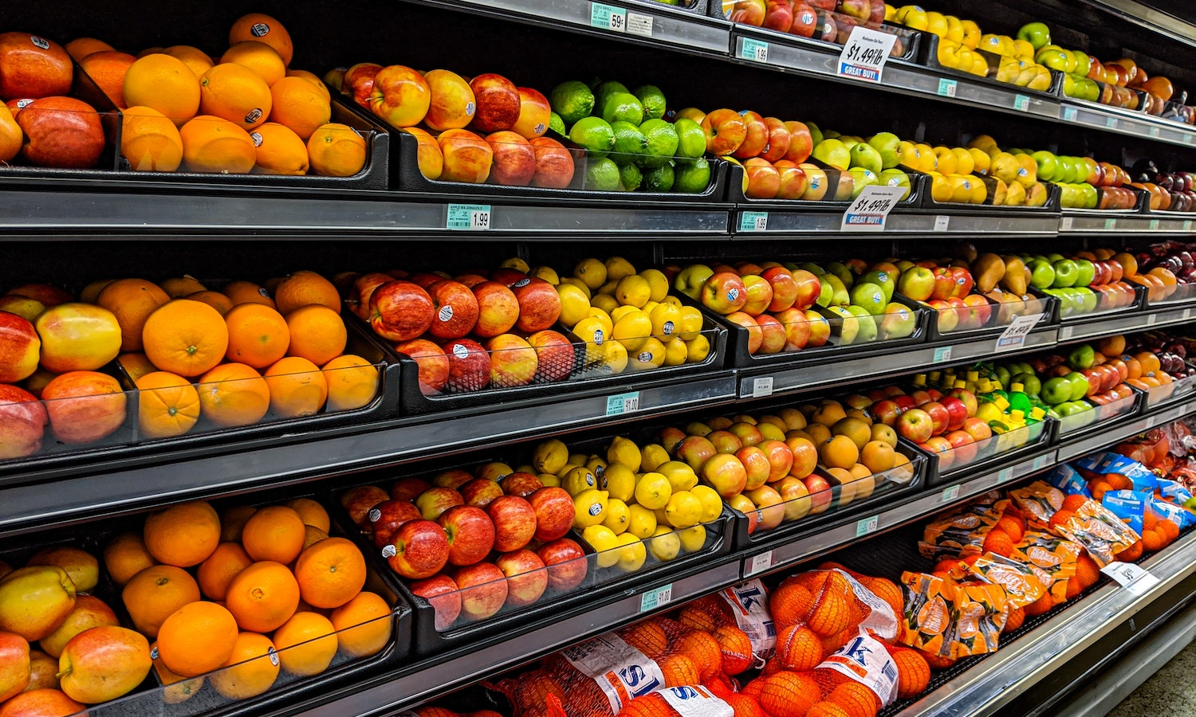
Problem Statement
Long queues at checkout
Manual fruit & vegetable identification
Complex variations in shape, color, and texture
Research Objective
Automate classification to reduce errors & speed up checkout

Slide 3
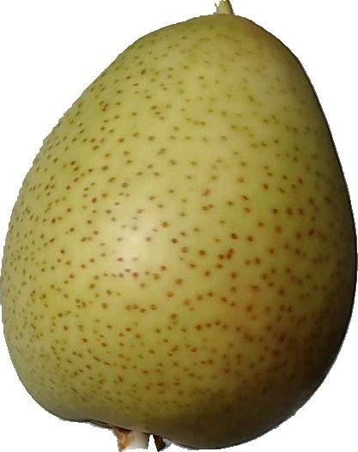
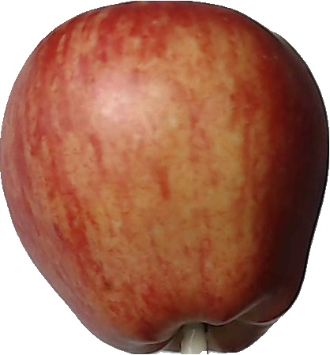
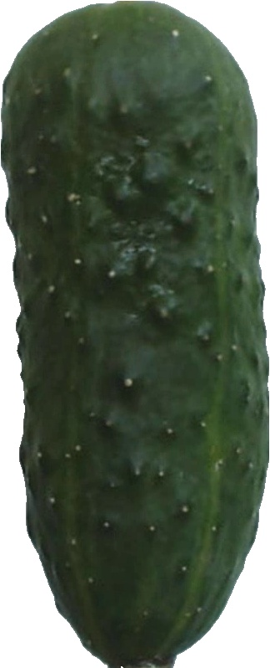
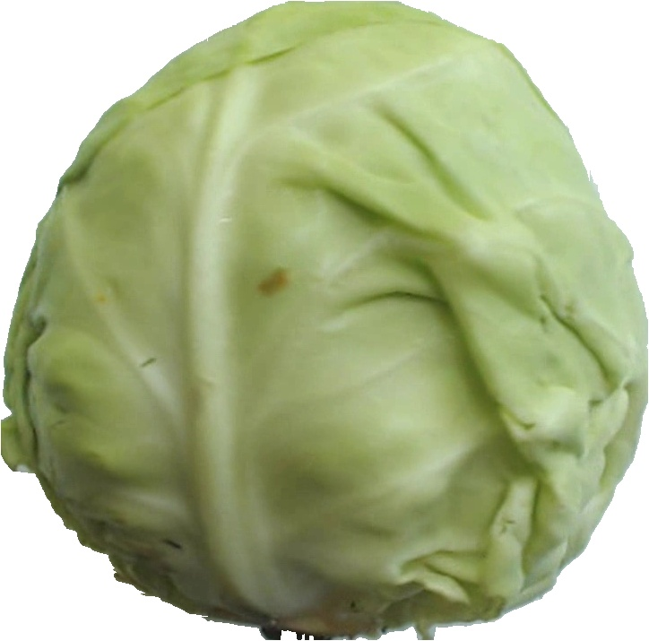
FRUIT-360
training set test set
9 341 3 110
samples samples
Initial Inspection

Slide 4
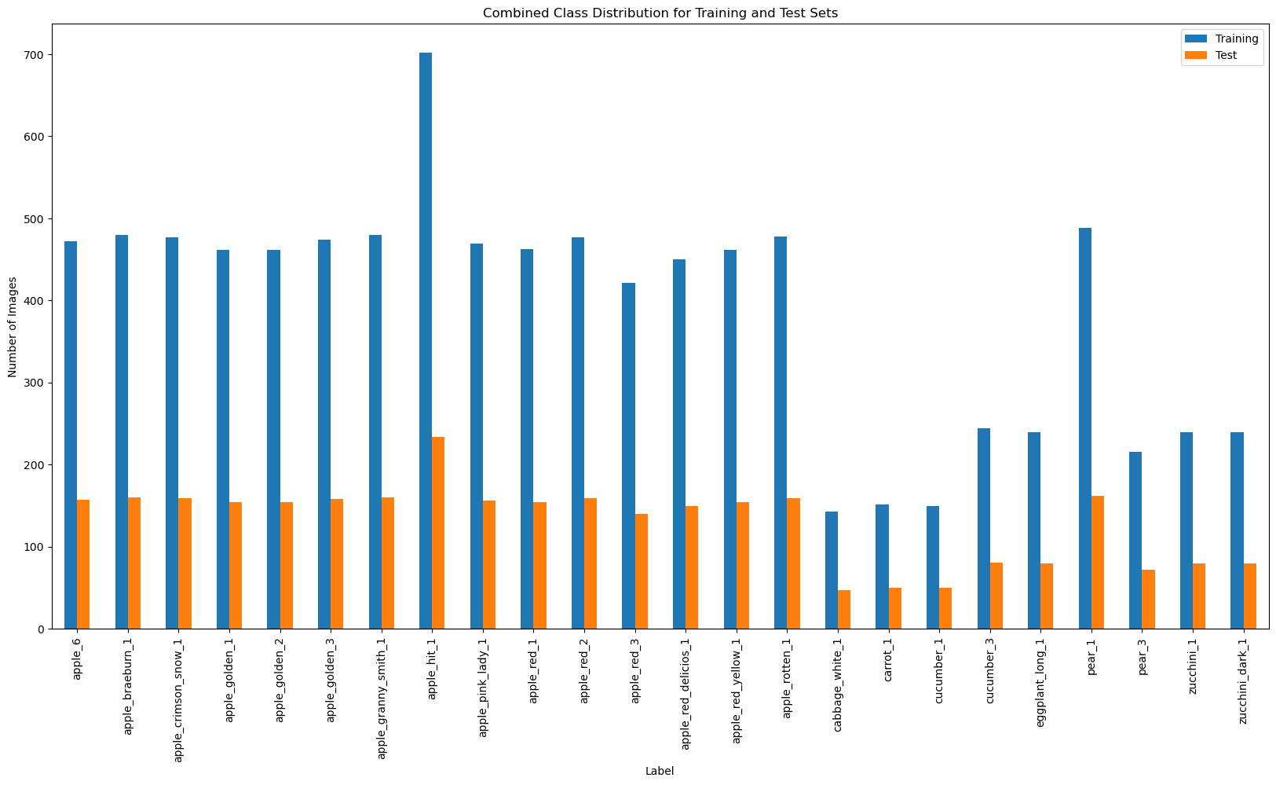
FRUIT-360
Key Observation
Imbalanced Classes

Slide 5
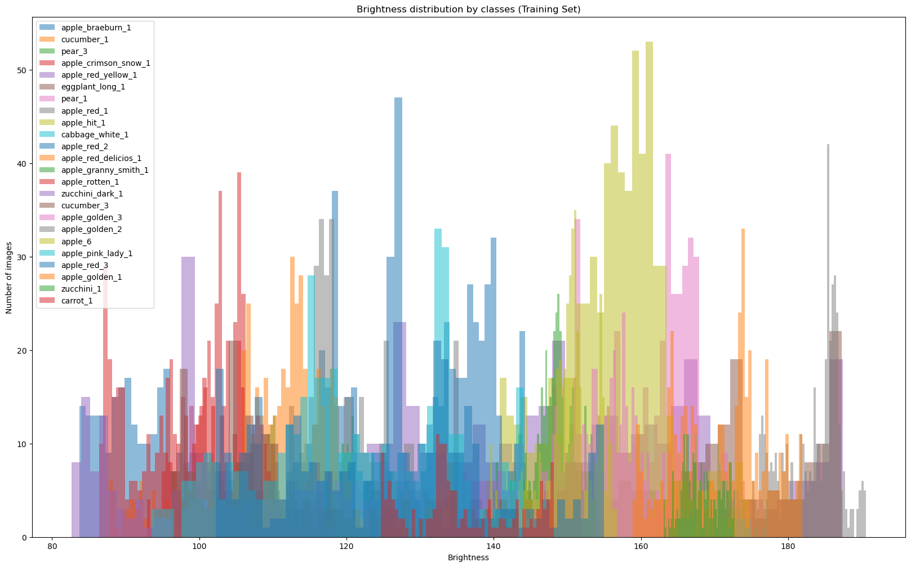
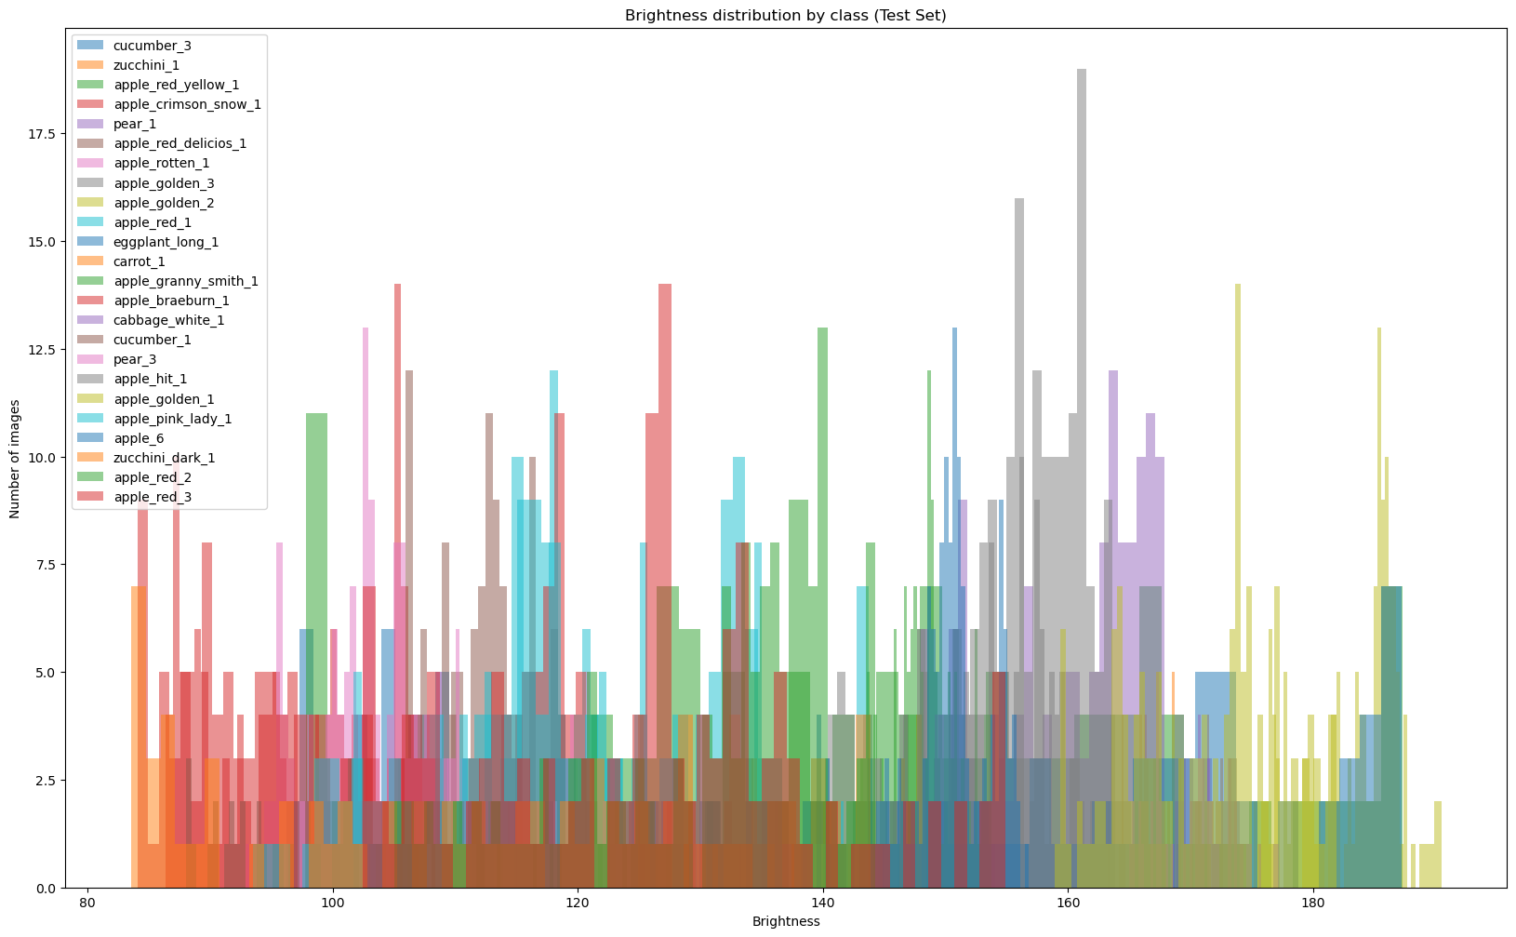
Exploratory Data Analysis (EDA)
Analysis of Image Brightness by Class
training set
test set

Slide 6
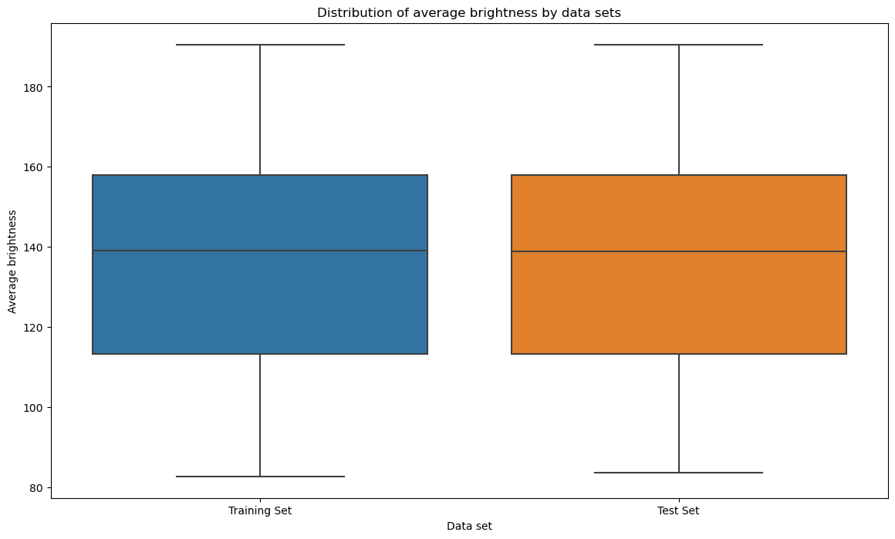
Exploratory Data Analysis (EDA)
Detection of Outliers

Slide 7
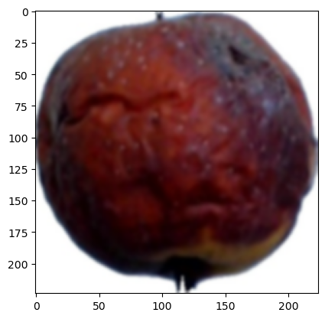
Image Size Analysis
Unique Image Sizes
Image Size | Training Set | Test Set
(347, 350) | 15 | 6
(527, 412) | 13 | 5
(316, 350) | 12 | 3
(318, 344) | 12 | 6
(348, 349) | 12 | 2
... | ... | ...
(703, 197) | 1 | 1
(320, 340) | 1 | 0
(660, 205) | 1 | 0
(970, 366) | 1 | 0
(570, 573) | 1 | 0
Resizing Images to a Uniform Size
Image Size | Training Set | Test Set
(224, 224) | 9341 | 3110

Slide 8
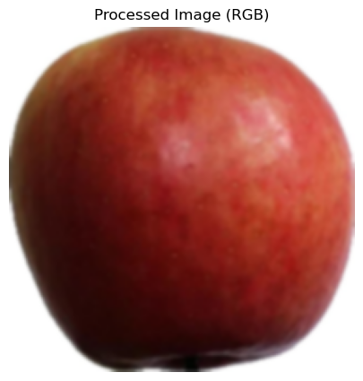
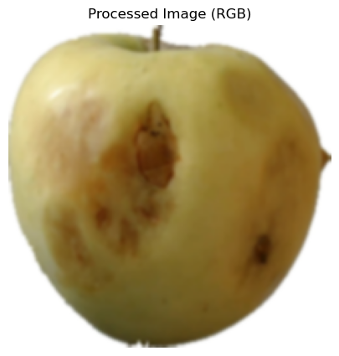
Color Image Enhancement

Slide 9
Preprocessing the Image Data
01
02
Normalizing Image Data
Encoding Labels for Modeling
Convert String Labels to Numerical Labels
One-Hot Encoding

Slide 10
CNN Model for Fruit & Vegetable Classification
Input Layer: (224, 224, 3) RGB images
3 Convolutional Layers with increasing filter sizes (32, 64, 128)
MaxPooling after each Conv layer to reduce dimensions
Flatten layer followed by Dense (512 neurons) + Dropout (60%)
Output Layer: 24 neurons with softmax activation
Data augmentation and class weighting applied to handle class imbalances.
Early stopping used to prevent overfitting during training
Optimizer: Adam
Loss: Categorical Crossentropy
Metric: Accuracy

Slide 11
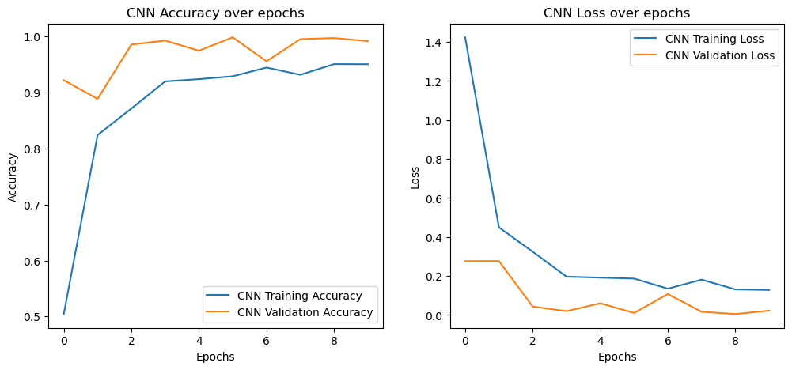
CNN Model for Fruit & Vegetable Classification

Slide 12
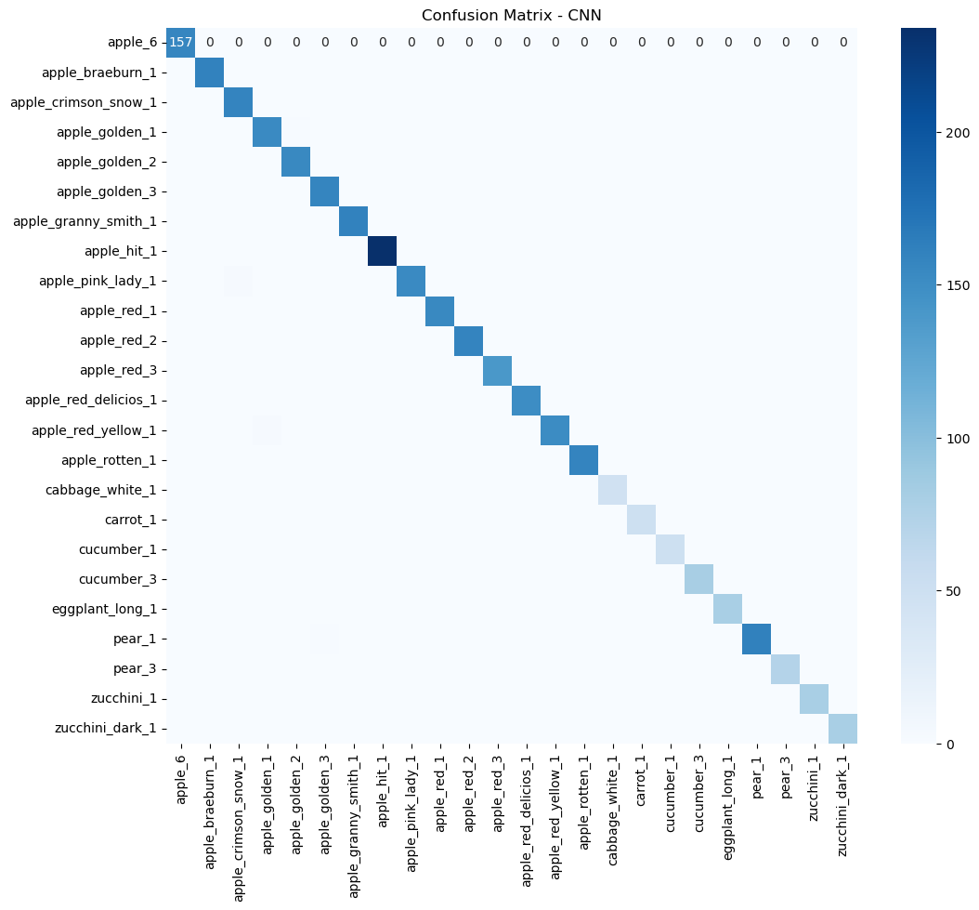
CNN Model for Fruit & Vegetable Classification

Slide 13
CNN Model for Fruit & Vegetable Classification
Class | Precision | Recall | F1-Score | Support
apple_6 | 1.00 | 1.00 | 1.00 | 157
apple_braeburn_1 | 1.00 | 1.00 | 1.00 | 160
apple_crimson_snow_1 | 0.98 | 1.00 | 0.99 | 159
apple_golden_1 | 0.98 | 0.99 | 0.99 | 154
...
apple_hit_1 | 1.00 | 1.00 | 1.00 | 234
zucchini_dark_1 | 1.00 | 1.00 | 1.00 | 80
Accuracy | 1.00 |  |  | 3110
Macro Avg | 1.00 | 1.00 | 1.00 | 3110
Weighted Avg | 1.00 | 1.00 | 1.00 | 3110

Slide 14
VGG16 Model for Fruit & Vegetable Classification
Pre-trained on ImageNet
Freezing Layers: layers frozen to retain feature extraction capabilities
Custom Layers: Dense layers added to suit the 24-category classification
Data augmentation and class weighting applied to handle class imbalances
Early stopping used to prevent overfitting during training

Slide 15
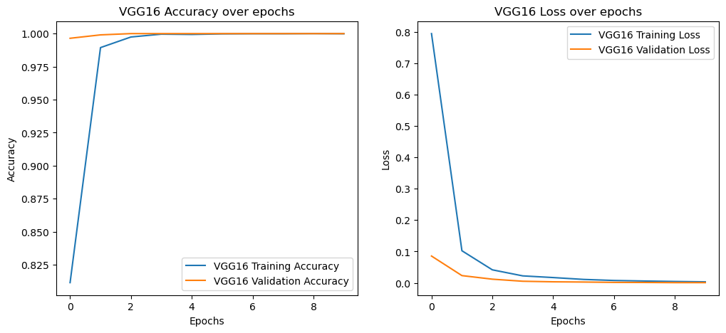
VGG16 Model for Fruit & Vegetable Classification

Slide 16

VGG16 Model for Fruit & Vegetable Classification

Slide 17
VGG16 Model for Fruit & Vegetable Classification
Class | Precision | Recall | F1-Score | Support
apple_6 | 1.00 | 1.00 | 1.00 | 157
apple_braeburn_1 | 1.00 | 1.00 | 1.00 | 160
apple_crimson_snow_1 | 1.00 | 1.00 | 1.00 | 159
apple_golden_1 | 1.00 | 1.00 | 1.00 | 154
...
apple_hit_1 | 1.00 | 1.00 | 1.00 | 234
zucchini_dark_1 | 1.00 | 1.00 | 1.00 | 80
Accuracy | 1.00 |  |  | 3110
Macro Avg | 1.00 | 1.00 | 1.00 | 3110
Weighted Avg | 1.00 | 1.00 | 1.00 | 3110

Slide 18
Comparison of CNN and VGG16 Models
Metric | CNN | VGG16
Test Accuracy | 99.74% | 100.00%
Precision (macro avg) | 1.00 | 1.00
Recall (macro avg) | 1.00 | 1.00
F1-Score (macro avg) | 1.00 | 1.00
Reasons to Choose VGG16 Over CNN:
Higher Accuracy
Pre-trained Weights
Deeper Architecture
Robust Generalization
Transfer Learning Efficiency
Proven Track Record

Slide 19
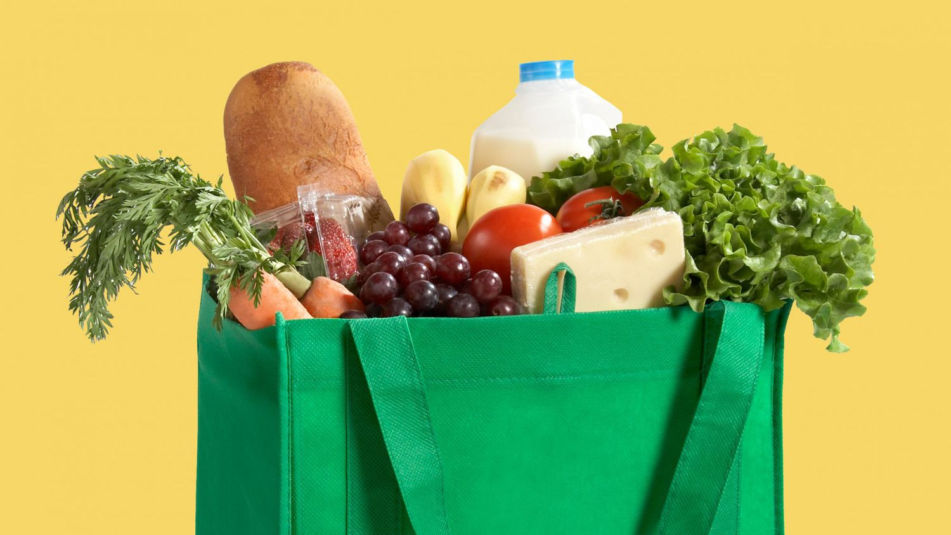
Simulating a Shopping Cart with VGG16
Number of products in cart: 16
Product | Count
apple_hit_1 | 2
apple_red_delicios_1 | 2
apple_red_3 | 3
pear_1 | 1
apple_granny_smith_1 | 1
...
pear_3 | 1
eggplant_long_1 | 1
apple_golden_2 | 1

Slide 20
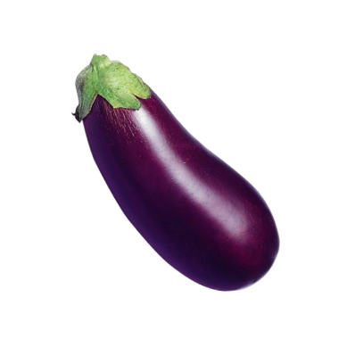
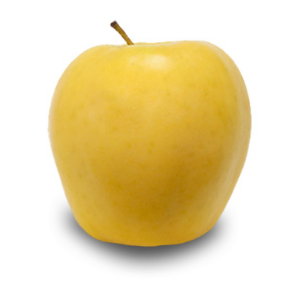
Simulating a Shopping Cart with VGG16
Predicted Class: apple_hit_1 with a probability of 0.89.
Additional Probabilities:
pear_1: 0.06
apple_rotten_1: 0.02
Predicted Class: eggplant_long_1 with a probability of 0.97.
Additional Probabilities:
apple_hit_1: 0.02
cucumber_3: 0.01

Slide 21
Summary
RECOMMENDATION
IMPROVEMENT SUGGESTION
Further Data Collection
Real-time Application
Class Balance Refinement
Further Model Fine-tuning
Edge Device Deployment

Slide 22
Thank you!
For any questions please text me on email: julibolg@gmail.com

