Slide 1
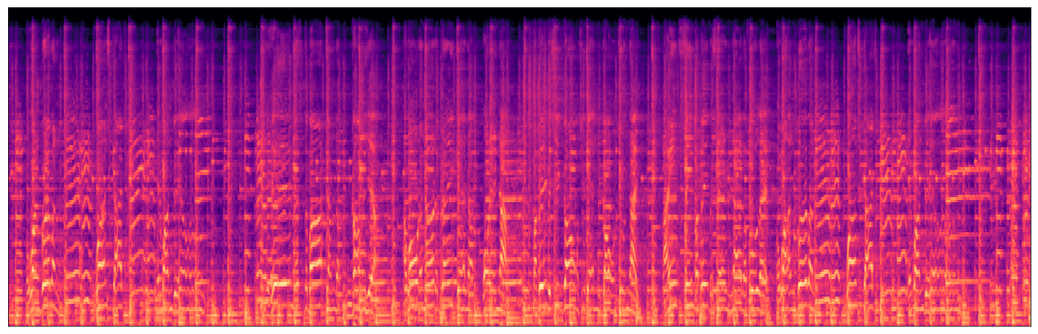

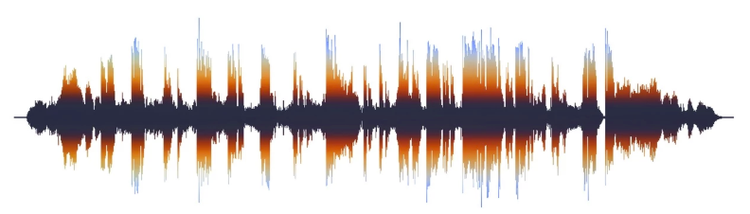
Music Genre and Semantics Classification
INTRO INTO DEEP LEARNING ECE 590
Duke University, Fall 2019
Bingying Echo Liu, MS in Interdisciplinary Data Science
Iuliia Oblasova, MS in Interdisciplinary Data Science
Zhuangdie Alan Zhou, MS in Interdisciplinary Data Science
Duke University

Slide 2
Introduction
Applications for music classification
Recommendation system (iTunes, Spotify);
Track separation and instrument recognition;
Music generation;
Automatic music transcription.

Slide 3
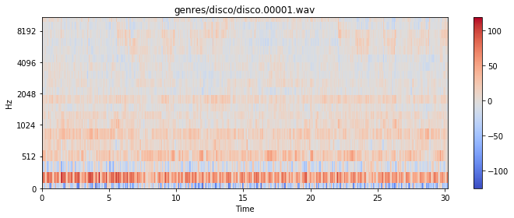
Approach
Dataset
Features
Models
Chromagram
Spectral centroid
P’th-order spectral bandwidth
Roll-off frequency
Zero-crossing rate
Mel-frequency cepstral coefficient (MFCC)*
SVM, Logistic Regression as a baseline
RNN (benefit from time-series nature of audio)
LSTM (eliminates the drawbacks of RNN such as gradient vanishing and gradient exploding and takes advantage of feedback connections
Parallel CNN and RNN (boosts the accuracy of predictions by taking the advantage of both image (mel spectrogram) and time-series information.
GTZAN
Try 5, 10, 15 seconds track lengths
Experiment with model architectures
*Visualization of MFCC feature

Slide 4
Literature review
The models achieving the highest accuracy of 77% are
Sequential CRNN and Parallel CNN and RNN.
Model | Motivation to use | Highest achieved accuracy in literature
SVM | Baseline model | 66.28%
Logistic regression | Baseline model | 59.91%
Vanilla LSTM | Prevent the vanishing gradient problem and use feedback connections | 65%
Sequential CRNN | Takes advantage of CNNs for local feature extraction and RNNs for temporal summarization of the extracted features. Only used 1000 sample data. Not enough training data. | 76%
Parallel CNN and RNN | Involves CNN layers for feature extraction on input data from both visual (mel spectrogram) and audio and combines it with GRU to support sequence prediction. | 77%

Slide 5
Data processing
GTZAN dataset
10 genres: blues, classical, country, disco, hiphop, jazz, metal, pop, reggae, rock
1000 songs: 100 songs for each genre (100*10)
Audio file format: 30 second for each audio file (.wav)

Slide 6
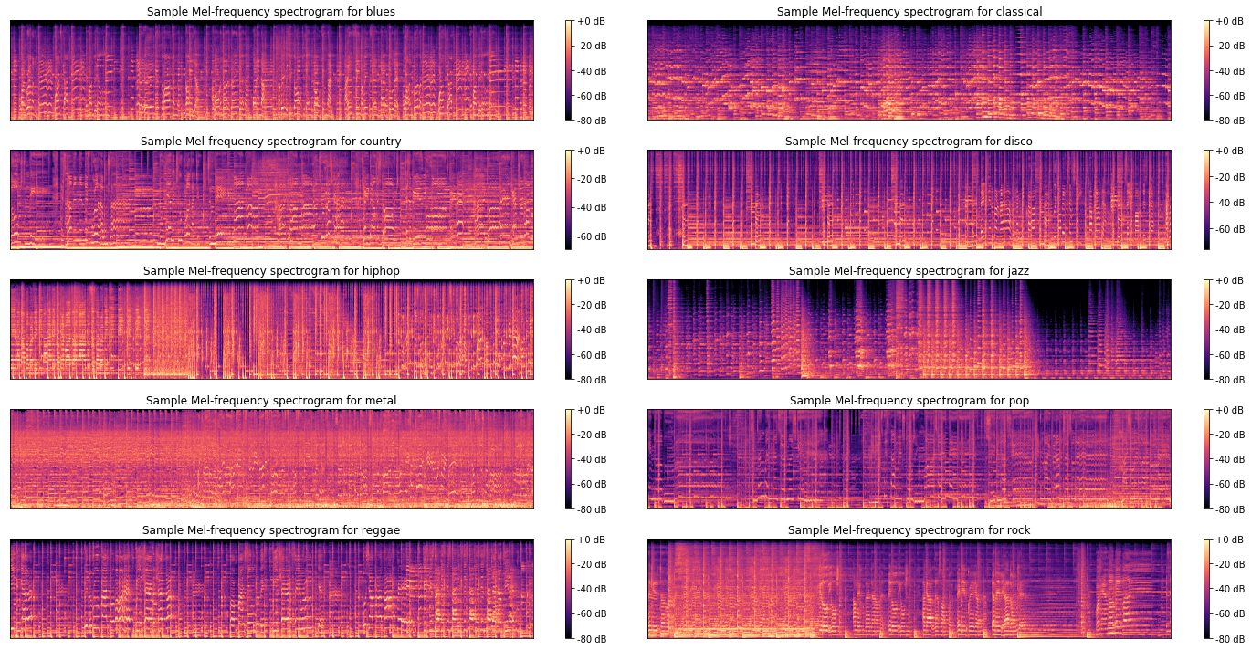
Data processing
Samples of MelSpectrograms

Slide 7
Data processing
Feature extraction
MelSpectrogram, Mel-frequency cepstral coefficients (MFCCs), Spectral Centroid, Chroma, Spectral Contrast, p’th-order spectral bandwidth, roll-off frequency, zero-crossing rate
Audio segmentation
Segmented the 30-second audio files by different lengths of cut points to obtain more input feature data
Excerpt
Excerpt audio by only 5-10 seconds. Intuition was that humans might tell the genre of a song by listening to a shorter length.

Slide 8
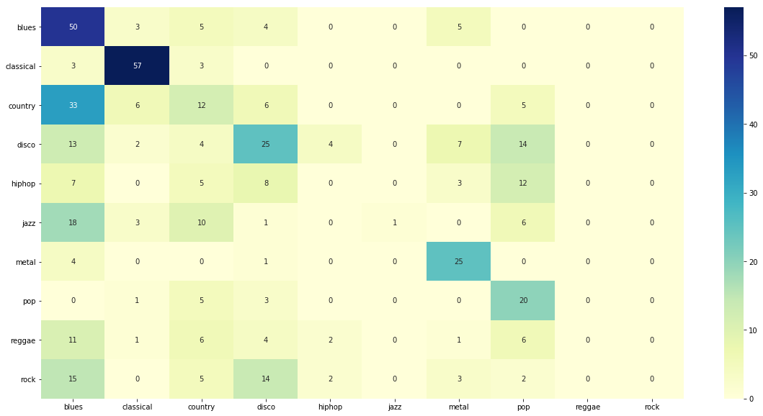
Methodology (SVM with a linear kernel)
Classification results for SVM model
1.Extract chromagram, spectral centroid, p’th-order spectral bandwidth, roll-off frequency, zero-crossing rate, and mel-frequency cepstral coefficients as the explanatory variable and music genre as a response variable from GTZAN data.
2.Split the data set on training (66%) and test (33%).
3.Standardize features and apply SVM with a linear kernel for classification.
From the confusion matrix above, we observe that classical, metal and blues genres are classified correctly with a high accuracy (84%, 64% and 45% respectively), whereas rock, reggae, and jazz are often misclassified.
The average accuracy of SVM model is 41% across all genres.

Slide 9
Methodology (Multilevel logistic regression)
Logistic Regression classification accuracy
*We used the same features for LR as for SVM model.
Genre | Precision | Recall | F-1 score | Support
blues | 0.24 | 0.28 | 0.26 | 36
classical | 0.5 | 0.91 | 0.65 | 22
country | 0.4 | 0.09 | 0.09 | 39
disco | 0.33 | 0.13 | 0.19 | 38
hiphop | 0.5 | 0.5 | 0.5 | 30
jazz | 0.56 | 0.45 | 0.5 | 40
metal | 0.48 | 0.9 | 0.63 | 31
pop | 0.33 | 0.75 | 0.46 | 28
reggae | 0.25 | 0.28 | 0.26 | 29
rock | 0.14 | 0.05 | 0.08 | 37
accuracy | 0.37 | 0.43 | 0.36 | 330
macro avg | 0.37 | 0.39 | 0.34 | 330
weighted avg | 0.05 | 0.08 | 0.08 | 330
Logistic regression performed slightly worse (by 5% on average) than SVM model.
Similarly to SVM, the model failed to classify reggae and rock music (26% and 8% respectively).

Slide 10
Methodology (Vanilla LSTM)
Vanilla LSTM Model Architecture
(dropout=0.5, recurrent_dropout=0.35, kernel_regularizer=regularizers.l2(0.01))
Performance
Epochs: 400
Training accuracy: 0.81
Test accuracy: 0.64
Evaluation
Pros: Take in the time series feature of audio files
Cons: Overfitting
Input Layer 1 | 20 MFCC features, 1 Spectral Center features, 12 Chroma features, 7 Spectral Contrast features from 30 secs audios as input data (normalized)
Hidden Layer 1 | 128 neurons
Hidden Layer 2 | 64 neurons
Output Layer | 10 outputs corresponding to 10 different music genres

Slide 11
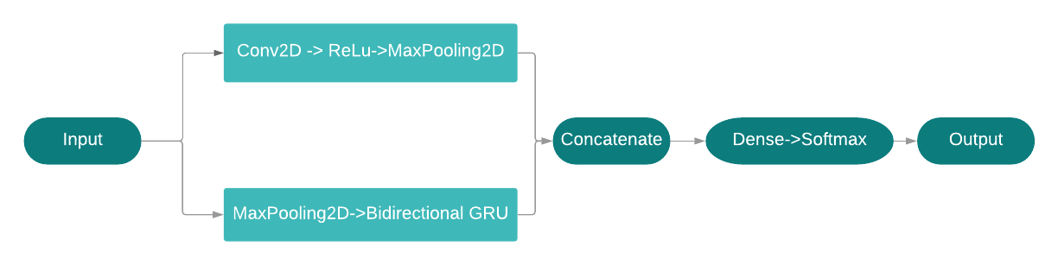
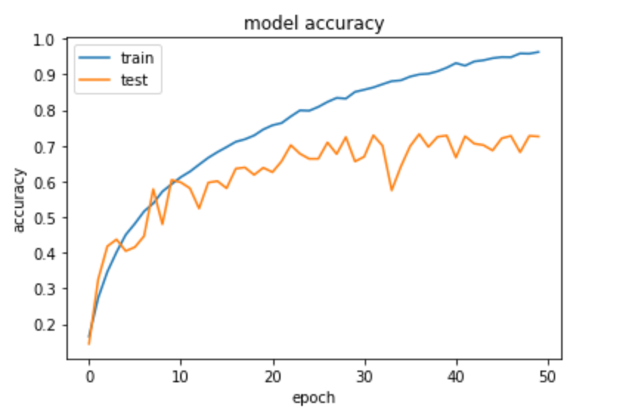
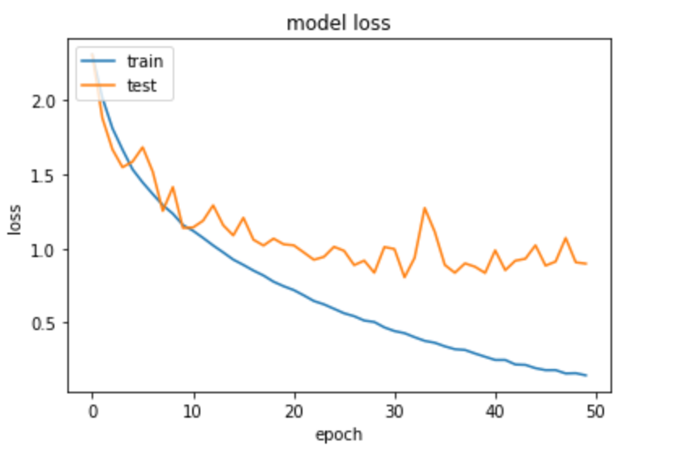
Methodology (Parallel CNN and RNN)
Model Architecture
Input layer: mel-spectrogram of audio of length 29.5 and 4.5 secs
Model: Pass input layer into CNN and RNN in parallel, concatenate their outputs and pass it through a dense layer with softmax activation
Pros: Preserve both image and time series signals
Loss and Accuracy
29.5 secs audio with 1000 sample data: 54.5%
4.5 secs audio with 6000 sample data: 72.5%
Test curve for model accuracy becomes flat after 20 epochs and still has relatively high variance, which means there exists overfitting problem
Figure 1: Architecture of Parallel CNN and RNN
Figure 2: Model accuracy and loss using 4.5 secs audio with 6000 sample audio

Slide 12
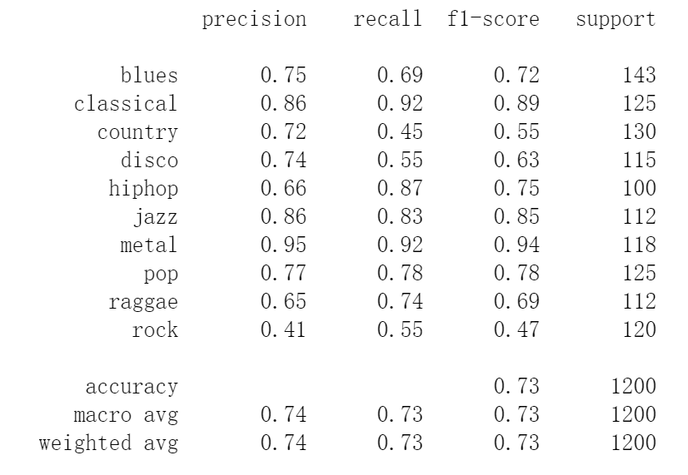
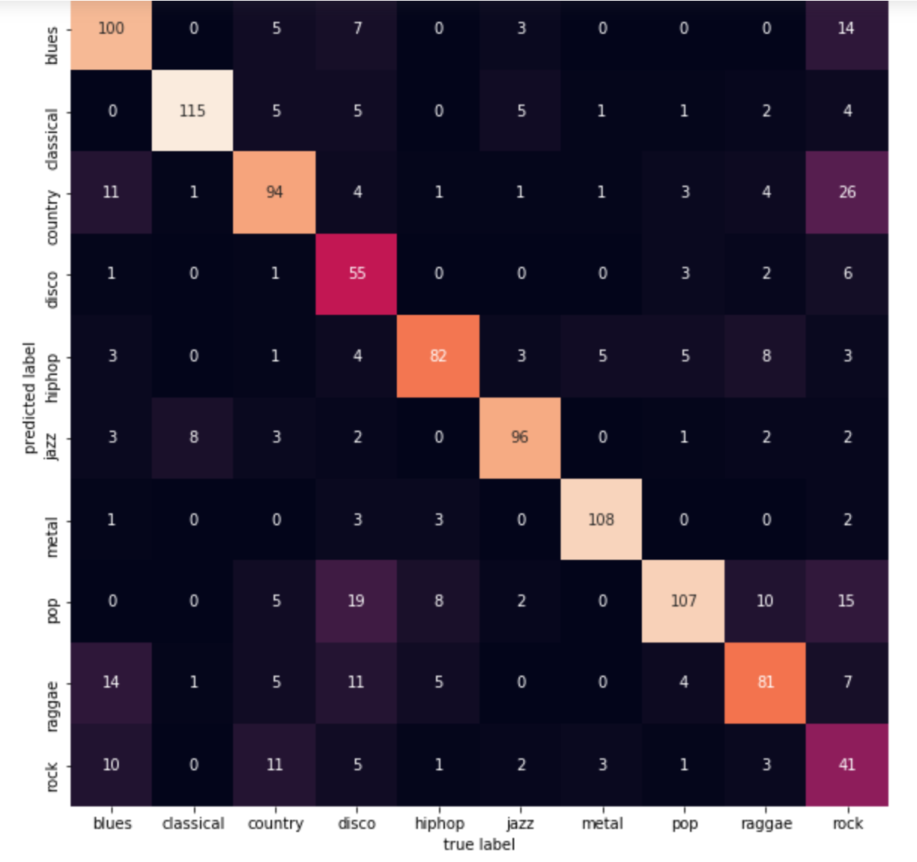
Methodology (Parallel CNN and RNN)
3. Precision, Recall and F1-score for each genre
Model classifies metal, classical and jazz well but rock and disco relatively worse
4. Confusion matrix for error observation
Rock is often mislabeled as blues or country and it can sometimes be categorized into other common genres as well. It’s because rock has many subgenres that are essentially mixtures of all other genres, such as country rock, blues rock, etc.
Hard-classifying music into one genre is not the optimal way, and one of the future improvements is to get multiple labels for one music and perform soft classification.
Figure 4: Precision, recall and f1-score for each genre
Figure 5: Confusion matrix

Slide 13
Experimental results
Parallel CNN and RNN model outperforms all other models for most of the genres except reggae and rock for which Vanilla LSTM model performed the best.
Music Genre Classification
Genre | Blues | Classical | Country | Disco | Hiphop | Jazz | Metal | Pop | Reggae | Rock
Logistic regression | 0.26 | 0.65 | 0.09 | 0.19 | 0.5 | 0.5 | 0.63 | 0.46 | 0.26 | 0.08
SVM | 0.23 | 0.65 | 0.22 | 0.17 | 0.56 | 0.5 | 0.57 | 0.36 | 0.22 | 0.3
Vanilla LSTM | 0.36 | 0.82 | 0.47 | 0.58 | 0.55 | 0.75 | 0.45 | 0.72 | 0.94 | 0.86
Parallel CNN and RNN | 0.72 | 0.89 | 0.55 | 0.63 | 0.75 | 0.85 | 0.92 | 0.78 | 0.74 | 0.55

Slide 14
Suggestions for future work
Soft classification
Misclassifications indicate that it might not be most appropriate to assign only one label to one song. Soft classification would be more reasonable in some cases. And that is what could be explored next.
Dataset fixing
GTZAN we used has its natural faults including repetitions, mislabelings, and distortions. There is research showing that there are misclassifications in the GTZAN dataset, which will definitely have a negative impact on genre classification.
Normalization
Features extracted from a single audio file has different scales, which results in biased weights when we stack features together. Therefore, recurrent batch normalization might be a feasible way to deal with this problem.
Pre-trained CNN
Instead of using a CNN from scratch we could try using pre-trained models like VGG or Inception when conducting parallel CNN and RNN.

Slide 15
References
[1] Long short-term memory. Wikipedia.
[2] Music information retrieval. Wikipedia.
[3] Bozena Kostek Aldona Rosner. Automatic music genre classification based on musical instrument track separation. SpringerLink, 2017.
[4] Librosa development team. Librosa package documentation: feature extraction.
[5] Priyanka Dwivedi. Deep learning for music recognition. 2018.
[6] Nadav Hollander Jeremy Irvin, Elliott Chartock. Recurrent neural networks with attention for genre classification. SemanticScholar, 2016.
[7] Armando Stellato Roberto Basili, Alfredo Serafini. Classification of musical genre: a machine learning approach. ResearchGate, 2013.
[8] Rongbin Li Scott Zhang, Huaping Gu. Music genre classification: near-real time vs sequential approach. 2019.
[9] Francesco Barbieri Sergio Oramas. Multimodal deep learning for music genre classification. TISMIR, 2018.
[10] Gonzalo R. Arce Yannis Panagakis, Constantine Kotropoulos. Music genre classification via sparse representations of auditory temporal modulations. IEEE, 2009

