Slide 1
In-situ OAM (IOAM)
IPPM
July 18th 2018

Slide 2
Change set
draft-ietf-ippm-ioam-data – Security consideration, Layering
Encapsulation:
VXLAN GPE: draft-brockners-ippm-ioam-vxlan-gpe
GENEVE: draft-brockners-ippm-ioam-geneve
GRE: draft-weis-ippm-ioam-gre
IPv6: draft-ioametal-ippm-6man-ioam-ipv6-options (New)
Export
draft-spiegel-ippm-ioam-rawexport
FYI: SFC wg adoption
NSH encapsulation - draft-ietf-sfc-ioam-nsh
Proof of transit - draft-ietf-sfc-proof-of-transit

Slide 3
Changes to draft-ietf-ippm-ioam-data
Layering:
If several encapsulation protocols (e.g., in case of tunneling) are stacked on top of each other, IOAM data-records could be present at every layer. The behavior follows the ships-in-the- night model, i.e. IOAM data in one layer is independent from IOAM data in another layer. Layering allows operators to instrument the protocol layer they want to measure. The different layers could, but do not have to share the same IOAM encapsulation and decapsulation.
Encapsulation drafts include RFC7605 based considerations: Ensure that transit devices don’t change IOAM data in environments where UDP port numbers aren’t controlled.
Security Considerations
Details on next slide

Slide 4
Security Considerations
Successful attack on IOAM may allow:
Compromise detection of failures / anomalies:
False positive
False negative
Reconnaissance
DoS:
Resource consumption
Packet length
Management plane attacks
Proof of transit (PoT) can be used for path verification

Slide 5
IOAM Encapsulation

Slide 6
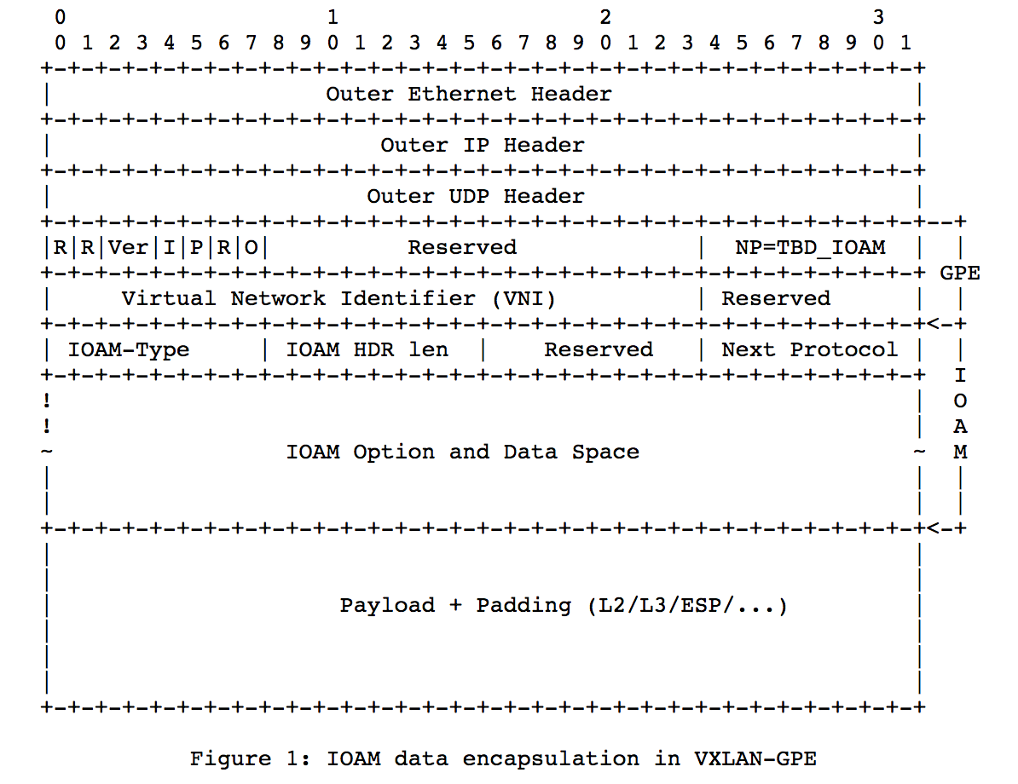
IOAM in VXLAN-GPE draft-brockners-ippm-ioam-vxlan-gpe
VXLAN GPE header
IOAM options

Slide 7
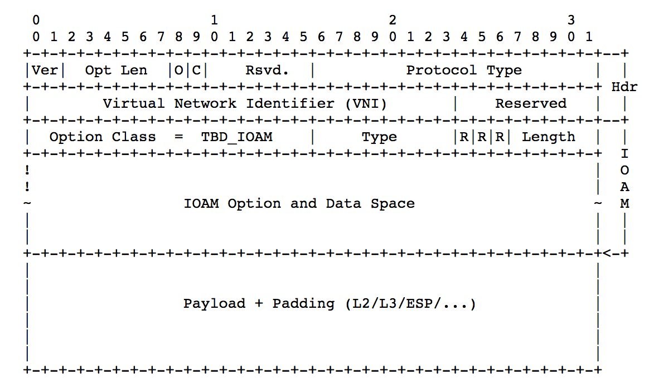
IOAM in Geneve draft-brockners-ippm-ioam-geneve
Geneve header
Geneve option class = IOAM,
Type as defined in:
draft-ietf-ippm-ioam-data

Slide 8
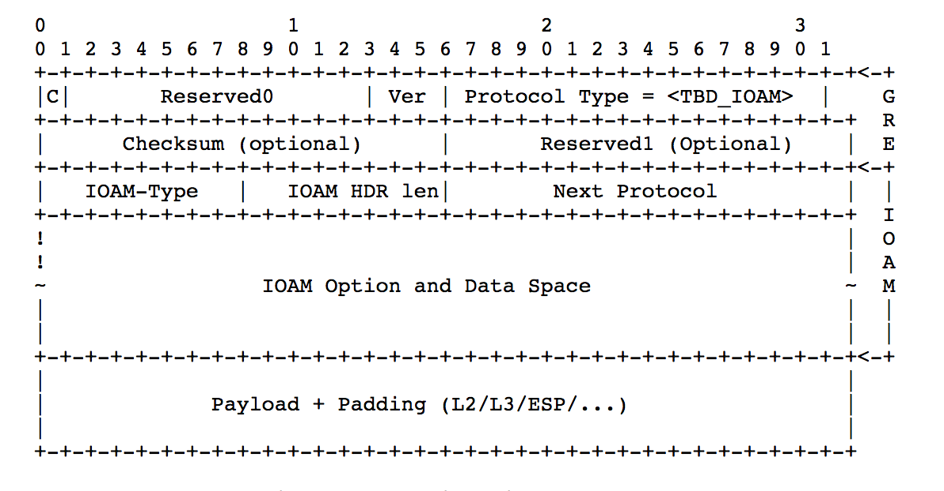
IOAM in GRE draft-weis-ippm-ioam-gre

Slide 9
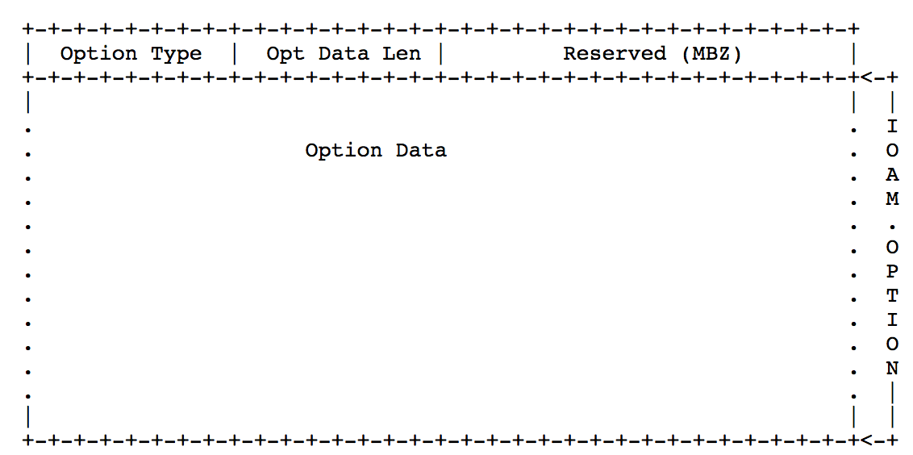
IOAM in IPv6 draft-ioametal-ippm-6man-ioam-ipv6-options
IPv6 Hop-by-Hop options
Pre-allocated Tracing Option
Incremental Tracing Option
Proof of Transit Option
IPv6 Destination Option
Edge to Edge Option

Slide 10
IOAM Raw Data Export with IPFIX
draft-spiegel-ippm-ioam-rawexport-00

Slide 11
Raw Export of IOAM Data
A mode of operation where a node exports the IOAM data as it is received in the packet
The exporting node neither interprets, aggregates nor reformats the IOAM data before it is exported
Off-load from the node which performs data plane operations
Implementable at billions of packets per second
Monitoring / Analytics System
Processed / interpreted /
aggregated IOAM data
IOAM Data Processing System
Raw export of
IOAM data
IOAM Node
Data packets

Slide 12
Using IPFIX for Raw Export of IOAM
IPFIX is defined as a generic export protocol that can export any Information Element(s) as long as they are described in the information model
IPFIX protocol is well suited for and is defined as the protocol for exporting packet samples in [RFC5476]
IPFIX/PSAMP already define many of the information elements needed for exporting raw sections of packets, needed for deriving context
Many network devices may be quite constrained in the IPFIX formats that they can support for IOAM export at high speeds
Small number of information elements supported
Alignment along 4 octet boundaries
Alignment constraint varies depending on the encoding used for packet snippets:
Fixed length : 4n
Variable length < 255 : 4n + 3
Variable length < 65536 : 4n + 1
Possibly a limited number of fixed templates

Slide 13
Key IPFIX IEs Leveraged for IOAM Raw Data Export
313 | ipHeaderPacketSection | octetArray | default | This Information Element carries a series of n octets from the IP header of a sampled packet … With sufficient length, this element also reports octets from the IP payload. …
315 | dataLinkFrameSection | octetArray | default | This Information Element carries n octets from the data link frame of a selected frame … Further Information Elements, i.e., dataLinkFrameType and dataLinkFrameSize, are needed to specify the data link type and the size of the data link frame of this Information Element. …
408 | dataLinkFrameType | unsigned16 | flags | This Information Element specifies the type of the selected data link frame. The following data link types are defined here: - 0x01 IEEE802.3 ETHERNET [IEEE802.3] - 0x02 IEEE802.11 MAC Frame format [IEEE802.11]
410 | sectionExportedOctets | unsigned16 | quantity | This Information Element specifies the observed length of the packet section … when padding is used. …
89 | forwardingStatus | unsigned8 | identifier | This Information Element describes the forwarding status of the flow and any attached reasons. …

Slide 14
Proposed new IPFIX Information Elements
ioamReportFlags | unsigned8 | flags | This IE describes properties associated with an IOAM report. bit description ---+-------------------------------------------- 0 Dropped Assn – Dropped packet of interest 1 Congested Queue Association – Indicates the presence of congestion on a monitored queue 2 Tracked Flow Association – Matched a flow of interest
ioamEncapsulationType | unsigned8 | identifier | 0 None: [I-D.ietf-ippm-ioam-data] GRE: [I-D.weis-ippm-ioam-gre] VXLAN-GPE: [I-D.brockners-ippm-ioam-vxlan-gpe] GENEVE: [I-D.brockners-ippm-ioam-geneve] NSH: [I-D.brockners-sfc-ioam-nsh]
ioamPreallocatedTraceData | octetArray | default | This IE carries n octets of IOAM Preallocated Trace data. *
ioamIncrementalTraceData | octetArray | default | This IE carries n octets of IOAM Incremental Trace data. *
ioamE2EData | octetArray | default | This IE carries n octets of IOAM E2E data. *
ioamPOTData | octetArray | default | This IE carries n octets of IOAM POT data. *
When ioamEncapsulationType is present and has a value other than "None”, and with sufficient length, this element may also report octets from subsequent headers and payload

Slide 15
Example: Variable Length < 255 IP Packet
0 1 2 3
0 1 2 3 4 5 6 7 8 9 0 1 2 3 4 5 6 7 8 9 0 1 2 3 4 5 6 7 8 9 0 1
+-+-+-+-+-+-+-+-+-+-+-+-+-+-+-+-+-+-+-+-+-+-+-+-+-+-+-+-+-+-+-+-+ ---+------
| Version Number | Length | |
+-+-+-+-+-+-+-+-+-+-+-+-+-+-+-+-+-+-+-+-+-+-+-+-+-+-+-+-+-+-+-+-+ |
| Export Time (seconds) | IPFIX
+-+-+-+-+-+-+-+-+-+-+-+-+-+-+-+-+-+-+-+-+-+-+-+-+-+-+-+-+-+-+-+-+ Message
| Sequence Number | Header
+-+-+-+-+-+-+-+-+-+-+-+-+-+-+-+-+-+-+-+-+-+-+-+-+-+-+-+-+-+-+-+-+ |
| Observation Domain ID | |
+-+-+-+-+-+-+-+-+-+-+-+-+-+-+-+-+-+-+-+-+-+-+-+-+-+-+-+-+-+-+-+-+ ---+------
| Set ID ( = Template ID) | Length | Set Header
+-+-+-+-+-+-+-+-+-+-+-+-+-+-+-+-+-+-+-+-+-+-+-+-+-+-+-+-+-+-+-+-+ ---+------
|ioamReportFlags| fwdingStatus | paddingOctets | Length (< 255)| |
+-+-+-+-+-+-+-+-+-+-+-+-+-+-+-+-+-+-+-+-+-+-+-+-+-+-+-+-+-+-+-+-+ |
| ipHeaderPacketSection (start) | |
+-+-+-+-+-+-+-+-+-+-+-+-+-+-+-+-+-+-+-+-+-+-+-+-+-+-+-+-+-+-+-+-+ Record 1 | ... | |
+-+-+-+-+-+-+-+-+-+-+-+-+-+-+-+-+-+-+-+-+-+-+-+-+-+-+-+-+-+-+-+-+ |
| ipHeaderPacketSection (end) | |
+-+-+-+-+-+-+-+-+-+-+-+-+-+-+-+-+-+-+-+-+-+-+-+-+-+-+-+-+-+-+-+-+ ---+------
|ioamReportFlags| fwdingStatus | paddingOctets | Length (< 255)| |
+-+-+-+-+-+-+-+-+-+-+-+-+-+-+-+-+-+-+-+-+-+-+-+-+-+-+-+-+-+-+-+-+ |
| ipHeaderPacketSection (start) | |
+-+-+-+-+-+-+-+-+-+-+-+-+-+-+-+-+-+-+-+-+-+-+-+-+-+-+-+-+-+-+-+-+ Record 2 | ... | |
+-+-+-+-+-+-+-+-+-+-+-+-+-+-+-+-+-+-+-+-+-+-+-+-+-+-+-+-+-+-+-+-+ |
| ipHeaderPacketSection (end) | |
+-+-+-+-+-+-+-+-+-+-+-+-+-+-+-+-+-+-+-+-+-+-+-+-+-+-+-+-+-+-+-+-+ ---+------
IOAM data is part of ipHeaderPacketSection

Slide 16
Example: Variable Length IP Packet w/ Outer Incremental Trace
0 1 2 3
0 1 2 3 4 5 6 7 8 9 0 1 2 3 4 5 6 7 8 9 0 1 2 3 4 5 6 7 8 9 0 1
+-+-+-+-+-+-+-+-+-+-+-+-+-+-+-+-+-+-+-+-+-+-+-+-+-+-+-+-+-+-+-+-+ ---+------
| Version Number | Length | |
+-+-+-+-+-+-+-+-+-+-+-+-+-+-+-+-+-+-+-+-+-+-+-+-+-+-+-+-+-+-+-+-+ |
| Export Time (seconds) | IPFIX
+-+-+-+-+-+-+-+-+-+-+-+-+-+-+-+-+-+-+-+-+-+-+-+-+-+-+-+-+-+-+-+-+ Message
| Sequence Number | Header
+-+-+-+-+-+-+-+-+-+-+-+-+-+-+-+-+-+-+-+-+-+-+-+-+-+-+-+-+-+-+-+-+ |
| Observation Domain ID | |
+-+-+-+-+-+-+-+-+-+-+-+-+-+-+-+-+-+-+-+-+-+-+-+-+-+-+-+-+-+-+-+-+ ---+------
| Set ID ( = Template ID) | Length | Set Header
+-+-+-+-+-+-+-+-+-+-+-+-+-+-+-+-+-+-+-+-+-+-+-+-+-+-+-+-+-+-+-+-+ ---+------
| ioamIncrementalTraceHeader (start) | |
+-+-+-+-+-+-+-+-+-+-+-+-+-+-+-+-+-+-+-+-+-+-+-+-+-+-+-+-+-+-+-+-+ |
| ... | |
+-+-+-+-+-+-+-+-+-+-+-+-+-+-+-+-+-+-+-+-+-+-+-+-+-+-+-+-+-+-+-+-+ |
| ioamIncrementalTraceHeader (end) | |
+-+-+-+-+-+-+-+-+-+-+-+-+-+-+-+-+-+-+-+-+-+-+-+-+-+-+-+-+-+-+-+-+ Record 1
|ioamReportFlags| fwdingStatus | paddingOctets | Length (< 255)| |
+-+-+-+-+-+-+-+-+-+-+-+-+-+-+-+-+-+-+-+-+-+-+-+-+-+-+-+-+-+-+-+-+ |
| ipHeaderPacketSection (start) | |
+-+-+-+-+-+-+-+-+-+-+-+-+-+-+-+-+-+-+-+-+-+-+-+-+-+-+-+-+-+-+-+-+ |
| ... | |
+-+-+-+-+-+-+-+-+-+-+-+-+-+-+-+-+-+-+-+-+-+-+-+-+-+-+-+-+-+-+-+-+ |
| ipHeaderPacketSection (end) | |
+-+-+-+-+-+-+-+-+-+-+-+-+-+-+-+-+-+-+-+-+-+-+-+-+-+-+-+-+-+-+-+-+ ---+------

Slide 17
Next Steps

Slide 18
Next Steps
draft-ietf-ippm-ioam-data – Has been stable. WGLC?
Encapsulation drafts adoption in IPPM:
VXLAN GPE: draft-brockners-ippm-ioam-vxlan-gpe
GENEVE: draft-brockners-ippm-ioam-geneve
GRE: draft-weis-ippm-ioam-gre
Export draft review
IPv6 draft review

Slide 19
Thank you

Slide 20
Backup Slides

Slide 21
Abstract and Requirements
Abstract:
This document discusses how In-situ Operations, Administration, and Maintenance (IOAM) information can be exported in raw, i.e. uninterpreted, format from network devices to systems, such as monitoring or analytics systems using IPFIX
Requirements
Export all IOAM information contained in a packet
Export a specific IOAM data type - Incremental Trace type, Preallocated Trace type, Proof of Transit type, Edge to Edge type
Support coalescing of the IOAM data from multiple packets into a single raw export packet.
Support export of additional parts of the packet, other than the IOAM data as part of the raw export. This could be parts of the packet header and/or parts of the packet payload. This additional information provides context to the IOAM data (e.g. to be used for flow identification) and is to enable the IOAM data processing system to perform further analysis on the received data.
Report the reason why IOAM data was exported. The "reason for export" is to complement the IOAM data retrieved from the packet. For example, if a packet was dropped by a node due to congestion, it could be helpful to export the IOAM data of this dropped packet along with an indication that the packet that the IOAM data belongs to was dropped due to congestion.

Slide 22
Scope
This document discusses raw export of IOAM data using IPFIX
Considered out of scope for this document:
Protocols other than IPFIX for raw export of IOAM data
Interpretation or aggregation of IOAM data prior to exporting
Configuration of network devices so that they can determine when to generate IOAM reports, and what information to include in those reports
Events that trigger generation of IOAM reports
Selection of particular destinations within distributed telemetry monitoring sy
Export format for flow statistics or processed/interpreted/aggregated IOAM datastems, to which IOAM reports will be sent

Slide 23
Example: Fixed Length IP Packet
0 1 2 3
0 1 2 3 4 5 6 7 8 9 0 1 2 3 4 5 6 7 8 9 0 1 2 3 4 5 6 7 8 9 0 1
+-+-+-+-+-+-+-+-+-+-+-+-+-+-+-+-+-+-+-+-+-+-+-+-+-+-+-+-+-+-+-+-+ ---+------
| Version Number | Length | |
+-+-+-+-+-+-+-+-+-+-+-+-+-+-+-+-+-+-+-+-+-+-+-+-+-+-+-+-+-+-+-+-+ |
| Export Time (seconds) | IPFIX
+-+-+-+-+-+-+-+-+-+-+-+-+-+-+-+-+-+-+-+-+-+-+-+-+-+-+-+-+-+-+-+-+ Message
| Sequence Number | Header
+-+-+-+-+-+-+-+-+-+-+-+-+-+-+-+-+-+-+-+-+-+-+-+-+-+-+-+-+-+-+-+-+ |
| Observation Domain ID | |
+-+-+-+-+-+-+-+-+-+-+-+-+-+-+-+-+-+-+-+-+-+-+-+-+-+-+-+-+-+-+-+-+ ---+------
| Set ID ( = Template ID) | Length | Set Header
+-+-+-+-+-+-+-+-+-+-+-+-+-+-+-+-+-+-+-+-+-+-+-+-+-+-+-+-+-+-+-+-+ ---+------
|ioamReportFlags| fwdingStatus | sectionExportedOctets | |
+-+-+-+-+-+-+-+-+-+-+-+-+-+-+-+-+-+-+-+-+-+-+-+-+-+-+-+-+-+-+-+-+ |
| ipHeaderPacketSection (start) | |
+-+-+-+-+-+-+-+-+-+-+-+-+-+-+-+-+-+-+-+-+-+-+-+-+-+-+-+-+-+-+-+-+ Record 1 | ... | |
+-+-+-+-+-+-+-+-+-+-+-+-+-+-+-+-+-+-+-+-+-+-+-+-+-+-+-+-+-+-+-+-+ |
| ipHeaderPacketSection (end) | |
+-+-+-+-+-+-+-+-+-+-+-+-+-+-+-+-+-+-+-+-+-+-+-+-+-+-+-+-+-+-+-+-+ ---+------
|ioamReportFlags| fwdingStatus | sectionExportedOctets | |
+-+-+-+-+-+-+-+-+-+-+-+-+-+-+-+-+-+-+-+-+-+-+-+-+-+-+-+-+-+-+-+-+ |
| ipHeaderPacketSection (start) | |
+-+-+-+-+-+-+-+-+-+-+-+-+-+-+-+-+-+-+-+-+-+-+-+-+-+-+-+-+-+-+-+-+ Record 2 | ... | |
+-+-+-+-+-+-+-+-+-+-+-+-+-+-+-+-+-+-+-+-+-+-+-+-+-+-+-+-+-+-+-+-+ |
| ipHeaderPacketSection (end) | |
+-+-+-+-+-+-+-+-+-+-+-+-+-+-+-+-+-+-+-+-+-+-+-+-+-+-+-+-+-+-+-+-+ ---+------
IOAM data is part of ipHeaderPacketSection

Slide 24
Example: Variable Length < 255 Ethernet Packet
0 1 2 3
0 1 2 3 4 5 6 7 8 9 0 1 2 3 4 5 6 7 8 9 0 1 2 3 4 5 6 7 8 9 0 1
+-+-+-+-+-+-+-+-+-+-+-+-+-+-+-+-+-+-+-+-+-+-+-+-+-+-+-+-+-+-+-+-+ ---+------
| Version Number | Length | |
+-+-+-+-+-+-+-+-+-+-+-+-+-+-+-+-+-+-+-+-+-+-+-+-+-+-+-+-+-+-+-+-+ |
| Export Time (seconds) | IPFIX
+-+-+-+-+-+-+-+-+-+-+-+-+-+-+-+-+-+-+-+-+-+-+-+-+-+-+-+-+-+-+-+-+ Message
| Sequence Number | Header
+-+-+-+-+-+-+-+-+-+-+-+-+-+-+-+-+-+-+-+-+-+-+-+-+-+-+-+-+-+-+-+-+ |
| Observation Domain ID | |
+-+-+-+-+-+-+-+-+-+-+-+-+-+-+-+-+-+-+-+-+-+-+-+-+-+-+-+-+-+-+-+-+ ---+------
| Set ID ( = Template ID) | Length | Set Header
+-+-+-+-+-+-+-+-+-+-+-+-+-+-+-+-+-+-+-+-+-+-+-+-+-+-+-+-+-+-+-+-+ ---+------
|ioamReportFlags| fwdingStatus | dataLinkFrameType = 0x01 | |
+-+-+-+-+-+-+-+-+-+-+-+-+-+-+-+-+-+-+-+-+-+-+-+-+-+-+-+-+-+-+-+-+ |
| dataLinkFrameSize | paddingOctets | Length (< 255)| |
+-+-+-+-+-+-+-+-+-+-+-+-+-+-+-+-+-+-+-+-+-+-+-+-+-+-+-+-+-+-+-+-+ |
| dataLinkFrameSection (start) | Record 1
+-+-+-+-+-+-+-+-+-+-+-+-+-+-+-+-+-+-+-+-+-+-+-+-+-+-+-+-+-+-+-+-+ |
| ... | |
+-+-+-+-+-+-+-+-+-+-+-+-+-+-+-+-+-+-+-+-+-+-+-+-+-+-+-+-+-+-+-+-+ |
| dataLinkFrameSection (end) | |
+-+-+-+-+-+-+-+-+-+-+-+-+-+-+-+-+-+-+-+-+-+-+-+-+-+-+-+-+-+-+-+-+ ---+------

