Slide 1
In-situ OAM (IOAM)
IPPM
July 18th 2018

Slide 2
Change set
draft-ietf-ippm-ioam-data – Security consideration, Layering
Encapsulation:
VXLAN GPE: draft-brockners-ippm-ioam-vxlan-gpe
GENEVE: draft-brockners-ippm-ioam-geneve
GRE: draft-weis-ippm-ioam-gre
IPv6: draft-ioametal-ippm-6man-ioam-ipv6-options (New)
Export
draft-spiegel-ippm-ioam-rawexport
FYI: SFC wg adoption
NSH encapsulation - draft-ietf-sfc-ioam-nsh
Proof of transit - draft-ietf-sfc-proof-of-transit

Slide 3
Changes to draft-ietf-ippm-ioam-data
Layering:
If several encapsulation protocols (e.g., in case of tunneling) are stacked on top of each other, IOAM data-records could be present at every layer. The behavior follows the ships-in-the- night model, i.e. IOAM data in one layer is independent from IOAM data in another layer. Layering allows operators to instrument the protocol layer they want to measure. The different layers could, but do not have to share the same IOAM encapsulation and decapsulation.
Encapsulation drafts include RFC7605 based considerations: Ensure that transit devices don’t change IOAM data in environments where UDP port numbers aren’t controlled.
Security Considerations
Details on next slide

Slide 4
Security Considerations
Successful attack on IOAM may allow:
Compromise detection of failures / anomalies:
False positive
False negative
Reconnaissance
DoS:
Resource consumption
Packet length
Management plane attacks
Proof of transit (PoT) can be used for path verification

Slide 5
For Discussion: On the need for a Namespace Identifier
“IOAM is a network domain focused feature, with "network domain" being a set of network devices or entities within a single administration.” (see draft-ietf-ippm-ioam-data-03, section 3)
IOAM data fields are defined in their own namespace. Data fields can have a domain specific interpretation, e.g. node id, interface id, queue depth (measured in memory buffers), app-data, opaque state snapshot.
A deployment could require several different interpretations of the data fields (i.e. namespaces), consider e.g. layered IOAM deployment
IOAM currently does not offer to carry an identifier for the namespace (to identify the interpretation context/domain) in the packet.

Slide 6
Namespace-ID proposal
Extend base header by 4-bytes, adding namespace specific information
Flag (Namespace bit) to identify whether the namespace ID is populated
Pre-Allocated trace option header:
0 1 2 3
0 1 2 3 4 5 6 7 8 9 0 1 2 3 4 5 6 7 8 9 0 1 2 3 4 5 6 7 8 9 0 1
+-+-+-+-+-+-+-+-+-+-+-+-+-+-+-+-+-+-+-+-+-+-+-+-+-+-+-+-+-+-+-+-+
| IOAM-Trace-Type | NodeLen | Flags |RemainingLen |
+-+-+-+-+-+-+-+-+-+-+-+-+-+-+-+-+-+-+-+-+-+-+-+-+-+-+-+-+-+-+-+-+
| Namespace ID | Namespace Specific data |
+-+-+-+-+-+-+-+-+-+-+-+-+-+-+-+-+-+-+-+-+-+-+-+-+-+-+-+-+-+-+-+-+
Incremental trace option header:
0 1 2 3
0 1 2 3 4 5 6 7 8 9 0 1 2 3 4 5 6 7 8 9 0 1 2 3 4 5 6 7 8 9 0 1
+-+-+-+-+-+-+-+-+-+-+-+-+-+-+-+-+-+-+-+-+-+-+-+-+-+-+-+-+-+-+-+-+
| IOAM-Trace-Type | NodeLen | Flags | Max Length |
+-+-+-+-+-+-+-+-+-+-+-+-+-+-+-+-+-+-+-+-+-+-+-+-+-+-+-+-+-+-+-+-+
| Namespace ID | Namespace Specific data |
+-+-+-+-+-+-+-+-+-+-+-+-+-+-+-+-+-+-+-+-+-+-+-+-+-+-+-+-+-+-+-+-+
Flags 4-bit field. New flag bit to extend the header for namespace specific data.
Bit 0 “Overflow (O-bit) (most significant bit).
Bit 1 “Loopback” (L-bit).
Bit 2 Namespace-ID (N-bit). Namespace-ID bit is used to indicate that the 4-octet of a namespace identifier and data is populated.
Bit 3 Reserved: Must be zero

Slide 7
Leveraging Namespace-ID for added flexibility
IOAM trace options fields in draft-ietf-ippm-ioam-data represent the main set of industry use-cases, but not all
Several cases have been made for specific enhancements, though they haven’t found wider consensus so far. Examples:
draft-kumar-ifa-00: Indicate per-node which data fields are filled/supported (which let IFA to define new fields rather than reuse IOAM data fields)
draft-song-ippm-ioam-scalability-00: Additional trace types for specific use-cases (e.g. record inter-packet gap, etc.)
Current approach to domain specific data fields and data interpretation is to use either “app-data” (short/wide) or “opaque state snapshot”
App-data is fixed free format, syntax/semantic is undefined
Opaque state snapshot is length/schema-id free format, syntax/semantic is undefined
Namespace concept allows to specify how fields like app-data, opaque-state snapshot are interpreted: Examples:
For draft-kumar-ifa-00: Interpret app-data as a bit-field to express which fields a node updated
For draft-song-ippm-ioam-scalability-00: Interpret app-data / opaque-state snapshot as per the newly identified use-cases
Consider renaming “app-data” field to “namespace-specific-data”.

Slide 8
IOAM Encapsulation

Slide 9
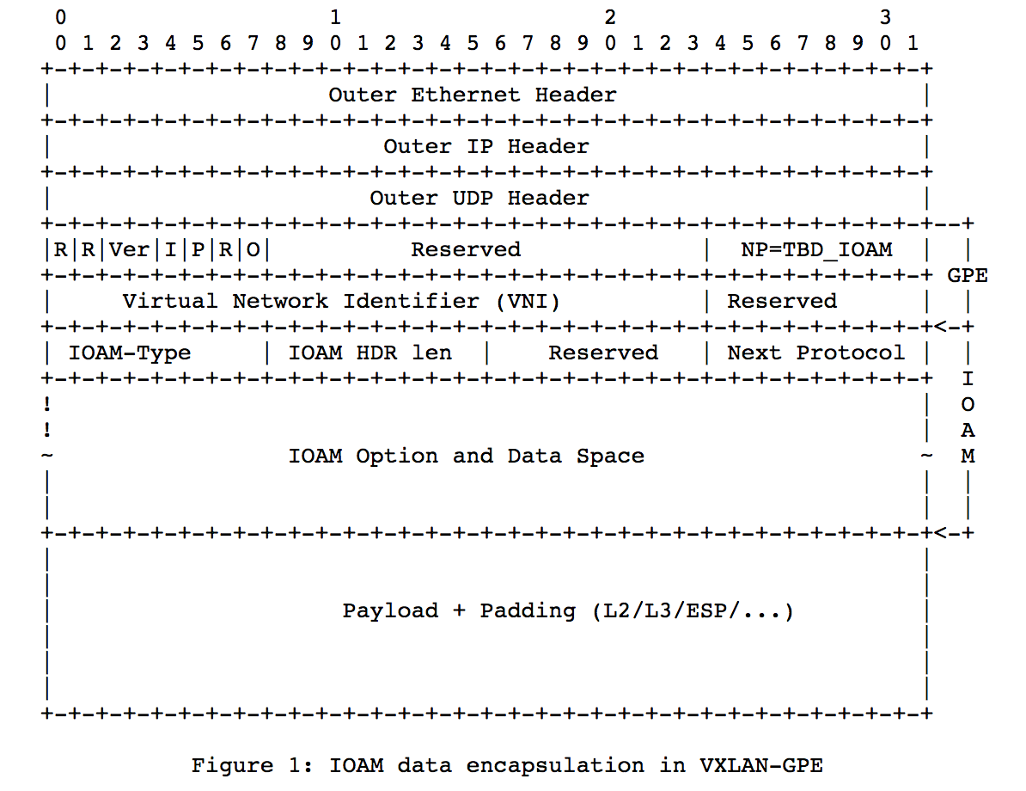
IOAM in VXLAN-GPE draft-brockners-ippm-ioam-vxlan-gpe
VXLAN GPE header
IOAM options

Slide 10
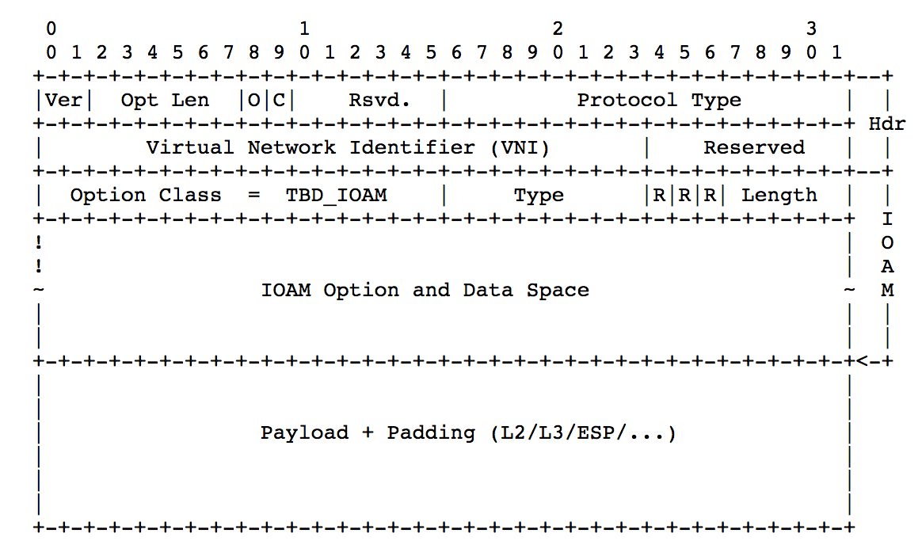
IOAM in Geneve draft-brockners-ippm-ioam-geneve
Geneve header
Geneve option class = IOAM,
Type as defined in:
draft-ietf-ippm-ioam-data

Slide 11
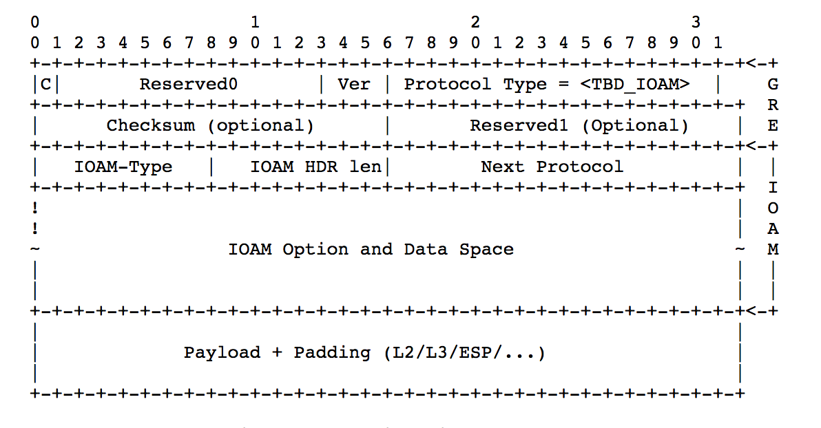
IOAM in GRE draft-weis-ippm-ioam-gre

Slide 12
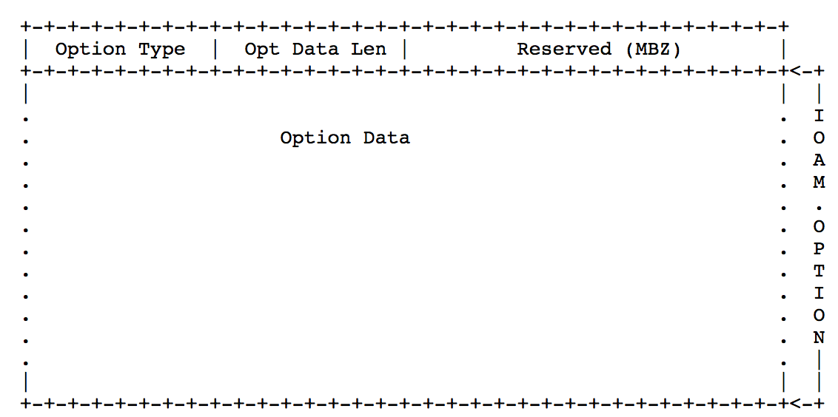
IOAM in IPv6 draft-ioametal-ippm-6man-ioam-ipv6-options
IPv6 Hop-by-Hop options
Pre-allocated Tracing Option
Incremental Tracing Option
Proof of Transit Option
IPv6 Destination Option
Edge to Edge Option

Slide 13
IOAM Raw Data Export with IPFIX
draft-spiegel-ippm-ioam-rawexport-00

Slide 14
Raw Export of IOAM Data
A mode of operation where a node exports the IOAM data as it is received in the packet
The exporting node neither interprets, aggregates nor reformats the IOAM data before it is exported
Off-load from the node which performs data plane operations
Implementable at billions of packets per second
Monitoring / Analytics System
Processed / interpreted /
aggregated IOAM data
IOAM Data Processing System
Raw export of
IOAM data
IOAM Node
Data packets

Slide 15
Using IPFIX for Raw Export of IOAM
IPFIX is defined as a generic export protocol that can export any Information Element(s) as long as they are described in the information model
IPFIX protocol is well suited for and is defined as the protocol for exporting packet samples in [RFC5476]
IPFIX/PSAMP already define many of the information elements needed for exporting raw sections of packets, needed for deriving context
Many network devices may be quite constrained in the IPFIX formats that they can support for IOAM export at high speeds
Small number of information elements supported
Alignment along 4 octet boundaries
Alignment constraint varies depending on the encoding used for packet snippets:
Fixed length : 4n
Variable length < 255 : 4n + 3
Variable length < 65536 : 4n + 1
Possibly a limited number of fixed templates

Slide 16
Key IPFIX IEs Leveraged for IOAM Raw Data Export
313 | ipHeaderPacketSection | octetArray | default | This Information Element carries a series of n octets from the IP header of a sampled packet … With sufficient length, this element also reports octets from the IP payload. …
315 | dataLinkFrameSection | octetArray | default | This Information Element carries n octets from the data link frame of a selected frame … Further Information Elements, i.e., dataLinkFrameType and dataLinkFrameSize, are needed to specify the data link type and the size of the data link frame of this Information Element. …
408 | dataLinkFrameType | unsigned16 | flags | This Information Element specifies the type of the selected data link frame. The following data link types are defined here: - 0x01 IEEE802.3 ETHERNET [IEEE802.3] - 0x02 IEEE802.11 MAC Frame format [IEEE802.11]
410 | sectionExportedOctets | unsigned16 | quantity | This Information Element specifies the observed length of the packet section … when padding is used. …
89 | forwardingStatus | unsigned8 | identifier | This Information Element describes the forwarding status of the flow and any attached reasons. …

Slide 17
Proposed new IPFIX Information Elements
ioamReportFlags | unsigned8 | flags | This IE describes properties associated with an IOAM report. bit description ---+-------------------------------------------- 0 Dropped Assn – Dropped packet of interest 1 Congested Queue Association – Indicates the presence of congestion on a monitored queue 2 Tracked Flow Association – Matched a flow of interest
ioamEncapsulationType | unsigned8 | identifier | 0 None: [I-D.ietf-ippm-ioam-data] GRE: [I-D.weis-ippm-ioam-gre] VXLAN-GPE: [I-D.brockners-ippm-ioam-vxlan-gpe] GENEVE: [I-D.brockners-ippm-ioam-geneve] NSH: [I-D.brockners-sfc-ioam-nsh]
ioamPreallocatedTraceData | octetArray | default | This IE carries n octets of IOAM Preallocated Trace data. *
ioamIncrementalTraceData | octetArray | default | This IE carries n octets of IOAM Incremental Trace data. *
ioamE2EData | octetArray | default | This IE carries n octets of IOAM E2E data. *
ioamPOTData | octetArray | default | This IE carries n octets of IOAM POT data. *
When ioamEncapsulationType is present and has a value other than "None”, and with sufficient length, this element may also report octets from subsequent headers and payload

Slide 18
Example: Variable Length < 255 IP Packet
0 1 2 3
0 1 2 3 4 5 6 7 8 9 0 1 2 3 4 5 6 7 8 9 0 1 2 3 4 5 6 7 8 9 0 1
+-+-+-+-+-+-+-+-+-+-+-+-+-+-+-+-+-+-+-+-+-+-+-+-+-+-+-+-+-+-+-+-+ ---+------
| Version Number | Length | |
+-+-+-+-+-+-+-+-+-+-+-+-+-+-+-+-+-+-+-+-+-+-+-+-+-+-+-+-+-+-+-+-+ |
| Export Time (seconds) | IPFIX
+-+-+-+-+-+-+-+-+-+-+-+-+-+-+-+-+-+-+-+-+-+-+-+-+-+-+-+-+-+-+-+-+ Message
| Sequence Number | Header
+-+-+-+-+-+-+-+-+-+-+-+-+-+-+-+-+-+-+-+-+-+-+-+-+-+-+-+-+-+-+-+-+ |
| Observation Domain ID | |
+-+-+-+-+-+-+-+-+-+-+-+-+-+-+-+-+-+-+-+-+-+-+-+-+-+-+-+-+-+-+-+-+ ---+------
| Set ID ( = Template ID) | Length | Set Header
+-+-+-+-+-+-+-+-+-+-+-+-+-+-+-+-+-+-+-+-+-+-+-+-+-+-+-+-+-+-+-+-+ ---+------
|ioamReportFlags| fwdingStatus | paddingOctets | Length (< 255)| |
+-+-+-+-+-+-+-+-+-+-+-+-+-+-+-+-+-+-+-+-+-+-+-+-+-+-+-+-+-+-+-+-+ |
| ipHeaderPacketSection (start) | |
+-+-+-+-+-+-+-+-+-+-+-+-+-+-+-+-+-+-+-+-+-+-+-+-+-+-+-+-+-+-+-+-+ Record 1 | ... | |
+-+-+-+-+-+-+-+-+-+-+-+-+-+-+-+-+-+-+-+-+-+-+-+-+-+-+-+-+-+-+-+-+ |
| ipHeaderPacketSection (end) | |
+-+-+-+-+-+-+-+-+-+-+-+-+-+-+-+-+-+-+-+-+-+-+-+-+-+-+-+-+-+-+-+-+ ---+------
|ioamReportFlags| fwdingStatus | paddingOctets | Length (< 255)| |
+-+-+-+-+-+-+-+-+-+-+-+-+-+-+-+-+-+-+-+-+-+-+-+-+-+-+-+-+-+-+-+-+ |
| ipHeaderPacketSection (start) | |
+-+-+-+-+-+-+-+-+-+-+-+-+-+-+-+-+-+-+-+-+-+-+-+-+-+-+-+-+-+-+-+-+ Record 2 | ... | |
+-+-+-+-+-+-+-+-+-+-+-+-+-+-+-+-+-+-+-+-+-+-+-+-+-+-+-+-+-+-+-+-+ |
| ipHeaderPacketSection (end) | |
+-+-+-+-+-+-+-+-+-+-+-+-+-+-+-+-+-+-+-+-+-+-+-+-+-+-+-+-+-+-+-+-+ ---+------
IOAM data is part of ipHeaderPacketSection

Slide 19
Example: Variable Length IP Packet w/ Outer Incremental Trace
0 1 2 3
0 1 2 3 4 5 6 7 8 9 0 1 2 3 4 5 6 7 8 9 0 1 2 3 4 5 6 7 8 9 0 1
+-+-+-+-+-+-+-+-+-+-+-+-+-+-+-+-+-+-+-+-+-+-+-+-+-+-+-+-+-+-+-+-+ ---+------
| Version Number | Length | |
+-+-+-+-+-+-+-+-+-+-+-+-+-+-+-+-+-+-+-+-+-+-+-+-+-+-+-+-+-+-+-+-+ |
| Export Time (seconds) | IPFIX
+-+-+-+-+-+-+-+-+-+-+-+-+-+-+-+-+-+-+-+-+-+-+-+-+-+-+-+-+-+-+-+-+ Message
| Sequence Number | Header
+-+-+-+-+-+-+-+-+-+-+-+-+-+-+-+-+-+-+-+-+-+-+-+-+-+-+-+-+-+-+-+-+ |
| Observation Domain ID | |
+-+-+-+-+-+-+-+-+-+-+-+-+-+-+-+-+-+-+-+-+-+-+-+-+-+-+-+-+-+-+-+-+ ---+------
| Set ID ( = Template ID) | Length | Set Header
+-+-+-+-+-+-+-+-+-+-+-+-+-+-+-+-+-+-+-+-+-+-+-+-+-+-+-+-+-+-+-+-+ ---+------
| ioamIncrementalTraceHeader (start) | |
+-+-+-+-+-+-+-+-+-+-+-+-+-+-+-+-+-+-+-+-+-+-+-+-+-+-+-+-+-+-+-+-+ |
| ... | |
+-+-+-+-+-+-+-+-+-+-+-+-+-+-+-+-+-+-+-+-+-+-+-+-+-+-+-+-+-+-+-+-+ |
| ioamIncrementalTraceHeader (end) | |
+-+-+-+-+-+-+-+-+-+-+-+-+-+-+-+-+-+-+-+-+-+-+-+-+-+-+-+-+-+-+-+-+ Record 1
|ioamReportFlags| fwdingStatus | paddingOctets | Length (< 255)| |
+-+-+-+-+-+-+-+-+-+-+-+-+-+-+-+-+-+-+-+-+-+-+-+-+-+-+-+-+-+-+-+-+ |
| ipHeaderPacketSection (start) | |
+-+-+-+-+-+-+-+-+-+-+-+-+-+-+-+-+-+-+-+-+-+-+-+-+-+-+-+-+-+-+-+-+ |
| ... | |
+-+-+-+-+-+-+-+-+-+-+-+-+-+-+-+-+-+-+-+-+-+-+-+-+-+-+-+-+-+-+-+-+ |
| ipHeaderPacketSection (end) | |
+-+-+-+-+-+-+-+-+-+-+-+-+-+-+-+-+-+-+-+-+-+-+-+-+-+-+-+-+-+-+-+-+ ---+------

Slide 20
Potential Updates to Existing IPFIX IEs?
The "descriptions" of some existing IPFIX information elements impose requirements
There are opportunities to improve efficiency by relaxing these requirements
313 ipHeaderPacketSection and 315 dataLinkFrameSection
“When the sectionExportedOctets field corresponding to this Information Element does not exist, this Information Element SHOULD have a variable length and MUST NOT be padded”
When ipHeaderPacketSection is fixed size, why can't one omit sectionExportedOctets and still use padding?
Use total length / payload length in the IP header to determine where padding begins
In order to align multiple records within a set, when:
the length of the IP packet is small and is not a multiple of 4 octets
there is a variable length instance of ipHeaderPacketSection without sectionExportedOctets
Could the Length be set to a multiple of 4 octets, inserting 0 to 3 octets of padding?
315 dataLinkFrameSection
“Further Information Elements, i.e., dataLinkFrameType and dataLinkFrameSize, are needed to specify the data link type and the size of the data link frame of this Information Element”
Why can't there be a default value of Ethernet II when dataLinkFrameSection is present but dataLinkFrameType is omitted?
Why does dataLinkFrameSize need to be present?

Slide 21
Next Steps

Slide 22
Next Steps
draft-ietf-ippm-ioam-data – Has been stable. WGLC?
Encapsulation drafts adoption in IPPM:
VXLAN GPE: draft-brockners-ippm-ioam-vxlan-gpe
GENEVE: draft-brockners-ippm-ioam-geneve
GRE: draft-weis-ippm-ioam-gre
Export draft review
IPv6 draft review

Slide 23
Thank you

Slide 24
Backup Slides

Slide 25
Abstract and Requirements
Abstract:
This document discusses how In-situ Operations, Administration, and Maintenance (IOAM) information can be exported in raw, i.e. uninterpreted, format from network devices to systems, such as monitoring or analytics systems using IPFIX
Requirements
Export all IOAM information contained in a packet
Export a specific IOAM data type - Incremental Trace type, Preallocated Trace type, Proof of Transit type, Edge to Edge type
Support coalescing of the IOAM data from multiple packets into a single raw export packet.
Support export of additional parts of the packet, other than the IOAM data as part of the raw export. This could be parts of the packet header and/or parts of the packet payload. This additional information provides context to the IOAM data (e.g. to be used for flow identification) and is to enable the IOAM data processing system to perform further analysis on the received data.
Report the reason why IOAM data was exported. The "reason for export" is to complement the IOAM data retrieved from the packet. For example, if a packet was dropped by a node due to congestion, it could be helpful to export the IOAM data of this dropped packet along with an indication that the packet that the IOAM data belongs to was dropped due to congestion.

Slide 26
Scope
This document discusses raw export of IOAM data using IPFIX
Considered out of scope for this document:
Protocols other than IPFIX for raw export of IOAM data
Interpretation or aggregation of IOAM data prior to exporting
Configuration of network devices so that they can determine when to generate IOAM reports, and what information to include in those reports
Events that trigger generation of IOAM reports
Selection of particular destinations within distributed telemetry monitoring sy
Export format for flow statistics or processed/interpreted/aggregated IOAM datastems, to which IOAM reports will be sent

Slide 27
Example: Fixed Length IP Packet
0 1 2 3
0 1 2 3 4 5 6 7 8 9 0 1 2 3 4 5 6 7 8 9 0 1 2 3 4 5 6 7 8 9 0 1
+-+-+-+-+-+-+-+-+-+-+-+-+-+-+-+-+-+-+-+-+-+-+-+-+-+-+-+-+-+-+-+-+ ---+------
| Version Number | Length | |
+-+-+-+-+-+-+-+-+-+-+-+-+-+-+-+-+-+-+-+-+-+-+-+-+-+-+-+-+-+-+-+-+ |
| Export Time (seconds) | IPFIX
+-+-+-+-+-+-+-+-+-+-+-+-+-+-+-+-+-+-+-+-+-+-+-+-+-+-+-+-+-+-+-+-+ Message
| Sequence Number | Header
+-+-+-+-+-+-+-+-+-+-+-+-+-+-+-+-+-+-+-+-+-+-+-+-+-+-+-+-+-+-+-+-+ |
| Observation Domain ID | |
+-+-+-+-+-+-+-+-+-+-+-+-+-+-+-+-+-+-+-+-+-+-+-+-+-+-+-+-+-+-+-+-+ ---+------
| Set ID ( = Template ID) | Length | Set Header
+-+-+-+-+-+-+-+-+-+-+-+-+-+-+-+-+-+-+-+-+-+-+-+-+-+-+-+-+-+-+-+-+ ---+------
|ioamReportFlags| fwdingStatus | sectionExportedOctets | |
+-+-+-+-+-+-+-+-+-+-+-+-+-+-+-+-+-+-+-+-+-+-+-+-+-+-+-+-+-+-+-+-+ |
| ipHeaderPacketSection (start) | |
+-+-+-+-+-+-+-+-+-+-+-+-+-+-+-+-+-+-+-+-+-+-+-+-+-+-+-+-+-+-+-+-+ Record 1 | ... | |
+-+-+-+-+-+-+-+-+-+-+-+-+-+-+-+-+-+-+-+-+-+-+-+-+-+-+-+-+-+-+-+-+ |
| ipHeaderPacketSection (end) | |
+-+-+-+-+-+-+-+-+-+-+-+-+-+-+-+-+-+-+-+-+-+-+-+-+-+-+-+-+-+-+-+-+ ---+------
|ioamReportFlags| fwdingStatus | sectionExportedOctets | |
+-+-+-+-+-+-+-+-+-+-+-+-+-+-+-+-+-+-+-+-+-+-+-+-+-+-+-+-+-+-+-+-+ |
| ipHeaderPacketSection (start) | |
+-+-+-+-+-+-+-+-+-+-+-+-+-+-+-+-+-+-+-+-+-+-+-+-+-+-+-+-+-+-+-+-+ Record 2 | ... | |
+-+-+-+-+-+-+-+-+-+-+-+-+-+-+-+-+-+-+-+-+-+-+-+-+-+-+-+-+-+-+-+-+ |
| ipHeaderPacketSection (end) | |
+-+-+-+-+-+-+-+-+-+-+-+-+-+-+-+-+-+-+-+-+-+-+-+-+-+-+-+-+-+-+-+-+ ---+------
IOAM data is part of ipHeaderPacketSection

Slide 28
Example: Variable Length < 255 Ethernet Packet
0 1 2 3
0 1 2 3 4 5 6 7 8 9 0 1 2 3 4 5 6 7 8 9 0 1 2 3 4 5 6 7 8 9 0 1
+-+-+-+-+-+-+-+-+-+-+-+-+-+-+-+-+-+-+-+-+-+-+-+-+-+-+-+-+-+-+-+-+ ---+------
| Version Number | Length | |
+-+-+-+-+-+-+-+-+-+-+-+-+-+-+-+-+-+-+-+-+-+-+-+-+-+-+-+-+-+-+-+-+ |
| Export Time (seconds) | IPFIX
+-+-+-+-+-+-+-+-+-+-+-+-+-+-+-+-+-+-+-+-+-+-+-+-+-+-+-+-+-+-+-+-+ Message
| Sequence Number | Header
+-+-+-+-+-+-+-+-+-+-+-+-+-+-+-+-+-+-+-+-+-+-+-+-+-+-+-+-+-+-+-+-+ |
| Observation Domain ID | |
+-+-+-+-+-+-+-+-+-+-+-+-+-+-+-+-+-+-+-+-+-+-+-+-+-+-+-+-+-+-+-+-+ ---+------
| Set ID ( = Template ID) | Length | Set Header
+-+-+-+-+-+-+-+-+-+-+-+-+-+-+-+-+-+-+-+-+-+-+-+-+-+-+-+-+-+-+-+-+ ---+------
|ioamReportFlags| fwdingStatus | dataLinkFrameType = 0x01 | |
+-+-+-+-+-+-+-+-+-+-+-+-+-+-+-+-+-+-+-+-+-+-+-+-+-+-+-+-+-+-+-+-+ |
| dataLinkFrameSize | paddingOctets | Length (< 255)| |
+-+-+-+-+-+-+-+-+-+-+-+-+-+-+-+-+-+-+-+-+-+-+-+-+-+-+-+-+-+-+-+-+ |
| dataLinkFrameSection (start) | Record 1
+-+-+-+-+-+-+-+-+-+-+-+-+-+-+-+-+-+-+-+-+-+-+-+-+-+-+-+-+-+-+-+-+ |
| ... | |
+-+-+-+-+-+-+-+-+-+-+-+-+-+-+-+-+-+-+-+-+-+-+-+-+-+-+-+-+-+-+-+-+ |
| dataLinkFrameSection (end) | |
+-+-+-+-+-+-+-+-+-+-+-+-+-+-+-+-+-+-+-+-+-+-+-+-+-+-+-+-+-+-+-+-+ ---+------

