Slide 1

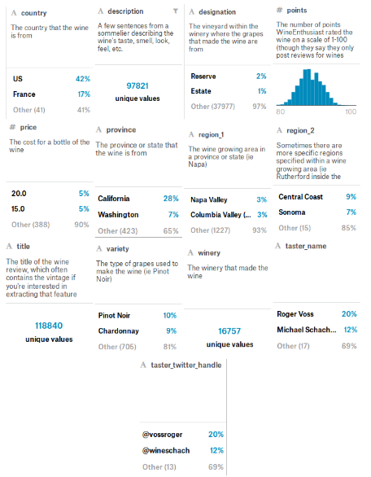
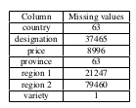
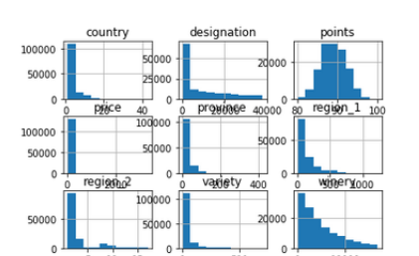
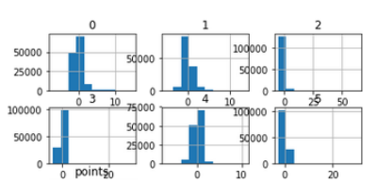






Data Preparation For Wine Quality Prediction
Ivan Kosarevych
Introduction
1
kosarevych@ucu.edu.ua
Methodology
2
Human error takes place in every activity a person participates in. Wine quality classification is not an exception. There is interest whether a machine can distinguish wines better than a human. Within this paper, I am touching mostly the part of dataset preparation for such experiment and in the end present a simple model for wine quality prediction.
The whole process consists of several stages:
• Data Cleaning
• Missing Values Imputation
• Outliers Investigation
• Data Transformation
• Data Normalization
• Dimension Reduction
• Model Selection
Experiment Setup
3
Data Parameters
Data Cleaning
Missing Values Imputation
Columns ‘taster name’, ‘taster twitter handle’, ‘title’, ‘description’ were dropped. They were considered as not connected with a target column.
In scope of this work two approaches were considered in dealing with missing values. They were selected based in the
assumption that data was missed at random. In order to test their quality a simple Linear Regression model was trained.
The second method is K-Nearest Neighbours Classifier. The columns of the data set were one by one imputed using KNN.
Other columns in order to train the classifier were imputed using global most common substitution. Columns which were imputed with KNN on the previous stages were not reimputed with global most common substitution again.
First of them is global most common substitution. Missings in categorical columns were filled with most frequent
value(mode). Missed values in numerical columns were imputed with average of this column.
In this data set ‘points’ is a target column as a measure of wine quality
Data Transformation
Outliers Detection
Dimension reduction
For every categorical column all its unique values were obtained. For every such value a unique integer identifier was assigned. Then every value in the column was replaced with its identifier.
Data has no significant number of outliers. However values in most of columns are very similar
We observed in previous work that our data has very similar values. We can deal with that by applying dimension reduction to the data set. This approach also decreases training time without significant loss in accuracy.
Model Selection
In order to accomplish it I considered two ways. The quality of the reduction was measured by a simple Linear Regression. Reduction was applied to normalized data set of features. Target column was not touched
It is important to notice that
the problem is a classification one with 100 classes. However, as our dataset contains only up to 20 classes (from 81 to 100) the more appropriate is to use one of the regression models. Meanwhile classification models are to be considered as well.
Principal Component Analysis is a basic approach and was considered at first.
The following models were studied: Linear Regression, Logistic Regression, SVM Classifier and MLP Regressor.
The second way is Decision Trees Classifier with 50 estimators. With this model I also found how each feature is important.
Results
4
Conclusions
5
For missing value imputation stage Global Most Common Substitution works better than K-Nearest Neighbours approach
PCA successfully reduces similarity and dimension of data and does it better than Decision Trees.
Neural network model overperformed others in prediction accuracy.
More complex approaches can be applied on the every stage. Other data sets can be found,
studied and possibly merged with this one. Own multilayer neural network can be composed and trained using more advanced technologies.
Conclusions
Applied Sciences Faculty, Ukrainian Catholic University, Lviv, Ukraine

