Slide 1
Hello Amadeus ☺
I’m Iva.
Today I’m showing my first project called find the shortest way in Bulgarian map.

Slide 2
Some deeply thankfully words…
Thank you for the great adventure to be part of this academy …
Thank you for your hospitality, organization and all staff support …
Thank you for showing what it means to be part of your team…
Тhank you for the most valuable thing you gave tо me – KNOWLEDGE!

Slide 3
Мy first project that I will talk about it in front of an audience
Please feel your self free to interrupt me and ask me any question, especially when things get complicated to me on disaster way ☹ ☺
Today we talk about roads, maps, distance, times, algorithms, solving problems with difference technology, good practices, and many more …
I hope your enjoy the time.

Slide 4
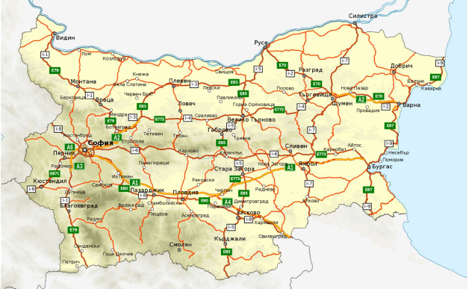
Introduction
Let’s find the optimal road to travel from one town to another, use some criteria

Slide 5
Introduction
This project was carried out in 2 phases.
The Path Planning algorithm for the starting point is described in the flowchart /p. 12/.
I will show how to solve the problem of finding the shortest path between two cities on a map of Bulgaria. For this purpose, I have chosen to implement one of the most popular algorithms used to find the solution, called A *.
The second phase is demonstrating the project in Spring.

Slide 6
Technology used in this project
Front end
No HTML, CSS, JS performance
Backend Logic
Java 11
Gradle
Spring Boot
JPA
MySQL 8 on localhost
Server
Tomcat
IDE
IntelliJ IDEA
Optional
Tomcat

Slide 7
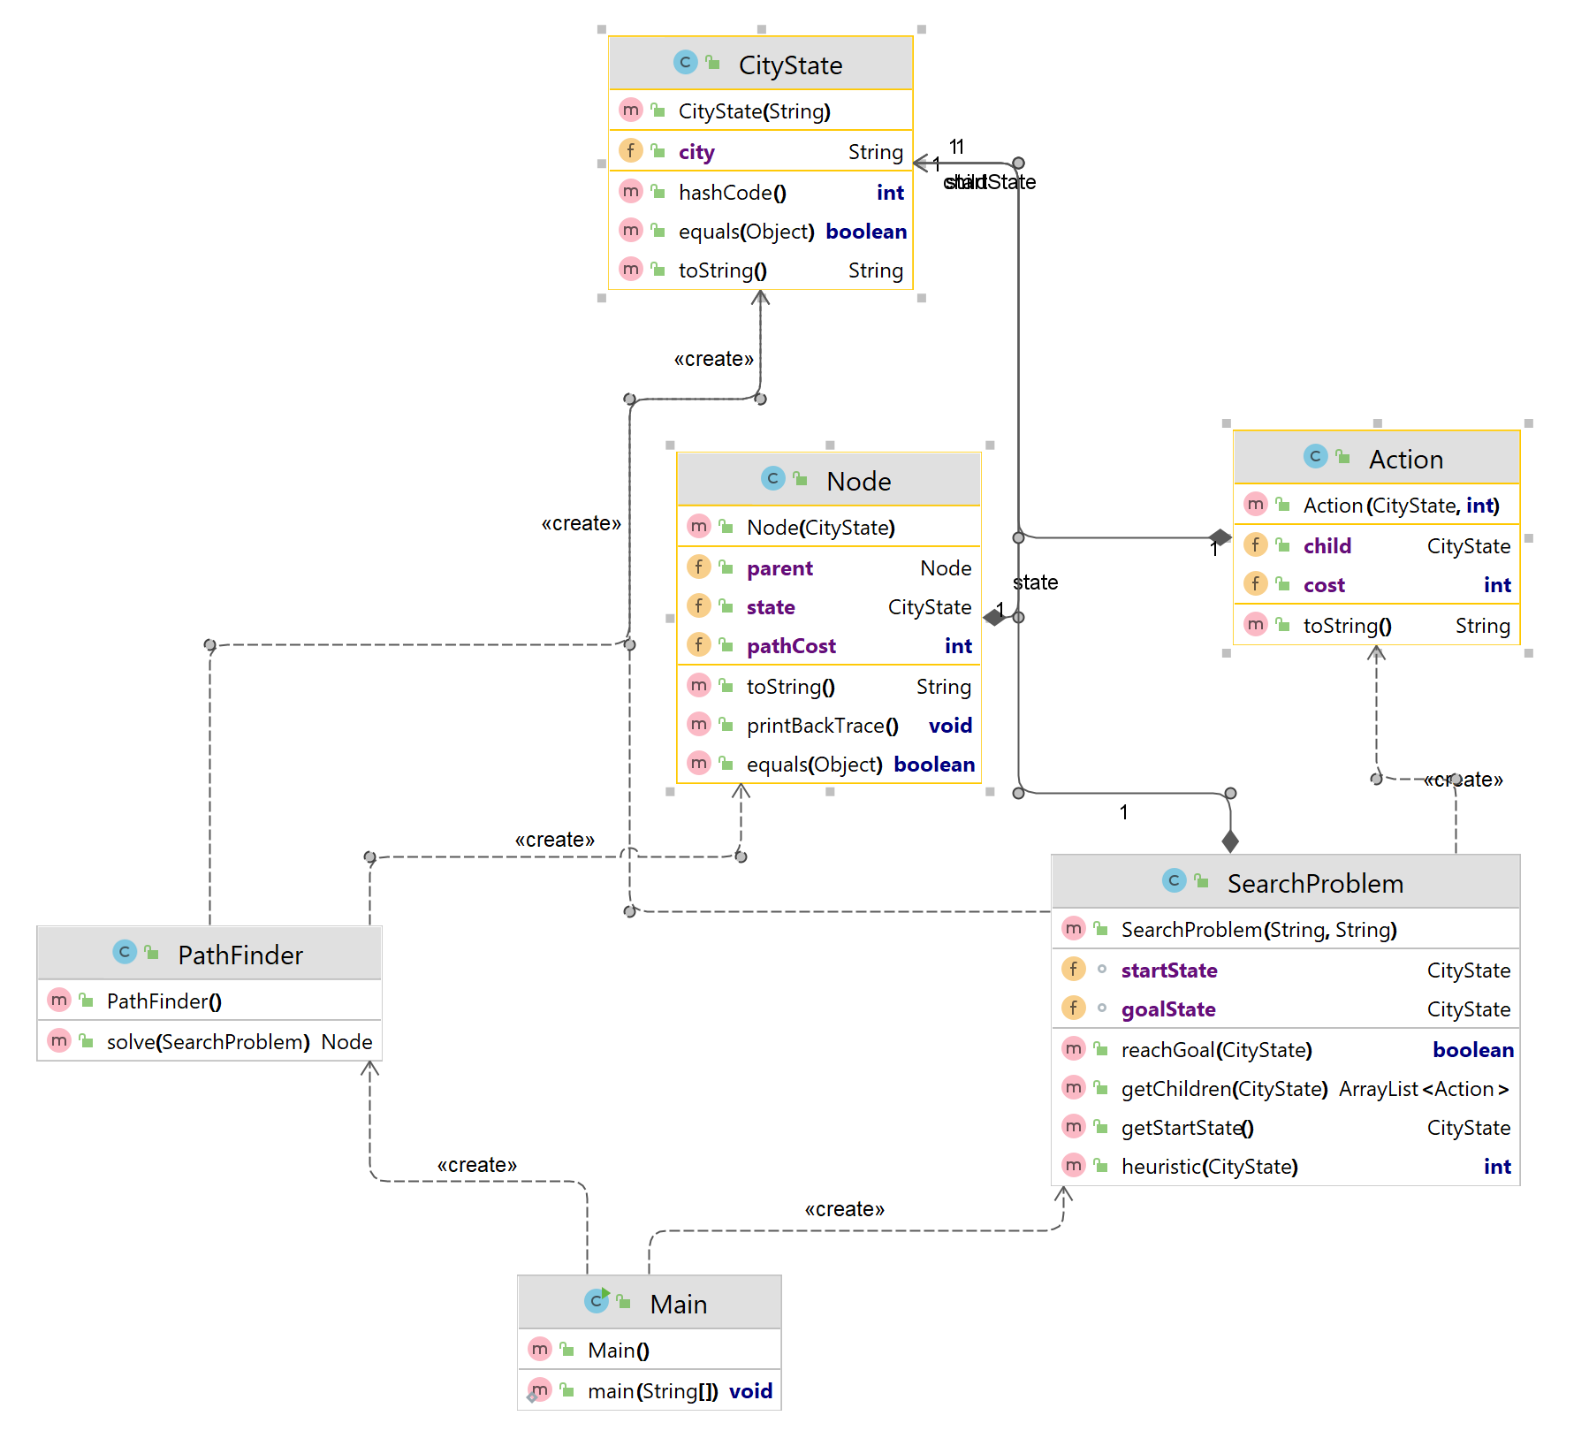
Class diagram

Slide 8
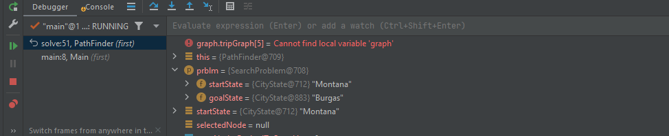
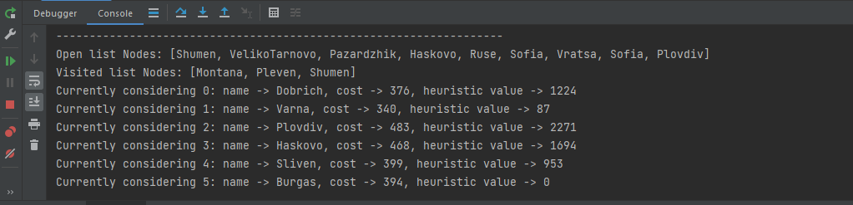
We may or may not have a direct route between our starting and ending points.
Every single step has a particular cost. In my case, this is the direct distance between cities.
My PathFinder class representing the algorithm that takes as input a collection of all the nodes – cities – and connections between them, and also the desired starting and ending points, declared in class SearchProblem.
The out put is the list of nodes that will get me from start to end, in the order that we need to go.

Slide 9
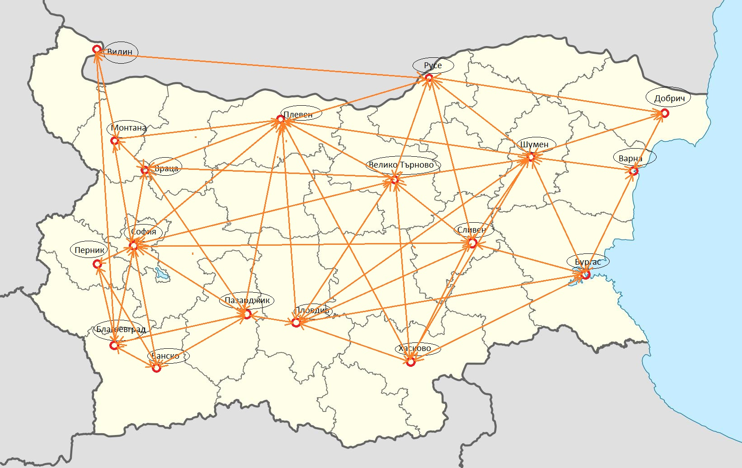
Problem In the project I’m using as a data the cities showing in the picture. I’m reading this data from local file /it can be .txt or .scv file/ and I choose to read them using Scanner class. In order to make the algorithm work, I have several pieces of data that needs to keep tracking of. The orange line is the cost of connecting points.

Slide 10
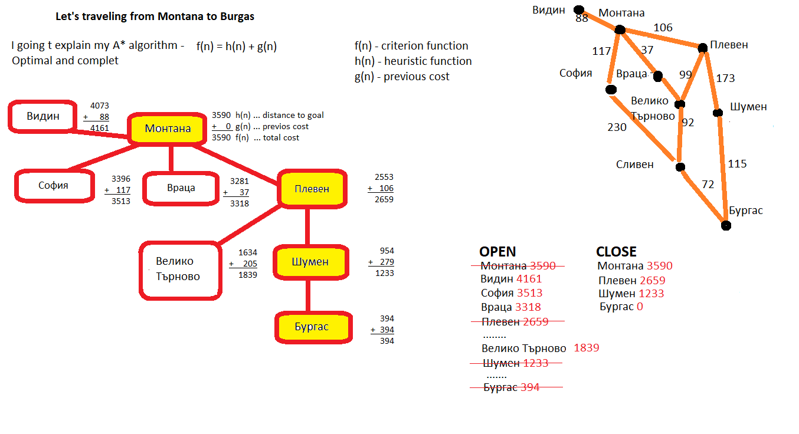
A* algorithm

Slide 11
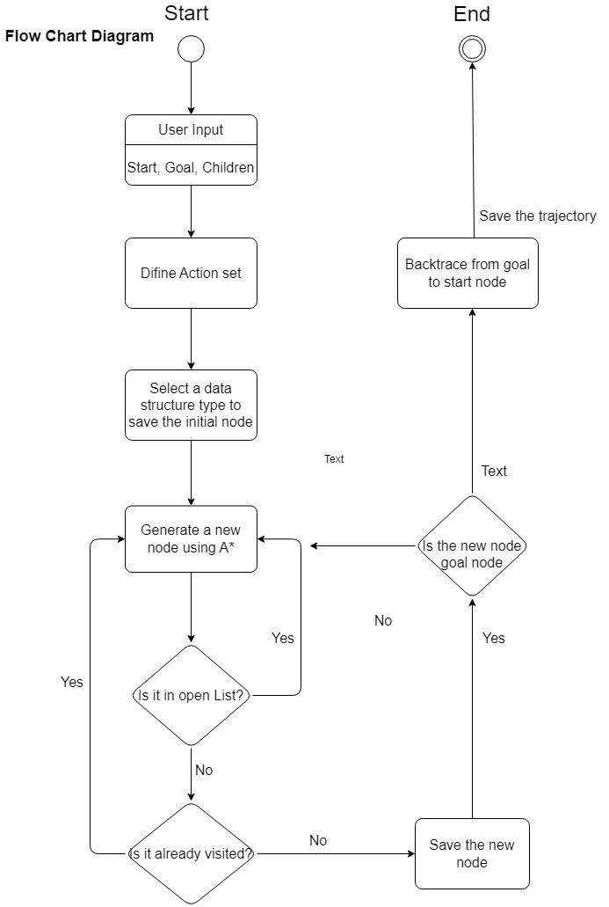

Slide 12
Junit testing
Let’s test the solve() method for the given example. Is it really 394 km between Montana and Burgas through Pleven and Shumen?

Slide 13


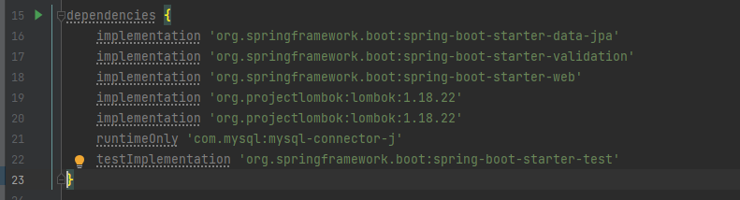
Let’s start with and
First we need to configure spring in build.grade file
Spring boot provide dependency ->
to connect Spring with database,
For using Java Bean Validation with Hibernate Validator,
For building web, including RESTful, uses Tomcat as default embedded container,
Automatic resource Management, automatic generation of getters, setters, constructors, etc.,
JDBC driver for MySQL

Slide 14

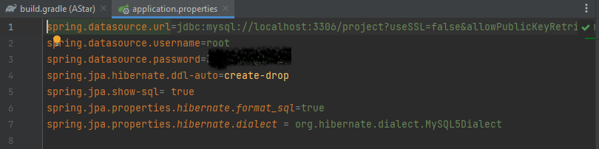
MySQL database
Configure the application.properties
Application uses a MySQL database via Hybernate JPA.
Let’s demo this one and show data in the MySQLBench

Slide 15
@Entity – Data Access level
An entity in my project are City and Path and representing a table stored in the database. They have a name element, primary key, strategy element, table and column annotation
@Entity @Table(name = "city") public class City { @Id @SequenceGenerator( name = "city_sequence", sequenceName = "city_sequence", allocationSize = 1 ) @GeneratedValue( strategy = GenerationType.SEQUENCE, generator = "city_sequence" ) @Column(name = "id") private Long Id; @Column( name = "name", nullable = false, columnDefinition = "TEXT" ) @NotBlank(message = "City name must not be blank") @Length(min = 3, max = 512, message = "City name must have 3-512 characters") public String city;

Slide 16
@Repository – Data access level
native @Query getDirectPath
Use more complexity Query

Slide 17
@Service – Business Logic Level
Here I show you my implementation in SpringBootDemo how to list the cities and path, delete them, update or add depend of some restrictions and validations.

Slide 18
@Controller – Presentation API
Url + Throwing request and response exceptions most basic and commend as:
For the client
OK 200
Bad Request 400
Not Found 404
For the server
Internal Server Error 500

Slide 19
@JsonView ResponseEntityExceptionHandler
Additional
Useful for hiding a sensitive information form the client or administrator!
CustomExceptionHandler catch the validations in my code and made it readable

Slide 20

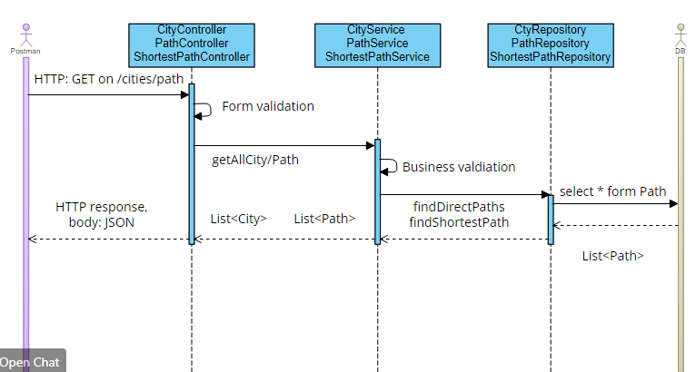
Postman client
Consuming a RESTful Web Services by using Postman client

Slide 21
Thank you for your attention
This is the Architecture of my project implemented in Spring MVC and uses standard Service Oriented Architecture

