Slide 1
Decision Trees
Simon & Ivan

Slide 2
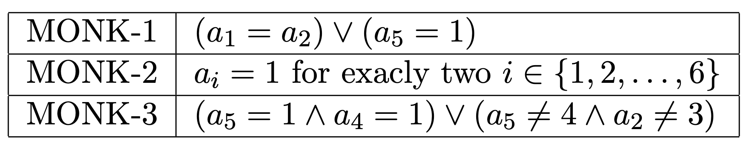
Difficult properties (ass. 0)
<In ass.5 when you generate the tree for monk-2 just insert the pic of the printed tree here>

Slide 3
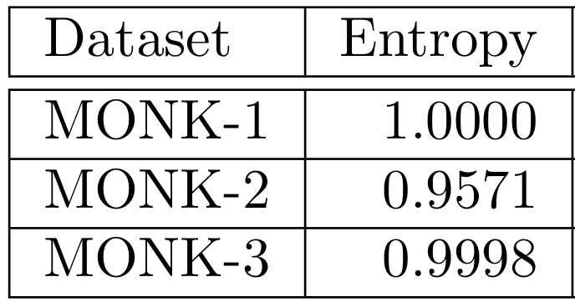
Entropies of the MONK datasets (ass 1.)

Slide 4
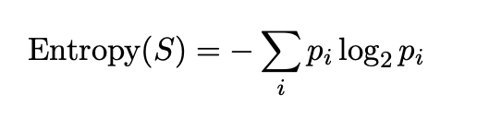
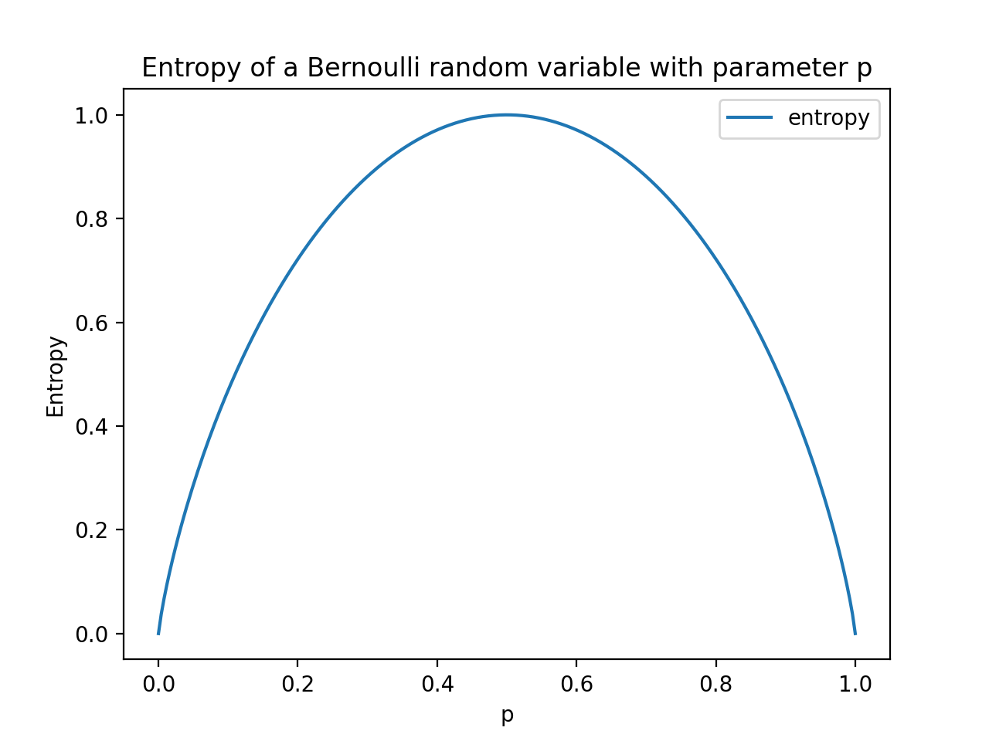
Entropy (ass. 2)

Slide 5
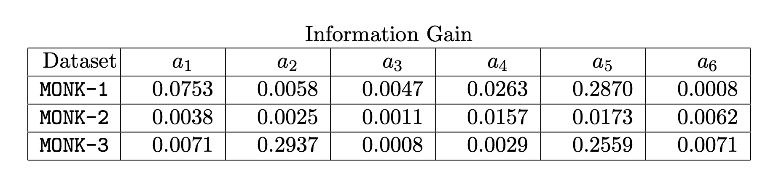
Information gain as a heuristic (ass. 3 & 4)

Slide 6
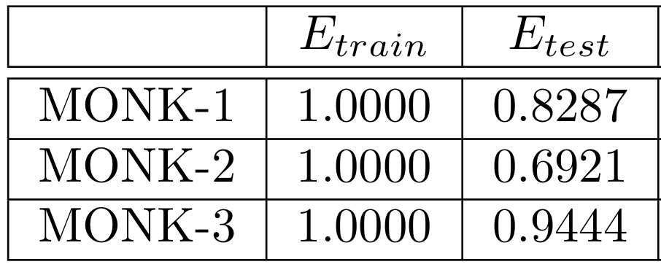
Assignment 5

Slide 7
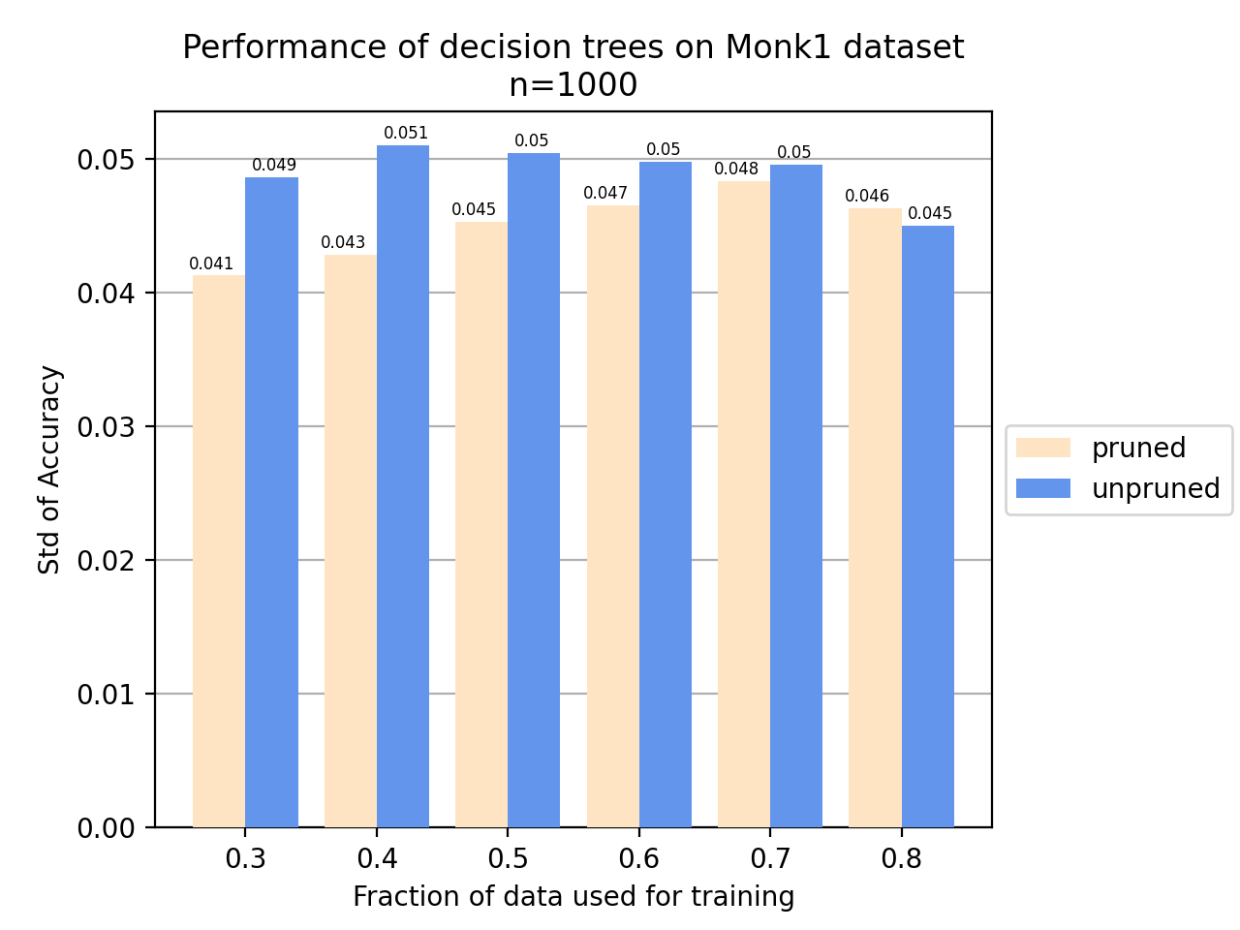
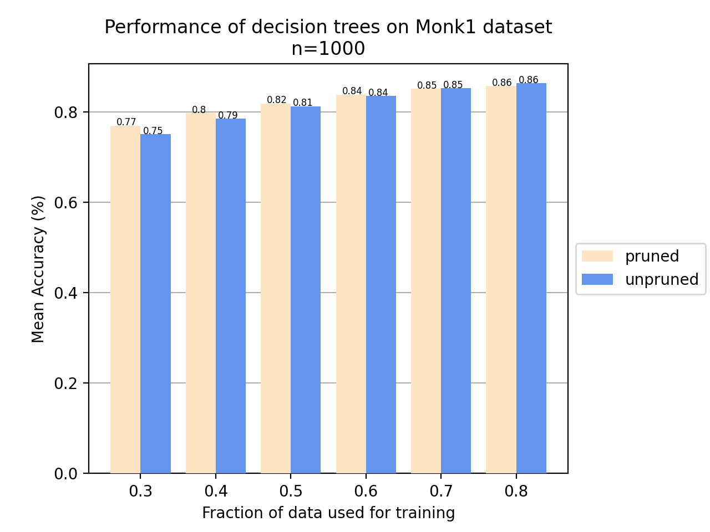
Pruning (ass. 6 & 7)

Slide 8
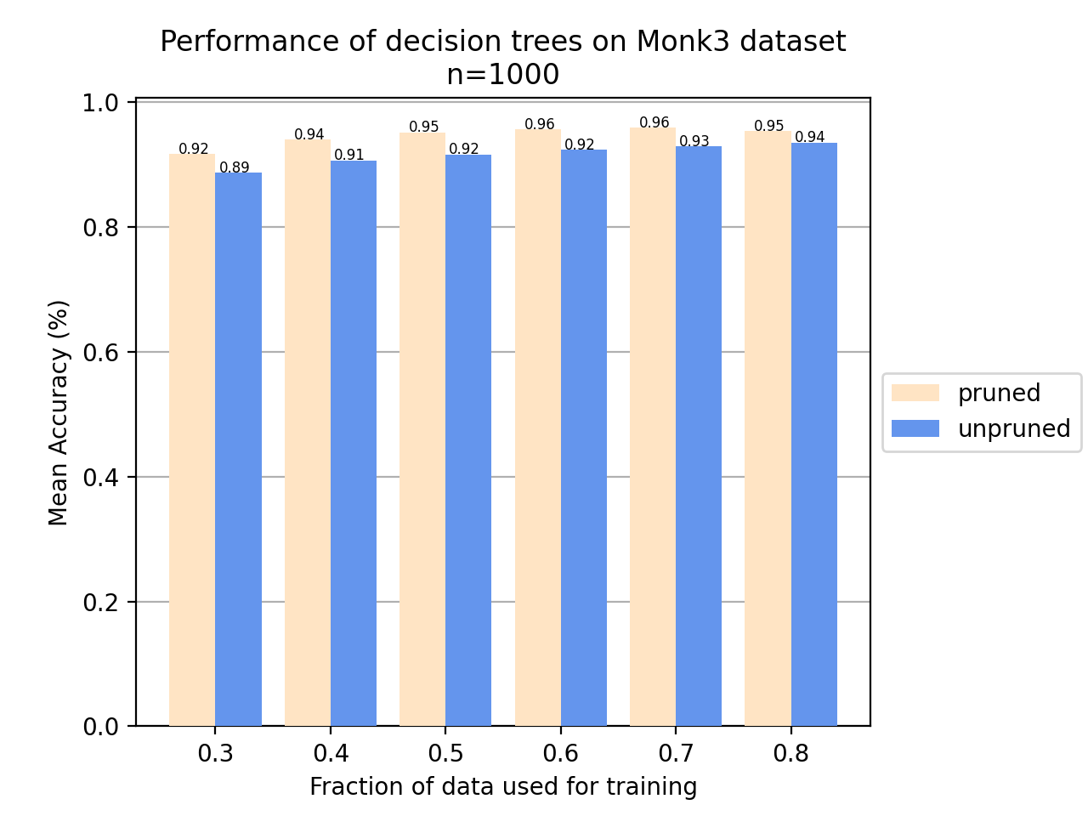
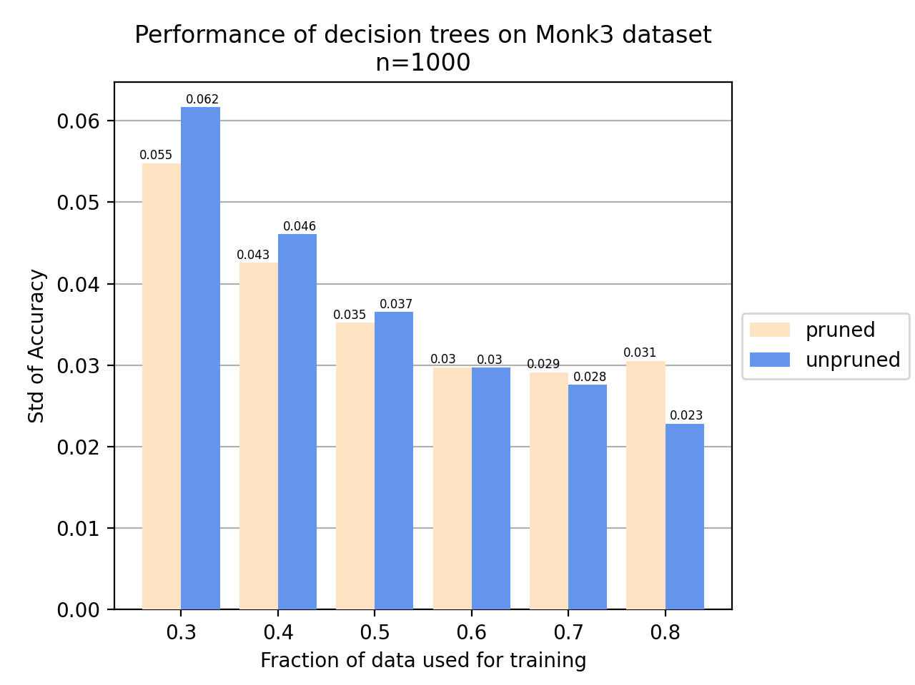
Pruning (ass. 6 & 7)

