Slide 1
Decision Trees
Simon & Ivan

Slide 2
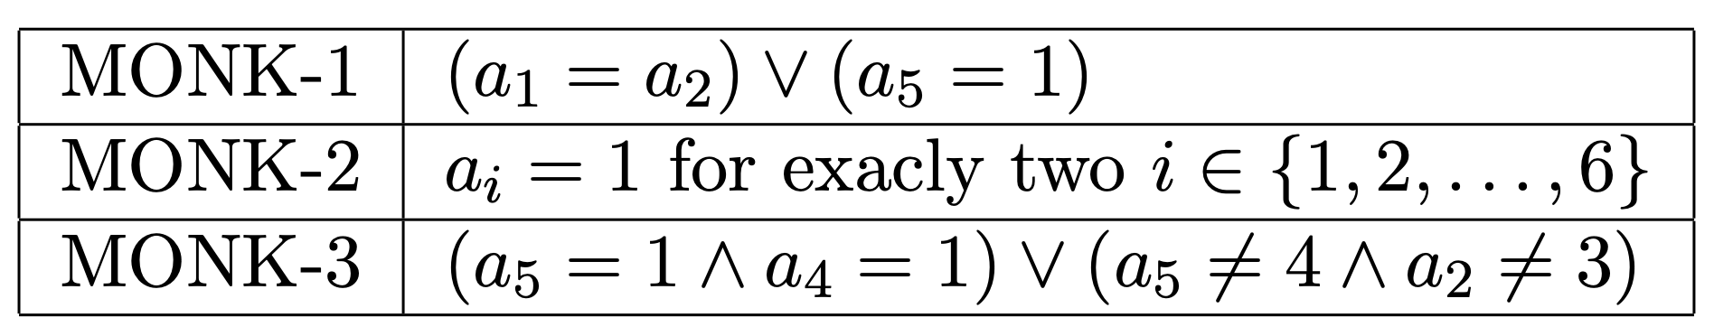
Difficult properties

Slide 3
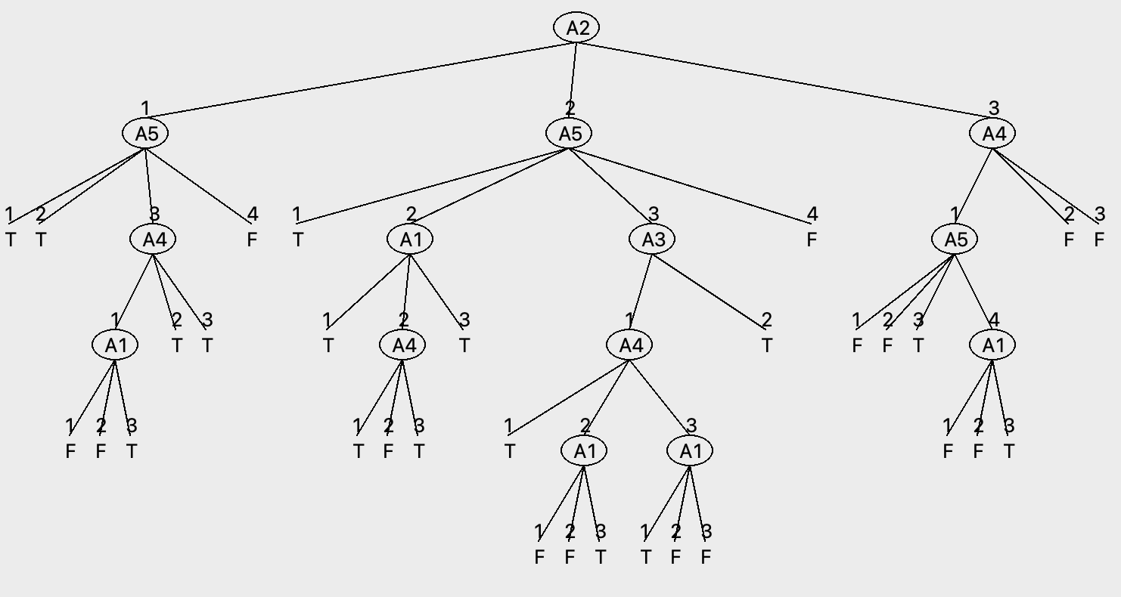
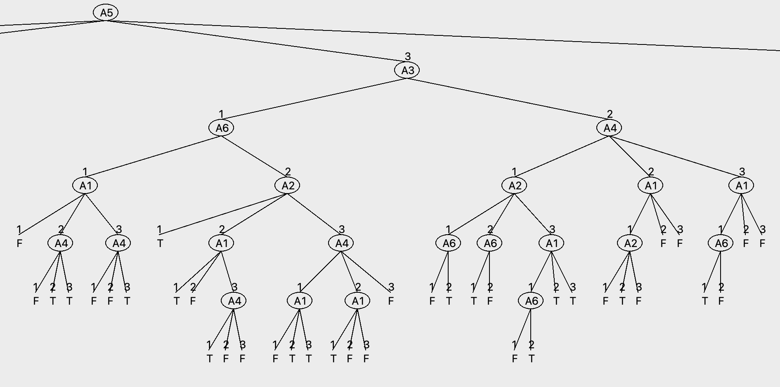
Tree size comparison
Full MONK-3 tree
Subtree of MONK-2

Slide 4
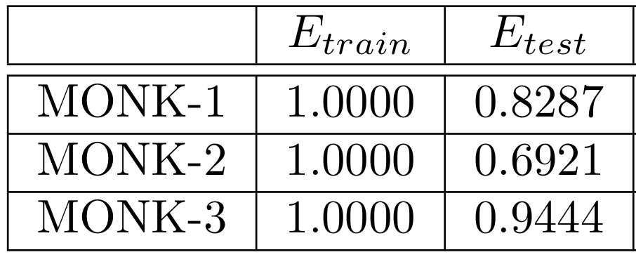
Assignment 5

Slide 5
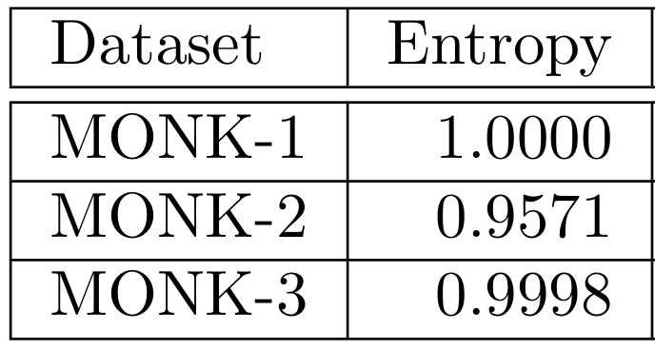
Entropies of the MONK datasets

Slide 6
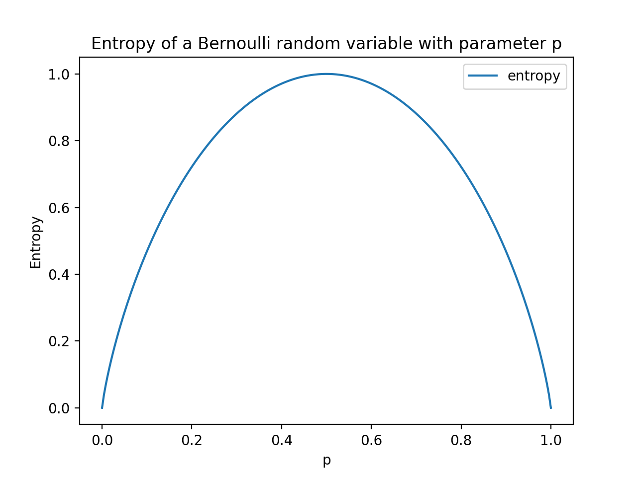
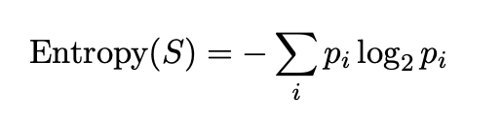
Entropy
Entropy – measure of data disorder
Uniform distribution – every outcome has the same probability, hence most chaotic
Non-uniform distribution - the higher probability of some outcomes reduces the disorder

Slide 7
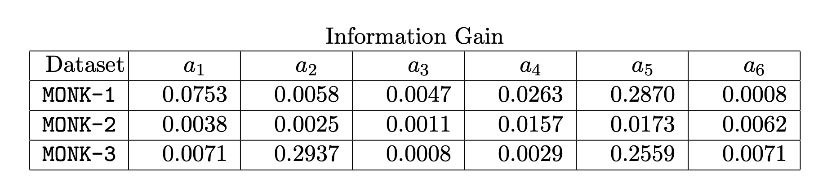
Information gain as a heuristic (ass. 3 & 4)

Slide 8
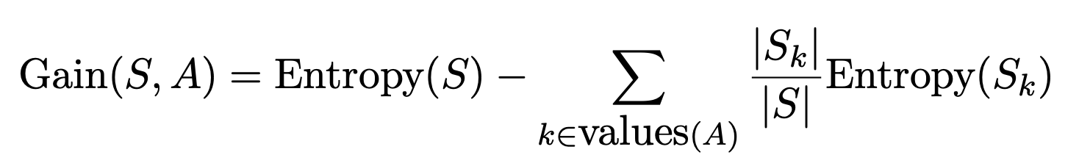
Max Information Gain

Slide 9
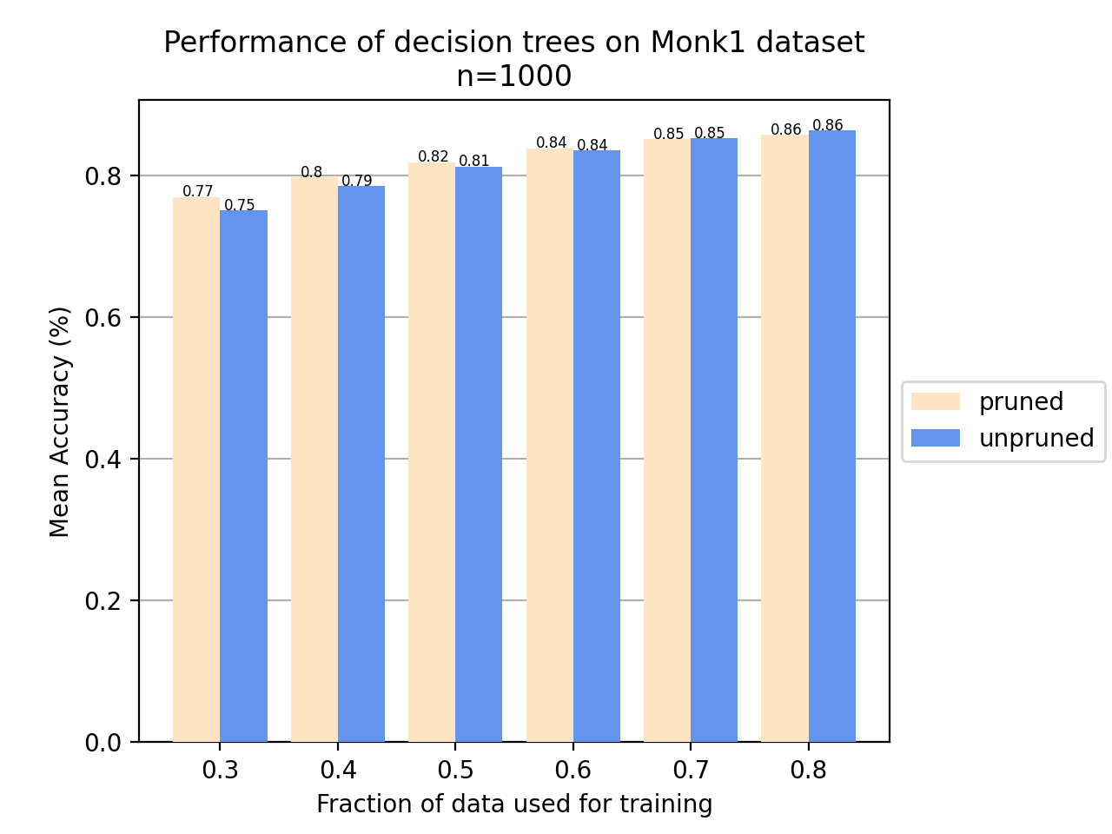
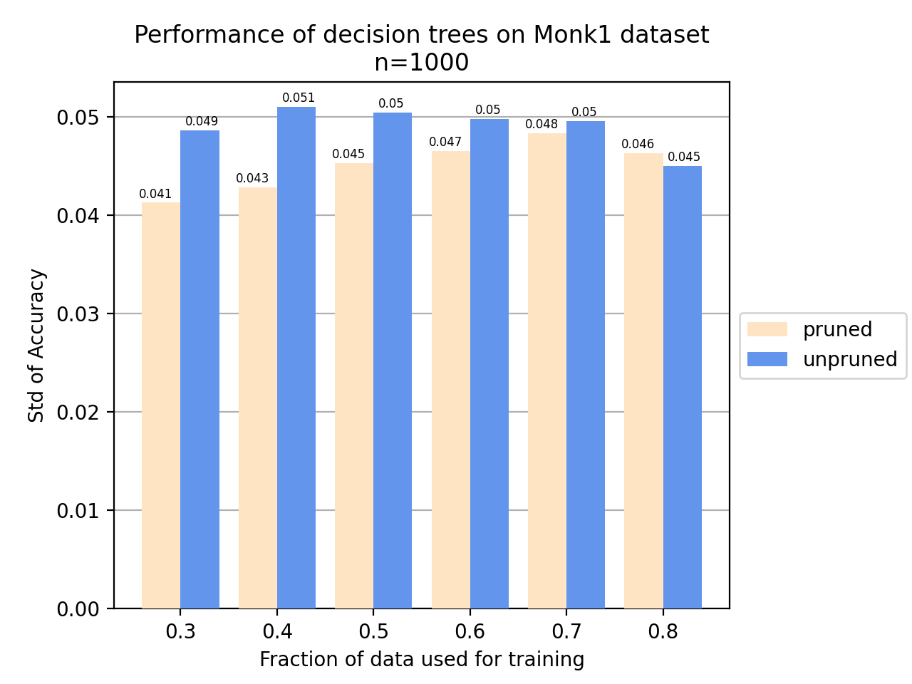
Pruning (ass. 6 & 7)

Slide 10
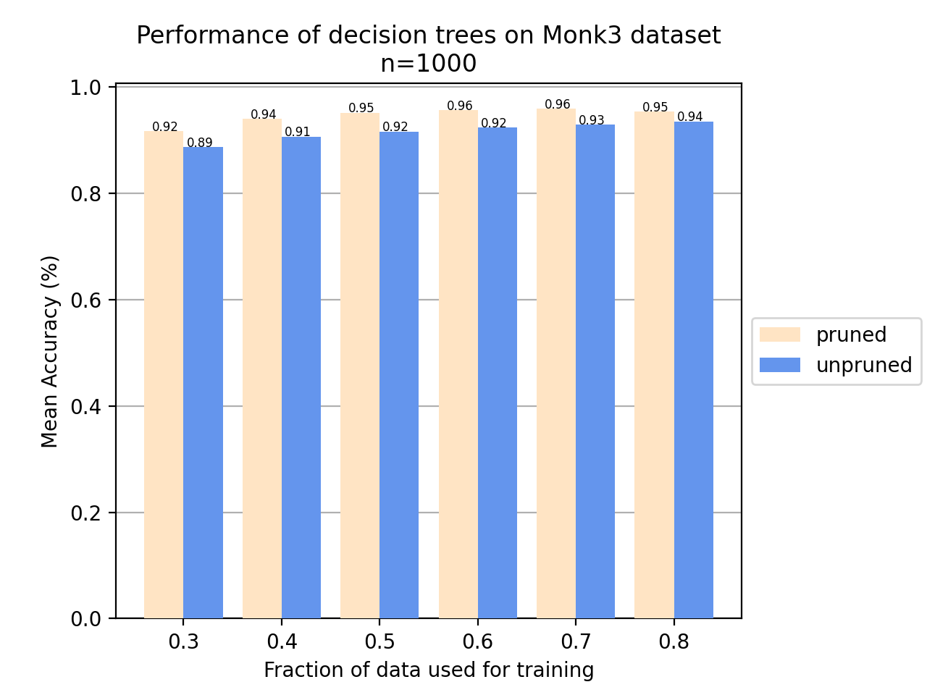
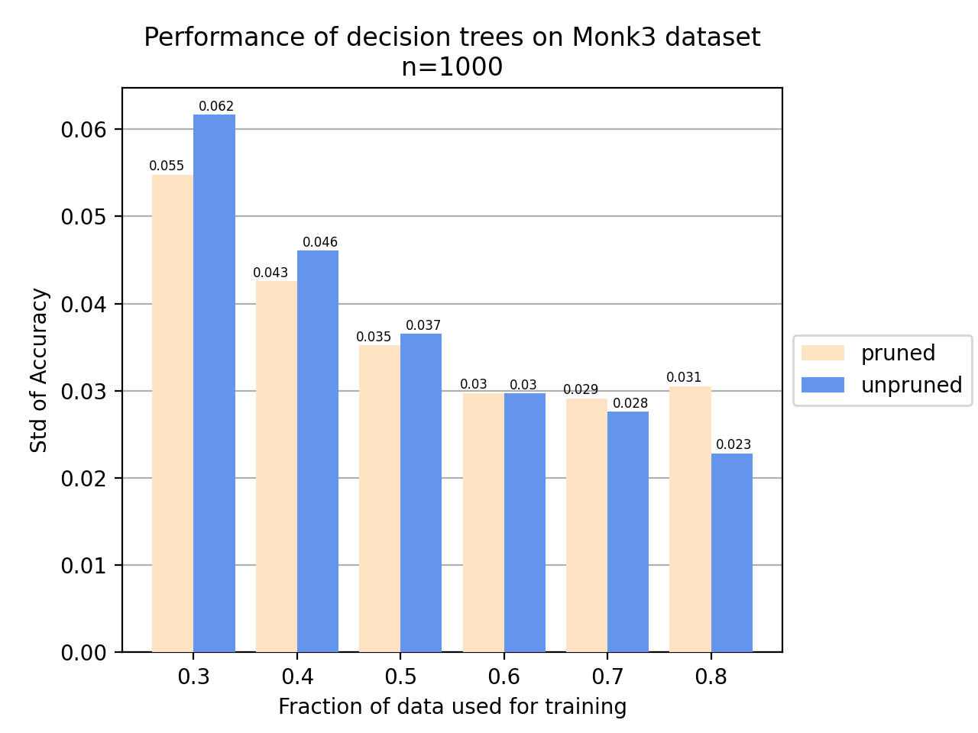
Pruning (ass. 6 & 7)

