Slide 1
Decision Trees
Simon & Ivan

Slide 2
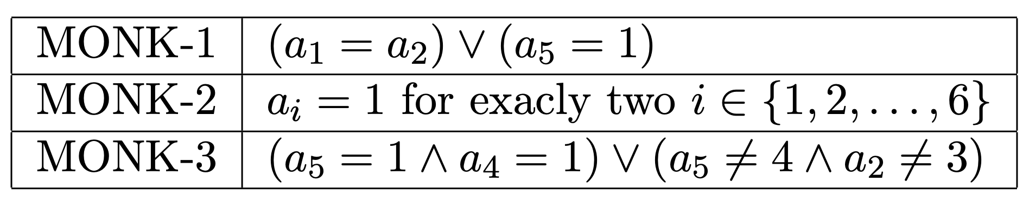
Difficult properties – assignment 0

Slide 3
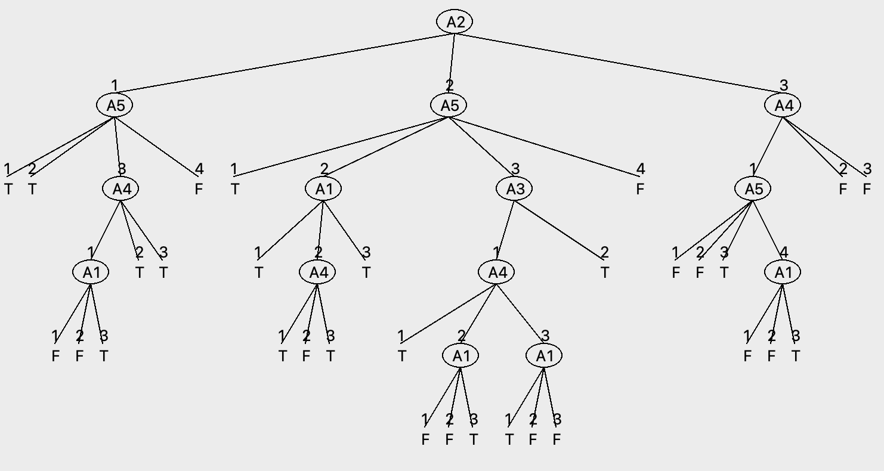
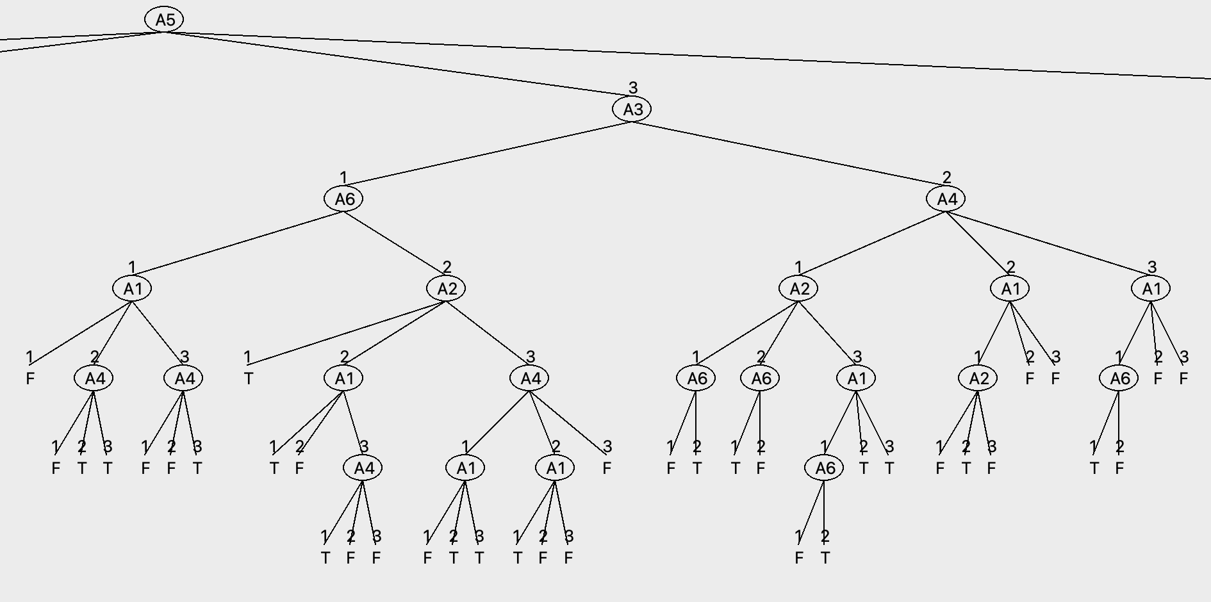
Tree size comparison – assignment 0 & 5
Full MONK-3 tree
Subtree of MONK-2

Slide 4
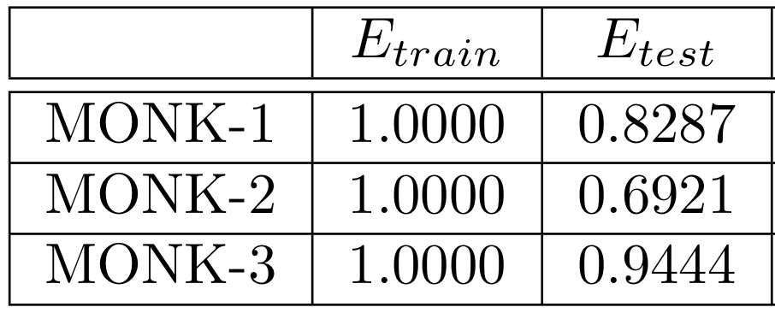
Performance on test data - assignment 5

Slide 5
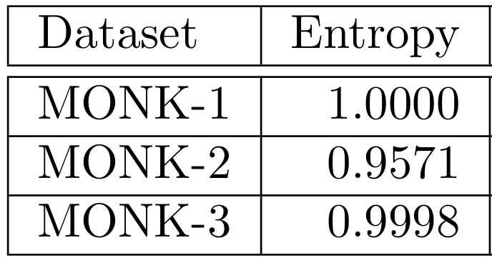
Entropies of the MONK datasets - assignment 1

Slide 6
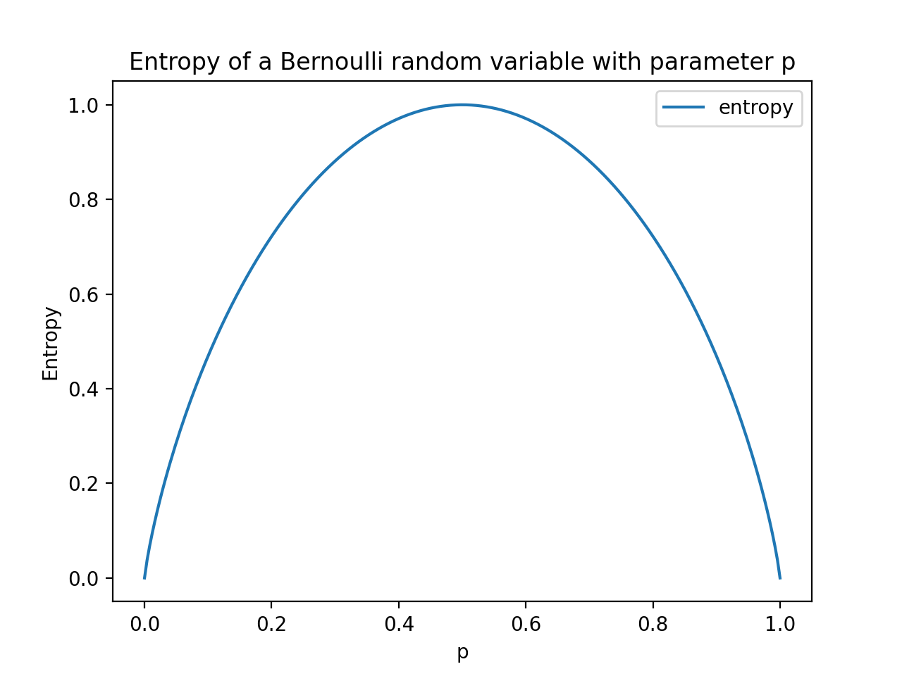
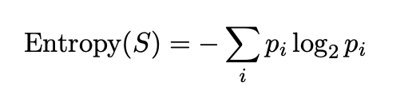
Entropy – assignment 2
Entropy – measure of data disorder
Uniform distribution – every outcome has the same probability, hence most chaotic
Non-uniform distribution - the higher probability of some outcomes reduces the disorder

Slide 7
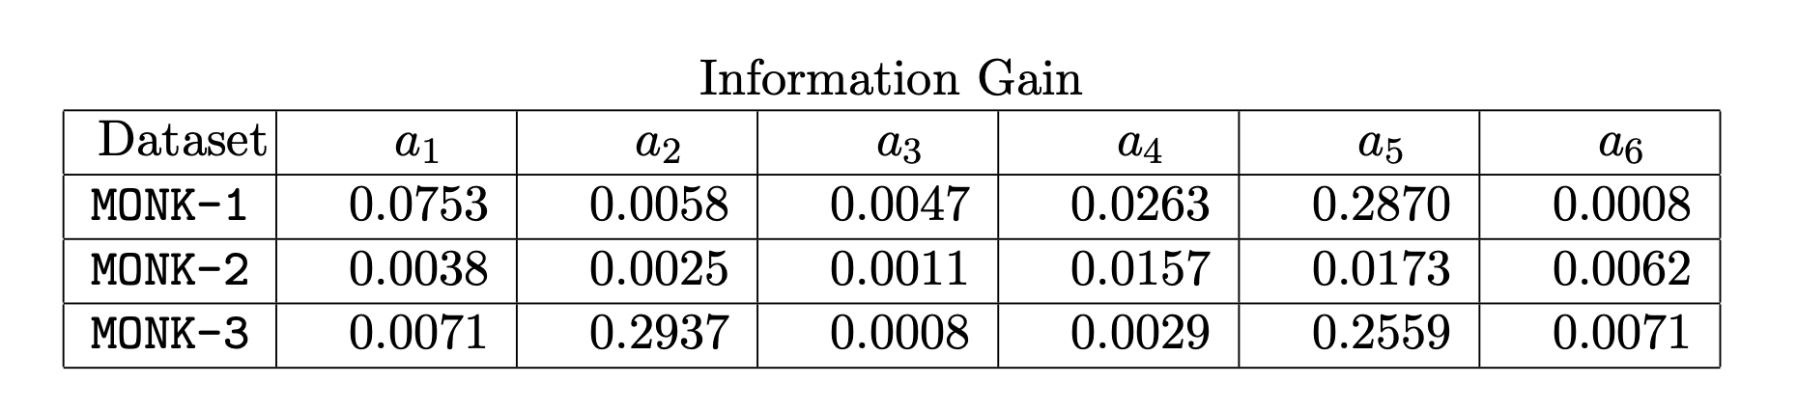
Information gain as a heuristic - assignment 3 & 4

Slide 8
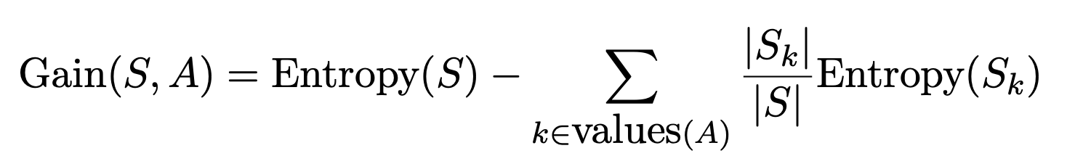
Max Information Gain – assignment 4

Slide 9
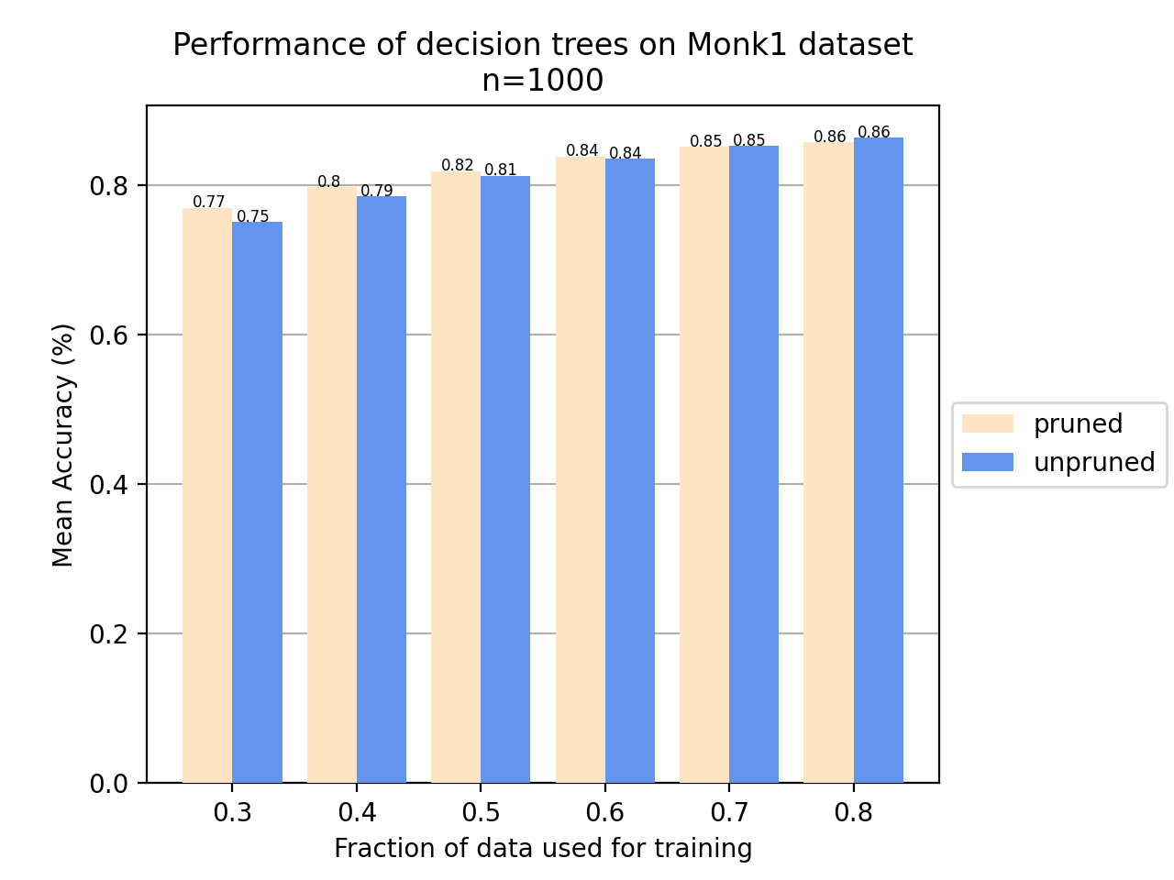
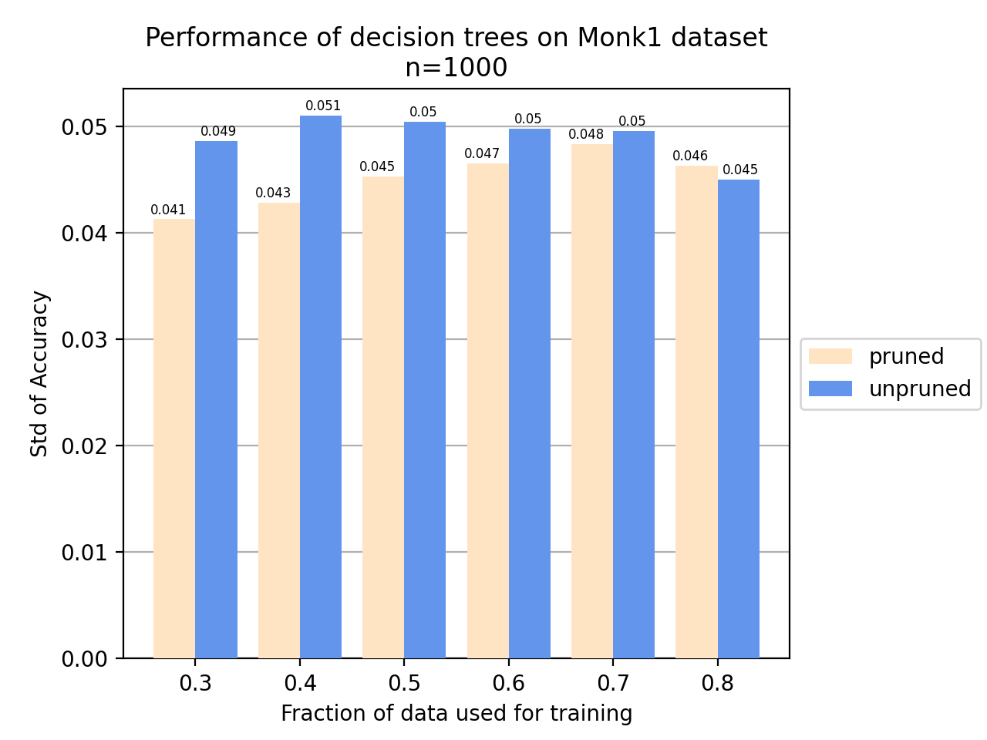
Pruning - assignment 6 & 7

Slide 10
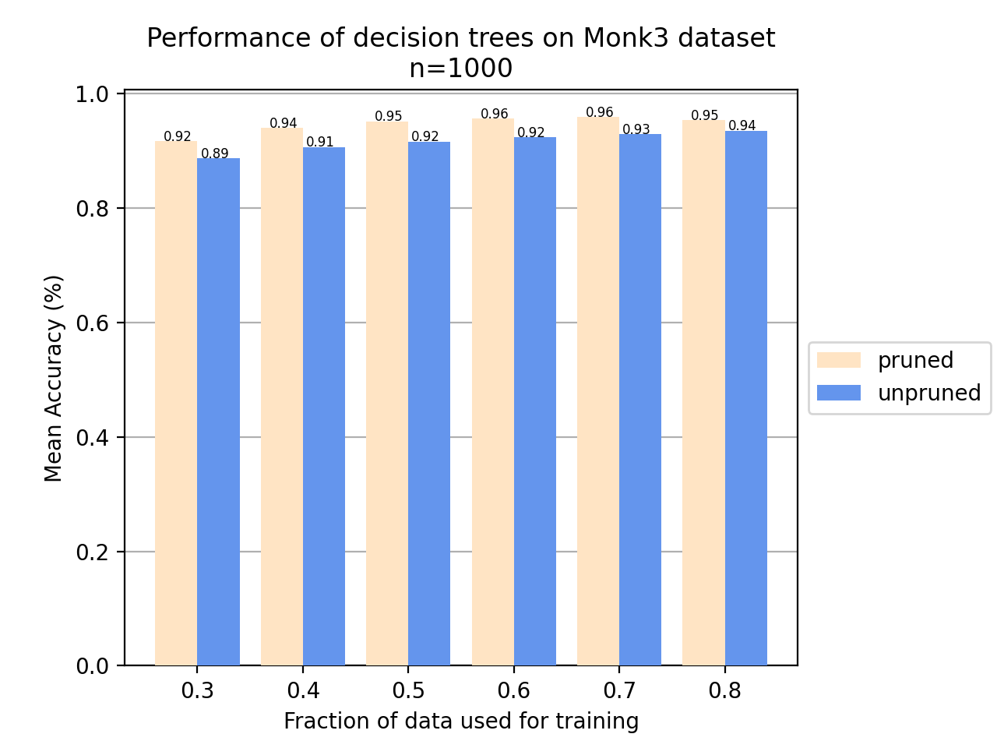
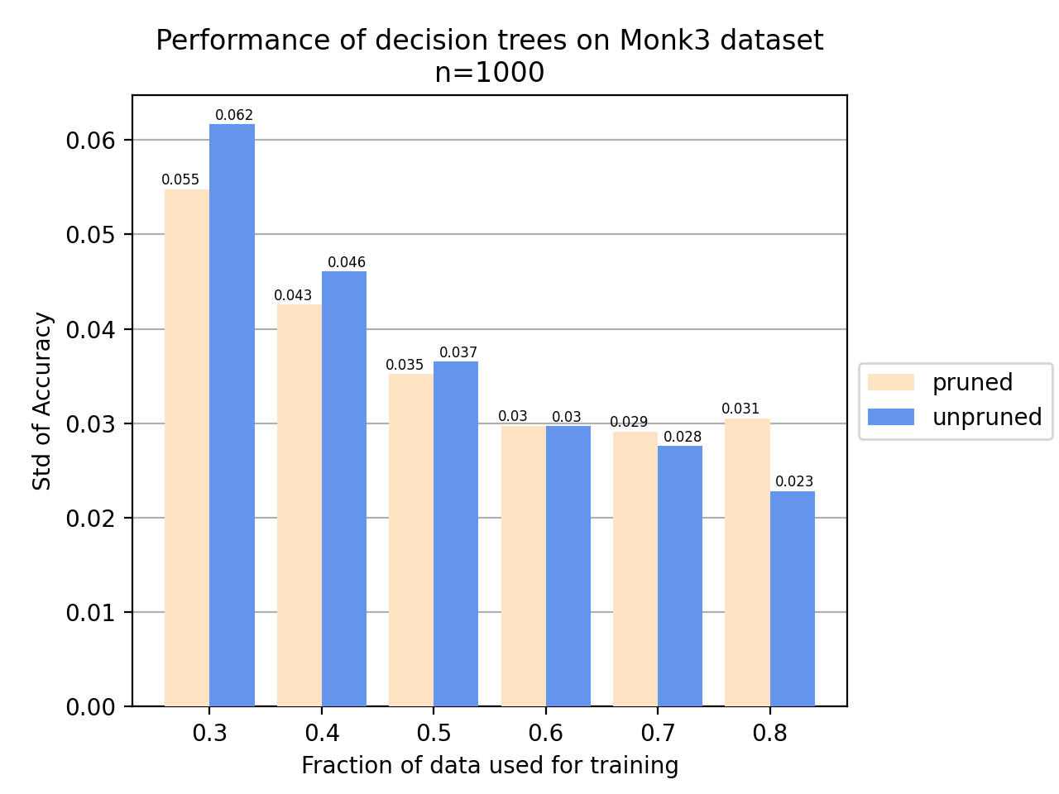
Pruning - assignment 6 & 7

