Slide 1
Seymour’s Theorem Formalization
Project Status Update
Martin Dvořák, Ivan Sergeev
12 June 2025

Slide 2
High-level Overview

Slide 3
Overall Status
Foundations
1-sum
2-sum
3-sum

Slide 4
Current Status of 3-Sum
01
3-Sum of Matrices
Basic definitions
API
02
Re-signing of Matrices
Re-signing 3x3 matrices
Re-signing matrices based on 3x3 submatrices
Total unimodularity
03
Canonical Signing of 3-Sum
Re-signing of summands
Canonical signing of 3-sum
Total unimodularity
04
Family of 3-Sum-Like Matrices
Structural definition
3-sums are generalized
Total unimodularity
05
3-Sum of Matroids
Standard representations
Matroids having a standard representation
Regularity

Slide 5
Progress Summary
Formalization of 3-sum
The 3-sum of matrices | Improved basic definition and API
Canonical signing of matrices | Already complete, fully retained
Canonical signing of 3-sum | Stated all necessary lemmas Proved total unimodularity results about adjoining columns
Family of 3-sum-like matrices | Stated definition and key lemmas Proved lemmas that directly reduce to simpler results
Blueprint
Content & dependency graph | Aligned more closely with implementation
Publicly displayed version | Updated to current version
CI/CD workflows | Re-enabled and updated

Slide 6
Next Steps
Family of 3-sum-like matrices | State remaining results Prove remaining statements
Canonical signing of 3-sum | Prove remaining statements
Blueprint | Keep up-to-date
External contributors | Potentially delegate selected proofs

Slide 7
Additional Slides

Slide 8
Dependency Graph

Slide 9
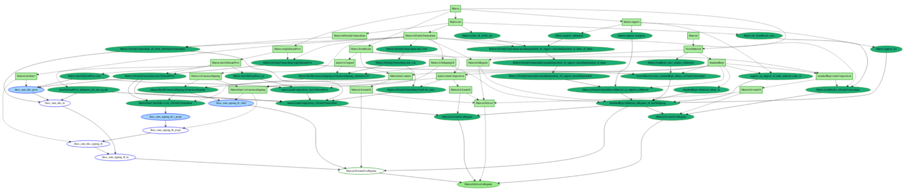
Entire Dependency Graph

Slide 10
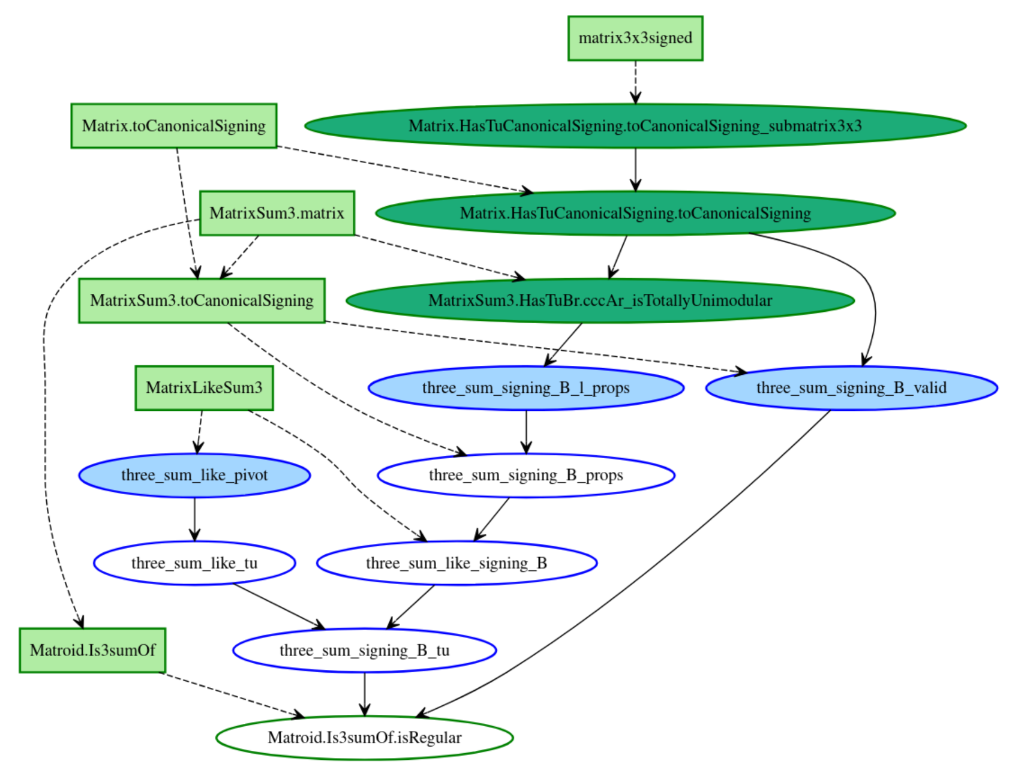
Dependency Graph of 3-Sum

Slide 11
Improvements in 3-Sum

Slide 12
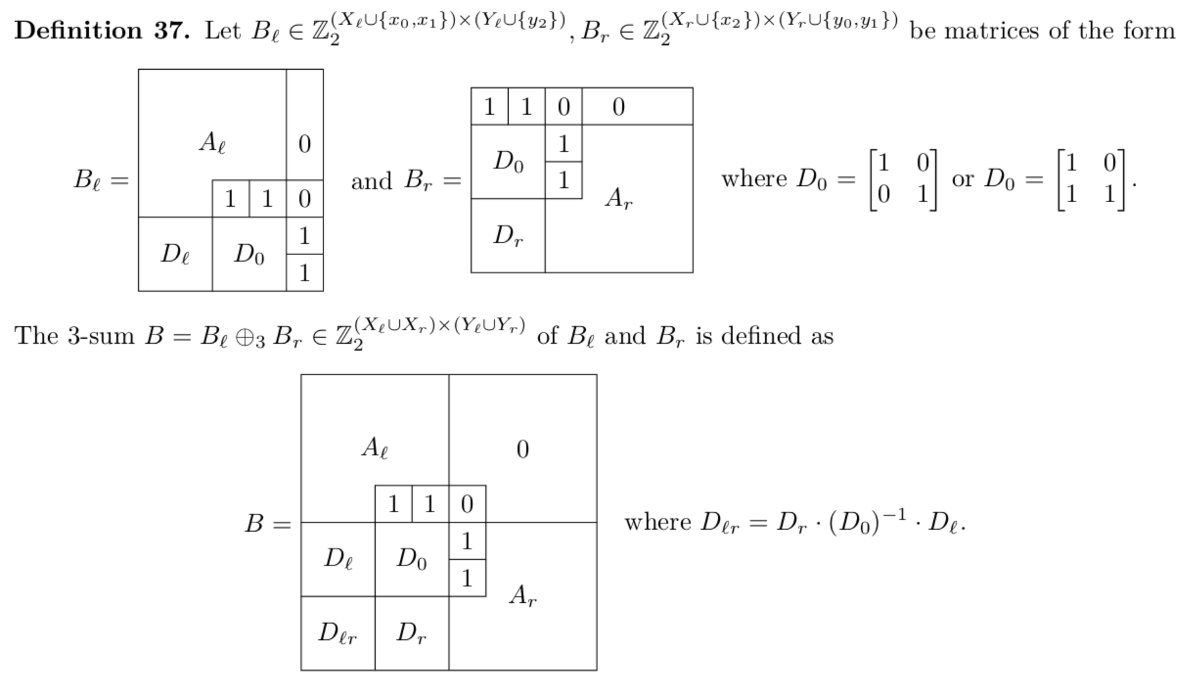
Refresher on Matrix Structure

Slide 13
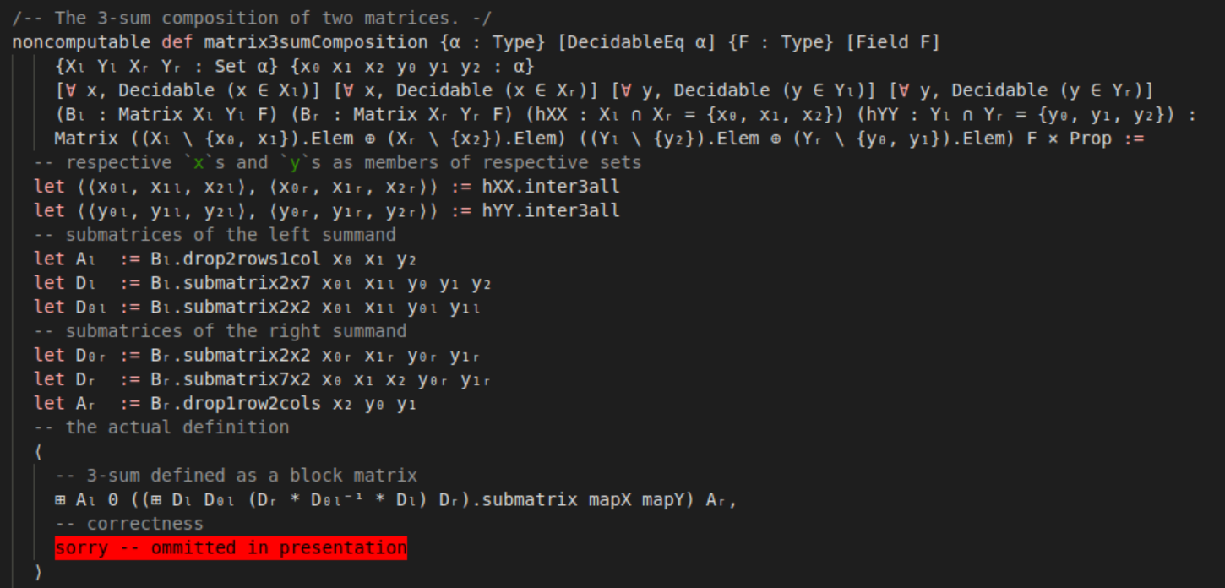
Previous Implementation: Matrices

Slide 14
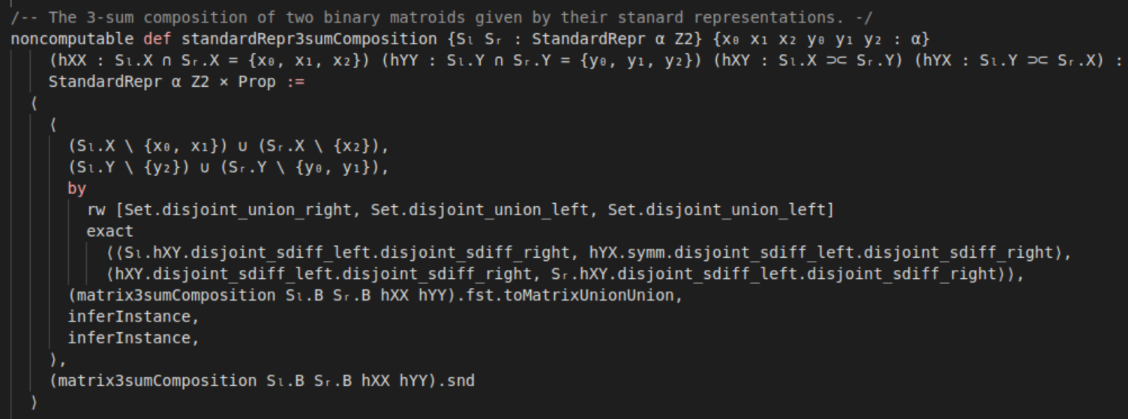
Previous Implementation: Standard Representations

Slide 15
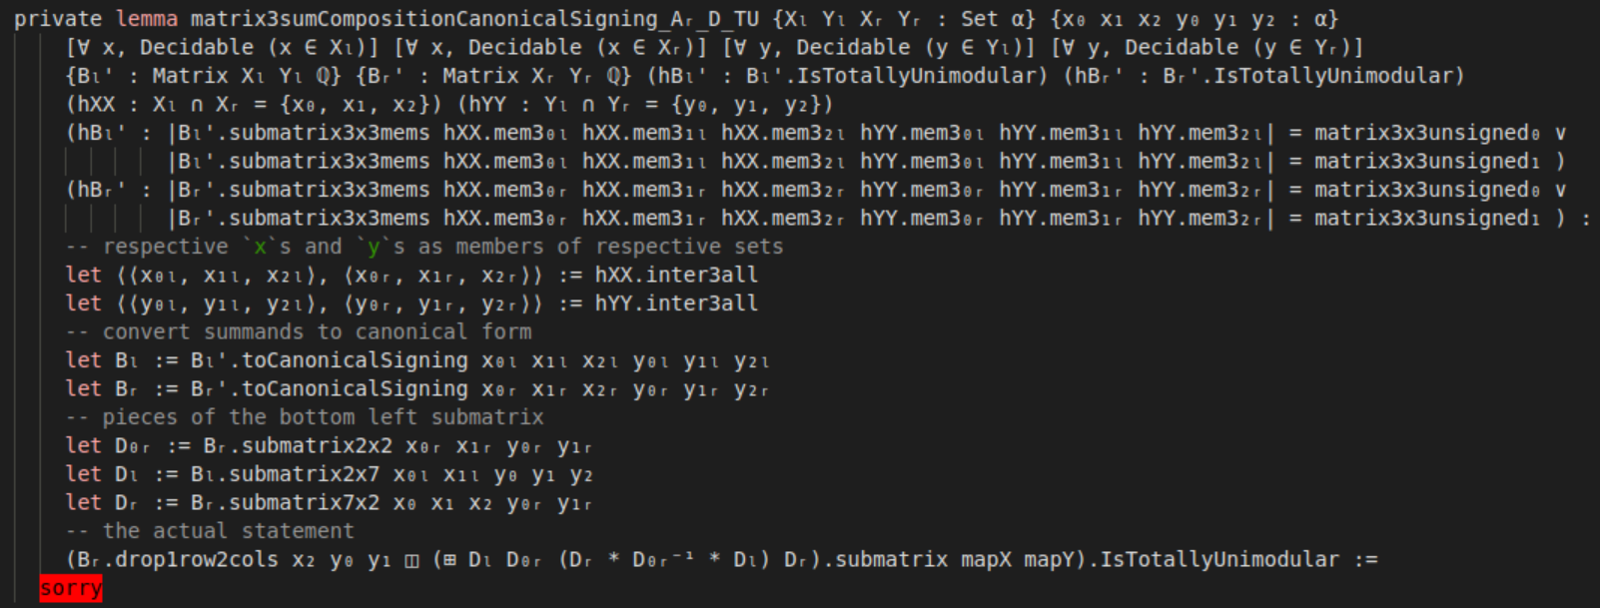
First Signs of Trouble

Slide 16
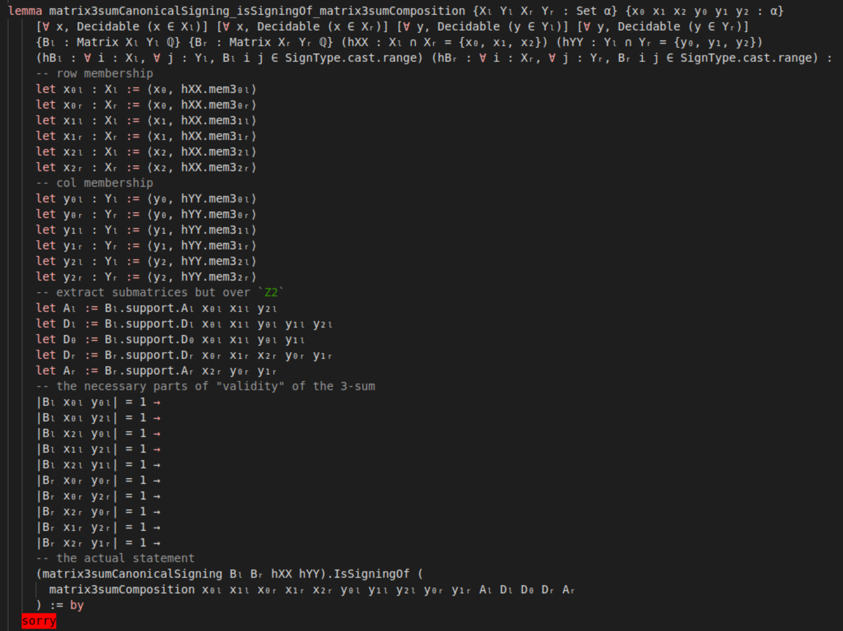
What Tipped the Scale

Slide 17
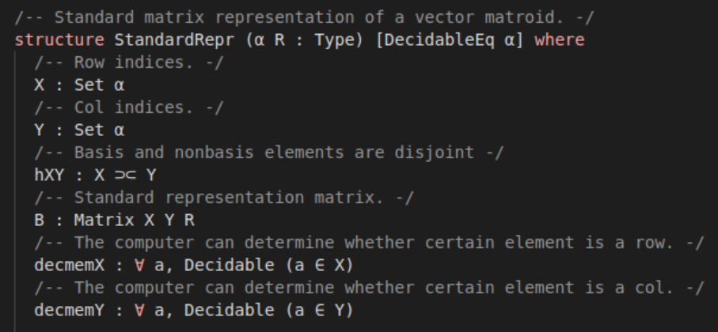
Inspiration from the Past

Slide 18
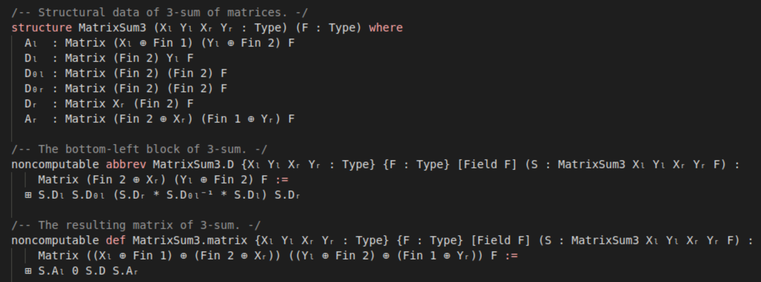
Updated 3-Sum of Matrices

Slide 19
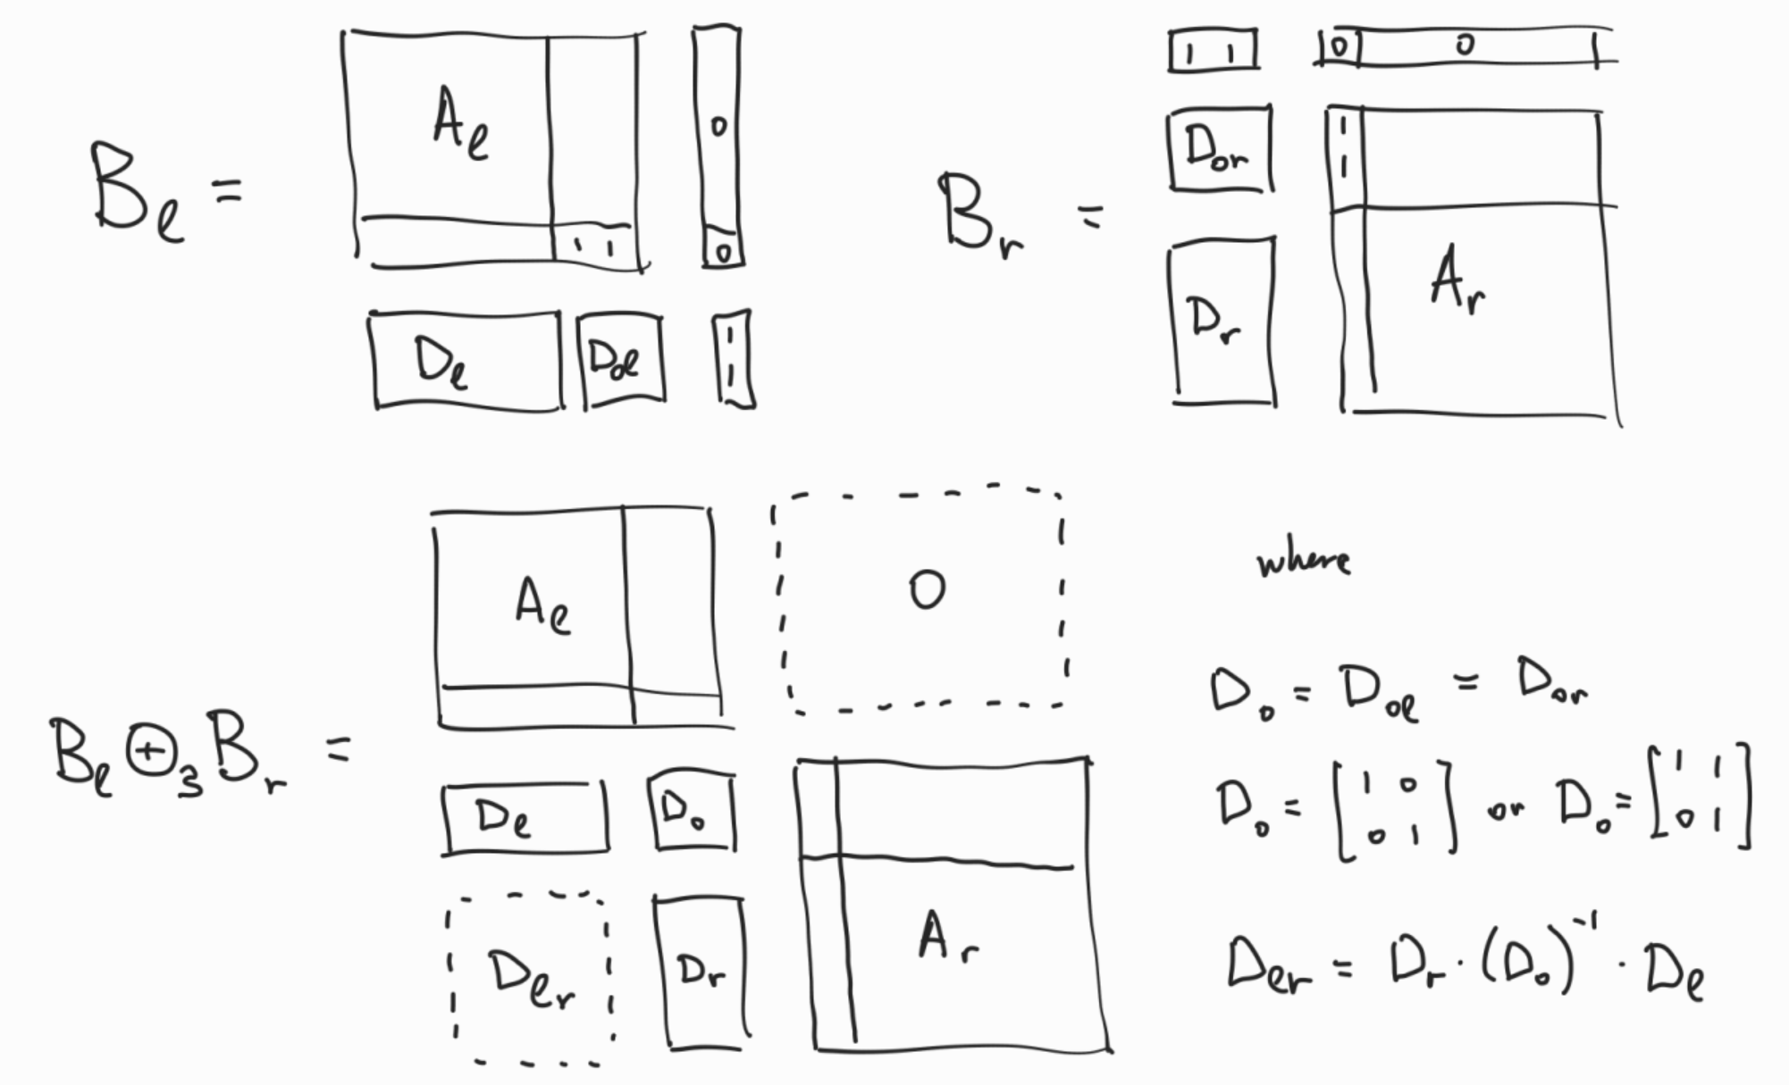
Matrix Structure Redux

Slide 20
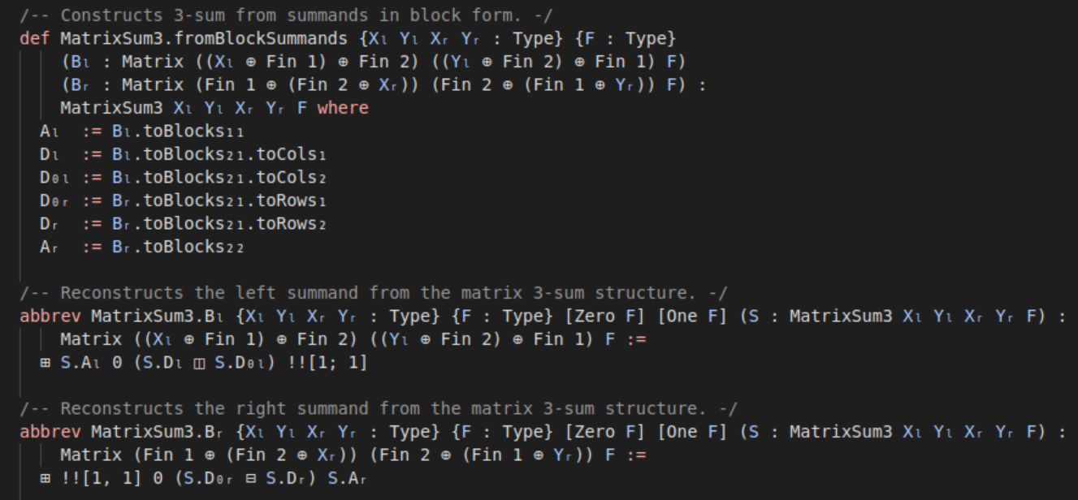
Summands in Block Form

Slide 21
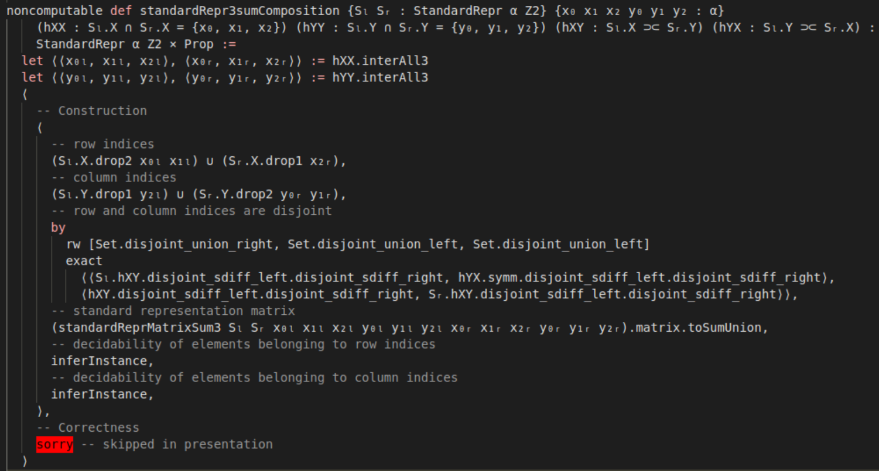
Standard Representations

Slide 22
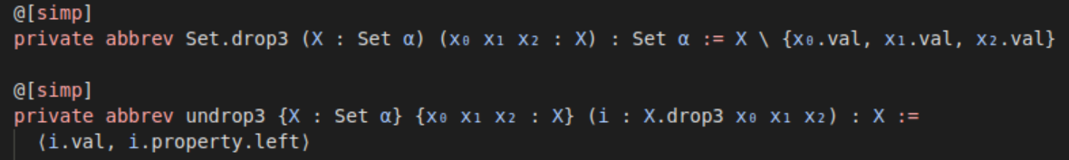
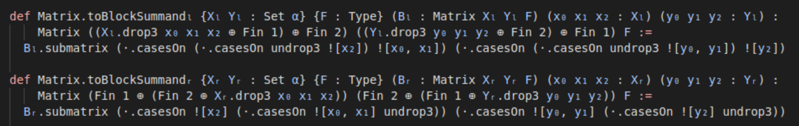
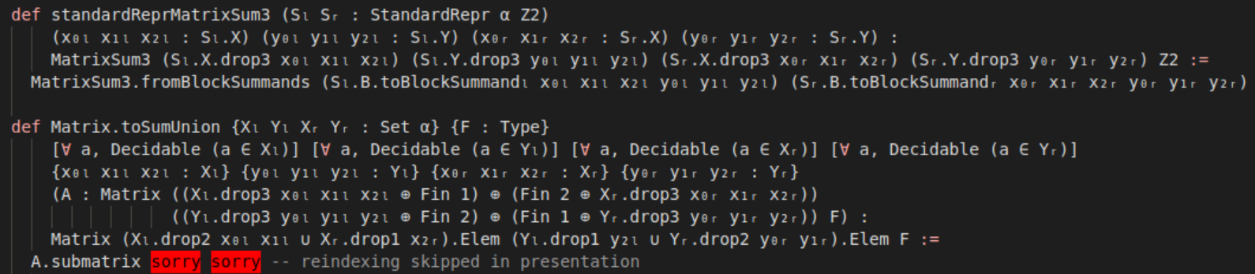

Slide 23
Benefits of Refactoring

Slide 24
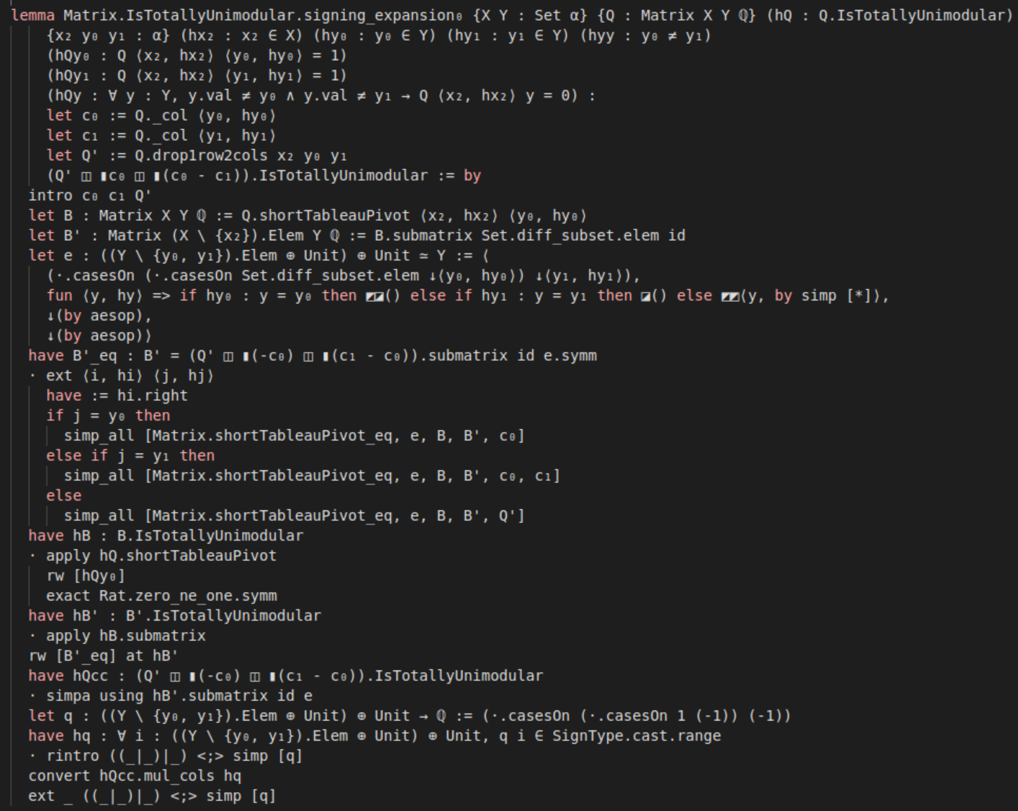

Slide 25


