Slide 1
Seymour’s Theorem Formalization
Project Status Update
Martin Dvořák, Ivan Sergeev
03 July 2025

Slide 2
Overall Status
Foundations
1-sum
2-sum
3-sum
3-sum

Slide 3
Current Status of 3-Sum
01
3-Sum of Matrices
Basic definitions
API
02
Re-signing of Matrices
Re-signing 3x3 matrices
Re-signing matrices based on 3x3 submatrices
Total unimodularity
03
03
Re-signing of summands
Canonical signing of 3-sum
Total unimodularity
Canonical Signing of 3-Sum
Re-signing of summands
Canonical signing of 3-sum
Total unimodularity
Canonical Signing of 3-Sum
04
04
Structural definition
3-sums are generalized
Total unimodularity
Family of 3-Sum-Like Matrices
Structural definition
3-sums are generalized
Total unimodularity
Family of 3-Sum-Like Matrices
05
3-Sum of Matroids
Standard representations
Matroids having a standard representation
Regularity

Slide 4
List of Contributions
Left block in canonically signed 3-sum is TU | Rida Hadamani
3-sum-like matrices are TU | Evgenia Karunus
Form of rows and columns of bottom-left block in canonically signed 3-sum | Alex Meiburg
Bottom-left block of canonically signed 3-sum = sum of outer products of vectors | Ivan Sergeev
Correctness of canonical signing of 3-sum (resulting form, is indeed signing) | Ivan Sergeev
Pivoting in top-left block of 3-sum-like matrix yields a 3-sum-like matrix | Ivan Sergeev & Martin Dvorak
TUness of extension of TU left summand matrix with parallel and zero rows | Martin Dvorak
Merging pull requests + reviewing and optimizing code + maintaining blueprint | Martin Dvorak

Slide 5
🥳 MVP Milestone Reached! 🎉

Slide 6
Verification of Verification: 2-Sum

Slide 7
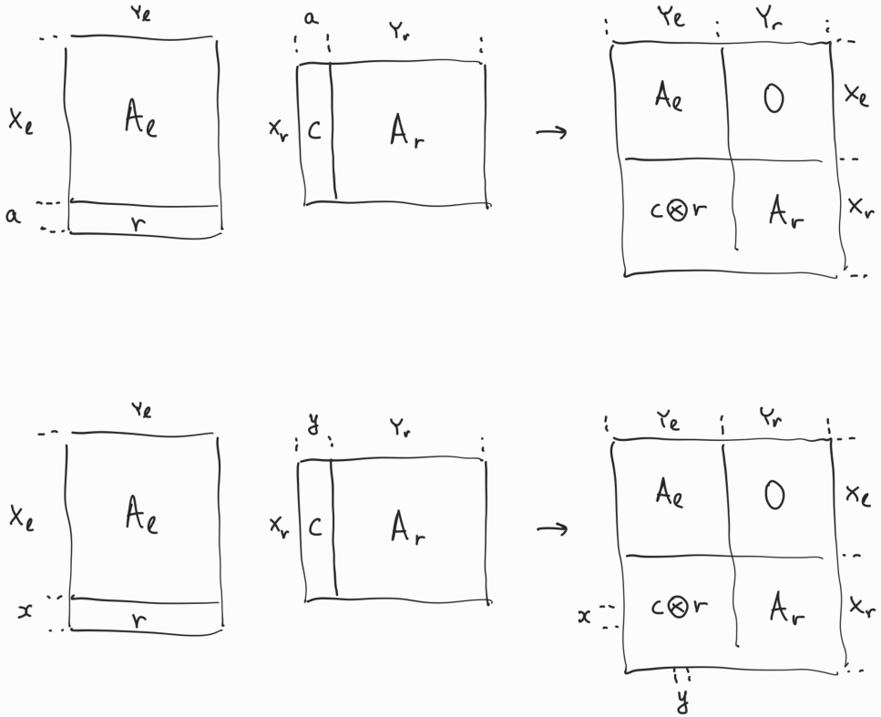
Verification of Verification: 2-Sum

Slide 8
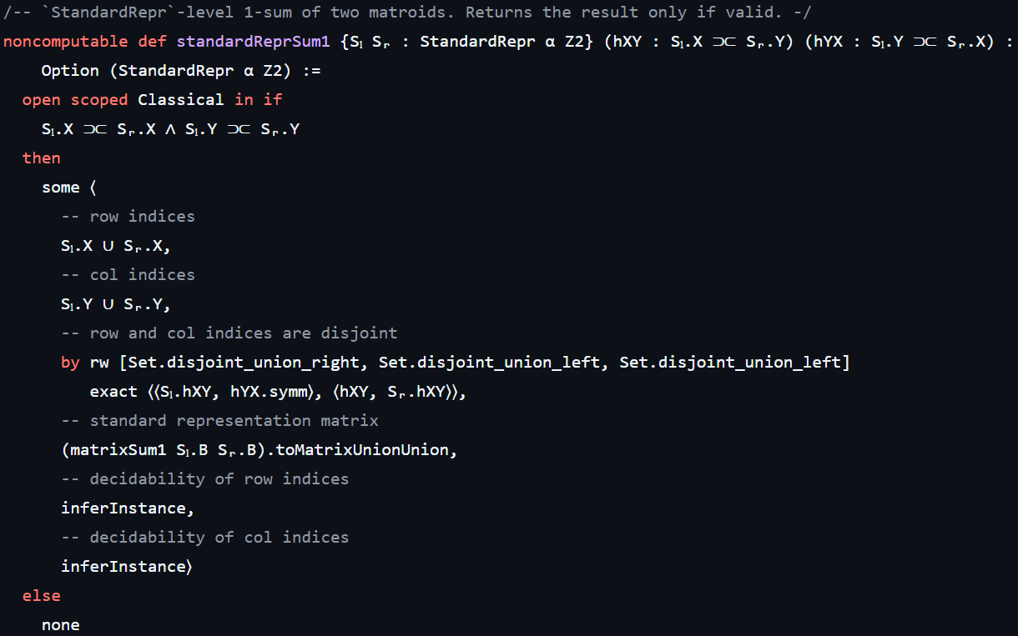
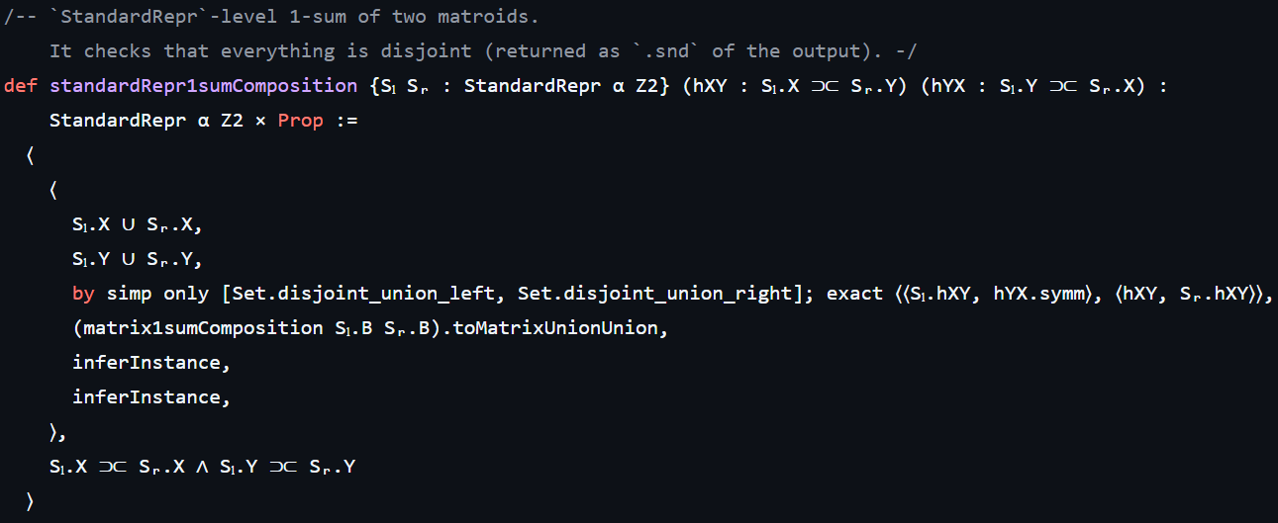
Verification of Verification: Standard Representation Level

Slide 9
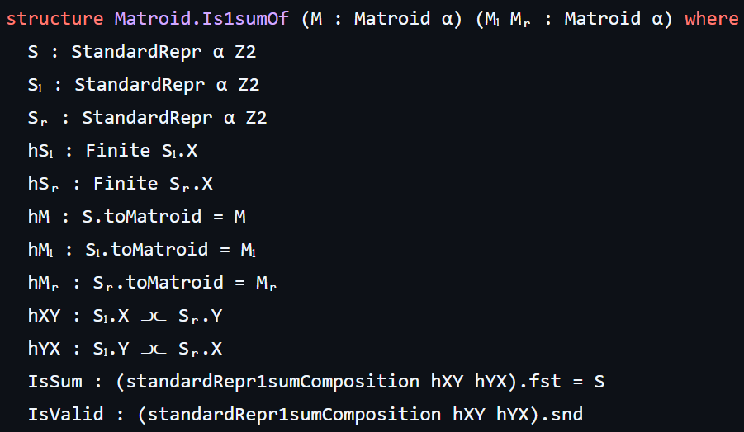
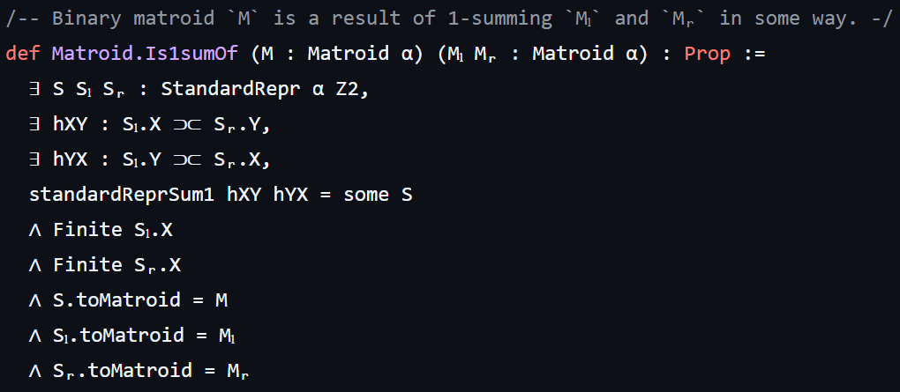
Verification of Verification: Matroid Level

Slide 10
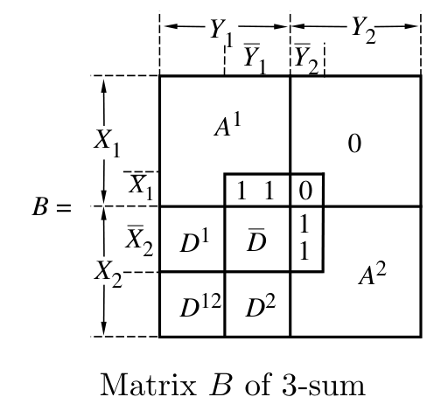
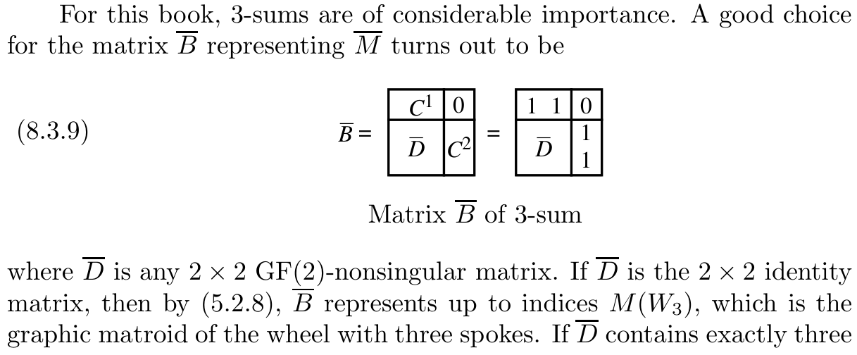
Verification of Verification: Extension of 3-Sum
Current: D is either the identity or contains exactly three ones
Desired: D is invertible

Slide 11
Next Steps: Timeline
Jul 07–11 | Finalize 3-sum
Jul 14–18 | Paper draft 1
Jul 21–25 | Paper draft 1
Jul 28–Aug 1 | Paper draft 2
Aug 04–08 | Paper draft 3
Aug 11–15 | Paper draft 4
Aug 18–22 | Paper draft 5
Aug 25–29 | Backup
Venue: CPP 2026
Abstract: 5 September 2025
Paper: 12 September 2025
Conference: January 12–13 2026

