Slide 1
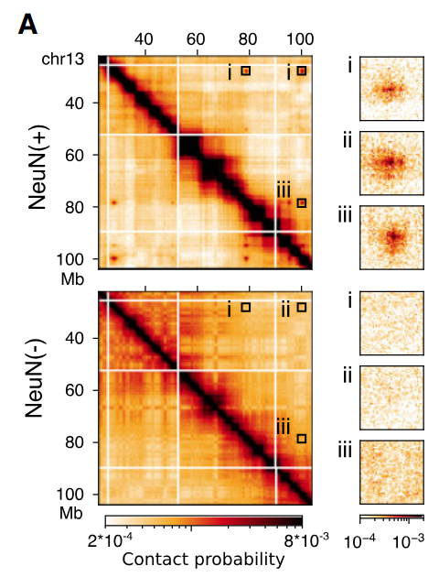
Problem statement: Neuronal dots
“Neuronal dots” – neuron-specific loci on HI-C map
Not fond in glia cells and astrocytes
Formed by long-range chromatin interactions
Provided by PcG-mediated contacts (H3K27)
Nucleic Acids Research, 2024, 52, 6234–6252
https://doi.org/10.1093/nar/gkae271)

Slide 2
Project outline
Starting point: neuronal dots Hi-C map contacts
(chromosome coordinates and annotated genes)
Extract gene set of neuronal dots
Find transcription factors (TFs)
Annotate target genes for each TF and collect set
Analyze cellular localization, molecular function and biological process for the target genes

Slide 3
Results
Neuronal dots contain 482 genes
197 genes were annotated as TFs with GO terms (“DNA binding”, “transcription factor activity”)
664 target genes were found with “Tftarget”
GO enrichments were build for target genes

Slide 4
GO enrichment: molecular function
DNA-binding transcription activator
DNA-binding transcription repressor
DNA-binding transcription factor binding
Integrin binding
Transcription coregulation binding
Receptor regulation
Signalling receptor activator activity
Cell adhesion molecule binding

Slide 5
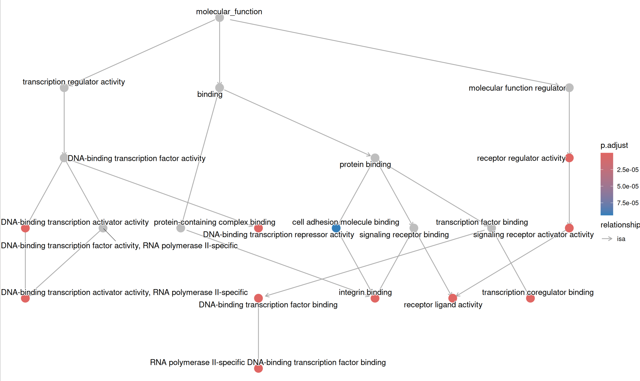
GO enrichment: molecular function

Slide 6
GO enrichment: biological process
Regulation of biological process
Regulation of cellular process
Cellular metabolic process
Cellular response to stimulus
Anatomical structure development
Cell communication
Signalling
Signal transduction

Slide 7
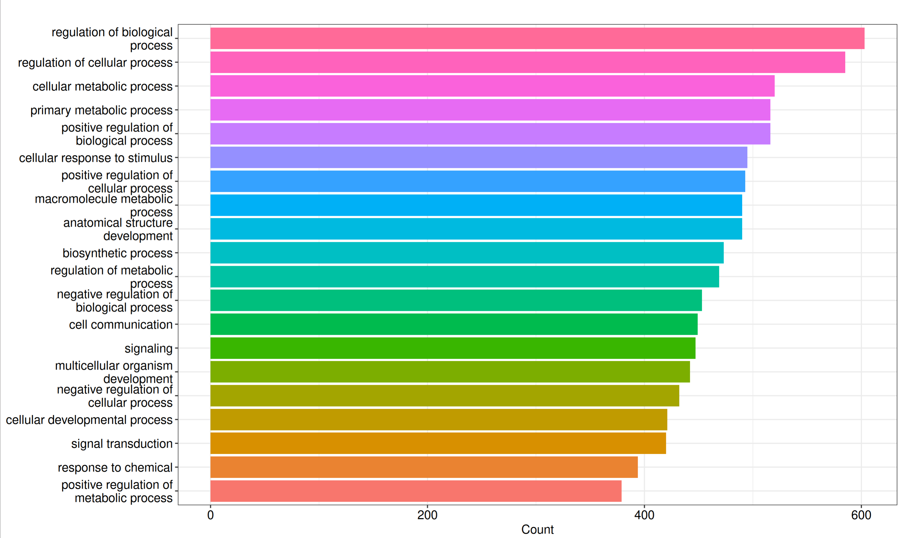
GO enrichment: biological process

Slide 8
GO enrichment: cellular localization
Transcription regulation complex
Receptor complex
Membrane microdomain
External site of plasma membrane
Extracellular matrix
Collagen-containing extracellular matrix
Plasma membrane raft
Platelet alpha granule

Slide 9
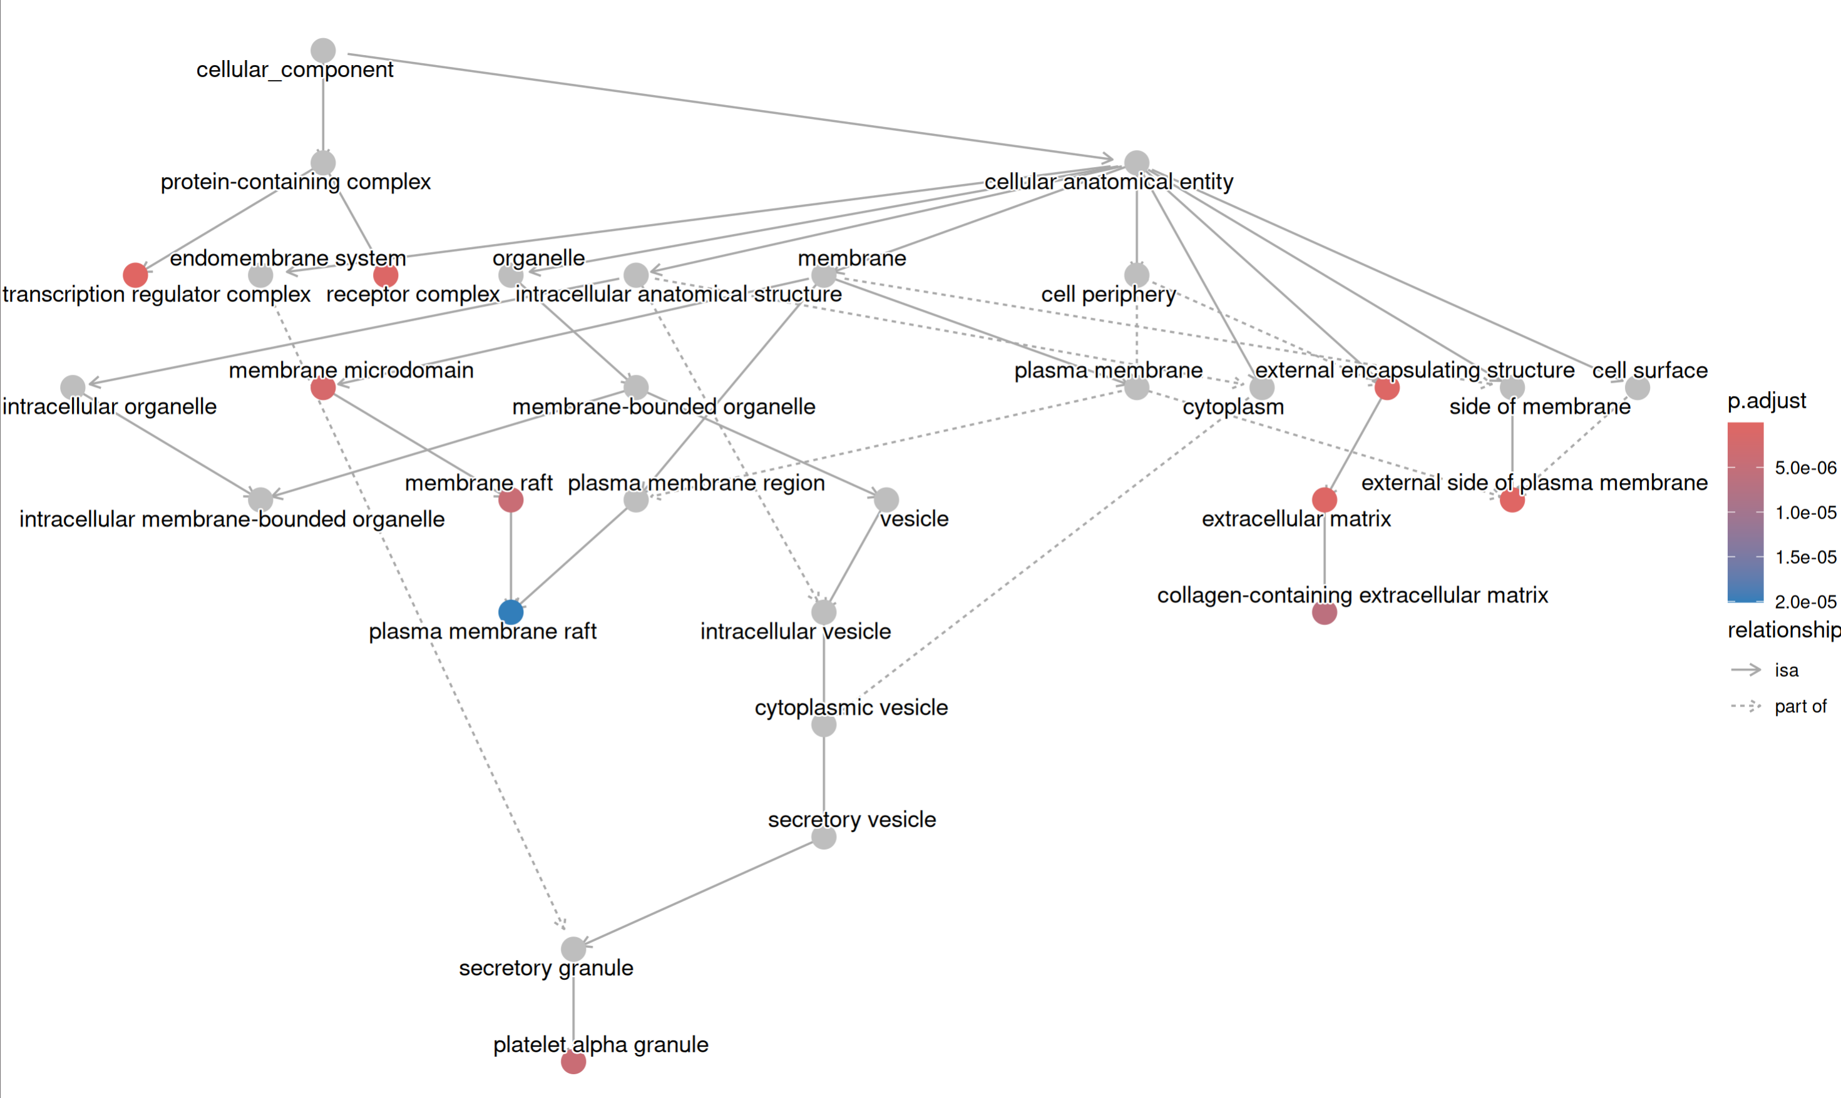
GO enrichment: cellular localization

