Slide 1
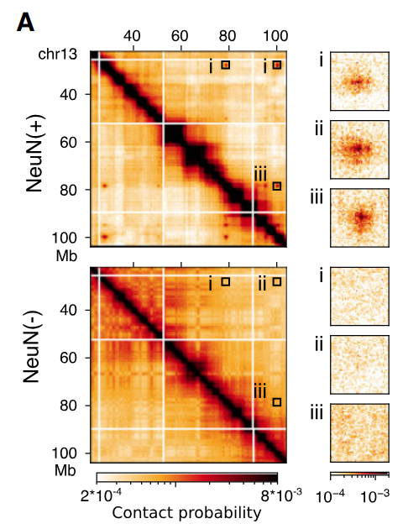
Annotating genes in “neuronal dots”
“Neuronal dots” – neuron-specific loci on HI-C map formed by long-range PcG-mediated chromatin interactions
GO terms
Tftarget.R
GO terms
482 genes
197 TFs
664 targets
197 TFs
GO enrichment:
Transcription regulation
Signal transduction
Cell communication
Response to stimulus / chemicals
Receptor activity

