Slide 1
On the Convergence and Robustness of Adversarial Training
论文阅读
6.6

Slide 2
Overview
1. Background
Target
FGSM
PGD
2.Contribution
Criteria to eval sample: FOSC
Discovery on training stages with diff quality examples
Dynamic training strategy

Slide 3


Background
Target for adversarial training (outer min and inner max)
Generating stage (inner max)
FGSM:
PGD:
Rmk: what’s norm in 3-d matrix e.g. CIFAR-10.

Slide 4
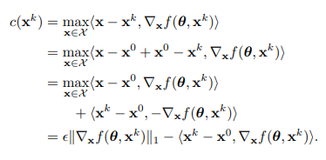
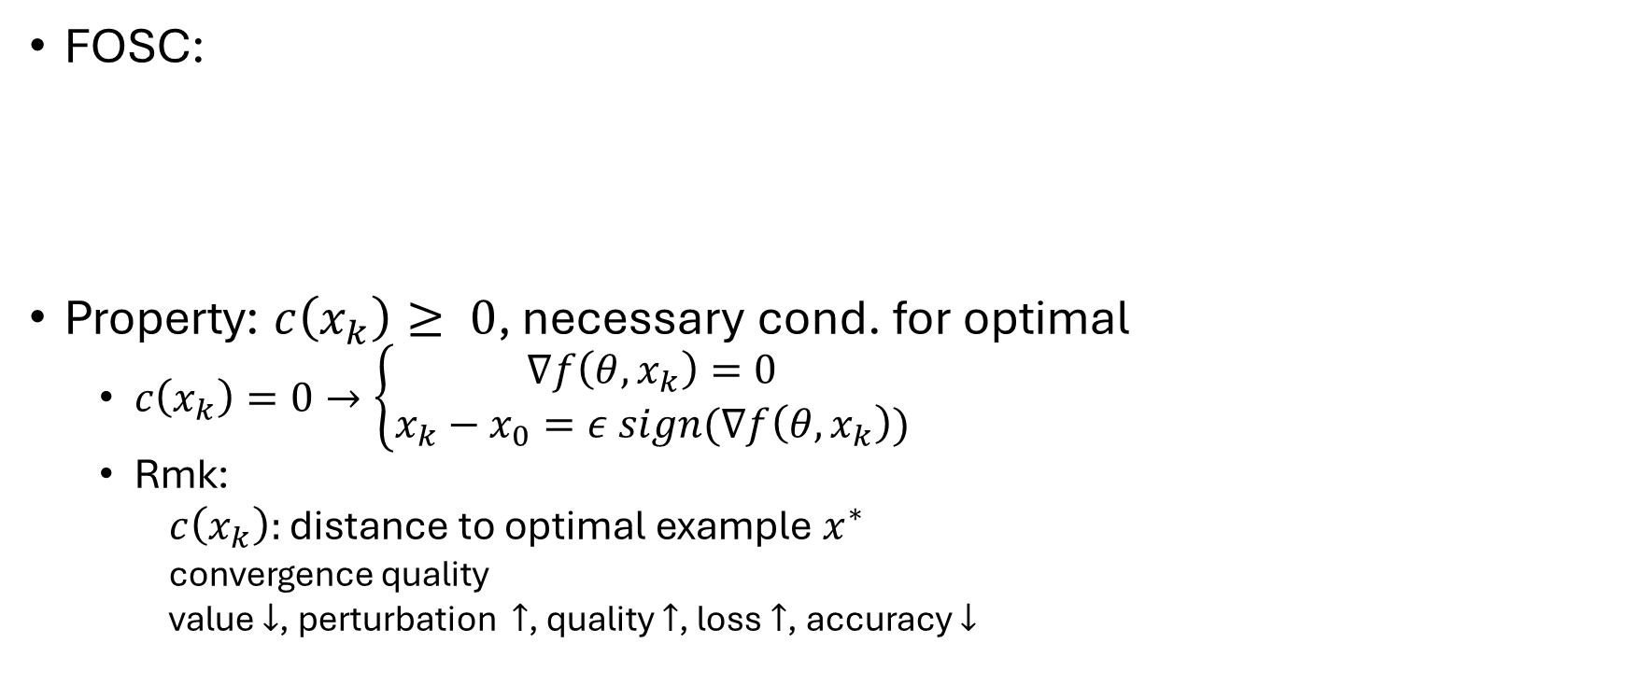
Criteria to eval sample: FOSC
FOSC:
Property: $c\left(x_{k}\right)≥ 0$, necessary cond. for optimal
$c\left(x_{k}\right)=0→\left\{\begin{aligned}∇f\left(θ, x_{k}\right)=0 \\ x_{k}−x_{0}=ε sign(∇f\left(θ, x_{k}\right))\end{aligned}\right.$
Rmk:
$c\left(x_{k}\right):$ distance to optimal example $x^{∗}$
convergence quality
value $↓$, perturbation $↑$, quality $↑$, loss $↑$, accuracy $↓$

Slide 5
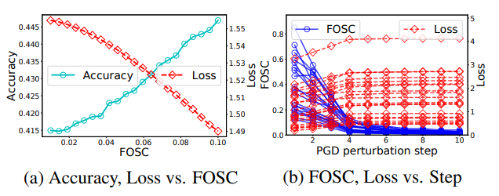
Criteria to eval sample: FOSC
Experiment to show effectiveness of FOSC
Group by FOSC, positive correlation between FOSC and acc, while negative correlation between FOSC and loss.

Slide 6
Discovery on training stages with diff quality examples
better robustness of adversarial training is associated with training on adversarial examples with better convergence quality in the later stages.
Experiment Concept:
White box test and Black box test
Gaussian kernel density estimation

Slide 7
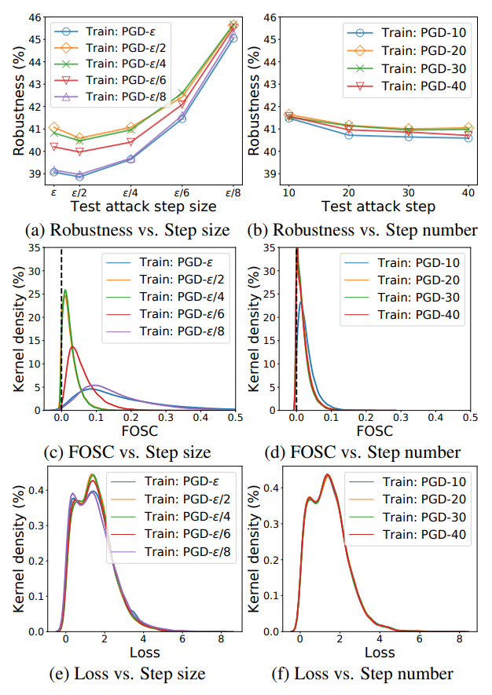
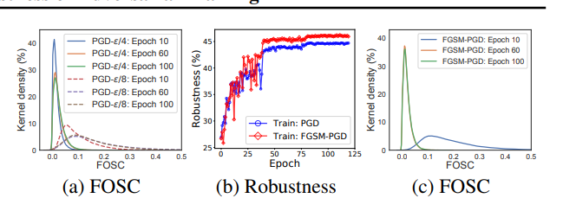
Discovery on training stages with diff quality examples

Slide 8
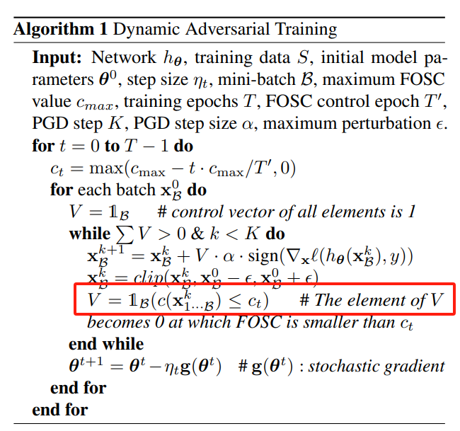
Dynamic training strategy
PGD but with a threshold control the convergence quality of examples.

Slide 9
Discussion
FOSC (evaluation criteria of examples but not algorithm)
Applicable for many other attack algorithms

Slide 10
Adversarial Training for Free
论文阅读
6.13

Slide 11
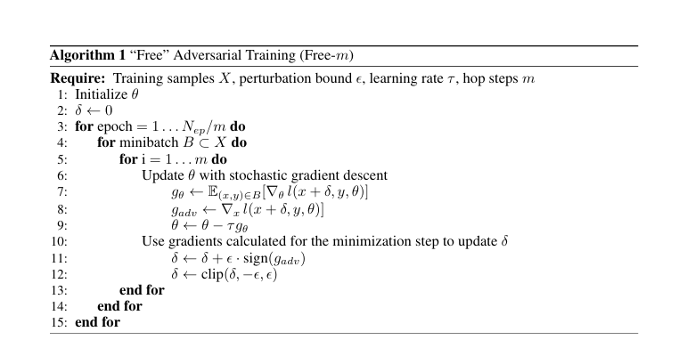
Free adversarial training

Slide 12


















PGD
$$X$$
$$f$$
$$Loss$$
$$∇f_{x}$$
$$X’$$
$$X′$$
$$f$$
$$Loss$$
$$∇f_{x′}$$
$$X′′$$
$$X^{k}$$
FREE
$$X’$$
$$∇f_{x}$$
$$X$$
$$f$$
$$Loss$$
$$∇f_{θ}$$
$$f’$$

Slide 13
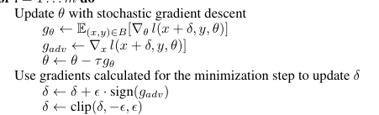
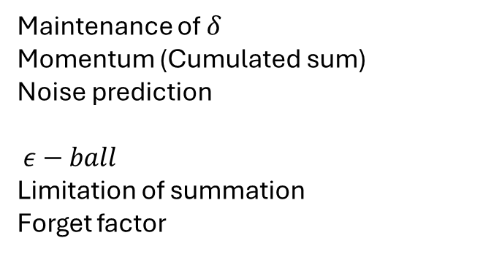
Maintenance of $δ$
Momentum (Cumulated sum)
Noise prediction
$ε−ball$
Limitation of summation
Forget factor

