Slide 1
Adversarial training
7.11
Adapt GD variant optimizers into adversarial attack

Slide 2
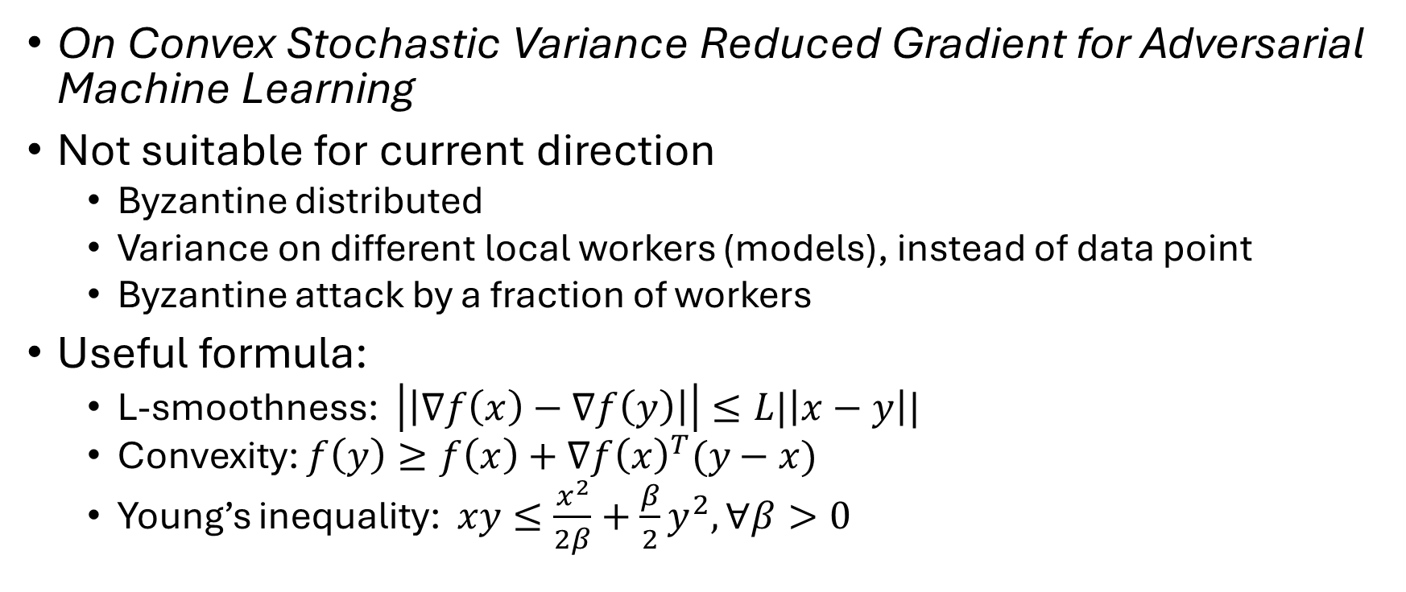
Paper reading
On Convex Stochastic Variance Reduced Gradient for Adversarial Machine Learning
Not suitable for current direction
Byzantine distributed
Variance on different local workers (models), instead of data point
Byzantine attack by a fraction of workers
Useful formula:
L-smoothness: $\left|\left|∇f\left(x\right)−∇f\left(y\right)\right|\right|≤L|\left|x−y\right||$
Convexity: $f\left(y\right)≥f\left(x\right)+∇f{\left(x\right)}^{T}(y−x)$
Young’s inequality: $xy≤\frac{x^{2}}{2β}+\frac{β}{2}y^{2},∀β>0$

Slide 3
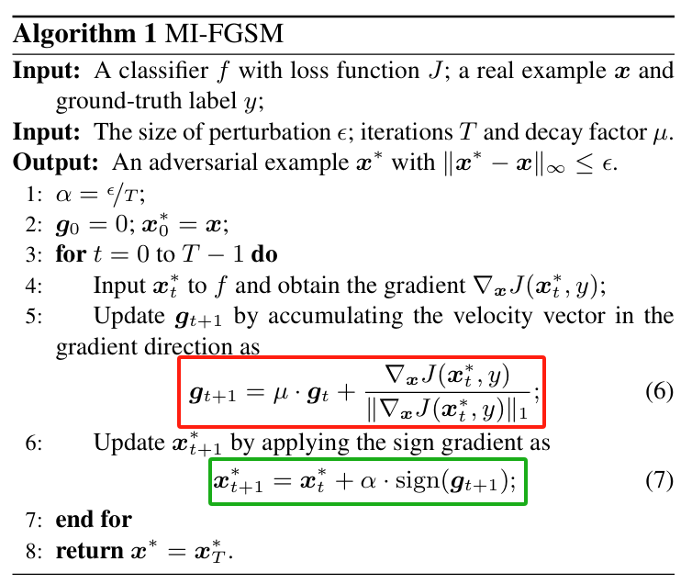
Applying momentum to adversarial attack I
Momentum-Iterative FGSM (MI-FGSM)
To prove:
Proof for convergence rate for adversarial attack may be meaningless. (almost the same)
Difference comes from epsilon restriction
GD with momentum not SGD.
To modify:
Linesearch for learning rate alpha, would be better if we can find the close form under some assumptions.
Rmk: theory part could be not only on proof, but also solution to a problem.

Slide 4
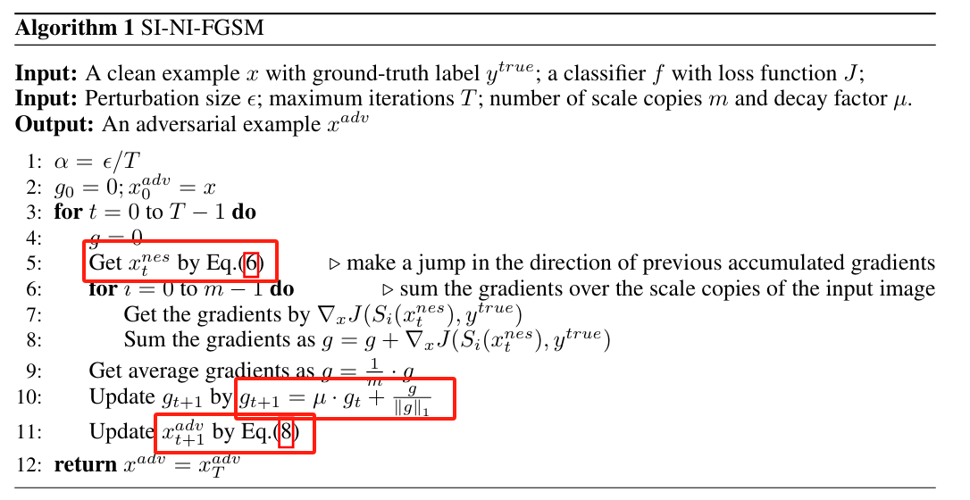
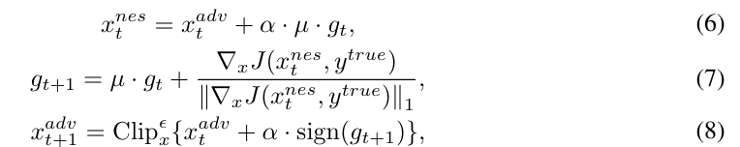
Applying momentum to adversarial attack II
Nesterov momentum (NI-FGSM)

Slide 5
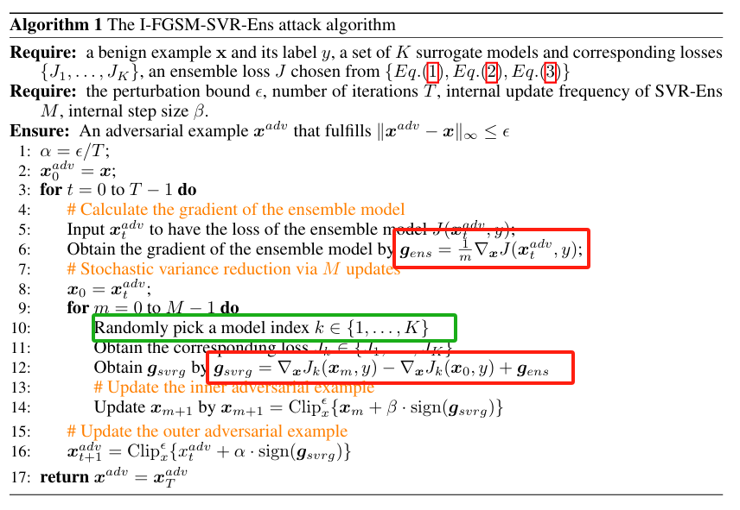
Applying variance reduction I
I-FGSM-SVR-Ens
Stochasticity from different models but not from sample points.
Convergence rate analysis may not be meaningful as adversarial inner attack only takes a few iteration step.
The outer gradient only capture average gradient for current sample x.

Slide 6
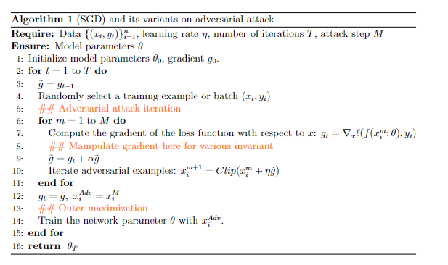
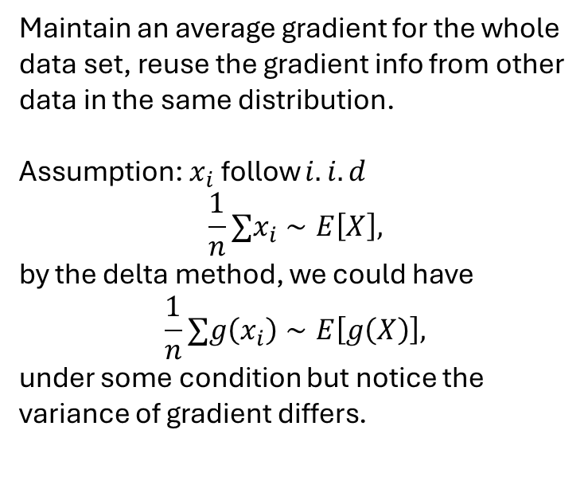
Proposed SGD variant on adversarial attack
Maintain an average gradient for the whole data set, reuse the gradient info from other data in the same distribution.
Assumption: $x_{i}$ follow $i.i.d$
$$\frac{1}{n}∑x_{i}∼E\left[X\right],$$
by the delta method, we could have
$$\frac{1}{n}∑g\left(x_{i}\right)∼E\left[g\left(X\right)\right],$$
under some condition but notice the variance of gradient differs.

Slide 7
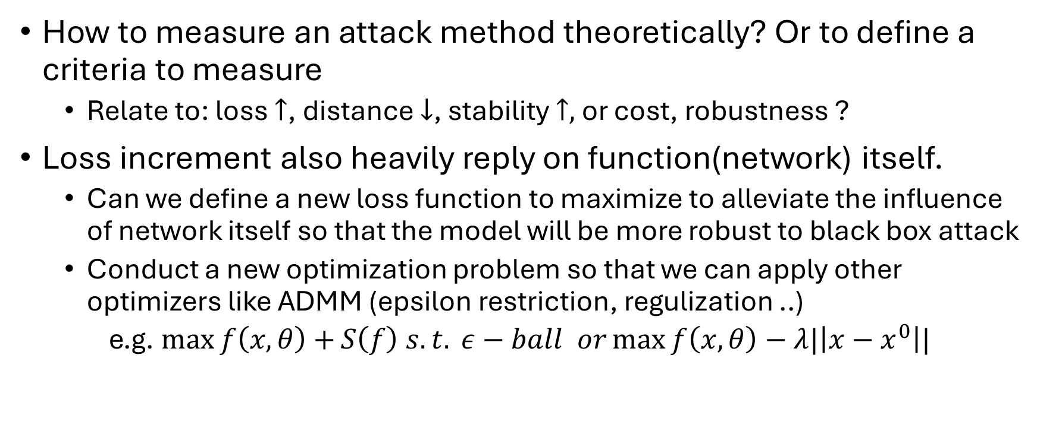
Evaluation criteria
How to measure an attack method theoretically? Or to define a criteria to measure
Relate to: loss $↑$, distance $↓$, stability $↑,$ or cost, robustness ?
Loss increment also heavily reply on function(network) itself.
Can we define a new loss function to maximize to alleviate the influence of network itself so that the model will be more robust to black box attack
Conduct a new optimization problem so that we can apply other optimizers like ADMM (epsilon restriction, regulization ..)
e.g. $\max{f\left(x,θ\right)+}S\left(f\right) s.t. ε−ball or\max{f\left(x,θ\right)−λ|\left|x−x^{0}\right||}$

