Slide 1
Adversarial training
7.18

Slide 2
Overview
Review of attach method and then with momentum
Attack method with previous knowledge
Our proposed method
Further discussion

Slide 3






Review of attack method
$$D_{x}:x_{1},x_{2}…,x_{n}$$
$$x_{1}$$
$$x_{2}$$
FGSM; PGD-k
Momentum: MI-FGSM; NI-FGSM;
FGSM-SVRG
$$x_{1}^{′}$$
$$x_{2}^{′}$$
$$f′$$

Slide 4






Attack with previous knowledge
$$D_{x}:x_{1},x_{2}…,x_{n}$$
$$x_{1}$$
$$x_{2}$$
PGI, PGK: PGI-BP; PGI-EP; PGI-MEP
Our proposed method:
$$x_{1}^{′}$$
$$x_{2}^{′}$$
$$f′$$

Slide 5
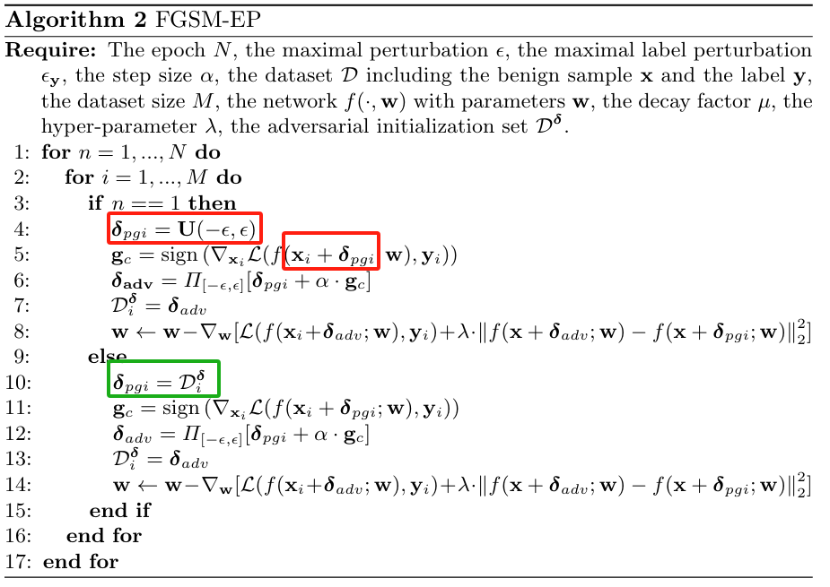
PGI: Prior Guided Initialization
Adversarial initialization from previous batch
It is possible to use previous knowledge to current iteration

Slide 6
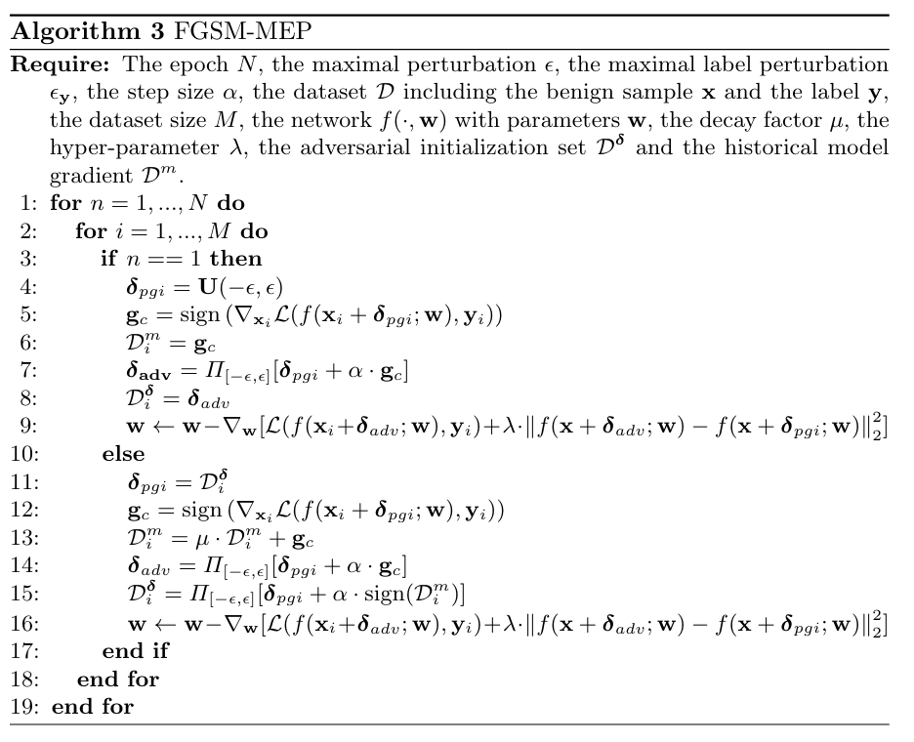
PGI: Prior Guided Initialization

Slide 7
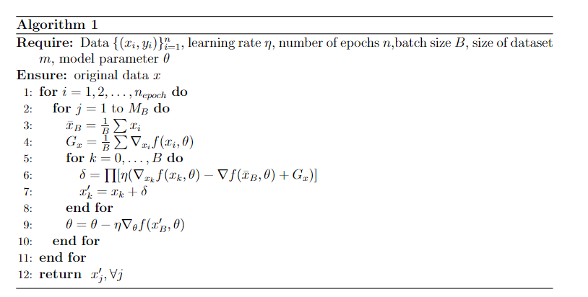
Our proposed method
$$x^{k+1}=x^{k}−η_{k}(∇f_{ik}\left(x^{k}\right)−∇f_{ik}\left(v\right)+∇f(v)$$

Slide 8
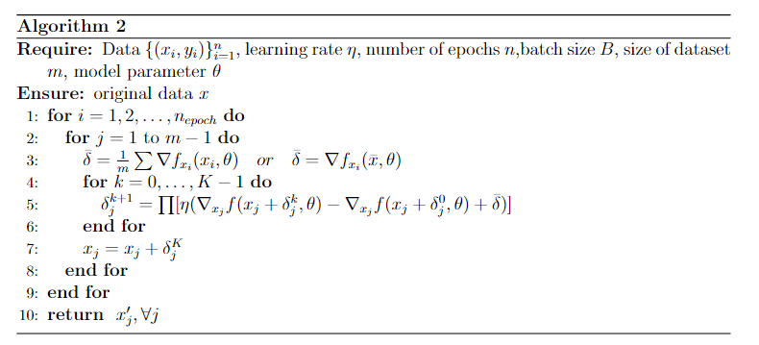
Our proposed method
$$x^{k+1}=x^{k}−η_{k}(∇f_{ik}\left(x^{k}\right)−∇f_{ik}\left(v\right)+∇f(v)$$

Slide 9
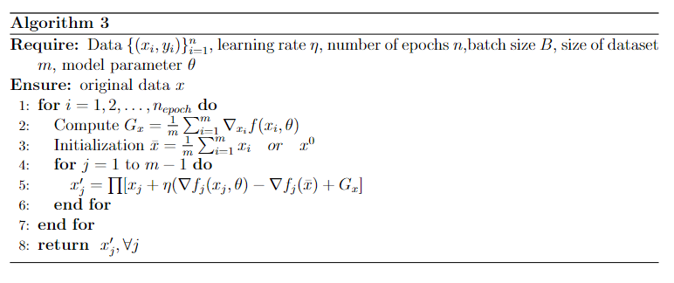
Our proposed method
$$x^{k+1}=x^{k}−η_{k}(∇f_{ik}\left(x^{k}\right)−∇f_{ik}\left(v\right)+∇f(v)$$

Slide 10
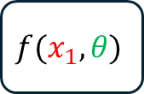
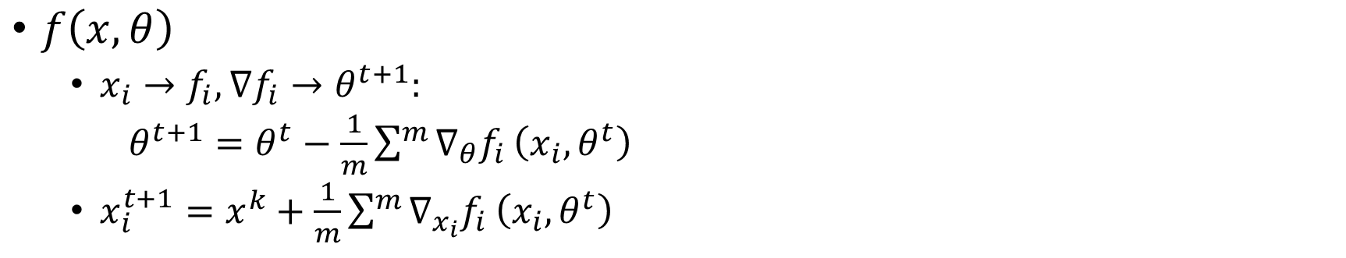

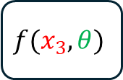
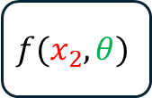
Further discussion
$f\left(x,θ\right)$
$x_{i}→f_{i},∇f_{i}→θ^{t+1}:$
$θ^{t+1}=θ^{t}−\frac{1}{m}\sum^{m}{∇_{θ}f_{i}}\left(x_{i},θ^{t}\right)$
$x_{i}^{t+1}=x^{k}+\frac{1}{m}\sum^{m}{∇_{x_{i}}f_{i}}\left(x_{i},θ^{t}\right)$
$$f(x_{1},θ)$$
$$f(x_{2},θ)$$
$$f(x_{3},θ)$$
$$f(x_{1},θ)$$

