Slide 1
Adversarial training meeting
6.20

Slide 2
Overview
Last week (code review):
Norm in high dim: didn’t consider but only flatten
Epsilon ball: elementwise truncate
Potential interest (cs)
Unsupervised
Pairwise
Language model
Multimodal

Slide 3
Unsupervised adversarial
Learning from Simulated and Unsupervised Images through Adversarial Training
GAN
Replace vector by image to generate synthetic images

Slide 4
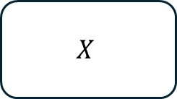


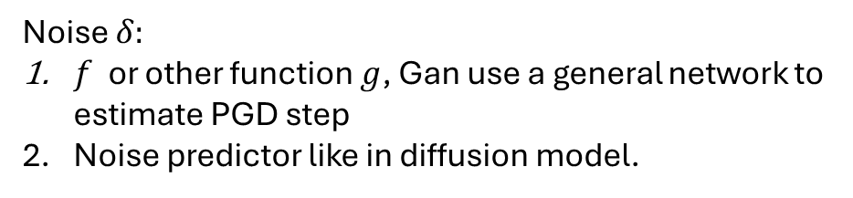




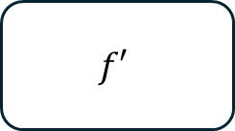


Connection with GAN
$$X$$
$$f$$
$$X′$$
$$f′$$
Gan will train the model with true and adversarial examples at the same time.
$$Gen$$
$$Dis$$
$$X$$
$$δ$$
$$X′$$
$$f′$$
Noise $δ:$
$f$ or other function $g$, Gan use a general network to estimate PGD step
Noise predictor like in diffusion model.

Slide 5
Pairwise adversarial training
Paper: PAIRWISE ADVERSARIAL TRAINING FOR UNSUPERVISED CLASS-IMBALANCED DOMAIN ADAPTATION
Background: Unsupervised Domain Adaptation (UDA)
UDA: transfer learning
Learn a map from source domain to target domain where source domain with labels while target domain with little labels.
Problem: unbalanced class problems
Method: generate adversarial examples by aligned pairwise samples

Slide 6
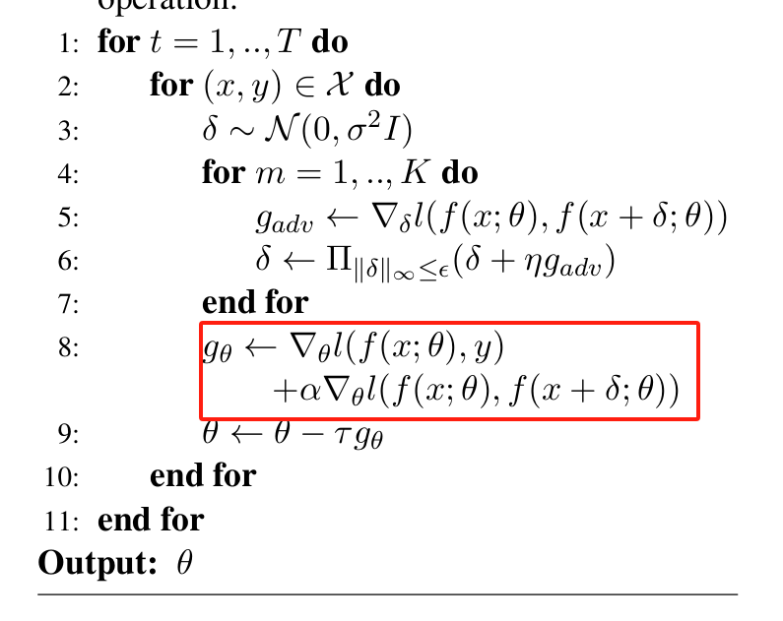
Adversarial on NLP
Nothing new but perturbation on embedding vector
Update network by true and adversarial examples at the same time

Slide 7
Adversarial attacks and defense summary
Papers:
Recent Advances in Adversarial Training for Adversarial Robustness (2021)
Adversarial Attacks and Defences: A Survey (2018)

Slide 8
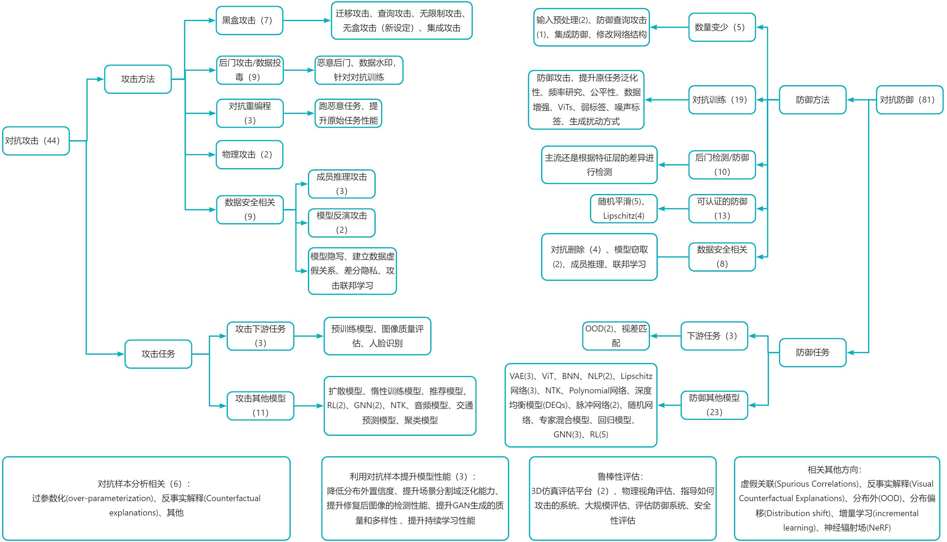
Adversarial Attacks and Defense NeurIPS2022
https://github.com/ylhz/Adversarial_Attacks_and_Defense_NeurIPS2022?tab=readme-ov-file

Slide 9
Papers on theory
THEORETICAL UNDERSTANDING OF LEARNING FROM ADVERSARIAL PERTURBATIONS (2024, Soichiro Kumano, Toshihiko Yamasaki)
Adversarial Training from Mean Field Perspective (Soichiro Kumano, Toshihiko Yamasaki)
Theoretical Analysis of Adversarial Learning: A Minimax Approach

