Slide 1
On the Convergence and Robustness of Adversarial Training
论文阅读
6.6

Slide 2
Overview
1. Background
Target
FGSM
PGD
2.Contribution
Criteria to eval sample: FOSC
Discovery on training stages with diff quality examples
Dynamic training strategy

Slide 3


Background
Target for adversarial training (outer min and inner max)
Generating stage (inner max)
FGSM:
PGD:
Rmk: what’s norm in 3-d matrix e.g. CIFAR-10.

Slide 4
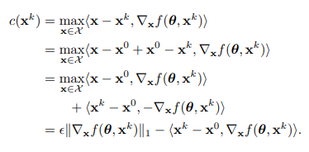
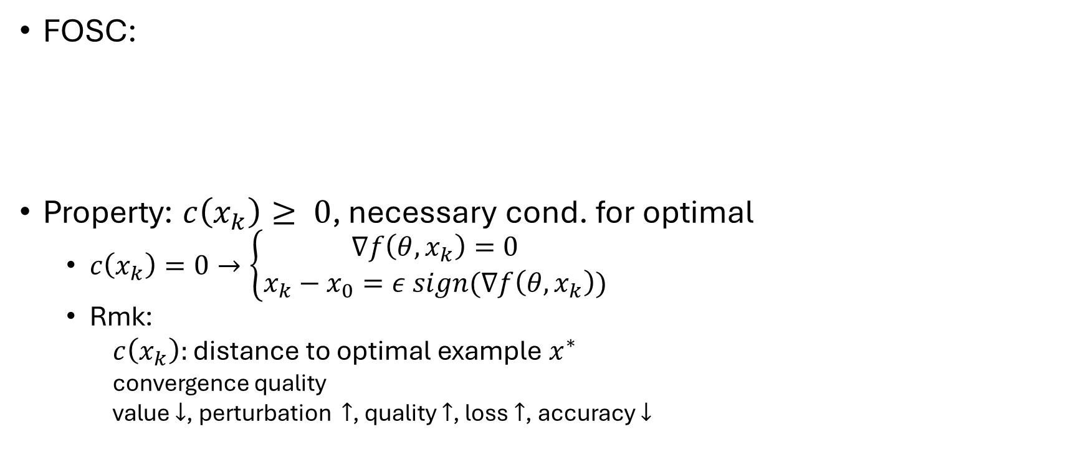
Criteria to eval sample: FOSC
FOSC:
Property: $c\left(x_{k}\right)≥ 0$, necessary cond. for optimal
$c\left(x_{k}\right)=0→\left\{\begin{aligned}∇f\left(θ, x_{k}\right)=0 \\ x_{k}−x_{0}=ε sign(∇f\left(θ, x_{k}\right))\end{aligned}\right.$
Rmk:
$c\left(x_{k}\right):$ distance to optimal example $x^{∗}$
convergence quality
value $↓$, perturbation $↑$, quality $↑$, loss $↑$, accuracy $↓$

Slide 5
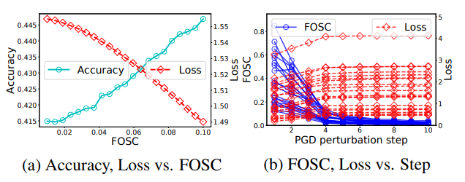
Criteria to eval sample: FOSC
Experiment to show effectiveness of FOSC
Group by FOSC, positive correlation between FOSC and acc, while negative correlation between FOSC and loss.

Slide 6
Discovery on training stages with diff quality examples
better robustness of adversarial training is associated with training on adversarial examples with better convergence quality in the later stages.
Experiment Concept:
White box test and Black box test
Gaussian kernel density estimation

Slide 7
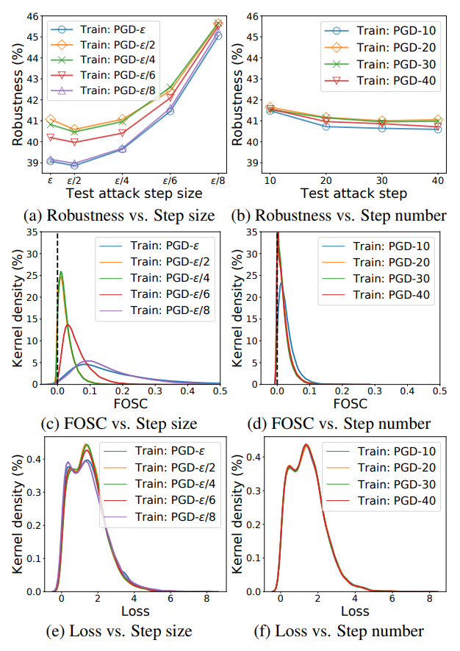
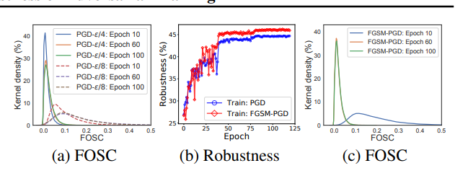
Discovery on training stages with diff quality examples

Slide 8
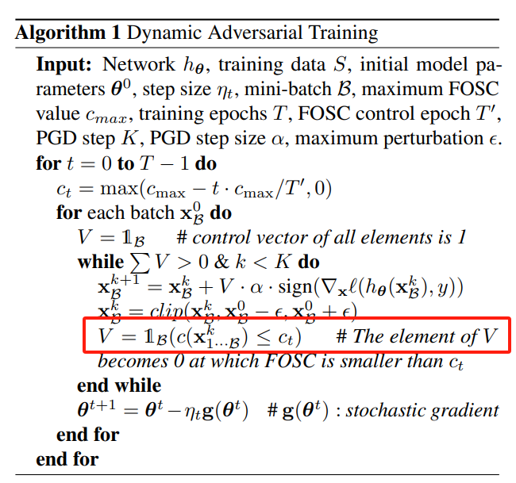
Dynamic training strategy
PGD but with a threshold control the convergence quality of examples.

Slide 9
Discussion
FOSC (evaluation criteria of examples but not algorithm)
Applicable for many other attack algorithms

