Slide 1
Stand By Me
The online therapy application

Slide 2
Greetings!
We are team ‘Solo Play’
Team members:
Immanuel Dsouza
Jeferson X

Slide 3
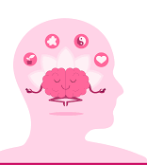
Importance of mental health:
Mental health includes our emotional, psychological, and social well-being. It affects how we think, feel, and act. It also helps determine how we handle stress, relate to others, and make healthy choices. Mental health is important at every stage of life, from childhood and adolescence through adulthood.

Slide 4
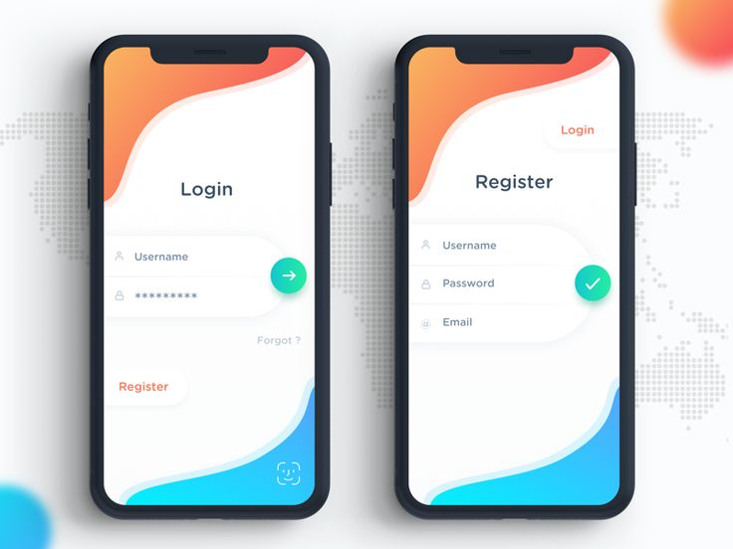
What is ‘Stand By Me’?
Stand By Me is a mobile application that lets you connect with a licensed therapist from the privacy of your device.

Slide 5
Why we need Stand by me:
Therapy can help you learn life-long coping skills.
Therapy can change how you interact with people in your life – in a good way.
Therapy can make you feel happier.
Through its link to happiness, therapy leads to more productivity.
Therapy can help improve chronic stress.

Slide 6
Our process is easy
Attend the online video call
Register an account
Book a time slot of any therapist

Slide 7
Thank You!
Any questions?

