Slide 1

Tito Team

Slide 2
What’s Qronociendo?
System that intends to teach foreign students how the university ambience is around Querétaro and the style of life outside the school environment; this is to be intended to be used as a helpful guide to get adapted quickly to Tec and Querétaro’s culture in a way that is easy to understand.

Slide 3
State-of-the-art
http://www.asomarte.com/
http://www.visitmexico.com/es
http://www.de-paseo.com/Home/Home.htm
http://venaltec.queretaro.itesm.mx/
http://www.queretaro.gob.mx/
http://www.mexicodestinos.com/

Slide 4
Opportunities for innovation
The main weakness we intend to solve or the way we intend to innovative is creating an interactive system that is directed towards a specific audience. All these websites are directed towards the general public, and you have to dive through the vast amount of information offered by these websites to find what is relevant to you, and this is determined on many occasions by the age group you belong to.

Slide 5


User Profile
18-25
Tec students
Foreign people

Slide 6
Design
Colour palette, textures, fonts and alignment type
Colour palette: Various blue tones along with solid white color.
Textures: Solid colors and gradients for: the background, the information text color and the borders of the shapes that encapsulate text and images.
Fonts: Sans-serif fonts (Oswald typeface would be our main font)
Alignment type: Most information would be aligned to the left. Some titles aligned to the center.

Slide 7
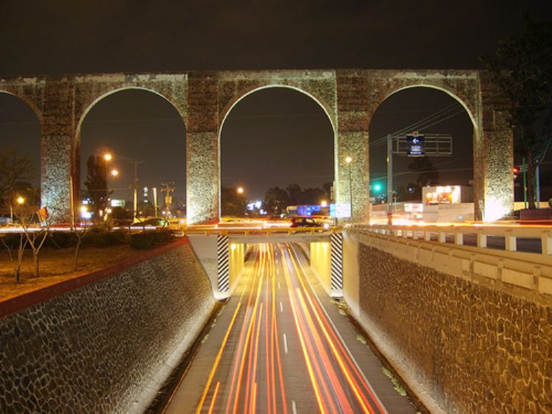

Location
ITESM Querétaro and the city of Querétaro

Slide 8
Interaction design
Since the interface is design for young foreign people that will browse and explore the information, we thought convenient a simple and intuitive interaction system, that supports the international- student experience, we are looking forward a positive, satisfactory, easy intuitive and pleasurable experience by using the application, an interface that reaches the users expectations that requires easy steps to perform tasks.

Slide 9
Interaction design
The system’s interface will be a Web interface, and the user will be able to interact with the following menus:
“Viviendo de noche”
“Frío o calor”
“¡De qué hablar!” a category that displays a list of the most trending youtube videos that everybody is talking about; includes politics, gossip, school, etc. as well as the direct link to the video.
“A viajar”

Slide 10
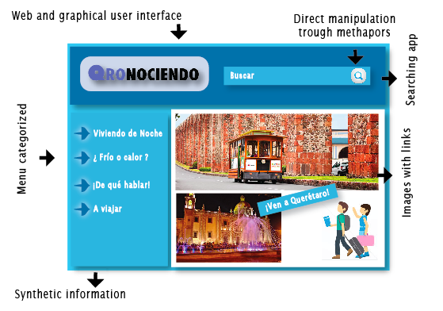
Scenario sketch

