Slide 1
QRONOCIENDO
II Delivery
Tito team

Slide 2
Getting user information:
Online Surveys and personal statements videos helped us to determine the characteristics of the personality of our targeted user group and the features that our application should content

Slide 3
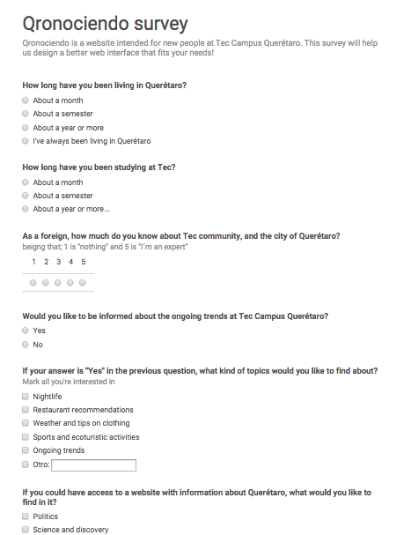
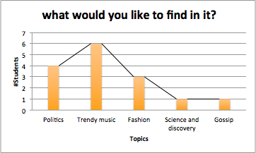
Survey

Slide 4

Potential users’ personal statement

Slide 5
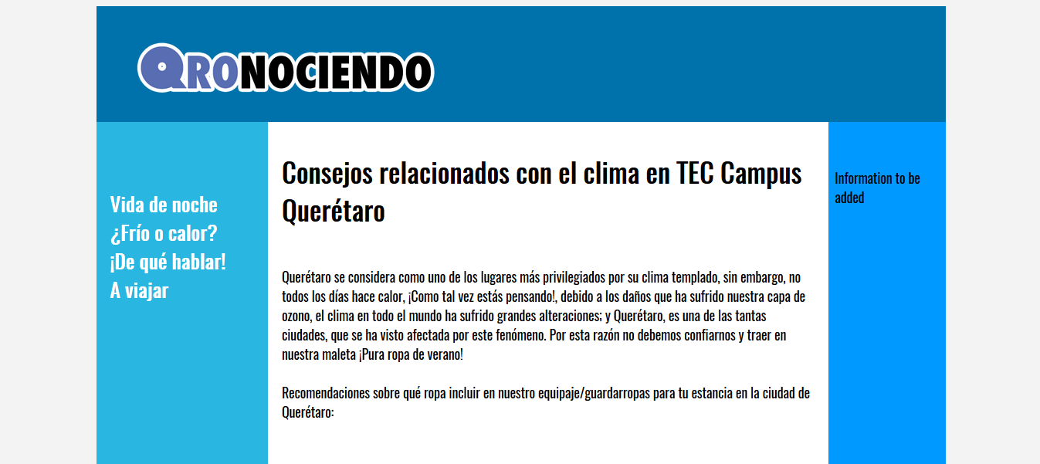
Prototype design

Slide 6
Prototype design
This website is the earliest version of the prototype we have so far, it shows the basic interactions that our system would have with the user, showing an example of an interaction scenario.

Slide 7
Prototype design
Information design: star organizational structure of the content. To get through the different information menus, the user does not have to follow a sequence, it can surf around the application in the order the user may wish.

Slide 8
Prototype design
Interaction design: we selected a group of interactive components, that allow the user to communicate with the application; based on the user personal characteristics and preferences. Which consists in pop up menus organized in easy and common topics.

Slide 9
Prototype design
Visual design: proximity of the buttons that constitutes the different topics of the website, so the user can group them as a principal menu and becomes easier to separate the different areas of the website on an easier way. We also apply the similarity principle, which consists in establishing the same appearance: colour, shape and size, to the elements of each topic, so the user can perceive them as a part of the same object.

Slide 10
Golden Rules
Strive to be consistent: keeping the same colours and typographies through the interface. Also the same way to interact, which is by menus, articles, and everything as the user choose.
Design of dialogues that lead to an end: leading the user through menu-> article-> home and viceversa.
It is better to prevent errors: Qronociendo won’t have UI elements that may cause an error.

Slide 11
Golden Rules
Allow "undo": The menu will be always there so the user can go to a page back.
Give the control to the user: if the user doesn’t click at any menu nothing would happen, he chooses between the topics in order to watch only what’s interesting to him.
Avoid to overload the user's memory: very simple interface, with no needs of instructions, just a side of menus and an intro to the site.

Slide 12
Design principles
Universal usability: a very simple interface so there will be no need to separate the different types of users (unless the user has special capabilities).
Windows and menus: the user chooses what he is interested in and navigates in the page throughout menus.
Icons and typography: icons as the logo and Queretaro pictures will remain through the interface, as the main typography oswald stencil.
Interaction devices: will be mainly computer as it’s what is designed for, but could be used in mobile and tablets (not app).

Slide 13
Design principles
Organization and distribution: star organizational structure, where the user does not need to follow any steps in order to get what they are interested in, they can navigate to other websites from Qronociendo.
Widgets and controls: the interface will use widgets in order to give an easy access to the frequently used functions.
Feedback and error handling: Qronociendo will provide feedback to the user when they search for specific things. The site will not pop up alert messages with red icons when an error is discovered.

Slide 14
Emotional aspects
Positive emotions: some of Qronociendo sections will have emoticons and sounds. The whole interface will be done very simple and with nice colours so the user have positive emotions while he’s in the site.
Frustration (how to avoid): will not have complex elements that could lead the user to not understand the interface.Avoid using childish designs that could make the user feel stupid and threatening messages
Persuasive technologies: we intend to persuade the user to go out and know the city they are living in and increase movement in their lives.

