Slide 1

Third Advance
Tito team
Iván Alejandro Soto Velázquez A00225851
Lilián Andrea Rosales Ramírez A01204565
Carla Serrano Pesquera A01206336

Slide 2
Development of the interactive system
The system is a website coded by the Bootstrap framework (HTML, CSS and a bit of jQuery knowledge )
Link:
http://siqueiros.qro.itesm.mx/al225851/Qronociendo2015/

Slide 3
Component evaluation design
Usability, design and functionality:
Our users were recorded after each session of navigating through the website.

Slide 4
The strategy Think Aloud ….
Consisted in the user describing their experience, navigating and tasks we asked them to perform. As a result, we got real and useful feedback for the improvement of the design and functionality of the interface.

Slide 5
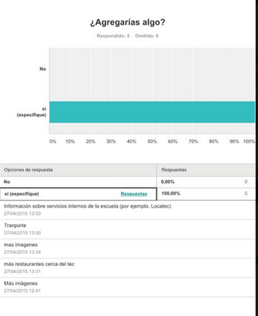
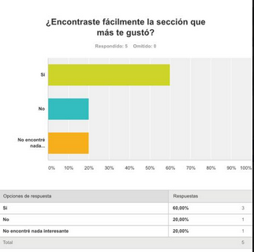
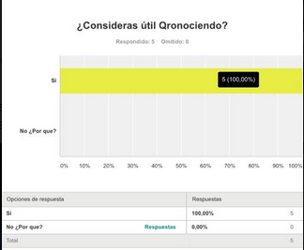
Also Surveys
This tool helped us to get in touch with more users.

Slide 6
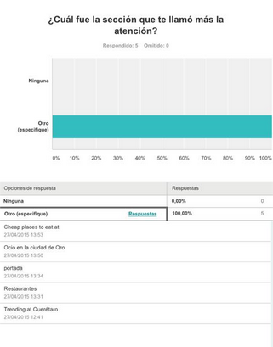
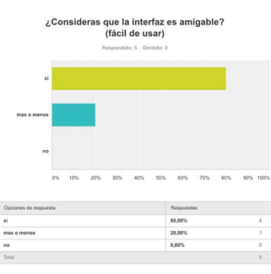
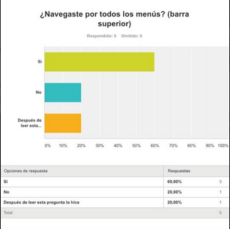

Slide 7
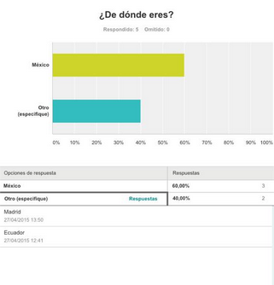
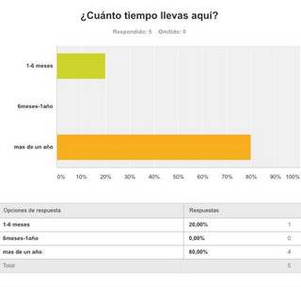

Slide 8
Analysis of the evaluation and determination of corrective actions
Opportunities for improvement and opinions from the users: INFORMATION WISE
How to get a book from the library?
Biking system inside Tec
Places in the city for currency exchange
Sports available in campus

Slide 9
An alternative spanish version of the site
Offer more alternatives to the “I´m looking for a roomie” section
Add info about what is unique in Querétaro city
Info about local sport schedules and events
Info about local cultural schedules and events
Info about transport (Bus-routes system in both; Tec and city)
Ongoing events/activities in the city

Slide 10
Opportunities for improvement and opinions from the users: DESIGN WISE
The main page should have most of the useful info, instead of have to navigate through the menus to find it
Stand out the “Restaurant” section
A more dynamic typography
All the images should belong to the designers

