Slide 1
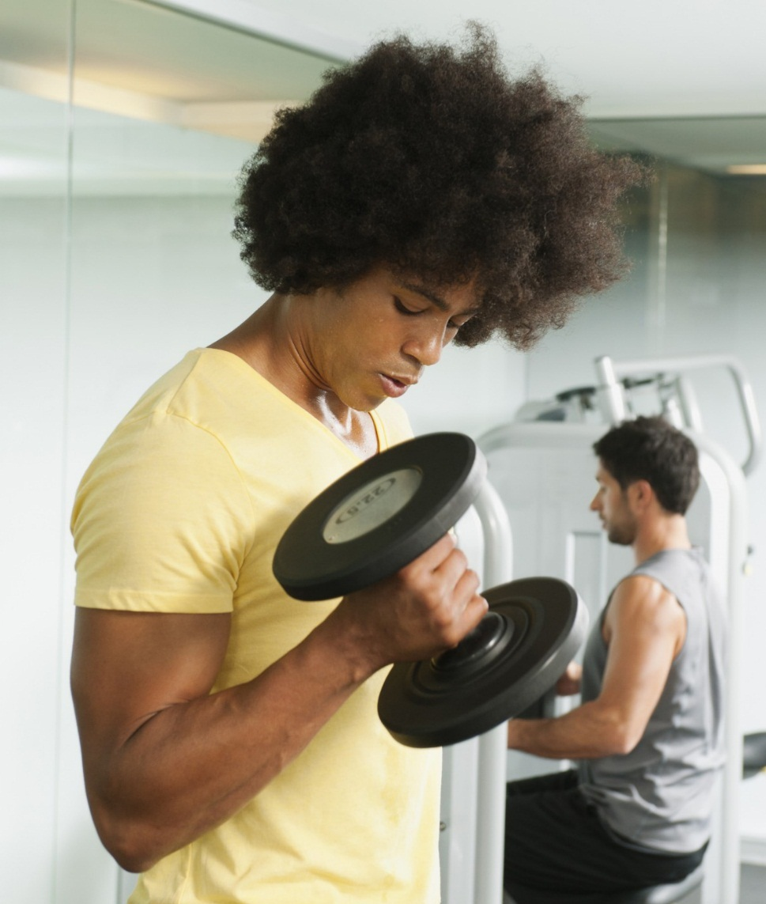
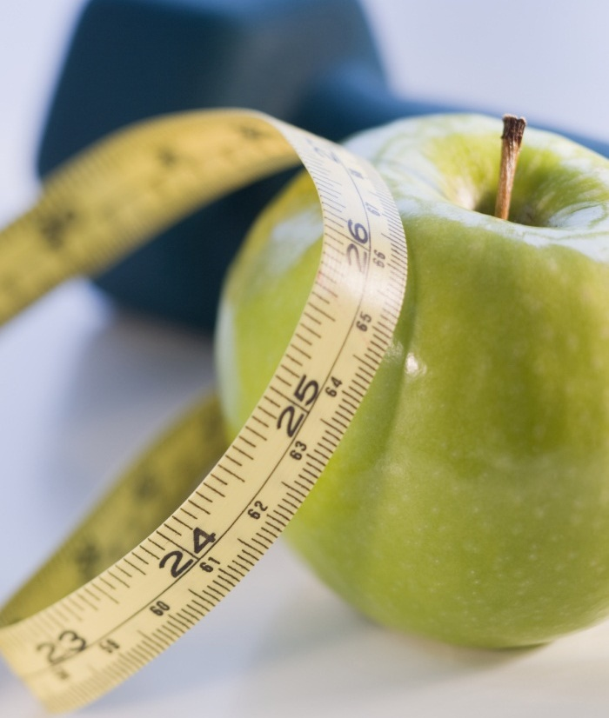
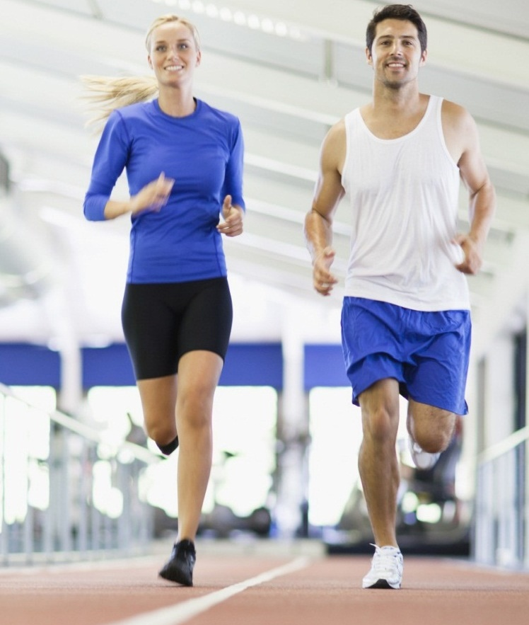
BALANCED LIFE
APP FOR BETTER HEALTH AND LIFE
Presenter: Ivan Azapovic

Slide 2
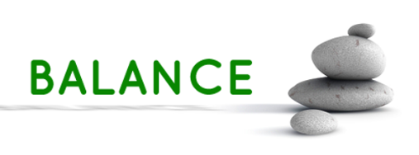
PROJECT OVERVIEW
Creation of a Wellness App aiming to promote balanced and healthy living by providing users with tools for managing their health effectively.
The inspiration came from a personal realization that maintaining a balanced lifestyle is vital for overall well-being and that finding time for wellness is very challenging nowadays. This App seeks to fill this gap by offering accessible and practical wellness solutions.
Project Goals:
Analyze and present global trends in nutritional consumption and BMI over time, fostering a broader understanding of health patterns.
Provide meal plans and exercise suggestions tailored to individual lifestyles.
Design and develop a user-friendly App to calculate Body Mass Index (BMI) and offer personalized nutritional advice.

Slide 3
PROJECT METHODOLOGY
Brainstorming -> used brainstorming sessions to refine project scope and establish objectives.
Agile Framework -> adopted an Agile approach, focusing on iterative development and continual feedback to refine the app based on user needs and insights.
Data Collection with Kaggle and APIs -> gathered diverse datasets from Kaggle, Our World in Data API, and API Ninjas, ensuring a comprehensive data foundation.
Data Processing in Python:
Pandas -> cleaned data by handling missing values and ensuring data consistency
Data Merging -> integrated datasets using full, left, and right joins to form a cohesive dataset
Feature Engineering -> transformed data to generate valuable insights and support advanced analysis
Exploratory Data Analysis with Descriptive Statistics -> analyzed data using Pandas' describe() for statistical summaries
Visualization Tools -> utilized Matplotlib and Seaborn to visualize trends and patterns effectively.

Slide 4
PROJECT METHODOLOGY
App Development:
Streamlit -> developed an interactive App interface with Streamlit, enhancing user engagement
API Integration -> incorporated real-time data features like exercise suggestions using API Ninjas.
Database Integration with SQL Database Connection -> set up a connection to SQL database, storing data in real-time, for seamless retrieval and future analysis.
Version Control and Development Environment:
GitHub -> managed project files and source code with GitHub, including essential files like README, requirements.txt, .gitignore, and .env.
VS Code -> utilized Visual Studio Code for development, and created an isolated environment ('balanced_life_env') for consistent execution.
These project’s methodology and tools resulted in a comprehensive App that offers valuable insights and supports users in managing their health effectively.

Slide 5
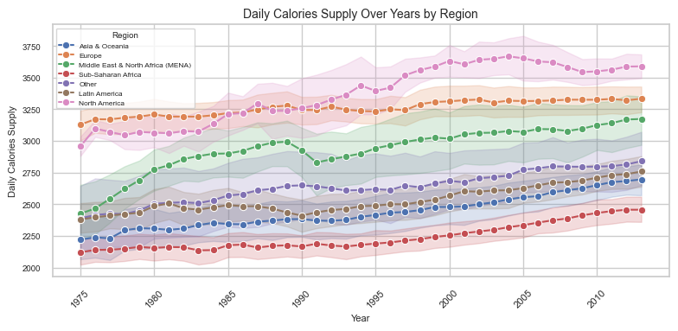
EXPLORATORY DATA ANALYSIS (EDA)
Calories intake Trend by Region

Slide 6
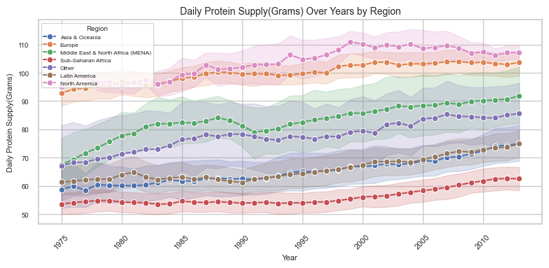
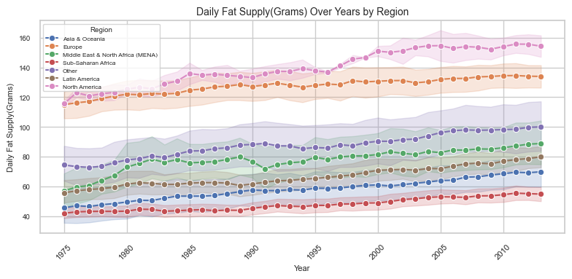
EXPLORATORY DATA ANALYSIS (EDA)
Protein intake Trend by Region
Fat intake Trend by Region

Slide 7
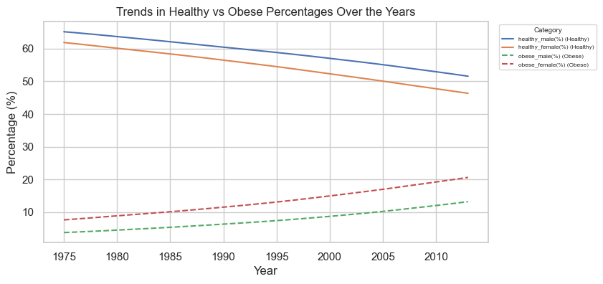
EXPLORATORY DATA ANALYSIS (EDA)
Health vs. Obese Trend (Male and Female)

Slide 8
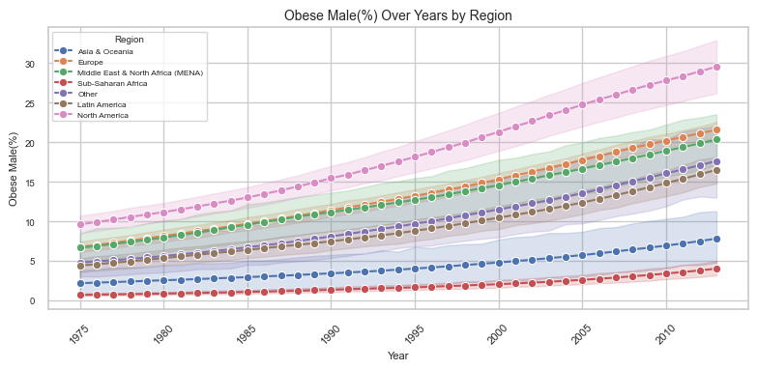
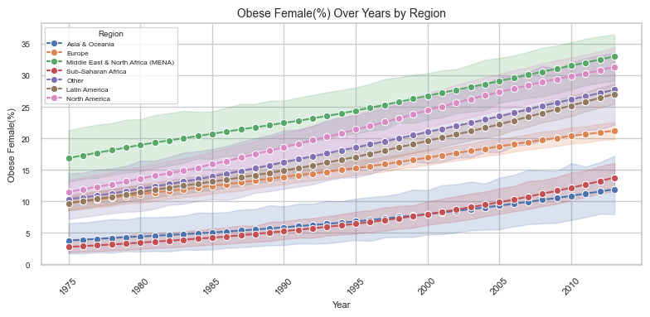
EXPLORATORY DATA ANALYSIS (EDA)
Obese Male Trend by Region
Obese Female Trend by Region

Slide 9
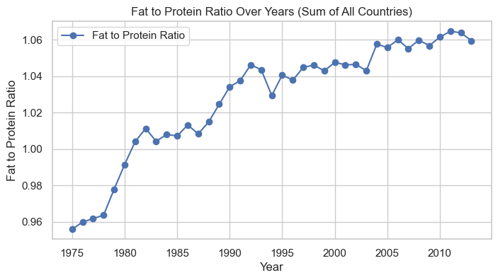
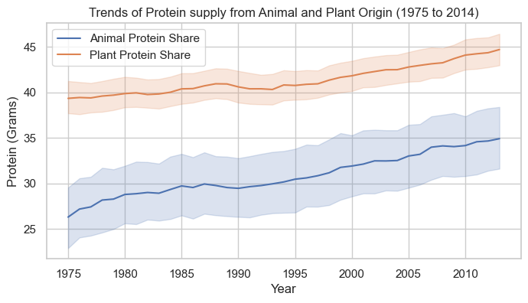
EXPLORATORY DATA ANALYSIS (EDA)
Fat/Protein Trend
Animal vs. Plant Protein Trend

Slide 10
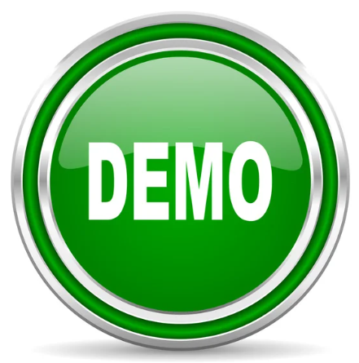
BALANCE LIFE APP DEMO

Slide 11
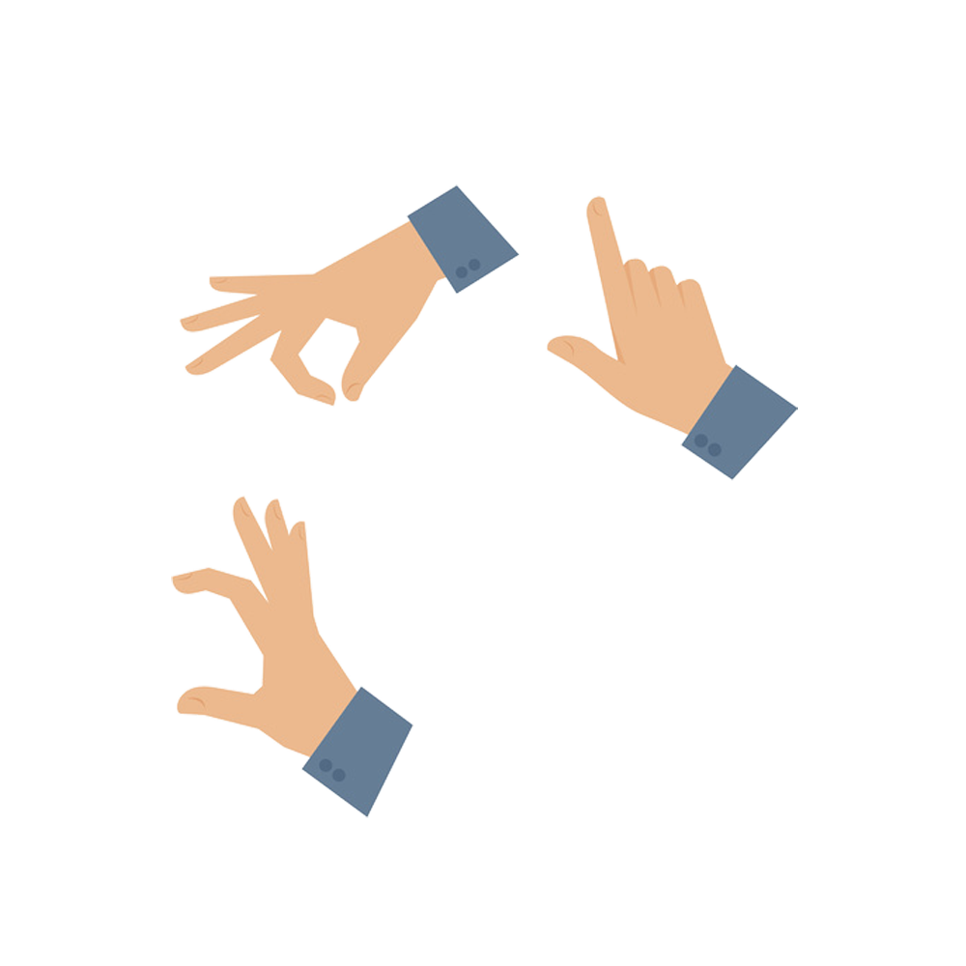
KEY FINDINGS
Nutritional Trends
Significant increase in protein, fat and generally calorie intake, with regions influencing BMI.
Weight Patterns
Substantial rises in obesity especially in certain regions (e.g. North America male and female obesity rate increased by 20%).
Health vs. Obesity
Major decrease in healthy weights across both genders, accompanied by a rise in obesity
Macronutrient Balance
Shift in fat-to-protein ratio indicating changing dietary habits globally.

Slide 12
NEXT STEPS -> FUTURE WORK
Launch & Iteration
Feature Expansion
Prepare for App launching and plan iterative updates for continuous improvement
Expand Data Sources
Develop additional functionalities, such as mental health tracking and personalized physical health coaching
Enhance User Feedback
Integrate more diverse datasets to broaden insights and recommendations
Continuously update and refine App features based on users' feedback

Slide 13
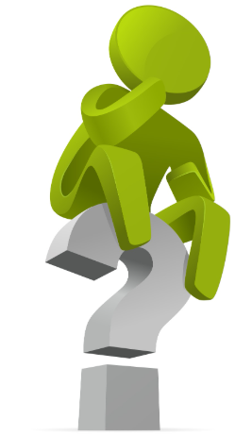
THANK YOU!
BALANCED LIFE
APP FOR BETTER HEALTH AND LIFE
PRESENTER: IVAN AZAPOVIC

