Slide 1
Market Segmentation Strategies
Ivan Bizberg Barraza

Slide 2
What is the main Objective?
Develop a strategy to maximize donation profits for MSF

Slide 3
Methodology
Understand the audience
Not all persons donate the same amount of money.
Objective
Target a specific audience to optimize both the likelihood of donations and the donation amounts.
Methodology
Utilize descriptive analytics to gain insights into our audience.
Employ a machine learning model to pinpoint the target audience and optimize donation profits, taking into account both the likelihood of responding to the donation request and the potential donation amount.
Results
Mainly target:
Unmarried male lawyers aged between 30 and 50.
Unmarried female artists aged between 71 and 100.

Slide 4
Requested descriptive analysis
What is the gender that donates the most?
What are the ages that donate the most?
There are no significant differences in the average donation between females and males*.
However, the number of male donors is 20% higher. Males contributed more to MSF funds by 14%.
On average, donors aged between 73 and 89 years old contribute the most.
However, as donors aged between 35 and 40 years old are more common, they contribute more to MSF funds.
What are the professions that donate for the longest periods?
Homemakers are the profession that donates for the longest duration on average, 3 years, followed by artists with 2.3 years.

Slide 5
total segmentation recommended
Objective
Target a specific audience to optimize both the likelihood of donations and the donation amounts.
Methodology
We employ logistic regression to identify a specific audience more prone to answering donation calls.
We calculated the expected value to consider both the likelihood of donating and the amount donated.
Why?: If we targeted a massive number of people, and each of these individuals gives just $1, and our costs are about $1 per person, we would make almost no money.

Slide 6
Methodology and results
Identifying important variables
Prediction
But we need to take into consideration the donation amount.
Using logistic regression and selecting the most important variables by comparing AIC, we identify:
Gender
Age
Profession
Marital situation
We used a logistic regression as it is a very simple model easy to interpret and fast to run
Our model predicted that the audience more likely to respond to donation calls are married female artists between 51 and 70 years old, followed by married female artists between 31 and 50 years.
To do so we calculated the expected value*
Cost: the cost to send ads is the 1$ per person
Because lawyers between 30 and 50 years old donate more money despite they lower response to donation call (61% likely to respond), they are interesting candidates to target
Best targets:
Unmarried male lawyers aged between 30 and 50.
Unmarried female artists aged between 71 and 100.

Slide 7
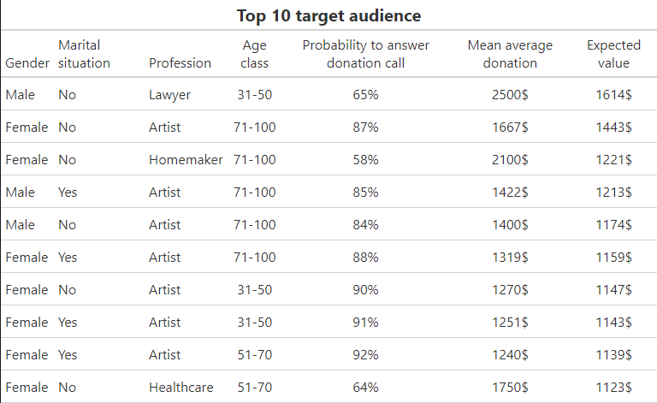
Result table

Slide 8
Future directions
Deal with selection bias
Try other ml models
TRACK STRATEGY PERFORMANCE
Because the data are from past donations there is very likely selection bias
Apply data science techniques to help deal with selection bias*
Use more flexible machine learning models and tune them using cross-validation to see how the model generalizes to new data and better estimate the type of results that we could expect when applying the strategy in real life.
Develop a strategy for tracking model performance in real life, such as A/B testing.

Slide 9
Conclusion
Audience target
To maximize donation profits, ad campaigns should be targeted to:
Unmarried male lawyers aged between 30 and 50.
Unmarried female artists aged between 71 and 100.

Slide 10
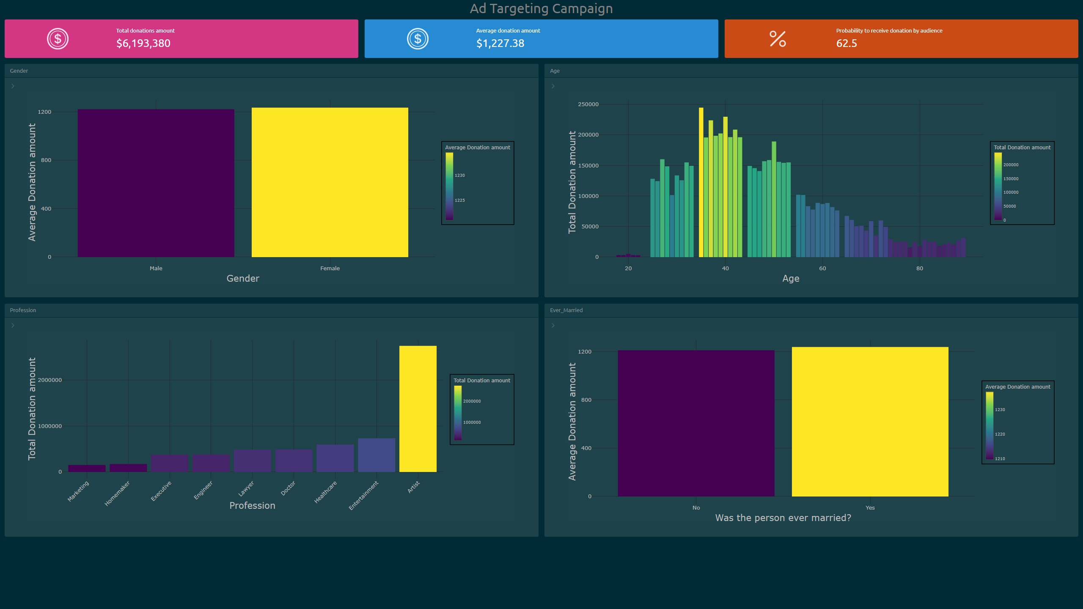

Slide 11
THANK YOU

