Slide 1

AJNA
Data Mining, Computer Vision and Machine Learning
Applied to Custom Risk Analysis, Surveillance and Operations

Slide 2
AJNA
- Integrate Risk Analysis and Operations Center
- Images central DataBase
- Data and Images integration platform
- Workflow to access data and delivering computer vision models training and production
- UX for search and retrieval, data crossing, auditing, filtering and comparison

Slide 3
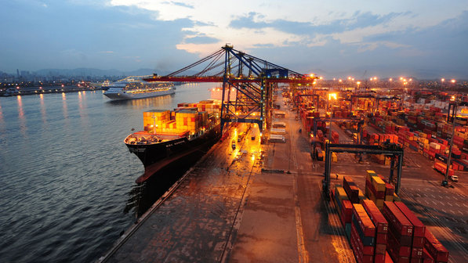
AJNA – The inspiration
Port of Santos: biggest in L.A.
25% of all Cargo imported and exported
5.000 containers a day, more than 2 million a year
More than 15 cargo/container terminals
Dozens of other types of cargo terminals
12 miles of ship pier
4 cities, more than 50 miles of possible routes
Just a few officers to cover all these
Cargo smuggling, ripon/ripoff fraud, false documents, no physical presence or control, great distances to cover, many systems to access and places to search

Slide 4
AJNA – COV
COV – The technology help
  Virtual presence
  Remote verification
  Traceability/Accountability and presence multiplication
  Human risk minimizing: OCR, scanning, automatic systems
  A central place to access images and diferent data sources
It was an improvement, but there were lots of information and no time/human resources to explore it

Slide 5
AJNA = COV 4.0
Why do not use machines to do the hard work and select the most promising cases for officers??
That’s AJNA idea, presented and selected on “2017 RFB Inovation Contest”
Simplified Workflow
  Capture images and WMS information (real world)
  Capture Custom DataBases (declared world)
  Integrate
  Make questions, prepare answers
  Provide Customs Officers (Augmented IA/Centaur)

Slide 6
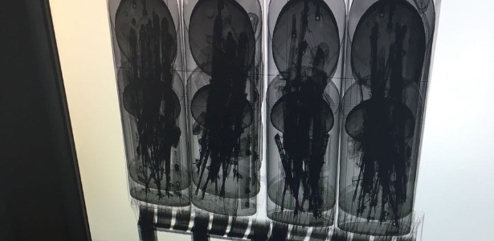
THE TRUTH IS
OUT THERE
/

Slide 7
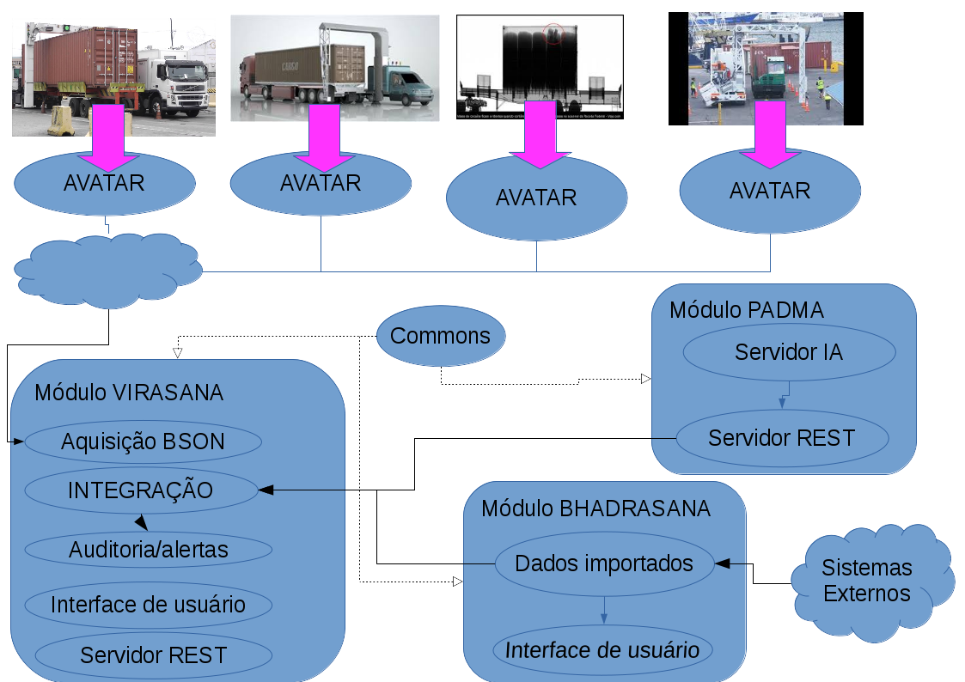
AJNA - Architecture

Slide 8
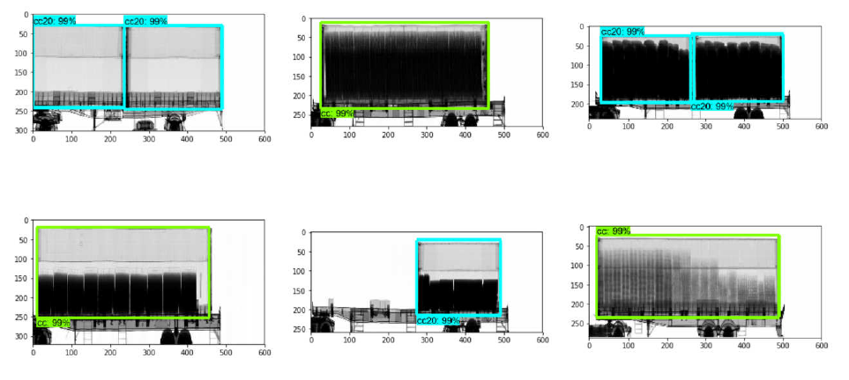
2018 - AJNA
Automatic analysis of images of container scanning, image search, data crossing and indication of anomalies.

Slide 9
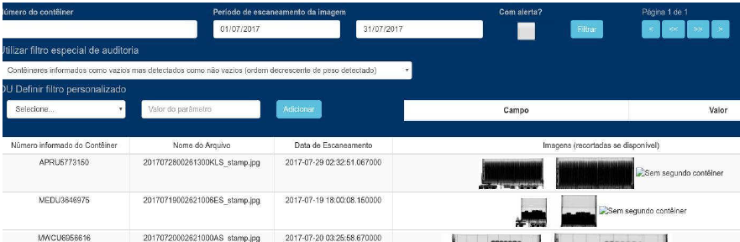
2018 - Sistema AJNA
Data crossing, auditing, image search and retrieval

Slide 10
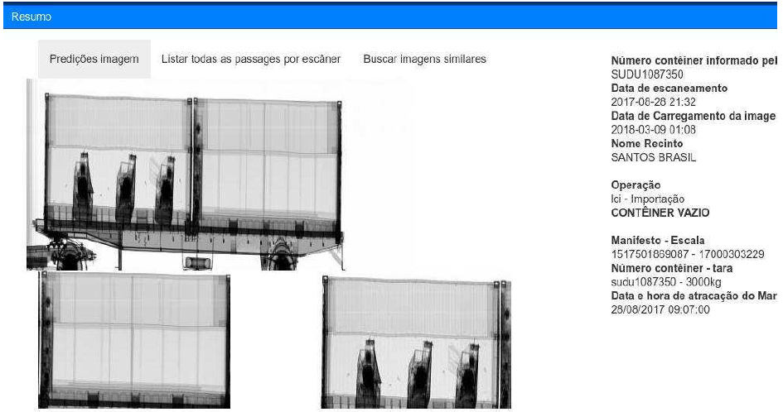
2018 - Sistema AJNA – visão computacional
Automatic and manual image analysis

Slide 11
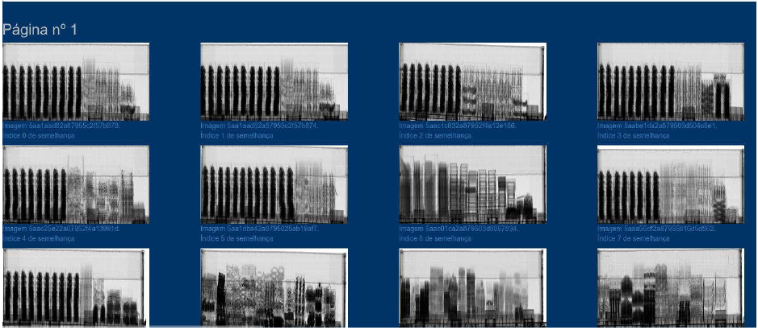
2018 - Sistema AJNA – visão computacional
Similar image search and filtering

Slide 12
AJNA - Architecture
X-Ray
Scanners
BHADRASANA
AVATAR
Terminals API
PUSH
Metadata
DB
Image DB
VIRASANA
API
SITE (UX)
integration
(ETL/scripts)
PADMA
API
SITE (UX)
Arrows indicate information flow.
Information always flow in a “pull” way, this means, the system looks for information.
One exception is UPLOAD of AVATAR images, made in a “push”.

