Slide 1
Papers & Link
2023 - NDLib wiki: https://ndlib.readthedocs.io/en/latest/index.html
2024 - CDLib wiki: https://cdlib.readthedocs.io/en/latest/
Title | Info | Year
NDlib: a Python Library to Model and Analyze Diffusion Processes Over Complex Networks | Library Info | 2017
NDLIB: Studying Network Diffusion Dynamics | Theoretical | 2017
Active and passive diffusion processes in complex networks | Theoretical | 2018
Title | Info | Year
CDLIB: a python library to extract, compare and evaluate communities from complex networks | Library Info | 2019
Mass media impact on opinion evolution in biased digital environments: a bounded confidence model | Use Case | 2022

Slide 2
Social Network Analysis

Slide 3
A Community Structure
Community Structure Definition:
A subset of nodes who have a strong internal connection and a weaker connection with elements outside the community
Why?
Identify groups of nodes with similar relationships or interactions to understand the structure and functionality of the graph.
How to identify Graph’s Communities?
Common algorithms include Louvain's method, modularity maximization, Girvan-Newman algorithm, and Label Propagation algorithm.
Use Case

Slide 4
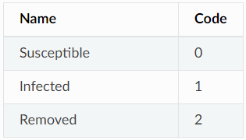
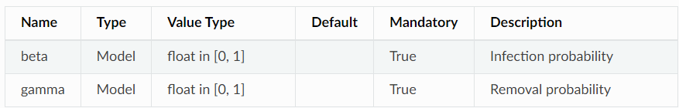
A General Model Structure
Example: SIR (Susceptible-Infected-Recovered)
The SIR Model divide the population (nodes) into 3 categories:
Susceptible (S): Individuals who can become infected
Infected (I): Individuals who have contracted the infection and can transmit it.
Recovered (R): Individuals who have recovered from the infection and can no longer transmit or contract it.
The SIR Model divide the population (nodes) into 3 categories:
beta (β): transmission rate, i.e., the probability that contact between a susceptible individual and an infected one will lead to transmission of the infection.
gamma (γ): recovery rate, i.e., the probability that an infected individual will recover and move to the recovered state.
(Optional) percentage_infected: Initial percentage of infected nodes (a list of initial infected nodes can also be specified).

Slide 5
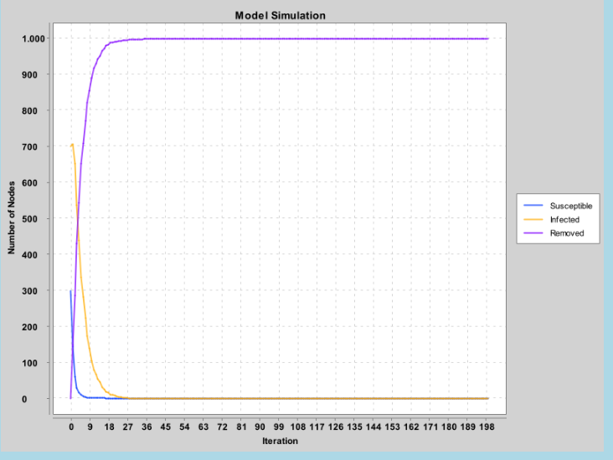
A General Model Structure
In the graph, the lines represent the number of nodes that have each of the states 0 (Susceptible), 1 (Infected), and 2 (Removed) over time.
Iteration: A single time step of the simulation. Each iteration corresponds to an update of the states of the nodes in the network

