Slide 1


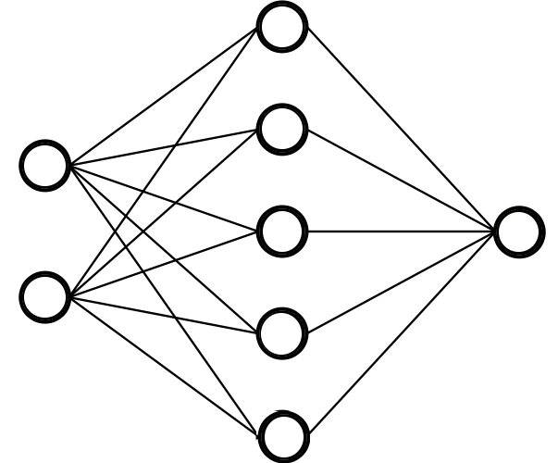
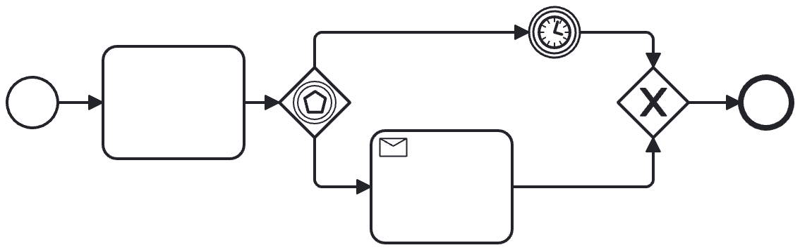


1
Model Construction
Event Logs
(Historical Traces)
Prefix Extraction
Predictive Model
2
Model Application
Remaining Time
Process Outcome
Next Event(s)
Ongoing Trace

Slide 2



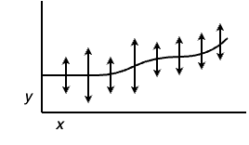


1
Model Construction
Data Preparation
Prefix Extraction
Data Encoding
Model Training
Event Logs
(Historical Traces)
Predictive Model
(LSTM)
ML Data Pipeline
2
Model Application
Remaining Time
Next Event(s)
p₁
Predictions
p…
p_{n}
Ongoing Trace
Conformal
Quantification

Slide 3


1
Model Construction
Data Pre-processing
Prefix Extraction
Data Encoding
Model Training
Event Logs
(Historical Traces)
Predictive Model
(LSTM)
ML Data Pipeline
2
Model Application
p₁
p…
p_{n}
T_{n}
P_{n}
P_{n.} + C_{n}
Predictions
Conformal
Quantification
Real-Time
Feedback
Ongoing Trace

Slide 4



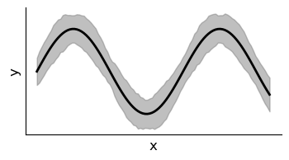
1
Model Construction
Monitoring Properties
P (MITL)
Data Pre-Processing
Prefix Extraction
Event Logs
(Historical Traces)
Features Encoding
Model Training
Predictive Model
(LSTM)
ML Data Pipeline
2
Model Application
P₁ _{[1, +∞, 99%]}
P₂ _{[0, 374939 , 97%]}
x_{t}
P₃ _{[1, -∞, 81%]}
P ( [0..1] , [-∞..+∞] , 99% )
Ongoing Trace
Predictions
Property
Satisfaction
Time-Robustness
Quantification
Conformal
Quantification
Real-Time Property Satisfaction
with Statistical Guarantees

Slide 5

1
Model Construction
Data Pre-Processing
Prefix Extraction
Offline Requirements
Monitoring
+
Event Logs
(Historical Traces)
Features Encoding
Model Training
Conformal Prediction
ML Data Pipeline
Conformalized Model
2
Model Application
P₁ _{[1, +∞, 99%]}
P.. _{[0, 374939 , 97%]}
x_{t}
P_{n} _{[1, -∞, 81%]}
P ( [0..1] , [-∞..+∞] , 99% )
Ongoing Trace
Predictions
Property
Satisfaction
Time-Robustness
Quantification
Conformal
Quantification
Real-Time Property Satisfaction
with Statistical Guarantees

Slide 6
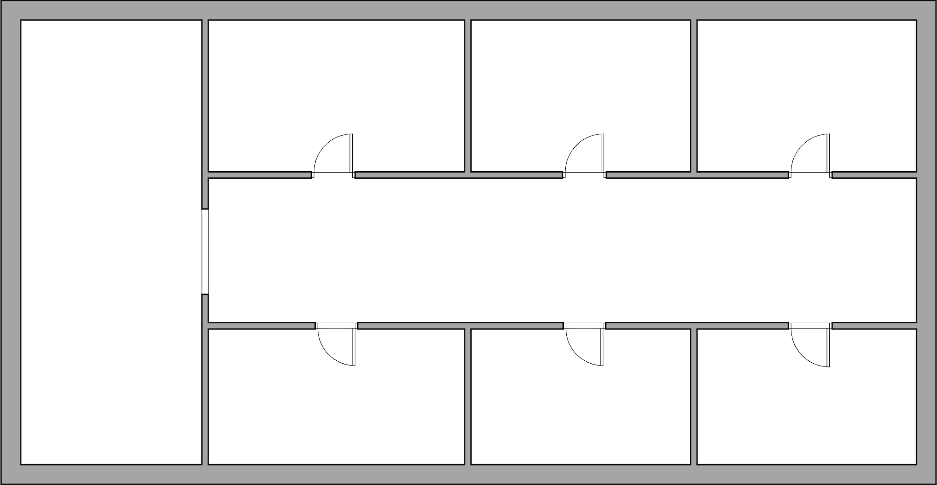






Pharmacy
Item_{Priority} «M»
Coordinator
Agent 2: «idle»
Item_{Priority} «H»
Agent 4: «move»
Agent 1: «free»
Item_{Priority} «L»
Agent 3: «drop»

