Slide 1
THE RHYTHM
OF A CITY
Scientific Data Visualization - 2026/27
Washington D.C. Bike Sharing
Student: Di Vita Ivan

Slide 2
PROJECT ROADMAP
01
GOAL
02
DATA
03
CLEAN
What shapes general demand?
Rentals divided into two time scales
Inspect and validate
04
SIMPLE PATTERNS
05
EXPLANATION
06
PREDICTION
Make patterns visible
Statistics + clustering
Out-of-time ML
02

Slide 3
Two views of the same bike-sharing system
HOURLY DATA
TIME SPAN
17,379
2 years
hours recorded
From 2011 to 2012
DAILY DATA
TOTAL RENTALS
731
3.3 million
calendar dates
From 2011 to 2012
Key variables
found in the tables
rentals (registered / casual), timestamp, working day, weather, temperature, humidity and wind
04

Slide 4
Data cleaning and data-quality inspection
01
Inspect
0 missing cells · 0 duplicate rows
02
Convert
dates, weekdays, temperature °C, humidity %
03
Validate
Check data integrity among the two tables.
04
Optimize
hourly gaps are not automatically zero rentals
Some hourly slots are absent so complete-day analyses use 655 of 731 days.
05

Slide 5
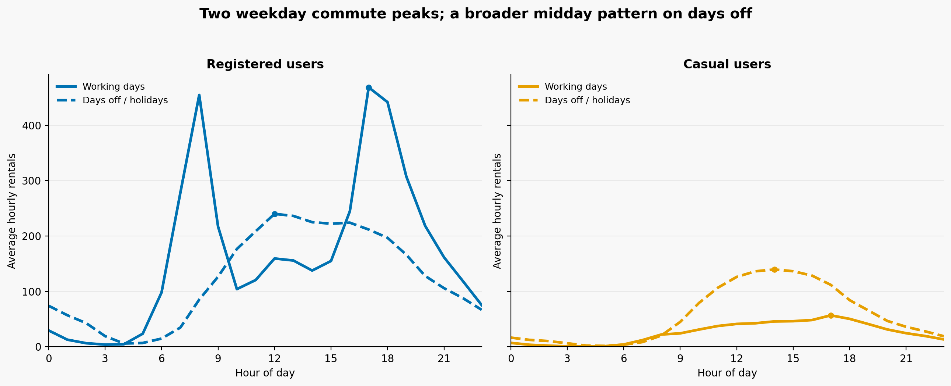
User behavior
Registered riders peak near 08:00 and 17:00 (work hours) while casual riders rise toward midday.
06

Slide 6
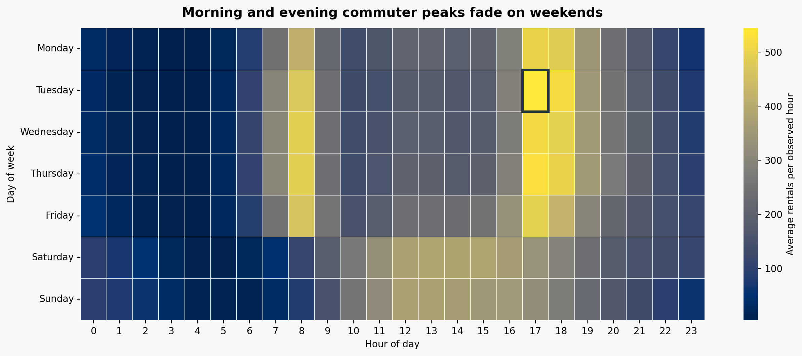
Heatmap: weekly rhythm
The heatmap (days x hours matrix) makes the workday–weekend contrast visible.
07

Slide 7
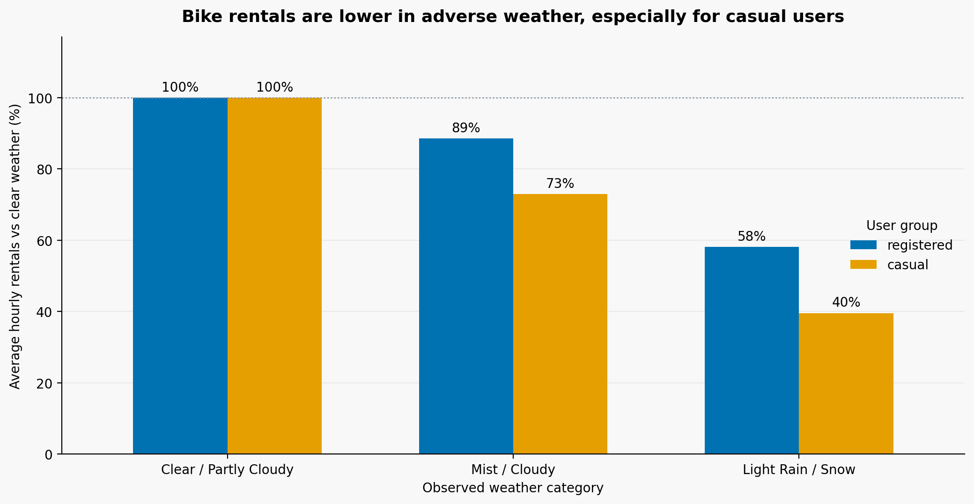
Adverse conditions coincide with lower bike usage
Light rain / snow: ~58% of clear-hour rentals for registered users; ~40% for casual.
08

Slide 8
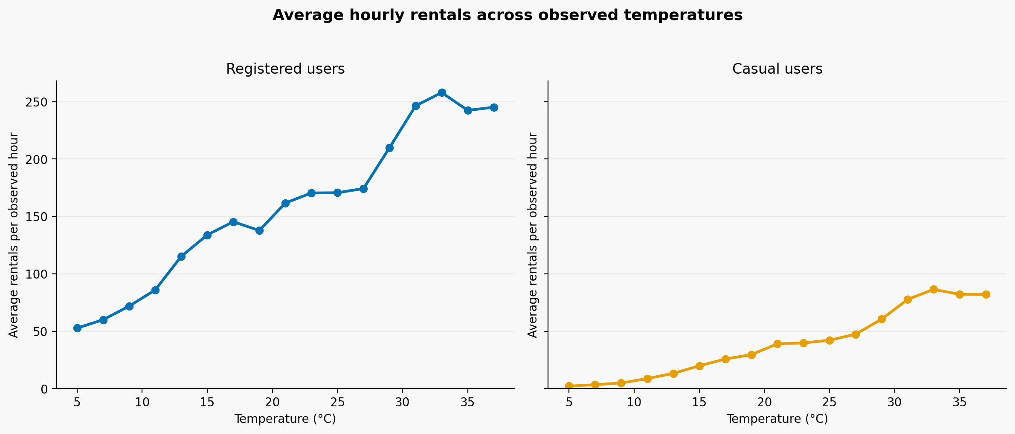
Demand rises with temperature
Hourly rentals tend to rise with the rise of temperature
09

Slide 9
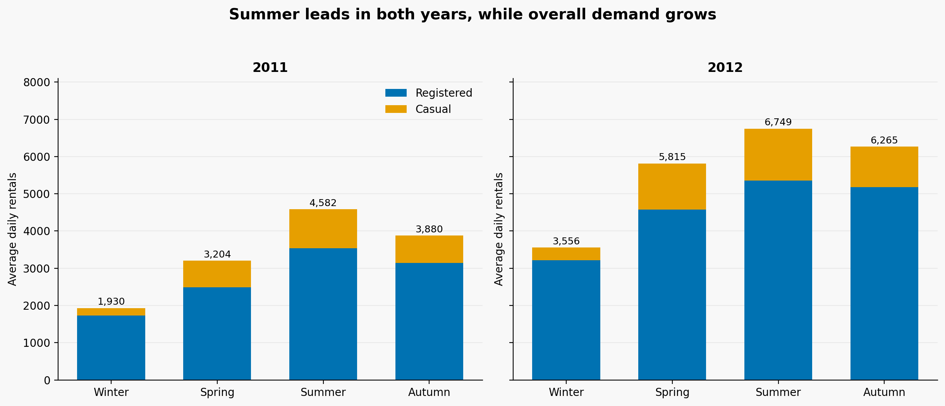
Summer leads in both years and demand is growing
Summer is the peak season for bike rental.
10

Slide 10
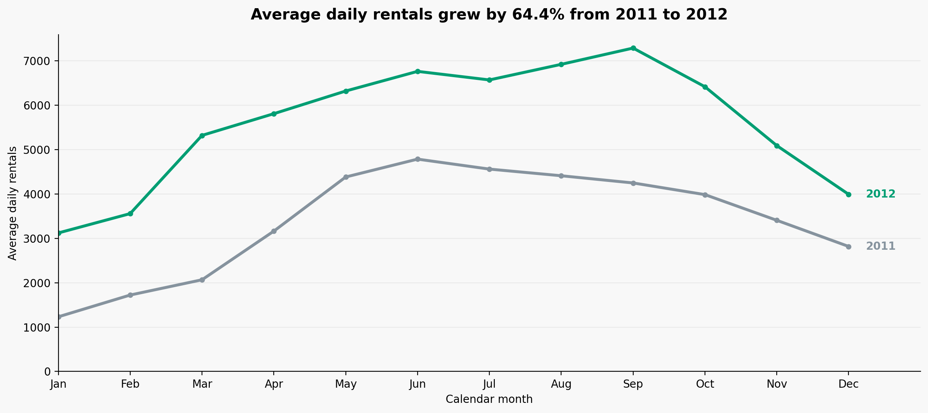
Average daily rentals increased by 64.4% in 2012
2012 has higher mean demand than 2011 comparing every month
11

Slide 11
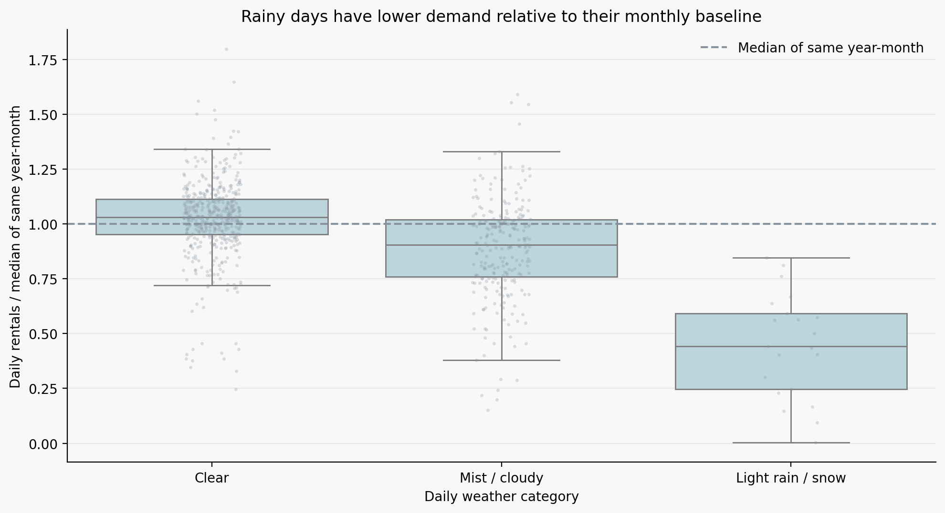
Rainy days are far below their month’s demand baseline
Rainy days generally show lower demand relative to the monthly reference.
12

Slide 12
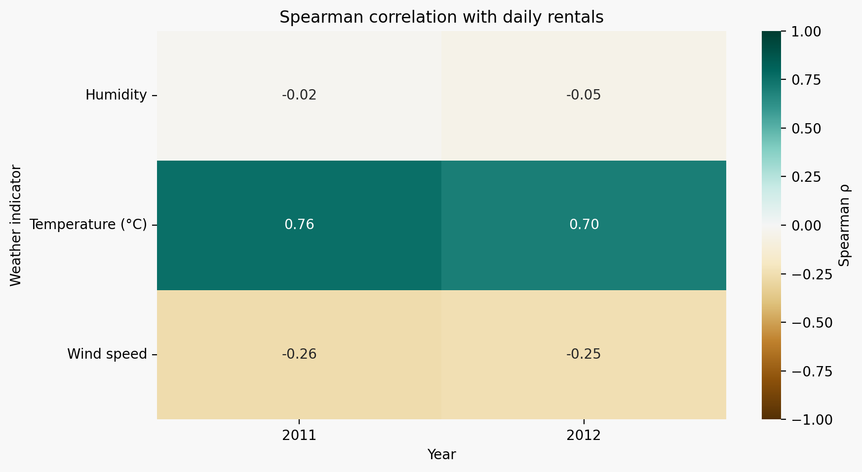
Temperature and demand rise together in both years
The temperature–demand association is positive in both years.
13

Slide 13
One day becomes a 24-dimensional profile
K-means sees the distribution of rentals across a day—not the calendar label.
01
03
05
731 days
24 features
Explanation
All calendar dates
Hourly share of daily rentals (%)
Interpret using calendar data
02
04
655 days
K-means
Complete 24-hour profiles
Group similar days
14

Slide 14
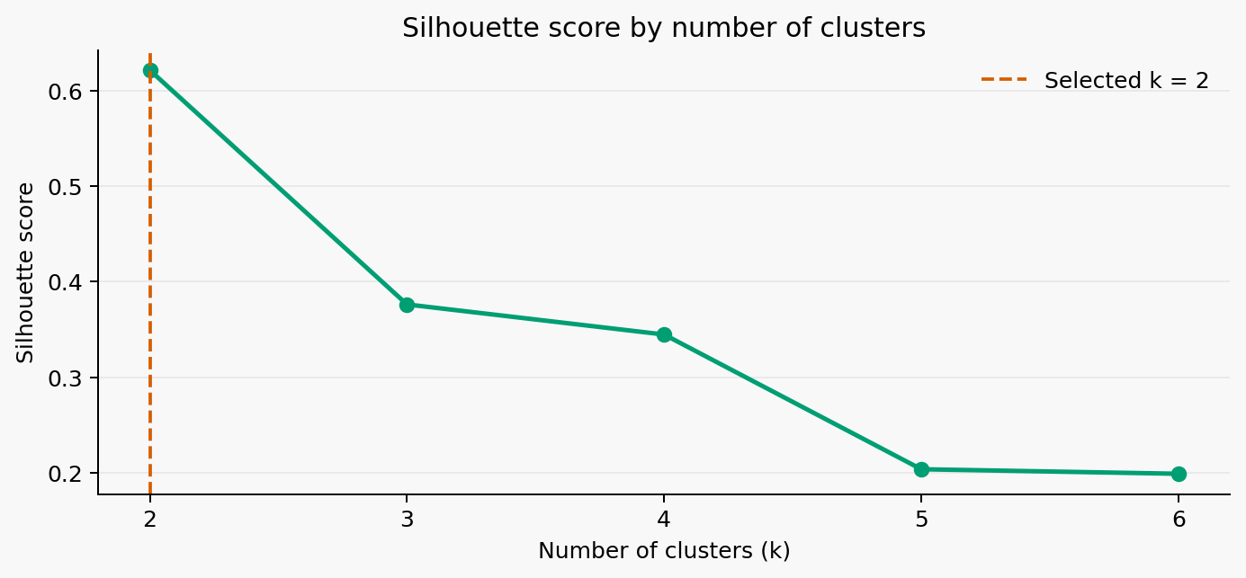
Two daily-pattern groups maximize silhouette
K = 2 has silhouette 0.621, higher than solutions with 3–6 groups.
15

Slide 15
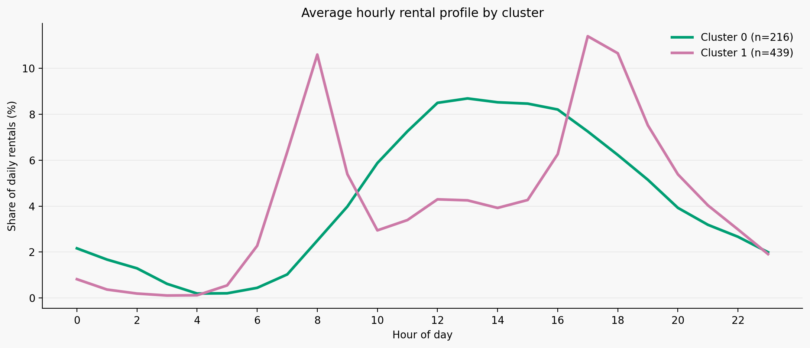
Cluster: two interpretable rhythms emerge without labels
One profile peaks twice, the other rises broadly around midday.
16

Slide 16
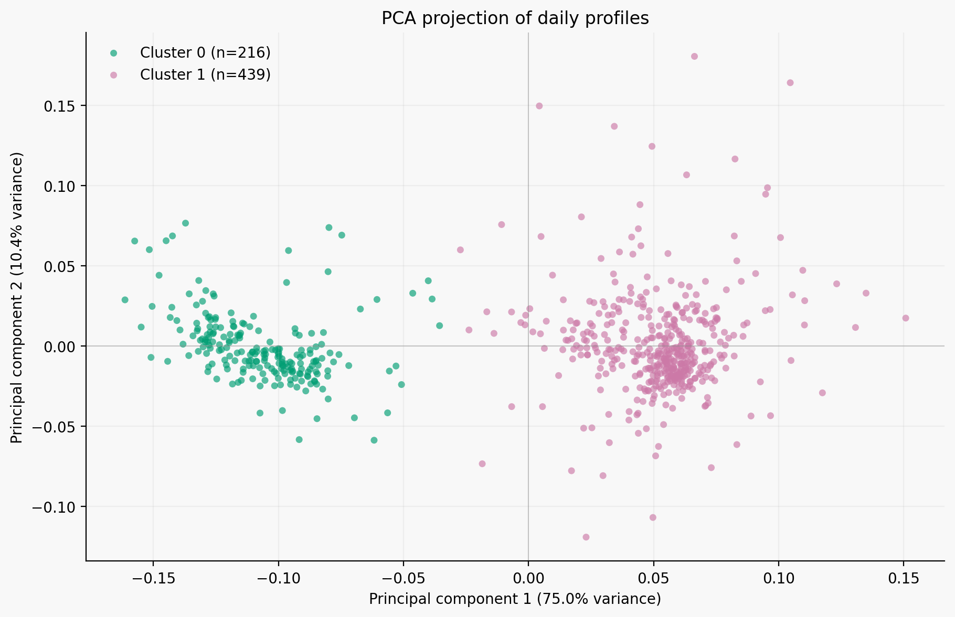
PCA: Two components preserve 85.4% of profile variance
PC1 explains 75.0%; PC2 explains 10.4% of the 24-feature variation.
17

Slide 17
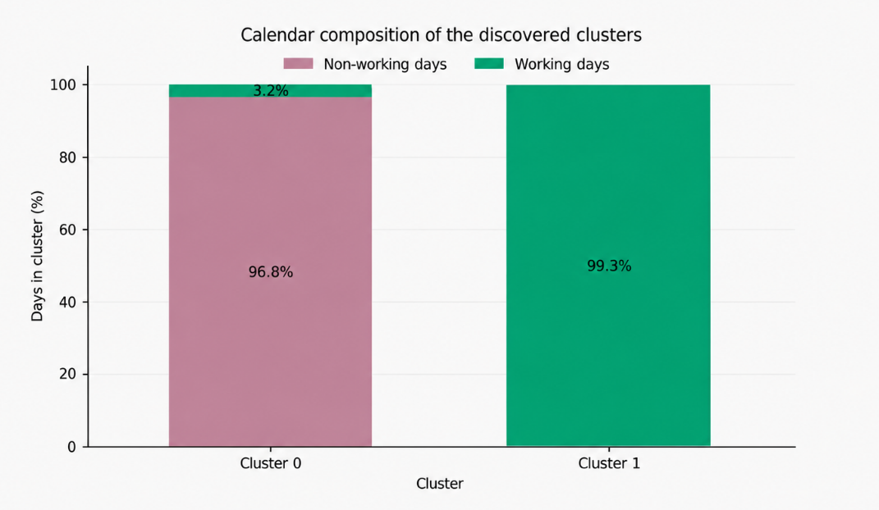
Calendar labels help interpret the discovered clusters
One group is 96.8% days off; the other 99.3% working days.
19

Slide 18
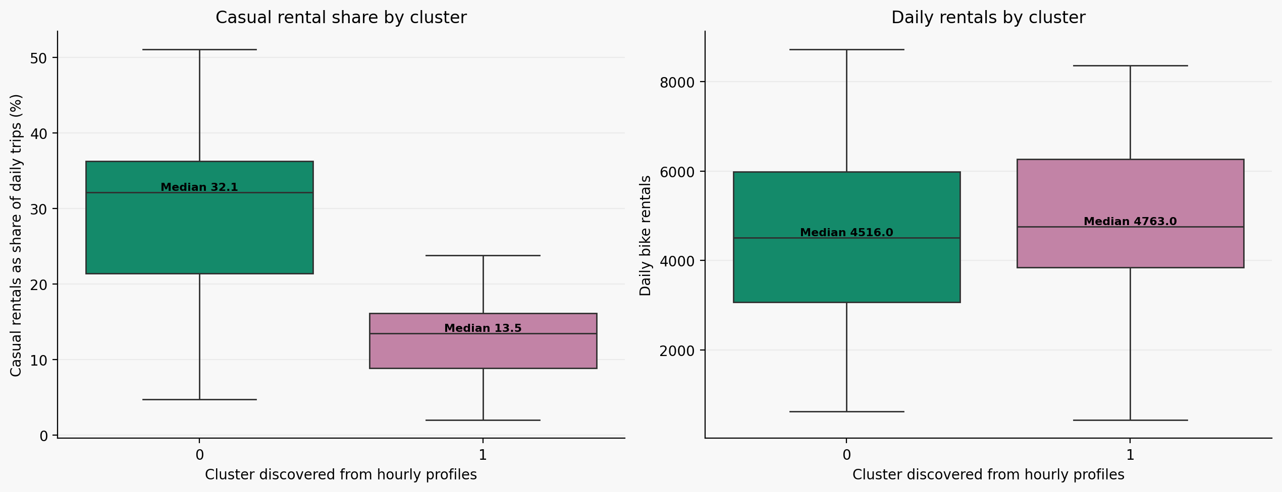
Clusters differ in who rides, not just when
Median casual share: 32.1% in days-off pattern vs 13.5% in commute pattern.
21

Slide 19
A supervised model must beat a simple baseline
How? Random Forest regression on weather and calendar information only
TRAINING HOURS
TEST PERIOD BEGINS
13,891
07 AUG 2012
HELD-OUT HOURS
RENTALS
3,488
3,292,679
23

Slide 20
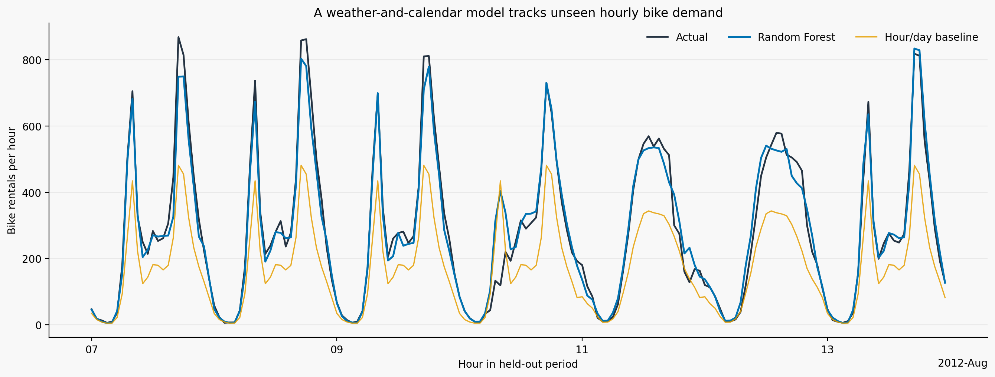
Random Forest predicts hourly demand much better than baseline
HELD-OUT TEST PERFORMANCE
ACTUAL vs PREDICTED · 7–14 AUG 2012
101.5
Baseline MAE · rentals/hour
47.6
Random Forest MAE
53% lower error
R² 0.57 → 0.89
MAE is reduced with the model, and also the coefficent of determination got a better value
24

Slide 21
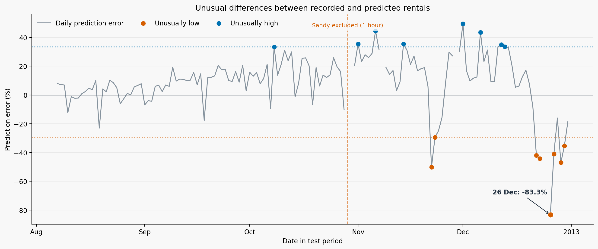
26 December 2012: an 83% gap between rentals and predictions
26 December has the largest negative prediction error in the test period
26

Slide 22
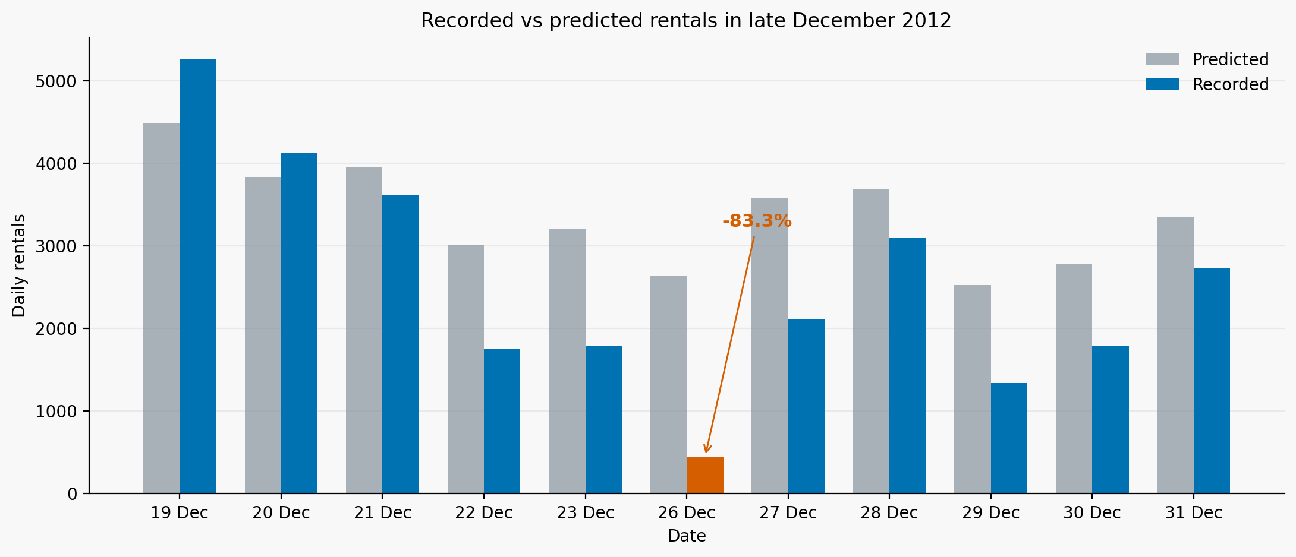
26 December 2012: observed demand was far below the model estimate
Observed demand was much lower than predicted during the Christmas period.
27

Slide 23
LIMITATIONS
OBSERVATIONAL
HISTORICAL DATA
Weather associations do not demonstrate causal effects.
Washington, D.C. only, from 2011 to 2012.
NO TRIP MOTIVES
INCOMPLETE DAYS
Counts do not reveal purposes, routes or disruptions.
76 days lack at least one recorded hour; Sandy has only one.
28

Slide 24
THANK YOU
FOR YOUR ATTENTION
DATA Fanaee-T & Gama (2013). Bike Sharing Dataset. UCI Repository. https://archive.ics.uci.edu/dataset/275/bike+sharing+dataset
WEATHER Washington Reagan Airport, 26 Dec 2012: 1.42 in precipitation. NOAA-derived daily record via extremeweatherwatch.com/cities/washington-dc/year-2012
STUDENT Ivan Di Vita

