Slide 1
Mind Maps Boost
Here is where your presentation begins
20XX
BUSINESS
VISUAL THINKING FOR SMARTER IDEAS

Slide 2

Contents of this template
Fonts
Colors
Thanks slide
Icons and infographics
To view this template correctly in PowerPoint, download and install the fonts we used
You can see on the link all the colors used in this presentation
You must keep it so that proper credits for our design are given
These can be used in the template, and their size and color can be edited
For more info: SLIDESGO | SLIDESGO AI TOOLS | BLOG | FAQs
You can edit the master slides easily. For more info, click here
You can visit our sister projects: FREEPIK AI TOOLS | FREEPIK LIBRARY RESOURCES
You can delete this slide when you’re done editing the presentation

Slide 3
01
02
03
04
05
06
Table of contents
07
08
Name of the section
Name of the section
Name of the section
Name of the section
Name of the section
Name of the section
Name of the section
Name of the section

Slide 4
Short title here
Mercury is the closest planet to the Sun and the smallest one in the entire Solar System. This planet’s name has nothing to do with the liquid metal, since Mercury was named after the Roman messenger god. Despite being closer to the Sun than Venus, its temperatures aren't as terribly hot as that planet’s. Its surface is quite similar to that of Earth’s Moon, which means there are a lot of craters and plains

Slide 5
01
This is the title of this section
20XX
BOOST YOUR PROJECTS
BOOST YOUR MIND

Slide 6

The slide title
goes here!
Mercury is the closest planet to the Sun and the smallest one in the entire Solar System. This planet’s name has nothing to do with the liquid metal, since Despite being closer to the Sun than Venus, its temperatures aren't as terribly hot as that planet’s. Its surface is quite similar to that of Earth’s Moon, which means there are a lot of craters and plains.

Slide 7
Maybe you need a long title to captivate your audience attention while showing your interesting ideas
Despite being red, Mars is actually a cold place. It’s full of iron oxide dust
Venus has a beautiful name and is the second planet from the Sun and is hot

Slide 8
Three interesting ideas you can explain to your audience
01
02
03
Mercury is the closest planet to the Sun and the smallest one in the entire Solar System
Mars is full of iron oxide dust, which gives the planet its reddish cast. Despite being red, it’s actually very cold
Jupiter is a huge gas giant and the biggest planet in the entire Solar System
“Venus has a beautiful name and is the second planet from the Sun”

Slide 9
01
02
03
04
Four ideas you need to know
This is what you need to know about Jupiter
Planet Mars is actually closer than you think
This is what you should know about Venus
These are a few interesting facts about Jupiter
It’s the fourth-brightest object in the night sky. It was named after the Roman god of the skies and lightning
Despite being red, Mars is actually a cold place. It is full of iron oxide dust, which gives the planet its reddish cast
Venus has a beautiful name and is the second planet from the Sun. Its atmosphere is extremely poisonous
Jupiter is a gas giant and the biggest planet in the Solar System. It’s the fourth-brightest object in the night sky

Slide 10
98,300,000
Big numbers catch your audience’s attention
20XX
KEY INSIGHT
AT A GLANCE

Slide 11
This is a mind map to represent your key metrics
This is Mercury
25%
50%
This is Mars
Mercury is the closest planet to the Sun and the smallest one of them all
Despite being red, Mars is actually a very cold place. It’s full of iron oxide dust
12,742 km
EARTH HARBORS LIFE
SATURN HAS MANY RINGS
The average diameter of Earth at the equator
This is Venus
10%
15%
This is Jupiter
Venus is the second planet from the Sun. It has a nice name but is hot
Jupiter is a huge gas giant and the biggest planet in the entire Solar System

Slide 12
This is a mind map infographic
Write here a title for your mind map
Mercury is the closest planet to the Sun and the smallest one of them all
Despite being red, Mars is actually a cold place. It’s full of iron oxide dust
List item here
List item here
List item here
List item here
List item here
List item here
List item here
Earth is the third planet from the Sun. It is the only planet known that has life
List item here
List item here
List item here

Slide 13
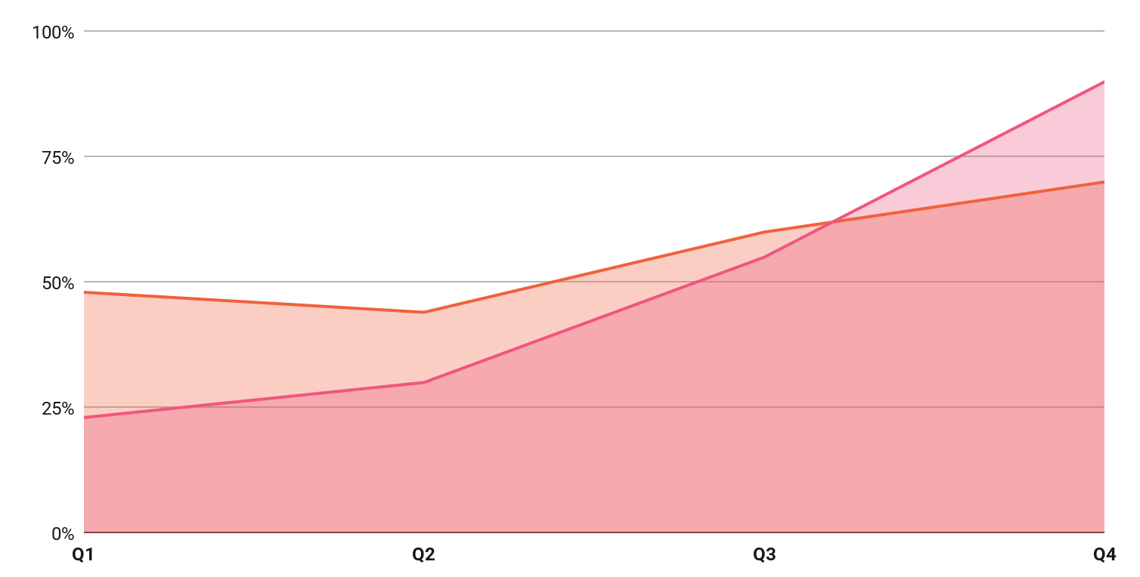
KPI dashboard
2h
 |  | Q1 | Q2 | Q3 | Q4
 | Mercury | 48% | 44% | 60% | 70%
 | Mars | 23% | 30% | 55% | 90%
Mercury is very small
120 u/day
Venus is a hot planet
Follow the link in the graph to modify its data and then paste the new one here.
For more info, click here

Slide 14
Thank you
Do you have any questions?
youremail@freepik.com
+00 000 000 000
yourwebsite.com
20XX
PLEASE KEEP THIS SLIDE FOR ATTRIBUTION

Slide 15
Instructions for use
If you have a free account, in order to use this template, you must credit Slidesgo by keeping the Thanks slide
As a Free user, you are allowed to:
Modify this template
Use it for both personal and commercial projects
You are not allowed to:
Sublicense, sell or rent any of Slidesgo Content
Distribute Slidesgo Content unless it has been expressly authorized by Slidesgo
Include Slidesgo Content in an online or offline database or file
Offer Slidesgo templates (or modified versions of Slidesgo templates) for download
Acquire the copyright of
Slidesgo Content
For more information about editing slides, please read our FAQs or visit our blog

Slide 16
Instructions for use (premium users)
As a Premium user, you can use this template without attributing Slidesgo or keeping the Thanks slide
You are allowed to:
Modify this template
Use it for both personal and commercial projects
Share this template in an
editable format
Hide or delete the “Thanks” slide and the mention to Slidesgo in the credits
You are not allowed to:
Sublicense, sell or rent any of Slidesgo Content
Distribute Slidesgo Content unless it has been expressly authorized by Slidesgo
Use any of the elements that are part in a separated way
Register any of the elements as a trademark or logo in an intellectual property registry
For more information about editing slides, please read our FAQs or visit our blog

Slide 17
Fonts
Colors
This presentation has been made using the following fonts:
All the colors used in this presentation
Click on the button of the link to the fonts
#191919
#efefef
#191919
Geist
Geist Mono
#f1613c
#f1584d
#f0567e
Funnel Sans
To view this template correctly in PowerPoint, download and install the fonts we used

Slide 18
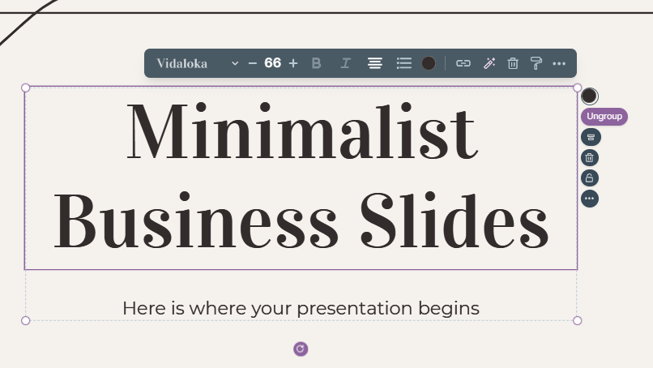
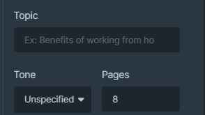
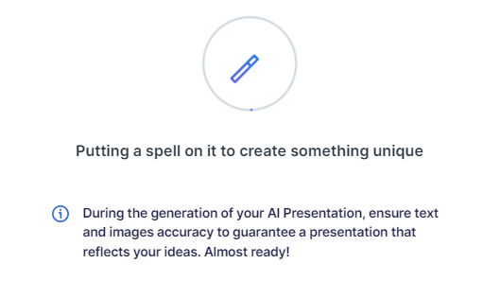
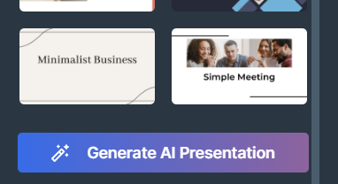
Presentation Maker
Slidesgo introduces its latest feature: the Presentation Maker. Enjoy two main functionalities - firstly, with a few clicks, create marvelous presentations with Artificial Intelligence that adapt to your needs. And it's completely free
Generate AI Presentation

Slide 19
Use our editable graphic resources...
You can easily resize these resources without losing quality. To change the color, just ungroup the resource and click on the object you want to change. You can also look for more infographics on Slidesgo

Slide 22
 | Jan | Feb | Mar | Apr | Jun
Task 1
Task 2
Task 3
 | No | Yes | Yes | No | Yes
 | Yes | No | Yes | No | Yes
 | Yes | Yes | No | Yes | No
 | Jan | Feb | Mar | Apr | Jun
Task 1
Task 2
Task 3

Slide 24
6/10 | 8/10 | 7/10 | 4/10

Slide 25
...and our sets of editable icons
You can resize these icons without losing quality
You can change the stroke and fill color; just select the icon and click on the paint bucket/pen
In Google Slides, you can also use Flaticon’s extension, allowing you to customize and add even more icons

Slide 26
Educational icons
Medical icons

Slide 27
Business icons
Teamwork icons

Slide 28
Help & support icons
Avatar icons

Slide 29
Creative process icons
Performing arts icons

Slide 30
Nature icons

Slide 31
SEO & marketing icons

Slide 32


