Slide 1

GCSE Computer Science
Computer Networks
COMPUTER NETWORKS
Mr Mitchell

Slide 2
LEARNING OBJECTIVES
Define what a computer network is.
Discuss the advantages and disadvantages of computer networks.
Describe the main types of computer network.

Slide 3

A computer network is two or more computers connected together, whereas a computer that is not connected to a network is stand-alone.
COMPUTER NETWORKS
The term ‘computer’ can mean a range of different devices, including laptops, tablets and smartphones.

Slide 4

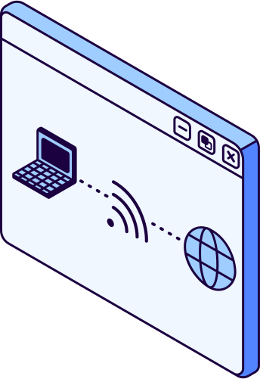
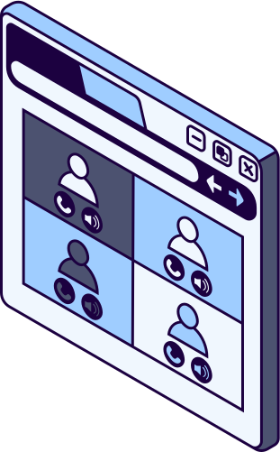
ADVANTAGES OF NETWORKING
Files are stored centrally on a server so can be accessed on computers across the network.
One internet connection can be used for multiple different devices using a router.
Devices (e.g. printers, scanners) are accessible on any network connected computer.
User accounts and software can be deployed across network computers.

Slide 5



DISADVANTAGES OF NETWORKING
Availability
Performance
Management
If connection is lost, files and devices are unavailable.
Larger networks are slower and less reliable.
Specialist knowledge and skills are required.

Slide 6

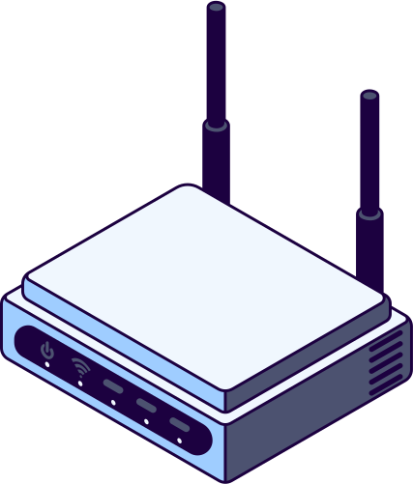
PAN
LAN
WAN
Personal Area Network
Local Area Network
Wide Area Network
TYPES OF NETWORKS

Slide 7

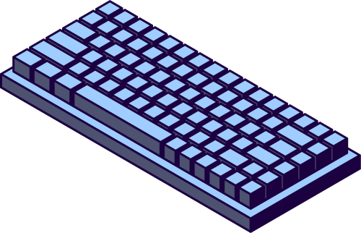
PAN (Personal Area Network) is used within a very small area. This is usually on a person or in a vehicle.
Bluetooth is usually used to connect these devices, which has a typical range of about 10 metres.
PERSONAL AREA NETWORK
Examples of PANs:
smartwatches
wireless headphones
wireless keyboards/mice
car entertainment systems

Slide 8

LAN (Local Area Network) is used within a small geographical area, which is usually limited to one building.
These networks can be connected wirelessly but for reliability, wired hardware (Ethernet) is often used.
LOCAL AREA NETWORK
Examples of LANs:
home networks
small businesses
schools and colleges

Slide 9
WAN (Wide Area Network) is spread across a large geographical area, often an entire country or further.
WIDE AREA NETWORK
The internet is a large scale WAN, which uses undersea cables to connect computers across the world.
Examples of WANs:
the internet
mobile networks
banking networks

Slide 10
Smartwatch
Office network
Bank network
Drag and drop the network examples into the correct category.
Home network
In-car systems
Headphones
School network
The internet
Mobile network
PAN
LAN
WAN

Slide 11
Drag and drop the network examples into the correct category.
PAN
Smartwatch
Headphones
In-car systems
LAN
Home network
Office network
School network
WAN
The internet
Mobile network
Bank network

