Slide 1
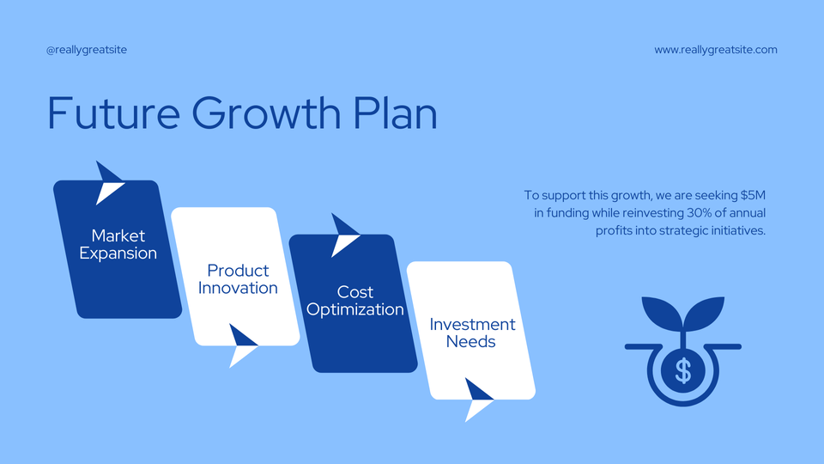

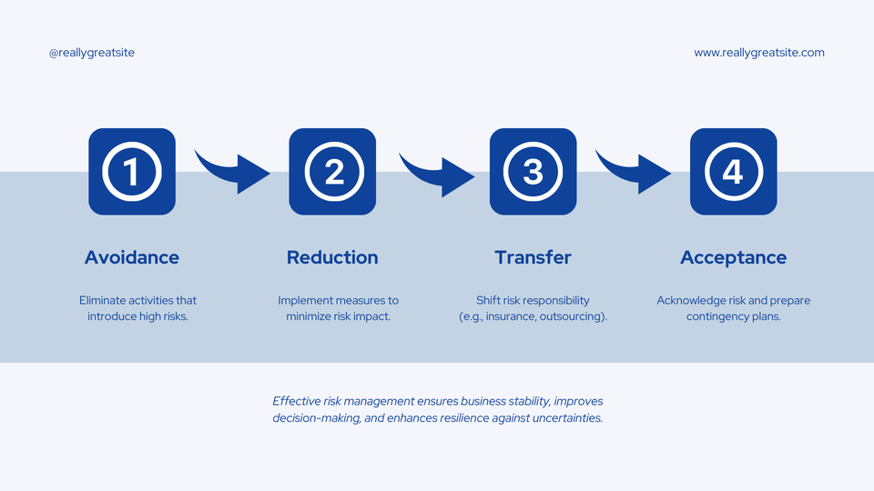
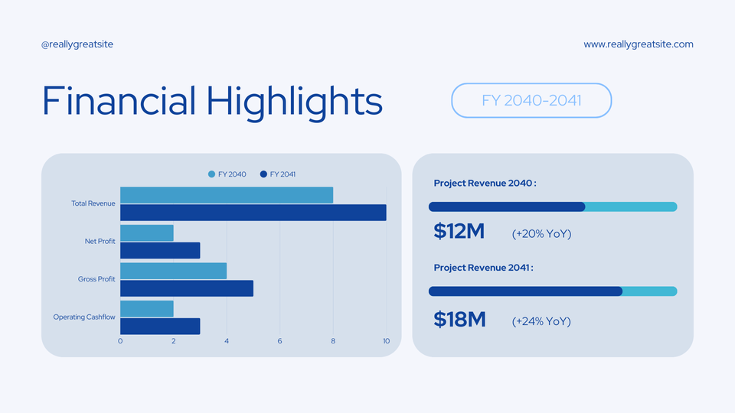

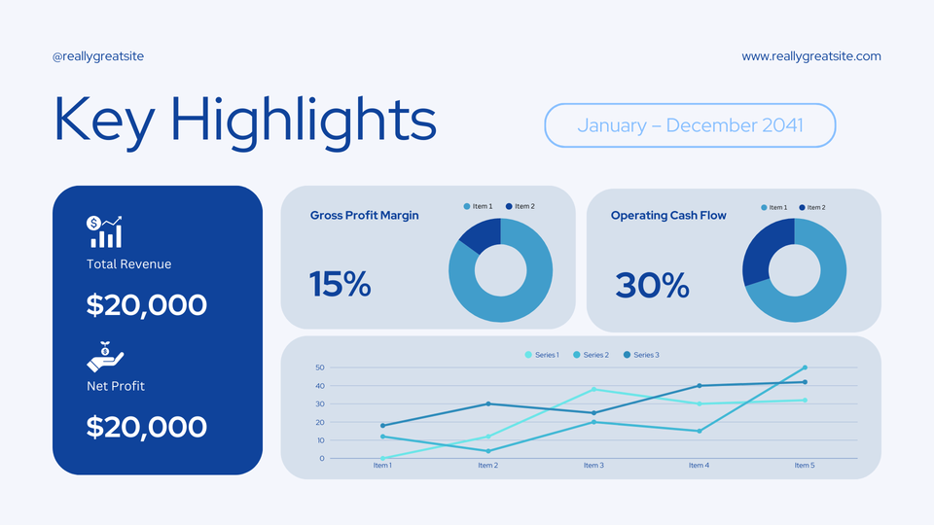


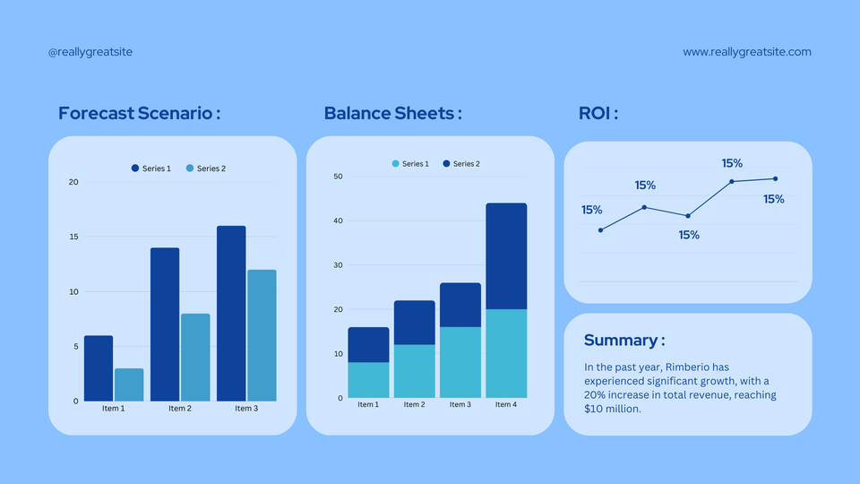
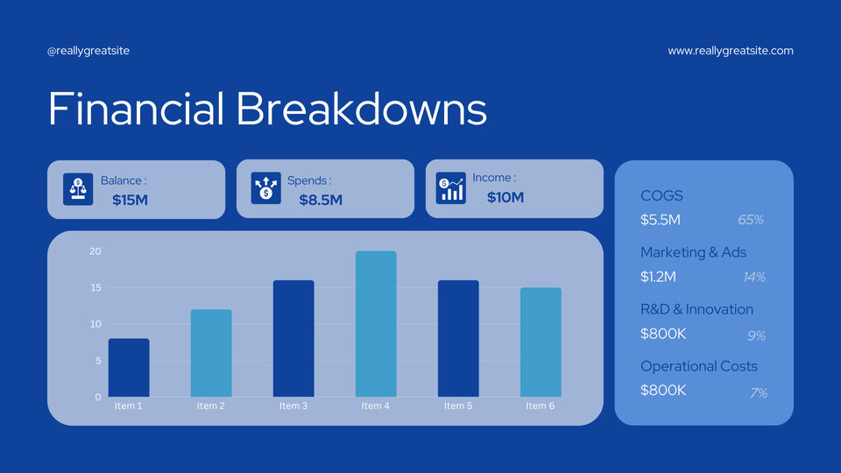

FINANCIAL INSIGHTS

Slide 2

@reallygreatsite
Financial
Presentation
Presentation Template
Presented by
Rimberio
Presented to
Wardiere Inc.
www.reallygreatsite.com

Slide 3

@reallygreatsite
www.reallygreatsite.com
The Overview
In the past year, Rimberio has experienced significant growth, with a 20% increase in total revenue, reaching $10 million.
This growth was primarily driven by the successful launch of our new product line, which accounted for 30% of total sales.
Total
Income
Net
Profit
$20,000
$15,500

Slide 4
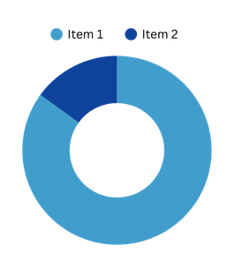
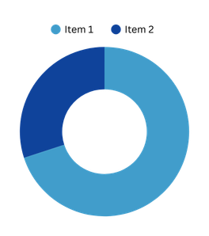

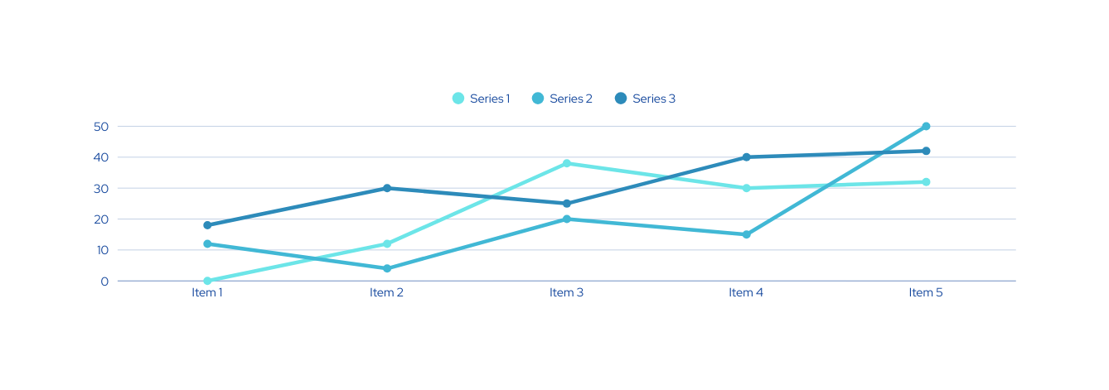

@reallygreatsite
www.reallygreatsite.com
Key Highlights
January – December 2041
Gross Profit Margin
Operating Cash Flow
Total Revenue
15%
30%
$20,000
Net Profit
$20,000

Slide 5
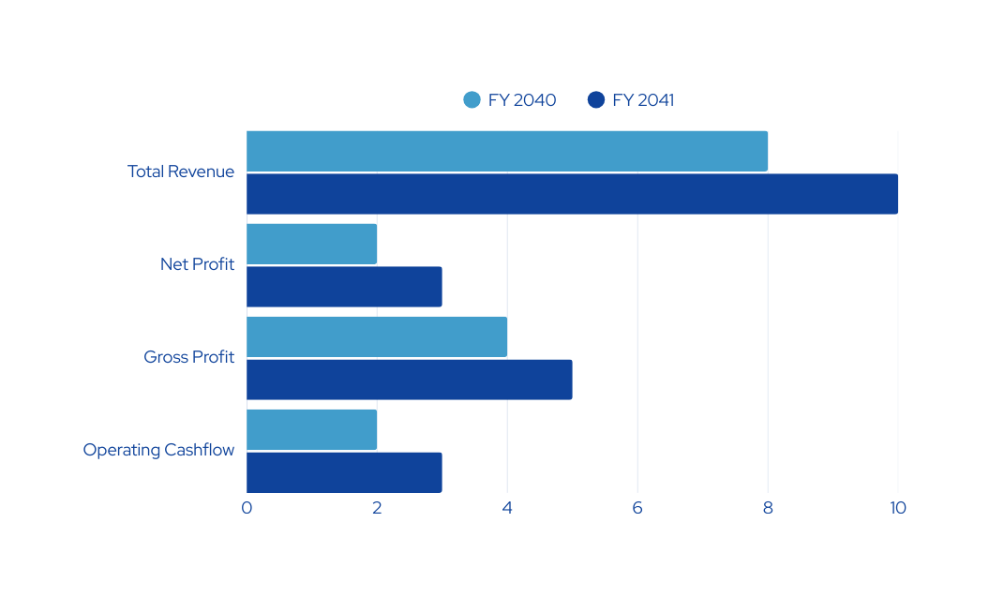


@reallygreatsite
www.reallygreatsite.com
Financial Highlights
FY 2040-2041
Project Revenue 2040 :
$12M
(+20% YoY)
Project Revenue 2041 :
$18M
(+24% YoY)

Slide 6
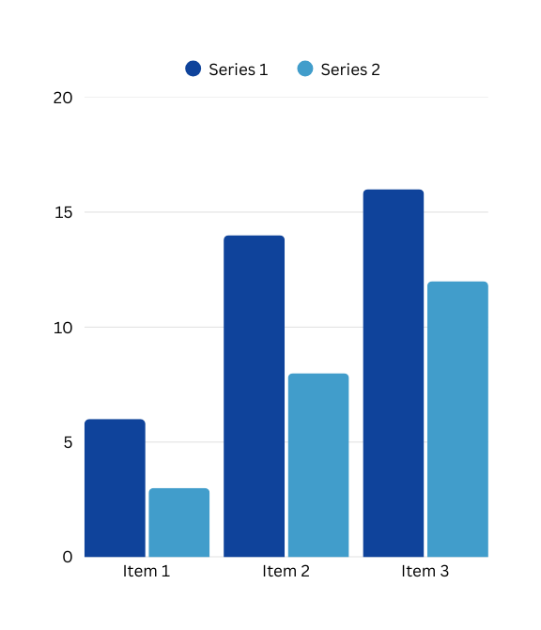
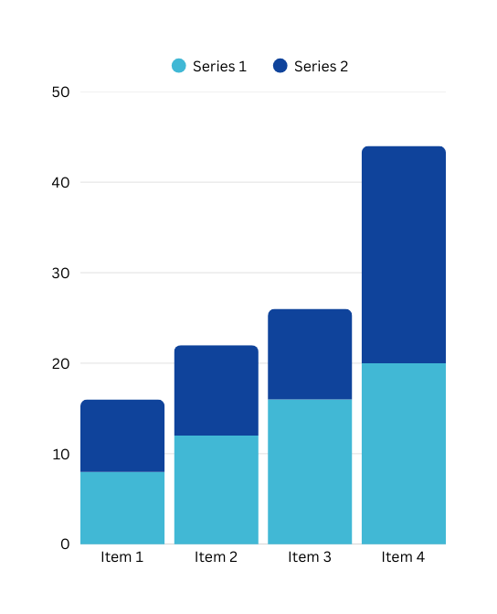
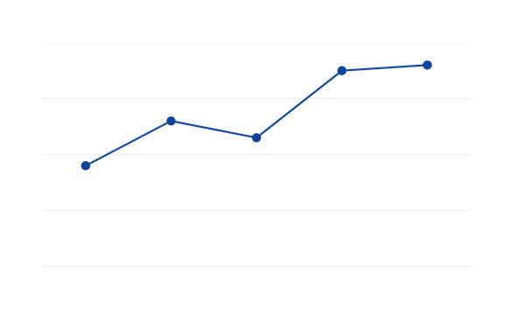
@reallygreatsite
www.reallygreatsite.com
Forecast Scenario :
Balance Sheets :
ROI :
15%
15%
15%
15%
15%
Summary :
In the past year, Rimberio has experienced significant growth, with a 20% increase in total revenue, reaching $10 million.

Slide 7



@reallygreatsite
www.reallygreatsite.com
Financial Breakdowns
Balance :
Spends :
Income :
$15M
$8.5M
$10M
COGS
$5.5M
65%
Marketing & Ads
$1.2M
14%
R&D & Innovation
$800K
9%
Operational Costs
$800K
7%

Slide 8





@reallygreatsite
www.reallygreatsite.com
Risk Analysis & Mitigation Strategies
Identify Risks
Assess Risks
Identify potential threats
Evaluate the likelihood and impact of each risk.
Prioritize Risks
Develop Responses
Rank risks based on severity and urgency.
Create strategies to mitigate, transfer, accept, or avoid risks.

Slide 9





@reallygreatsite
www.reallygreatsite.com
Avoidance
Reduction
Transfer
Acceptance
Eliminate activities that introduce high risks.
Implement measures to minimize risk impact.
Shift risk responsibility
(e.g., insurance, outsourcing).
Acknowledge risk and prepare contingency plans.
Effective risk management ensures business stability, improves decision-making, and enhances resilience against uncertainties.

Slide 10



@reallygreatsite
www.reallygreatsite.com
Future Growth Plan
@powerpointrus
Market
Expansion
Product
Innovation
Cost
Optimization
Investment
Needs

Slide 11


Thank You for Your Attention
hello@reallygreatsite.com
www.reallygreatsite.com
Presentation Template

