Slide 1

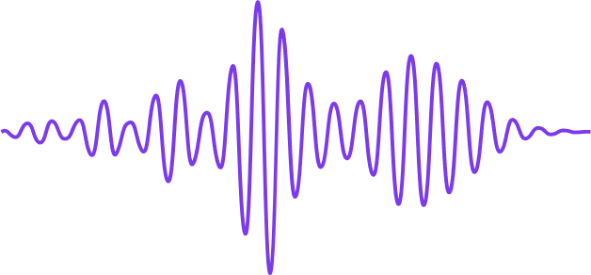
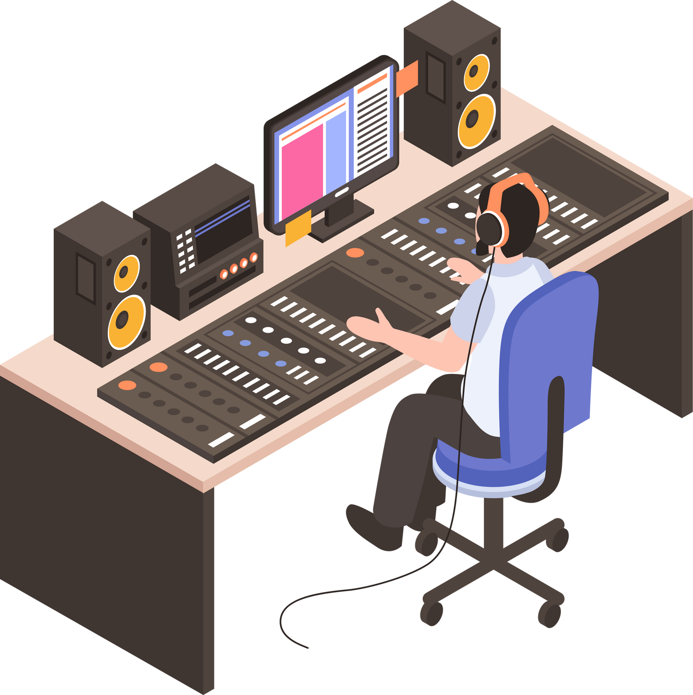

MUSIC PRODUCTION PROCESS
From Idea, to Recording, to Release to the World

Slide 2
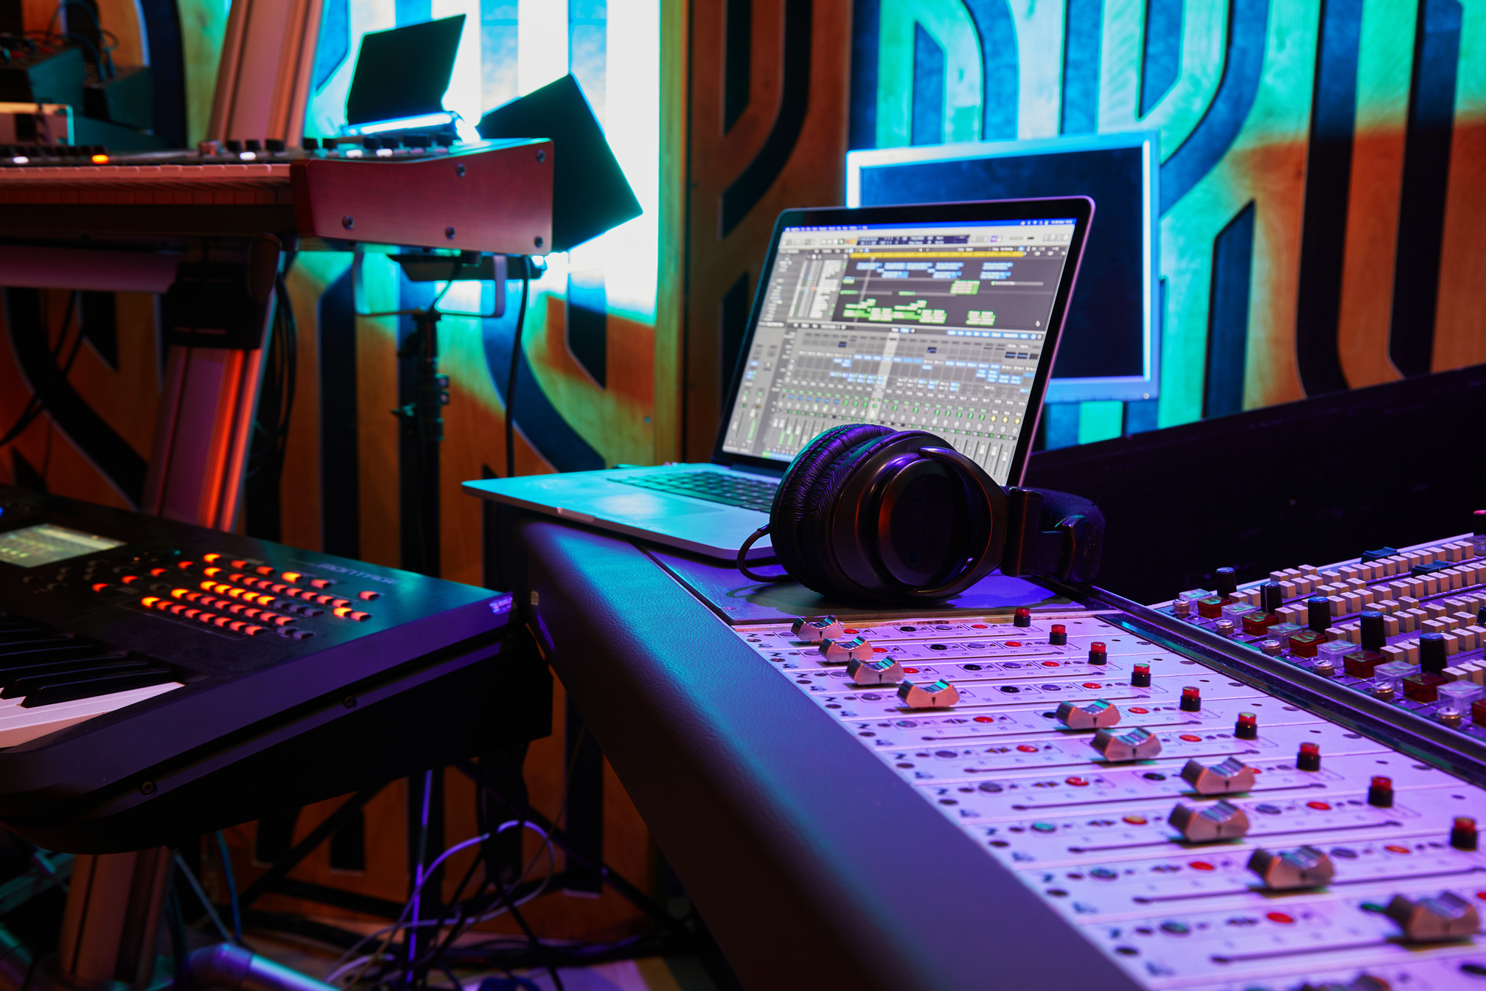
WHAT IS MUSIC PRODUCTION?
Music production is the process of creating, recording, processing, and refining a musical work until it is ready for public listening.
Music production involves both technical and creative aspects.

Slide 3


MAIN STAGES OF MUSIC PRODUCTION
Determining the instruments, flow, harmony, dynamics, and parts of the song so that the main melody has a complete "shape"; usually a guide demo is made for recording.
Finishing touches to improve tonal balance, loudness and consistency between songs; prepare files for distribution formats (streaming, radio, CD)
Tidying up the recording: selecting the best takes (comping), removing clutter, aligning time, and fixing pitch/noise before mixing.
SONGWRITING
ARRANGEMENT
RECORDING
EDITING
MIXING
MASTERING
DISTRIBUTION AND RELEASE
Create a musical idea: melody, chords, lyrics, and song structure (verse, chorus, bridge). The foundation is the message and emotion you want to convey.
Record vocal and instrumental performances onto digital tracks using a microphone, interface, and DAW. This process can be done live or track-by-track (overdubbing).
Balancing levels, panning, EQ, and dynamic processing; adding effects (reverb, delay) to create space and cohesion between elements so the song sounds complete.
Determine release strategy (single/album), upload to distributors/streamers, prepare metadata & artwork, and run promotion and distribution to platforms.

Slide 4


SONGWRITING
@powerpointrus

Slide 5

ARRANGEMENT
Determine which instruments to use.
Set the tempo, dynamics, and musical style (genre).
Create a demo version for recording reference.

Slide 6

RECORDING
The process of capturing vocal and instrument sounds.
This is done in a studio using a microphone, audio interface, and DAW (Digital Audio Workstation).
This can be done track by track.

Slide 7
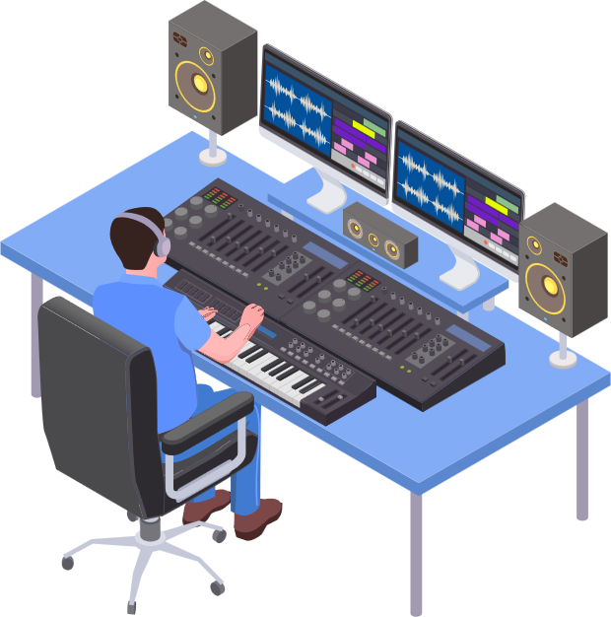
EDITING
Perfecting recordings
Cutting out bad parts
Rearranging tracks
Adjusting timing and pitch
Tools: Auto-Tune, Melodyne, and other DAW tools.

Slide 8
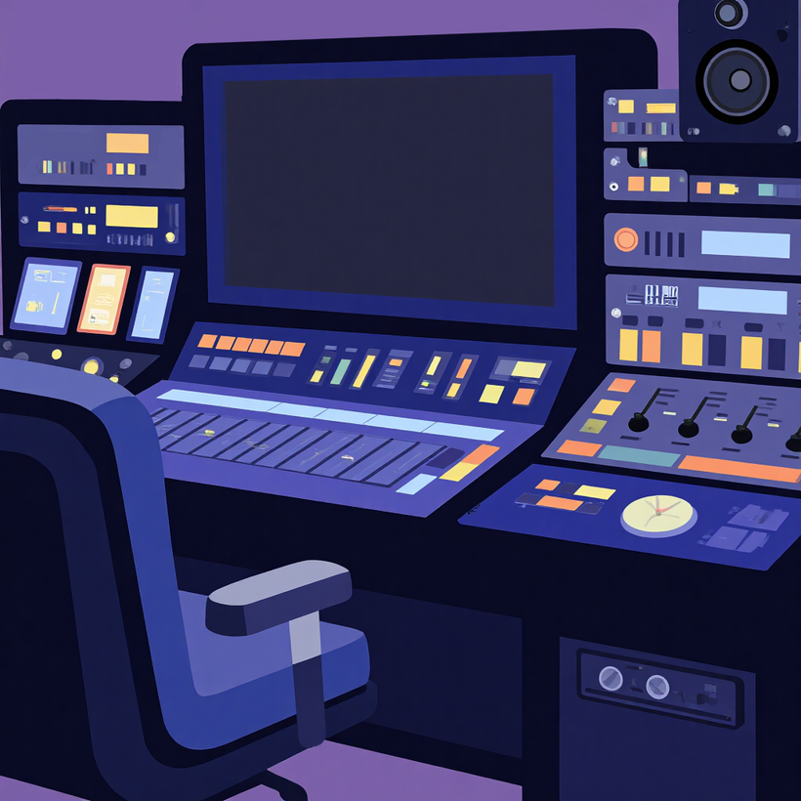
MIXING
Balance the volume between instruments.
Add effects (reverb, delay, EQ, compression).
Goal: Make the song sound unified and pleasing to the ear.

Slide 9

MASTERING AND DISTRIBUTION
Mastering is the final stage of audio refinement.
Equalizing sound levels between songs.
Adjusting for various media (Spotify, radio, YouTube).
After that: release and promotion.

Slide 10

CONCLUSION
Music production is a blend of creativity and technique, Every step is crucial to a professional end result. From a simple idea, an extraordinary work can be born.

