Slide 1
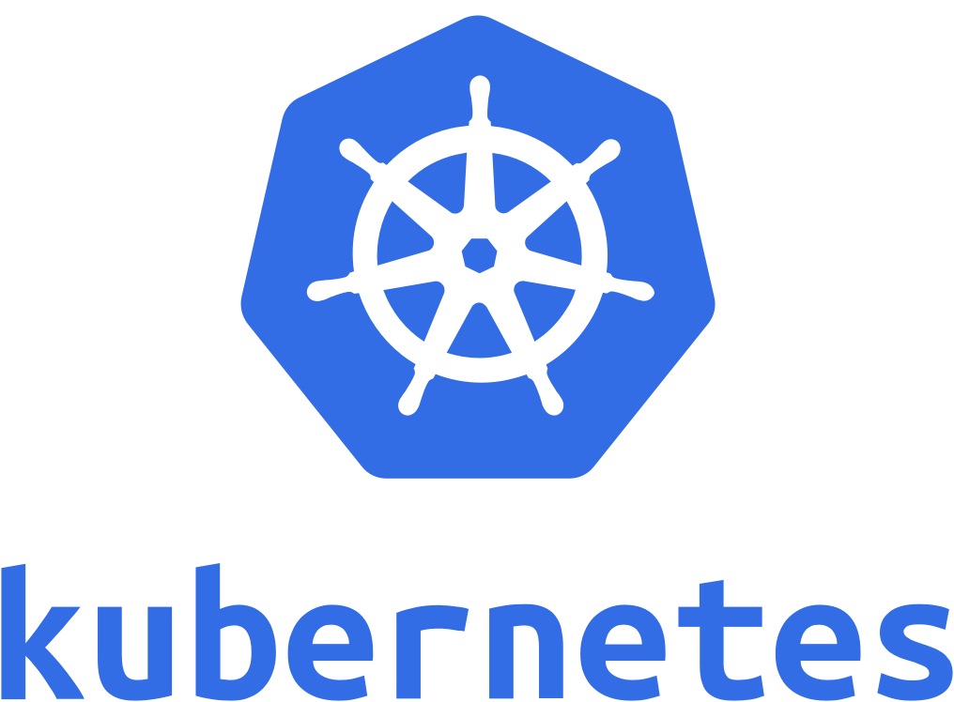

A brief guide about kubernetes for 5andhalf team
By : Ivan Fan

Slide 2
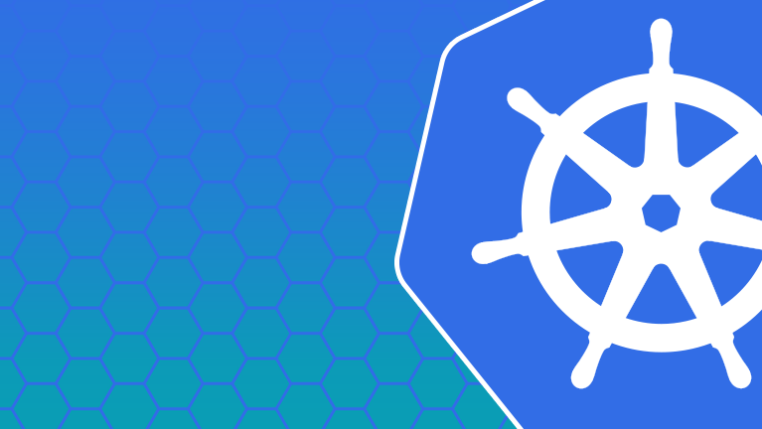
What is it?
Kubernetes is an open-source system for automating deployment, scaling, and management of containerized applications.
It’s a containers framework for deployment

Slide 3
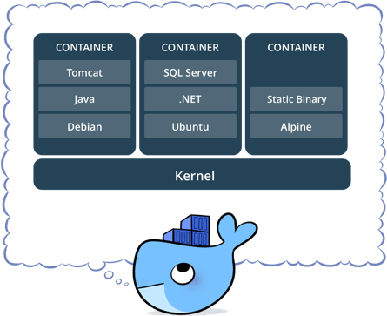
What is it? – Container?
A container is a lightweight, stand-alone, executable package of a piece of software that includes everything needed to run it: code, runtime, system tools, system libraries, settings.
With the Container, we can setup the dev and runtime environment with only one click.

Slide 4
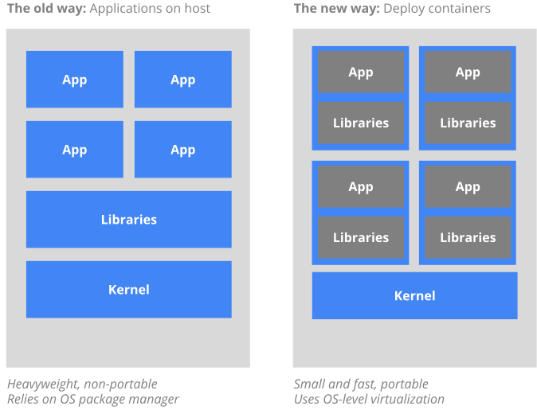
What is it? – Container?

Slide 5
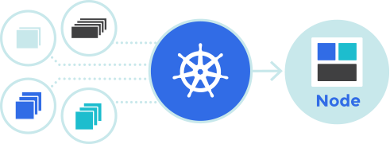
What is it? - a production solution for container
Kubernetes groups containers that make up an application into logical units for easy management and discovery

Slide 6



Why should we use it?
Deploy your applications quickly and predictably.
Scale your applications on the fly.
Roll out new features seamlessly.
Limit hardware usage to required resources only.

Slide 7
Why should we use it? - What else?
It’s a sidecar for small business
Docker Engine
Horizontal Scaling
Portable
Extensible
Self-healing
Automated rollouts and rollbacks
Rolling update
Load balancing
Google support: setting the rule of the game
Notes:
Hadoop setup hadoop can become a business
Same to spark
Network issue, disk IO , distribution system
# Container Network Interface
# Container Runtime Interface
# Container Storage Interface

Slide 8




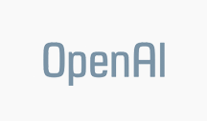

Why should we use it? - Who is using it?

Slide 9


Any competitor?
Docker Swarm and Kubernetes
Swarm
- Easy installation and setup.
- Easy integration with Docker
- It’s tied to Docker
- Not as extensible
Kubernetes
- Native support with GCE
- It’s not tied to Docker
- Setup is arguably more complicated ( But not for GCE )

Slide 10
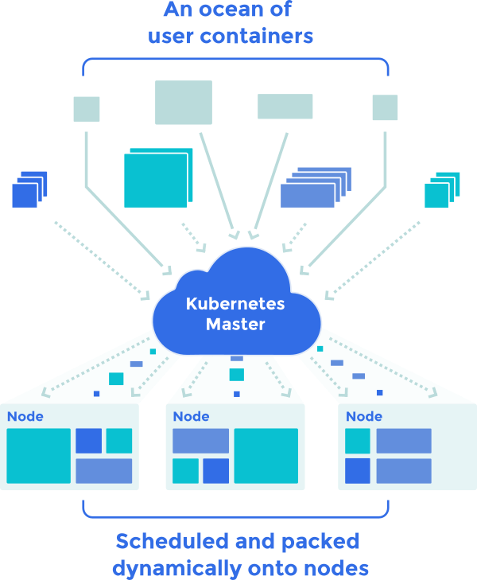
How it works?
Basic concepts
How to do it
Advanced features

Slide 11
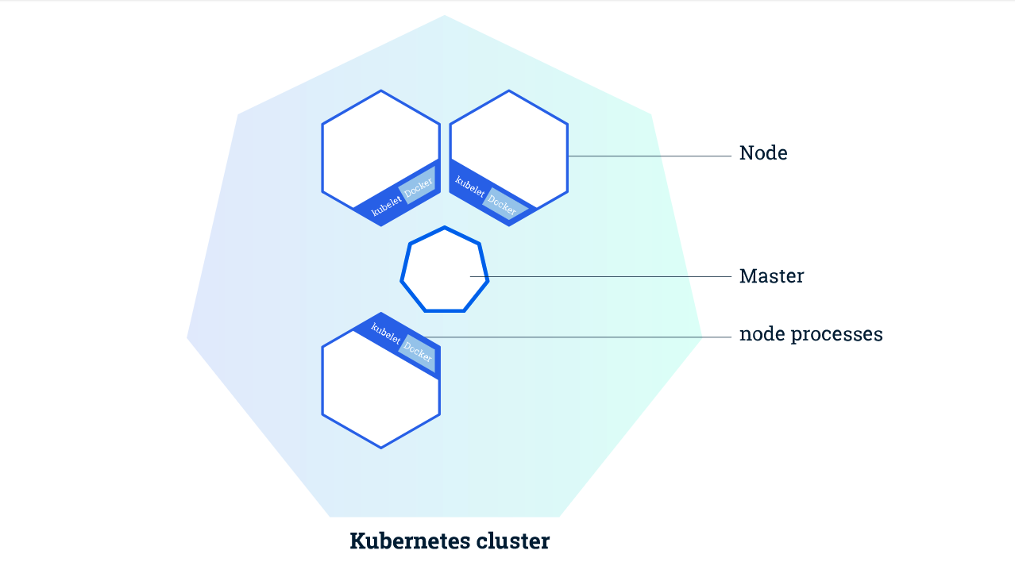
Basic concepts - Kubernetes Clusters
Notes:
Kubernetes coordinates a highly available cluster of computers that are connected to work as a single unit
The Master coordinates the cluster
Node are the works that run applications
The Master is responsible for managing the cluster.
A node is a VM or a physical computer that serves as a worker machine in a Kubernetes cluster.
When you deploy applications on Kubernetes, you tell the master to start the application containers. The master schedules the containers to run on the cluster's nodes. The nodes communicate with the master using the Kubernetes API, which the master exposes. End users can also use the Kubernetes API directly to interact with the cluster.
A Kubernetes cluster can be deployed on either physical or virtual machines.

Slide 12
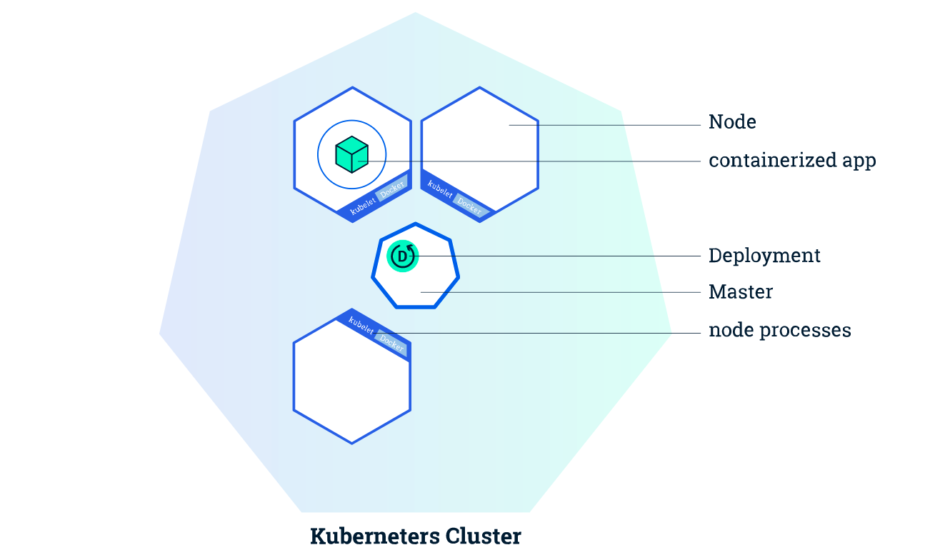
Basic concepts - Kubernetes Deployments
Notes:
Once you have a running Kubernetes cluster, you can deploy your containerized applications on top of it. To do so, you create a Kubernetes Deployment. The Deployment is responsible for creating and updating instances of your application. Once you've created a Deployment, the Kubernetes master schedules the application instances that the Deployment creates onto individual Nodes in the cluster.
Once the application instances are created, a Kubernetes Deployment Controller continuously monitors those instances. If the Node hosting an instance goes down or is deleted, the Deployment controller replaces it.

Slide 13
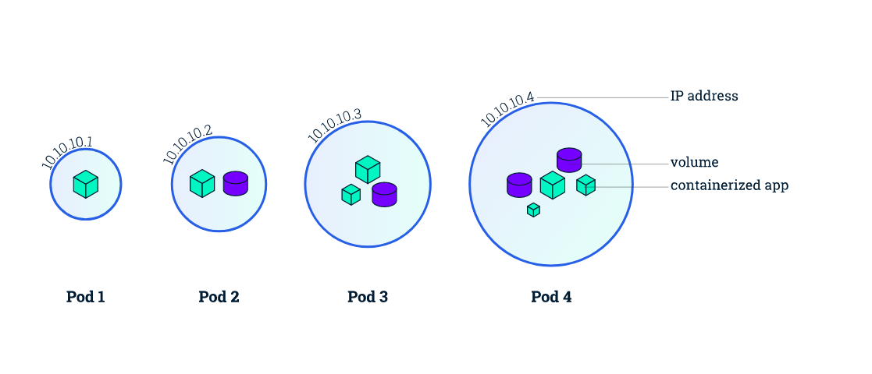
Basic concepts - Kubernetes Pods
Notes:
When you created a Deployment in Module 2, Kubernetes created a Pod to host your application instance. A Pod is a Kubernetes abstraction that represents a group of one or more application containers (such as Docker or rkt), and some shared resources for those containers
a Pod might include both the container with your Node.js app as well as a different container that feeds the data to be published by the Node.js webserver.

Slide 14
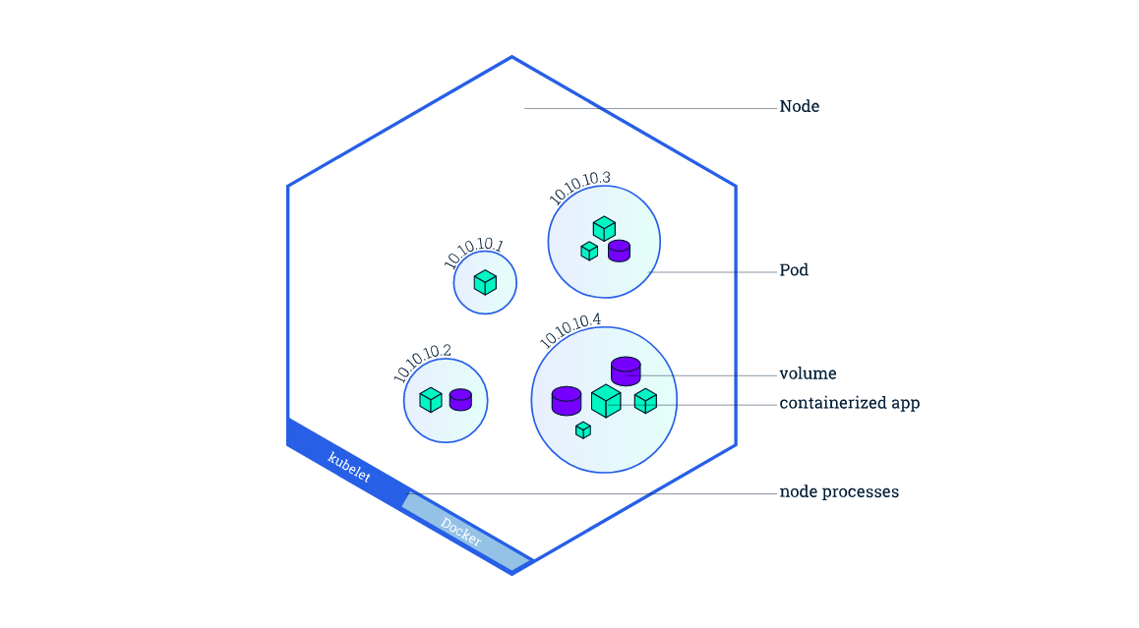
Basic concepts - Kubernetes Nodes
Notes:
A Pod always runs on a Node. A Node is a worker machine in Kubernetes and may be either a virtual or a physical machine, depending on the cluster. Each Node is managed by the Master. A Node can have multiple pods, and the Kubernetes master automatically handles scheduling the pods across the Nodes in the cluster. The Master's automatic scheduling takes into account the available resources on each Node.

Slide 15
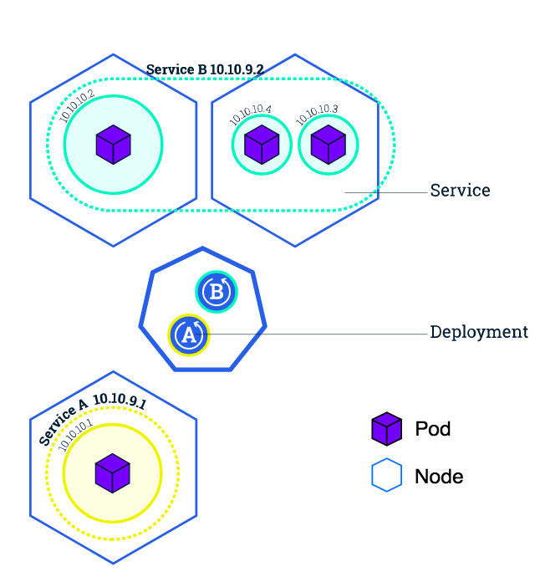
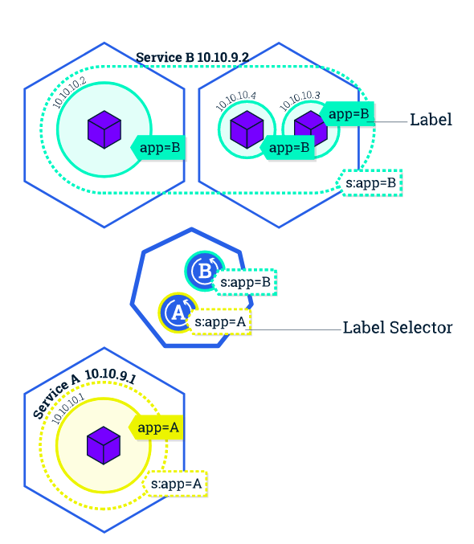
Basic concepts - Kubernetes Services
Notes:
A Service in Kubernetes is an abstraction which defines a logical set of Pods and a policy by which to access them. Services enable a loose coupling between dependent Pods.
ExternalName - Exposes the Service using an arbitrary name (specified by externalName in the spec) by returning a CNAME record with the name.

Slide 16
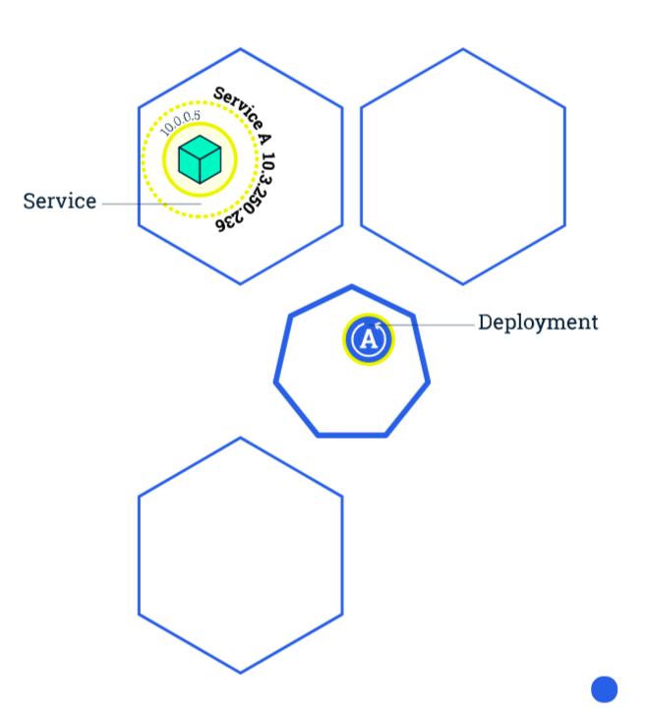
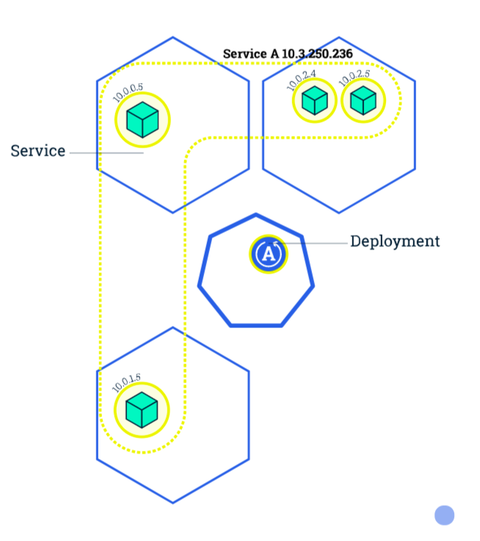
Basic concepts - Scaling an application
Scaling is accomplished by changing the number of replicas in a Deployment
Notes:
Services have an integrated load-balancer that will distribute network traffic to all Pods of an exposed Deployment. Services will monitor continuously the running Pods using endpoints, to ensure the traffic is sent only to available Pods.
Once you have multiple instances of an Application running, you would be able to do Rolling updates without downtime.

Slide 17
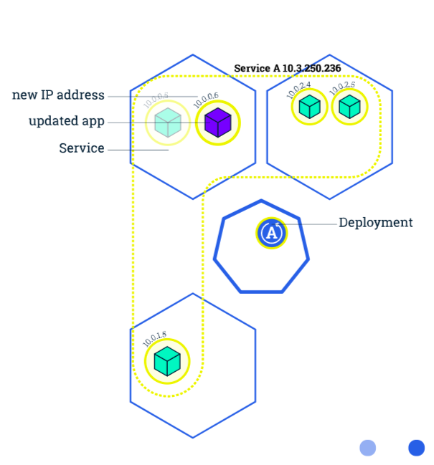
Basic concepts - Scaling an application
Notes:
Rolling updates allow Deployments' update to take place with zero downtime by incrementally updating Pods instances with new ones. The new Pods will be scheduled on Nodes with available resources.
Similar to application Scaling, if a Deployment is exposed publicly, the Service will load-balance the traffic only to available Pods during the update. An available Pod is an instance that is available to the users of the application.

Slide 18
How to do it : kubectl
K8s provides a command line tool box for all relevant operations
GCE has the native support for kubectl

Slide 19
Example: Stream Lending

Slide 20
Advanced Features
Storage
Network
Service
Configuration

Slide 21
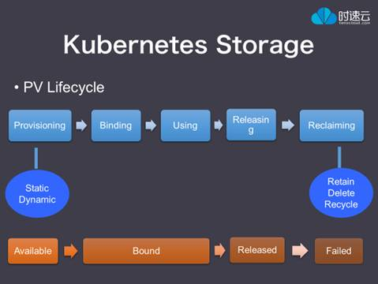
Storage : NFS (Network File System)
Volumes
Persistent Volumes: GCE, AWS etc
Container Storage Interface (standard)
GC strategy: Retain, Delete and Recycle
Notes:
Kubernetes supports several types of Volumes
Volumes: static binding with pod, can not exist by it self, have to be connected with pod
Persistent Volumes: a resource object, can exist separately , need Persistent Volumes Claim to bind with Pod
PVs are volume plugins like Volumes, but have a lifecycle independent of any individual pod that uses the PV. This API object captures the details of the implementation of the storage, be that NFS, iSCSI, or a cloud-provider-specific storage system.
Retain: don’t touch after release
Delete: auto delete
Recycle: auto delete and change the status to available

Slide 22
Network
Service Discovery & Health check
Internal: Pod to Pod (global unique IP), Pod to Service (cluster IP, kube-DNS), etcd
External: Load Balancer, Ingress
Flannel: connection between different machines

Slide 23
Service
Stateless
Stateful
Notes:
Stateless: if down create a new one exactly the same
Stateful: using volume to save the state

Slide 24
Configuration
Yaml
Deployment.yml
Service.yml

Slide 25
Questions?

Slide 26
End - What’s Next?
Notes:
Security?
Linux kernel?
Operating system?
System design?
Redis cluster?

