Slide 1
How to work
Workstation and Cluster

Slide 2
Outline
Connecting remotely to the workstation
Modules
Jupyter notebook / Software packages
Cluster

Slide 3
Connect to your workstation remotely
Install VPN (Cisco AnyConnect client)
Connect to: vpn.sissa.it
Enter your SISSA account password
ssh username@workstationname.phys.sissa.it
Enter your password
Type less
ssh-keygen
ssh-copy-id username@workstationname.phys.sissa.it
.ssh/config
Host workstationname
HostName workstationname.phys.sissa.it
User username

Slide 4
On the workstation / Modules
/home
/scratch
/??? (ask your supervisor)
Module avail
Fundamental software
Module load modulename
Module spider specificmodulename
List of modules required for successfull loading
Module unload modulename / Module purge
You always need the same modules?
.bashrc

Slide 5
Making your own module

Slide 6
Jupyter notebook
Conda: open-source package management system
wget https://repo.anaconda.com/miniconda/Miniconda3-latest-Linux-x86_64.sh
bash Miniconda3-latest-Linux-x86_64.sh
conda install -c conda-forge notebook --user
Start jupyter notebook on your workstation:
jupyter notebook --no-browser --port=8888
Connect to notebook remotely:
ssh -N -f -L localhost: 8889 :localhost: 8888 username@workstationname.phys.sissa.it
Connect via browser http://localhost:8889

Slide 7
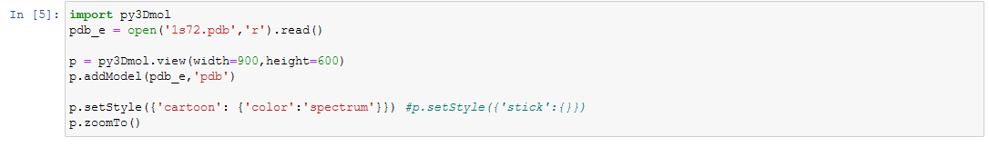
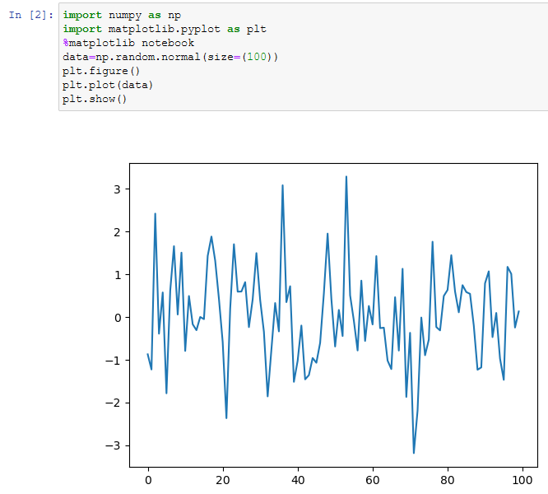
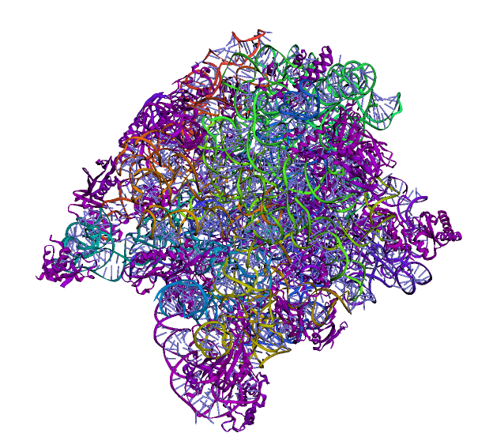
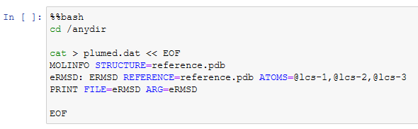
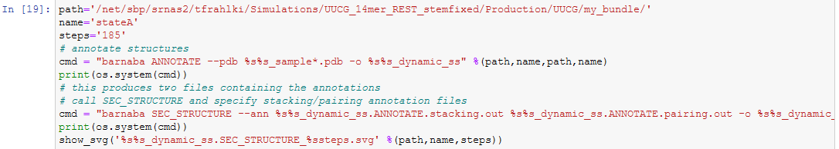
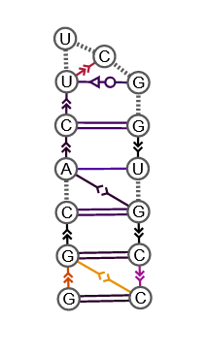
%magic

Slide 8
Cluster
Write to helpdesk-hpc@sissa.it. for enabling access
ssh username@frontend1.hpc.sissa.it (old→ soon new)
ssh username@frontend2.hpc.sissa.it (standard)
Navigation
/home/username (important files)
/scratch/username (run jobs)
Ulysses specification:
job scheduler – SLURM
Queues (sinfo):
Regular 1/2 (16 nodes, 12 h walltime)
Long 1/2 (8 nodes, 48 h walltime)
Wide 1/2 (32 nodes , 8 h walltime)
Gpu 1/2 (4 nodes, 12 h walltime)
Queue 1→ old nodes
Queue 2→ new nodes

Slide 9
Automatic login
Trusted computer:
ssh-keygen
ssh-copy-id username@frontend2.hpc.sissa.it
.ssh/config
Host frontend2
HostName frontend2.hpc.sissa.it
User username

Slide 10
Preparing a jobscript

Slide 11
Interactive jobs
Debugging, installing software, testing scripts
On login node:
module load python3
module load cuda
git clone git@github.com:cudamat/cudamat.git cudamat-build
cd cudamat-build
pip install --user .
On cluster node
srun -N 1 -p gpu2 --pty bash
python3 (check if you can import new package)
--partition=regular1,regular2
--time=00:30:00
--ntasks=1
--cpus-per-task=1

Slide 12
Questions/Expectations

